Slide 1
FUNGI

Slide 2
FUNGI
Fungi are simply built organisms, without real tissues and organs; the cell contains one or more nuclei.

Slide 3
FUNGI CELL STRUCTURE
The cell contains one or more nuclei.
The cell is surrounded by a cell wall from CHITIN.
It is a substance also found in the outer skeleton of arthropods - insects, crabs…

Slide 4
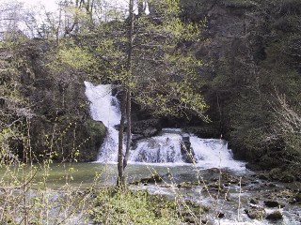
FUNGI GROW EVERYWHERE…
in forests, meadows
and pastures,
snowfields and glaciers, deserts,
in flowing waters and seas,
in the human body, dishwasher, built facilities…

Slide 5
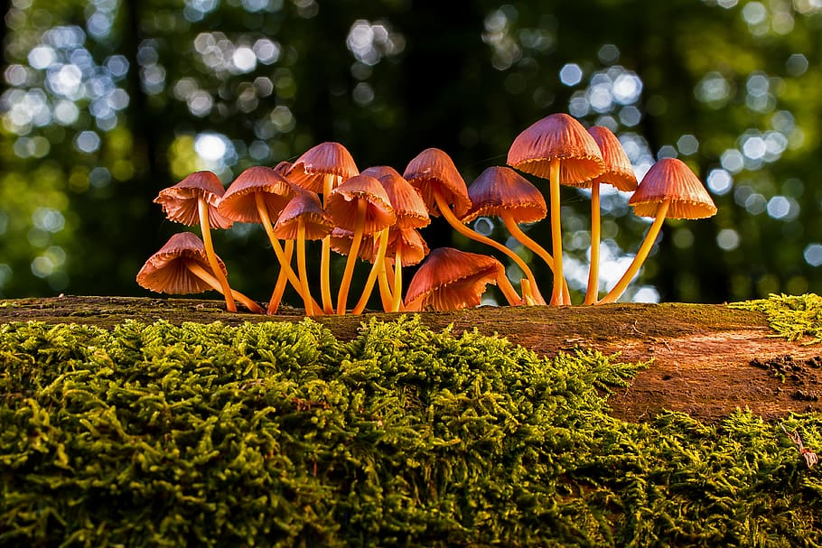
FUNGI
Fungi do not have green dye or
chlorophyll, they draw nutrients
from the environment with the help of hyphae.

Slide 6
According to principles of nutrition, we distinguish:
SAPROPHYTES
MUTUALISTS (SYMBIONTS)
PARASITES
They feed on dead organisms and turn organic matter into inorganic (decomposers).
They participate in the circulation of matter in nature.
The coexistence between fungi and higher plants is called MYCORRHIZA.
Fungi supply plants with minerals as well as with water during the dry season.
Plants supply the fungus with nutrients.
Examples of mycorrhiza: pine trees and porcini, birch trees and Birch Bolete, grass and champignon mushroom (Agaricus bisporus).
They get their food from living organisms.

Slide 7
THE IMPORTANCE OF COEXISTENCE BETWEEN FUNGI AND PLANTS
a better and more even plant growth,
a healthier and denser root system,
larger and more numerous crops and flowers,
greater drought resistance,
lesser need for watering and fertilizing.

Slide 8
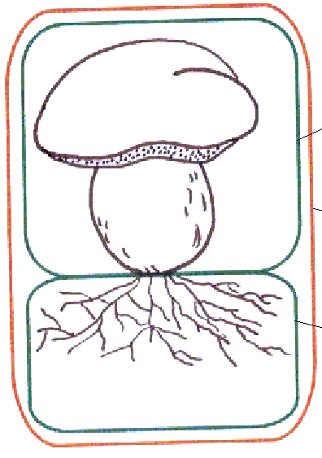
PARTS OF A MUSHROOM
CAP
FUNGUS
GILLS
MUSHROOM
STEM
MYCELLUM
HYPHAE

Slide 9
THE IMPORTANCE OF COEXISTENCE BETWEEN FUNGI AND PLANTS
Yeasts are unicellular fungi.
They are important in the production of alcoholic beverages, beer and the baking of bread.
In conditions without oxygen, they enable the course of ALCOHOLIC FERTILIZATION, in which sugar is converted into alcohol and carbon dioxide. Carbon dioxide causes the dough to rise.
Under conditions with oxygen, they perform cellular respiration.

Slide 10
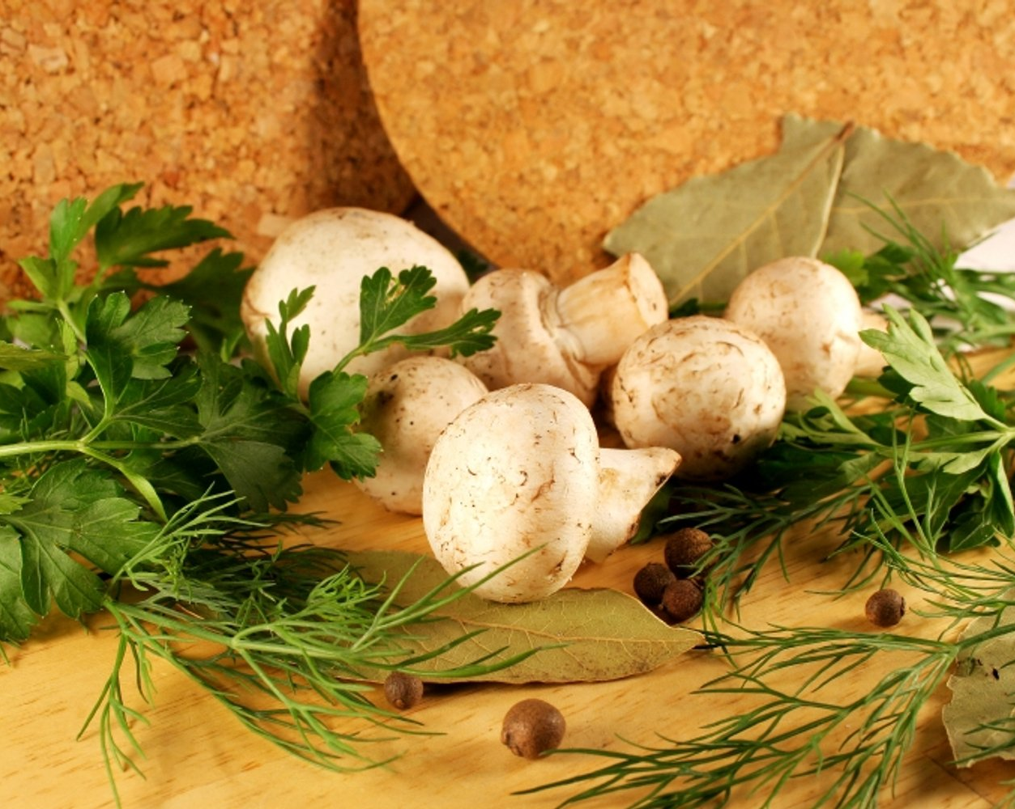
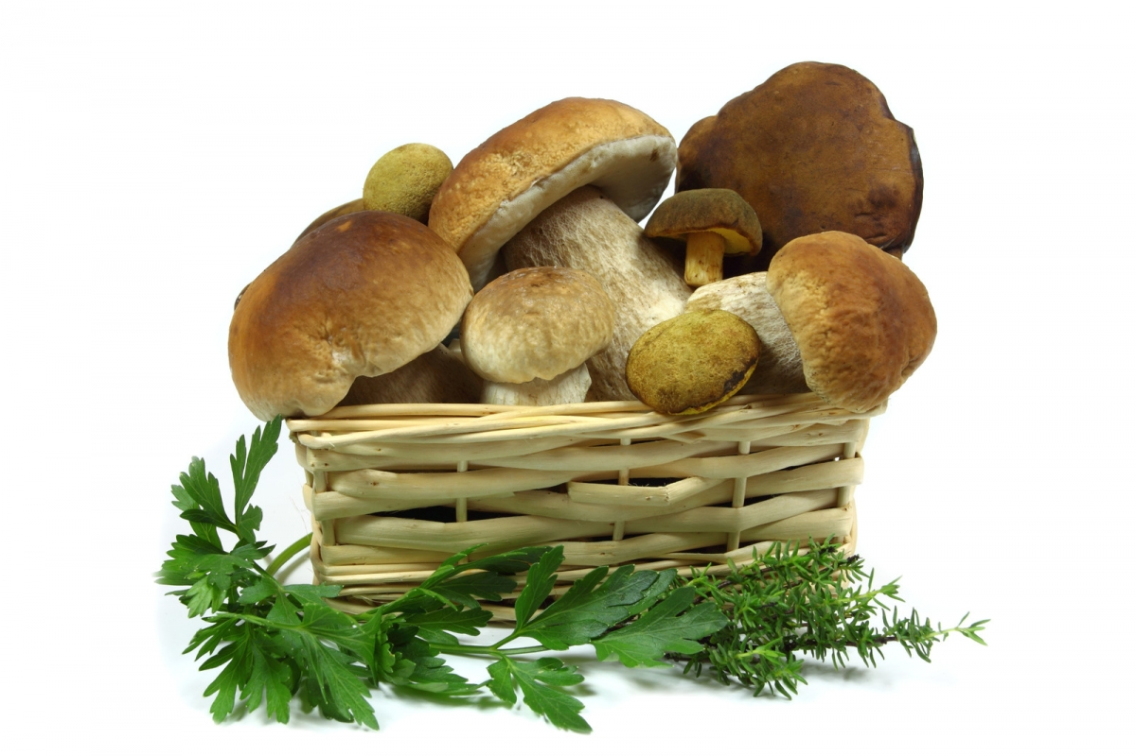
USE
Fungi or their active substances are used both in medicine and nutrition, as well as in agriculture, livestock farming… fungi are the main decomposers or saprophytes in ecosystems.

Slide 11
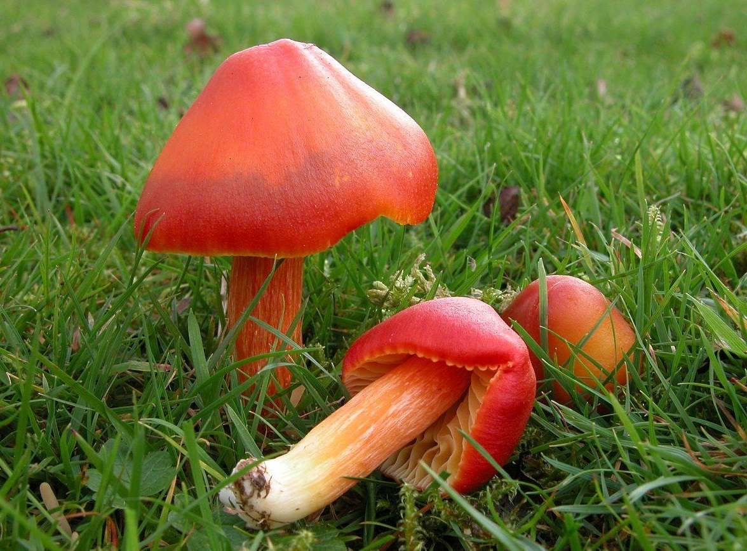
USE
Fungi have another characteristic - they are able to resolve lignin and cellulose by secreting enzymes (in addition to cellulose, lignin is found in the cell wall of plants)
Thanks to fungi, leaves, branches and trunks decompose into rich humus.
Some fungi species are indicators of a clean, unpolluted environment (especially Hygrocybe and lichens).

Slide 12
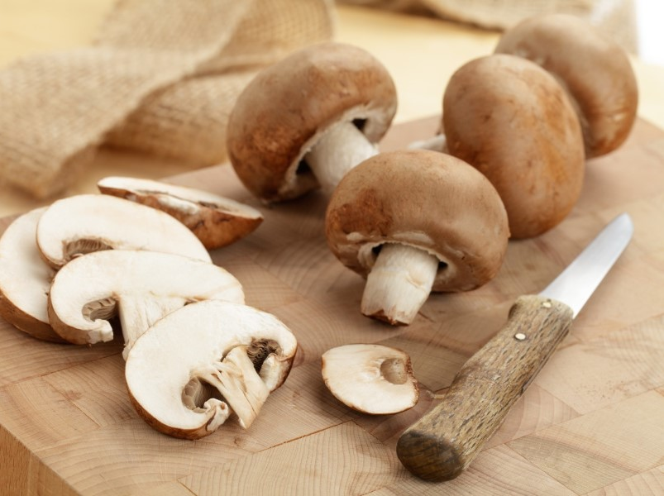
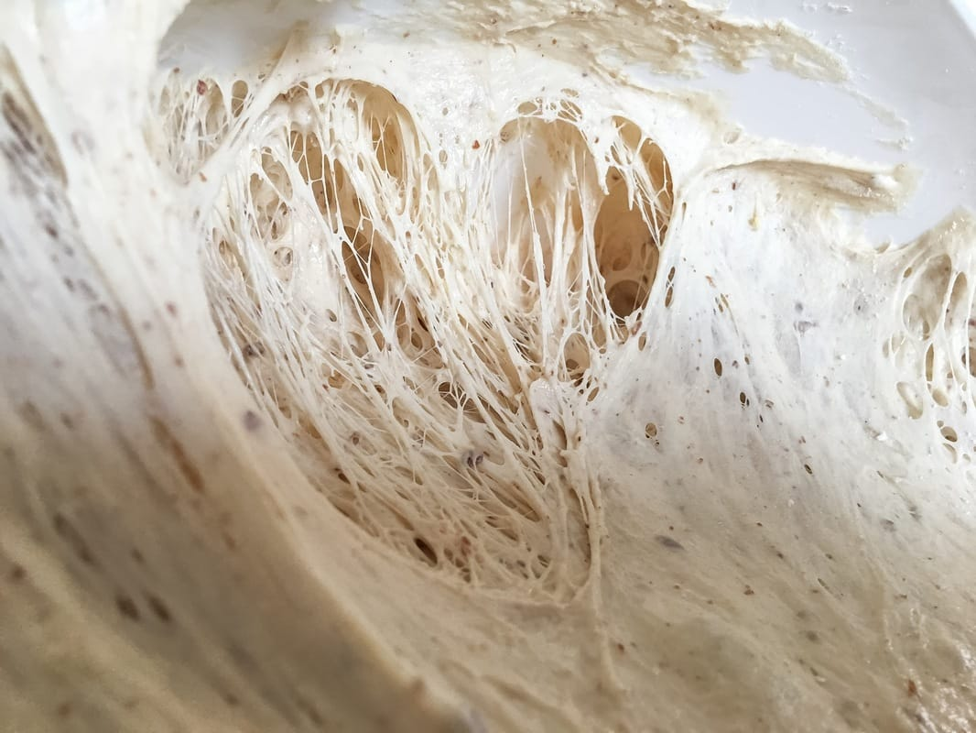
USE
Yeast fungi are important in the production of alcoholic beverages (beer, wine, brandy) due to the ability of the alcoholic fermentation process;
cheese production depends on fungi (Aspergillus and Rhizomucor),
rising of dough (alcoholic fermentation),
mushrooms are increasingly useful in nutrition (they are low in fat and contain zero cholesterol).

Slide 13
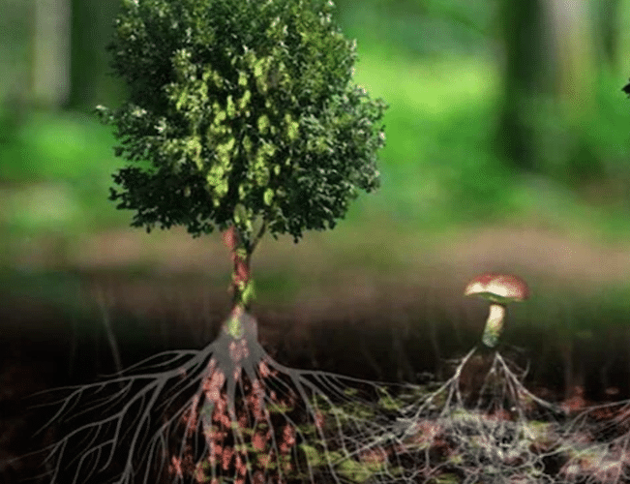
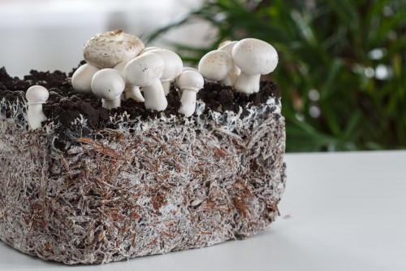
USE
Fungal enzymes are used in the food industry, they are important in the preparation of sprays, solving problems due to environmental pollution.
Recent research has also shown that some types of fungi, for example: Trametes versicolor, are useful in the decomposition of plastics.
Fungi, with their expanded mycelium, effectively excrete heavy metal from the soil or release enzymes into the environment, decomposing some harmful organic substances into harmless ones.
The use of fungi reduces soil and groundwater pollution.

Slide 14
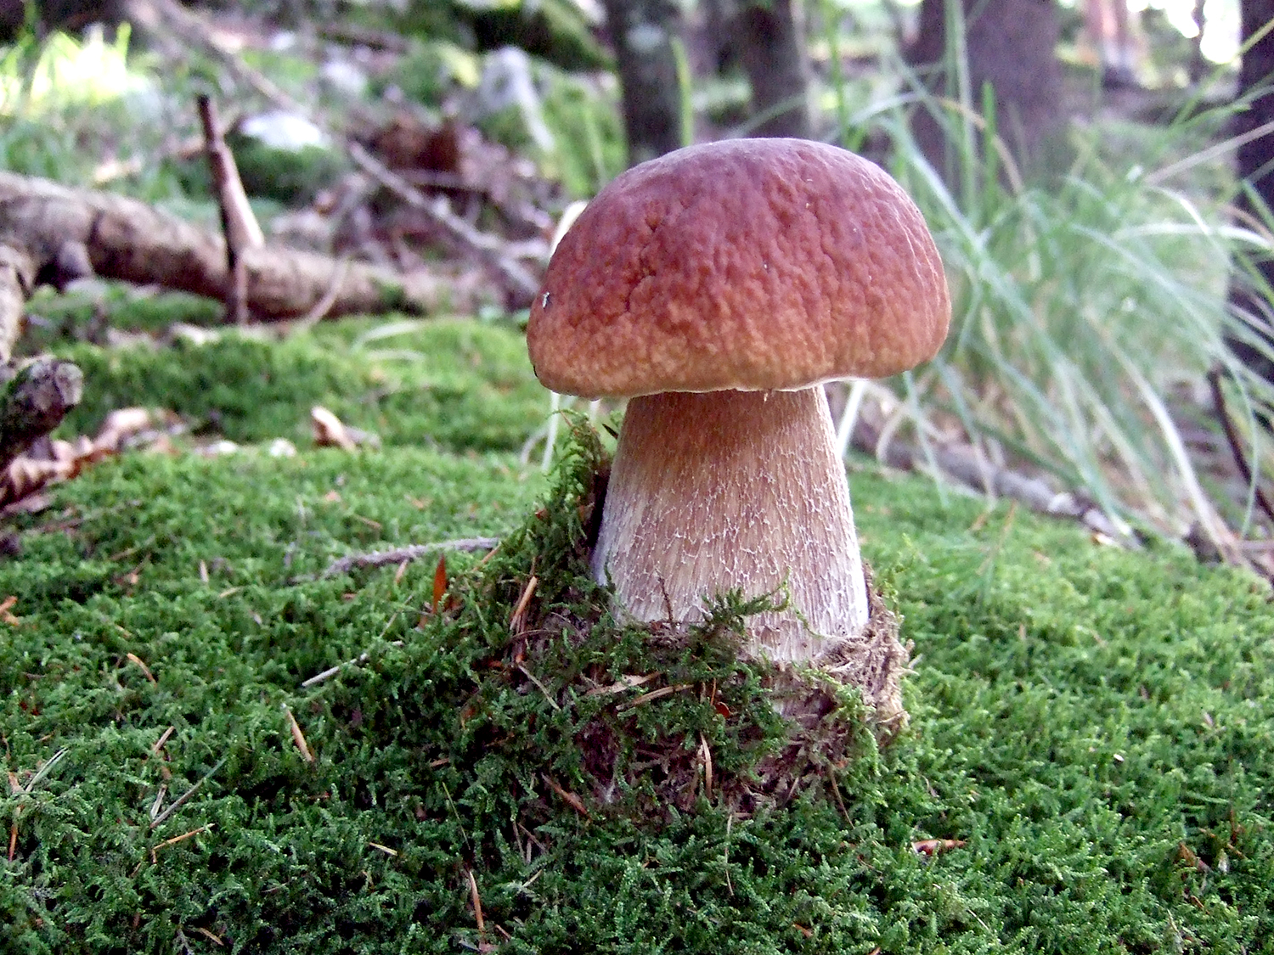
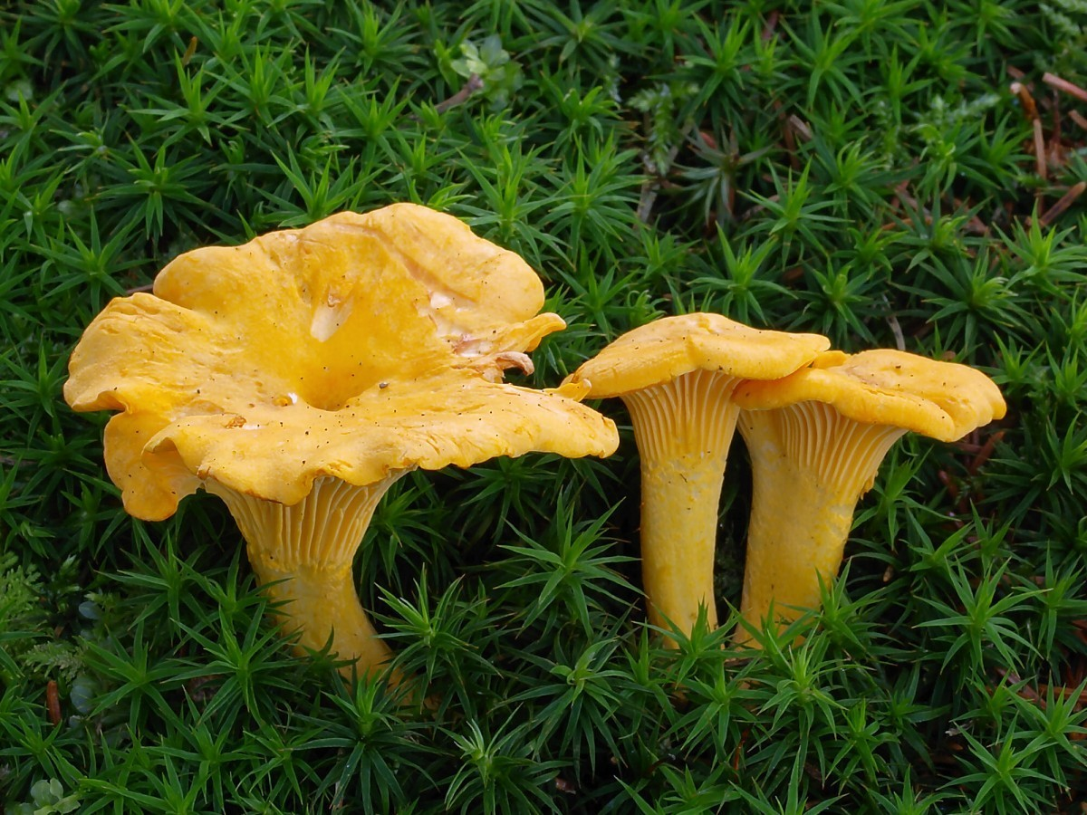
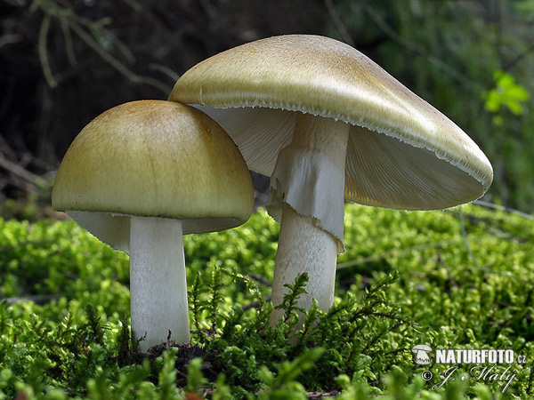
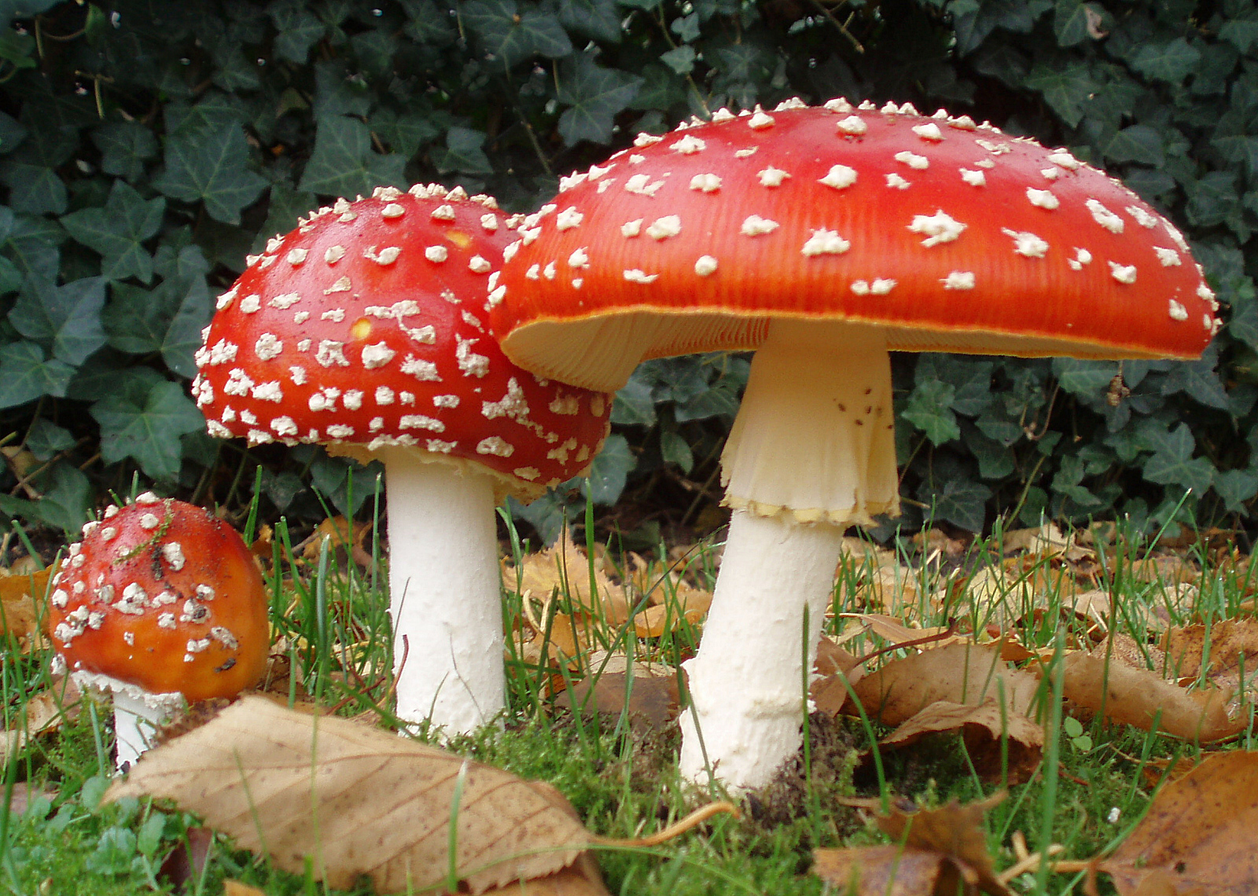
EXAMPLES: porcini, chanterelle, fly agaric, death cap, parasol mushroom

Slide 15
Let us watch the video…

Slide 16
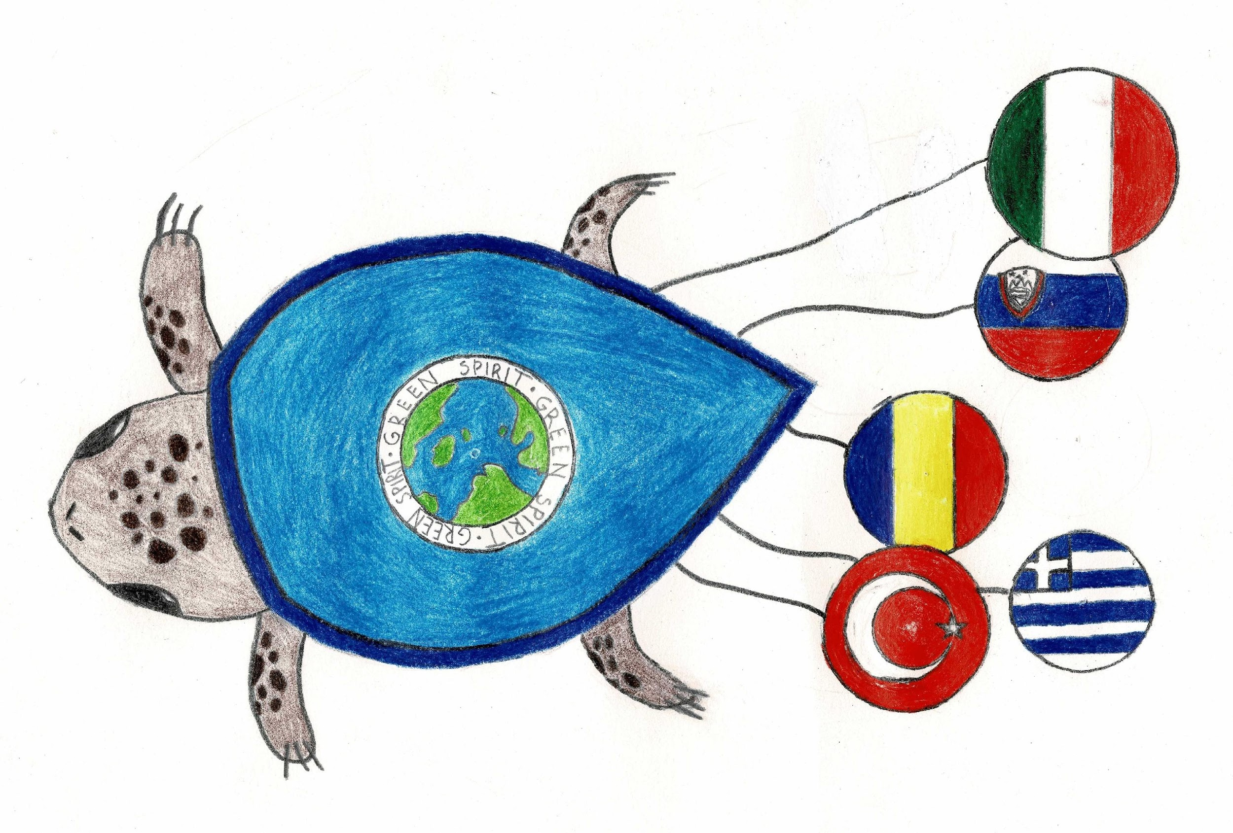
WRITTEN BY:
“The sense of responsibility
for Environment”
Teachers of
OŠ Cvetka Golarja Škofja Loka:
Petra Kavčič, Jerneja Bokal,
Katja Grah and Nina Granda.
November 2020

