Slide 1
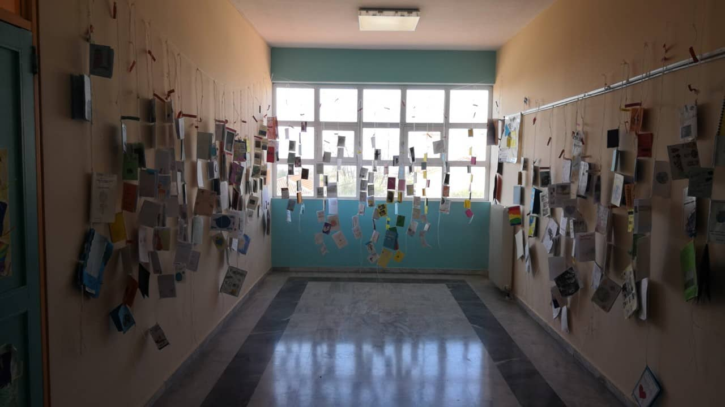
Action Aid initiative and exhibition about the environment

Slide 2
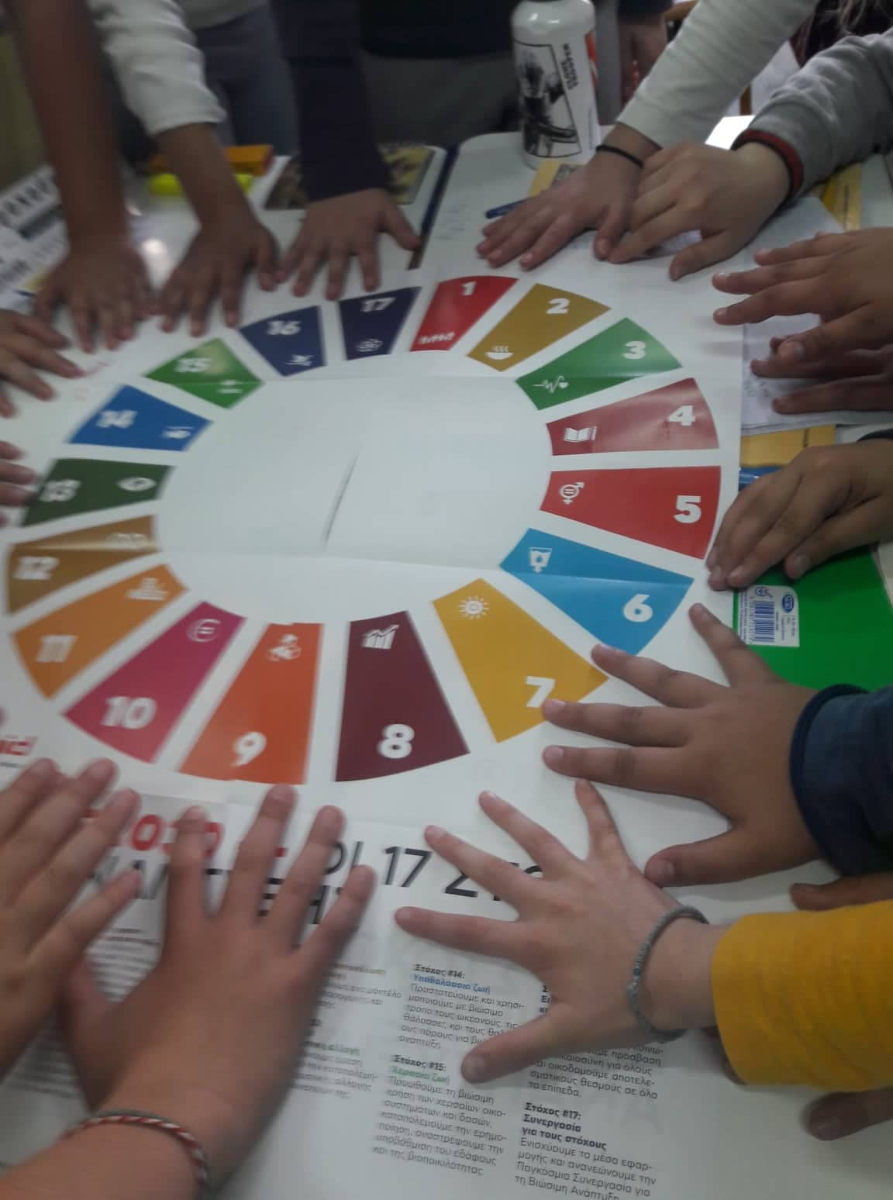
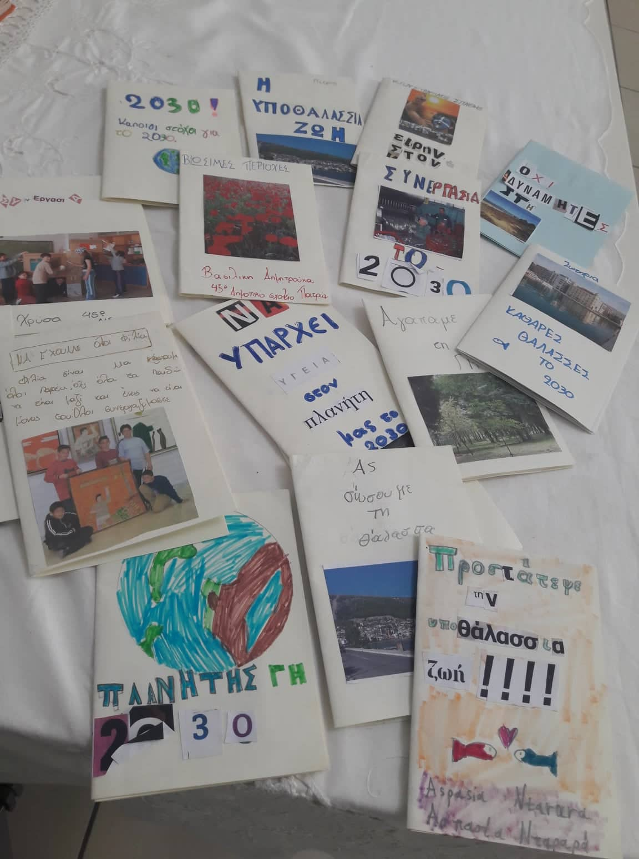
What is this all about?
Our school actively participated in an exhibition organized by Action Aid in Greece about environmental issues that concern us today. Various schools from all over Greece participated. Students created fanzines (blend of fan & magazine) to share their interest on protecting our planet.

Slide 3
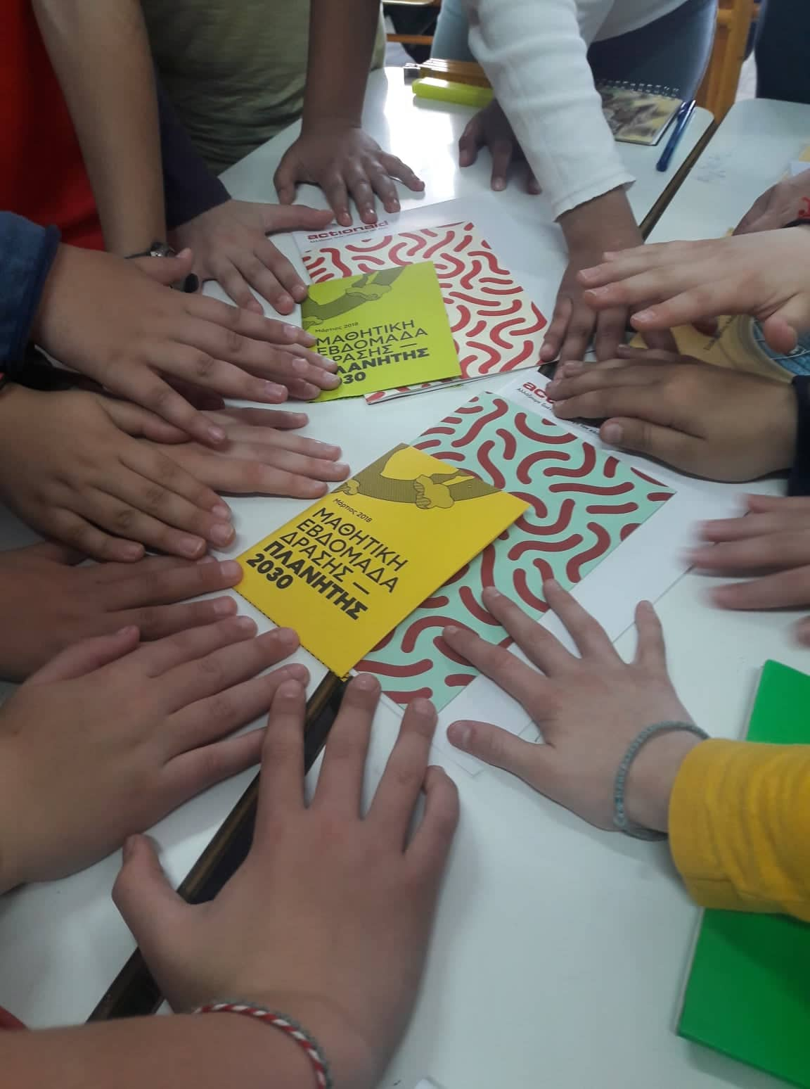
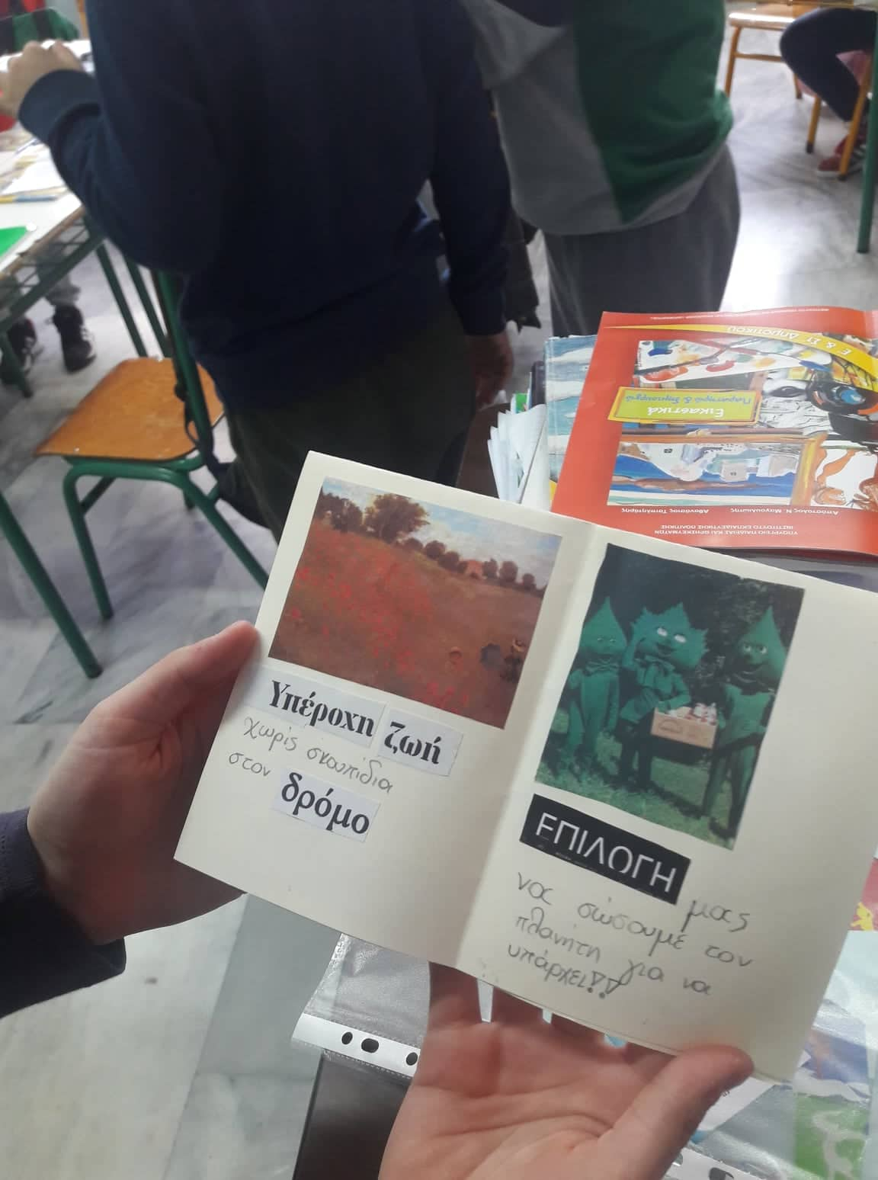
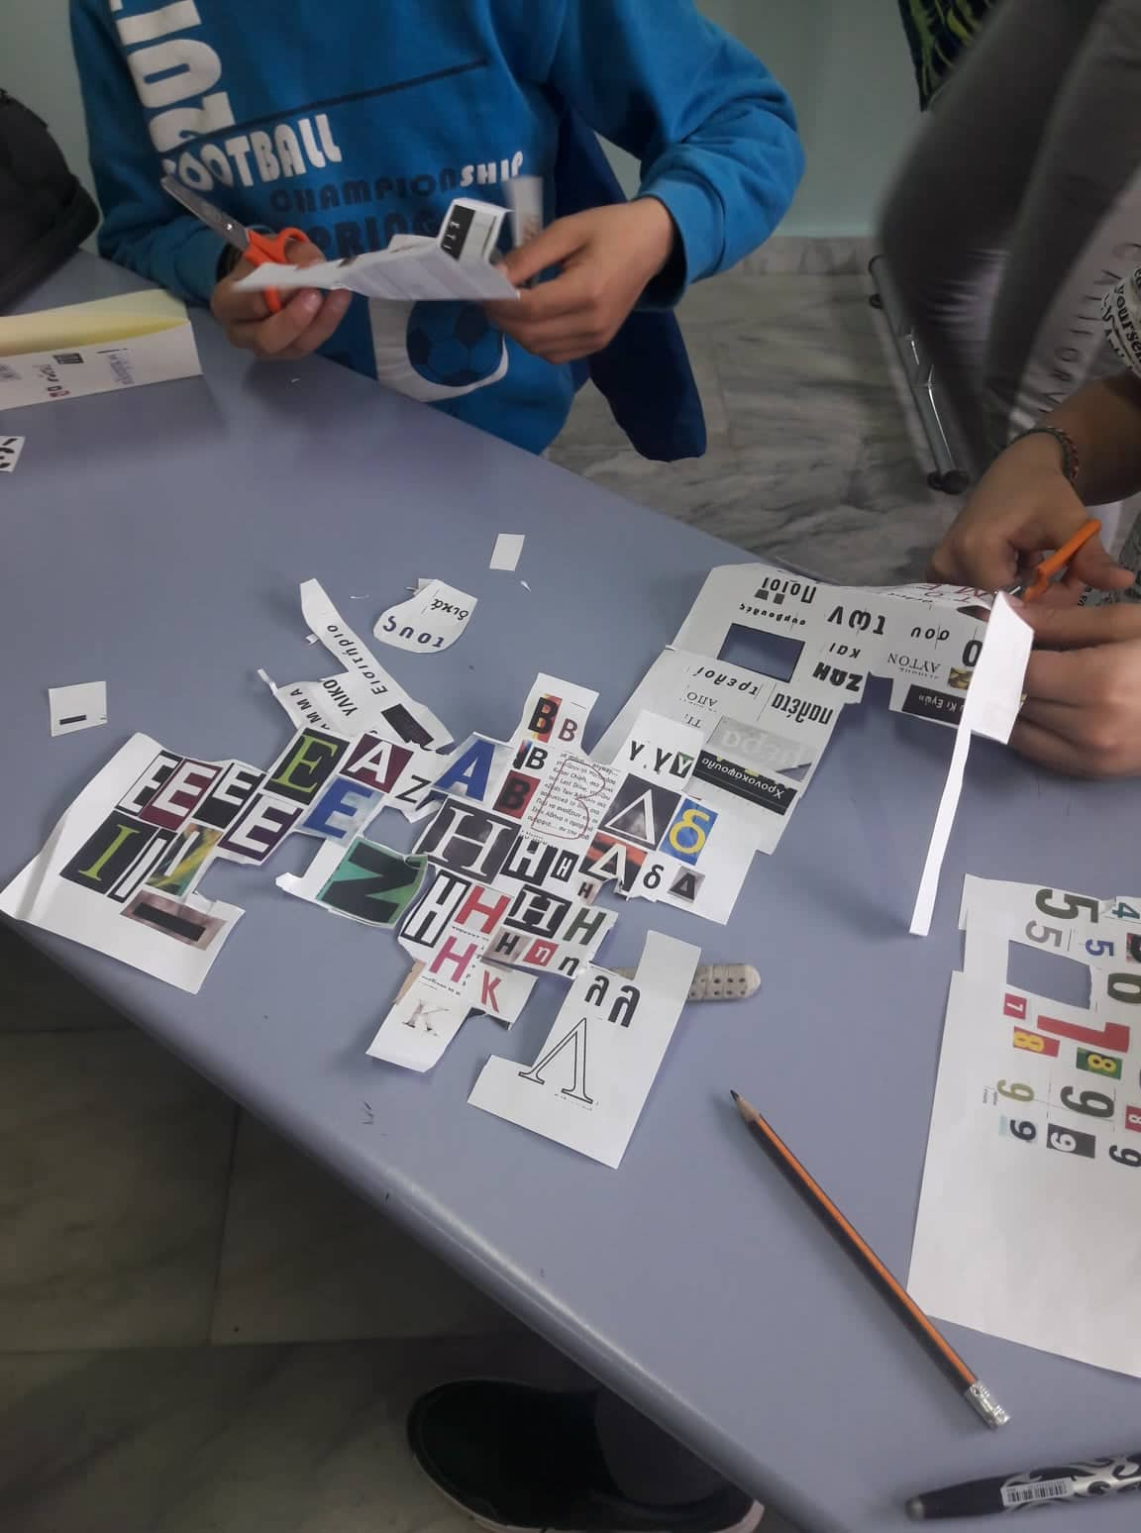
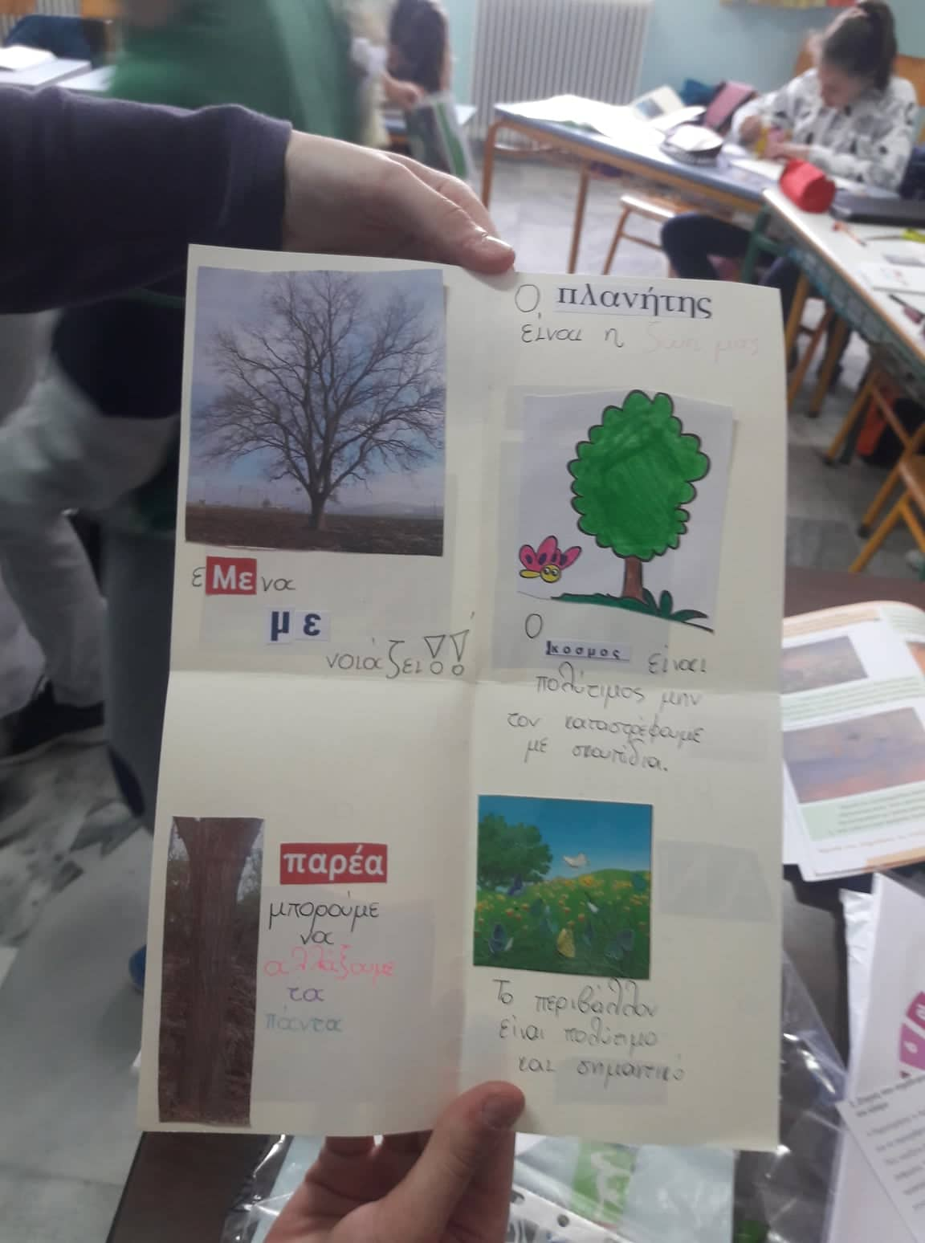

Slide 4
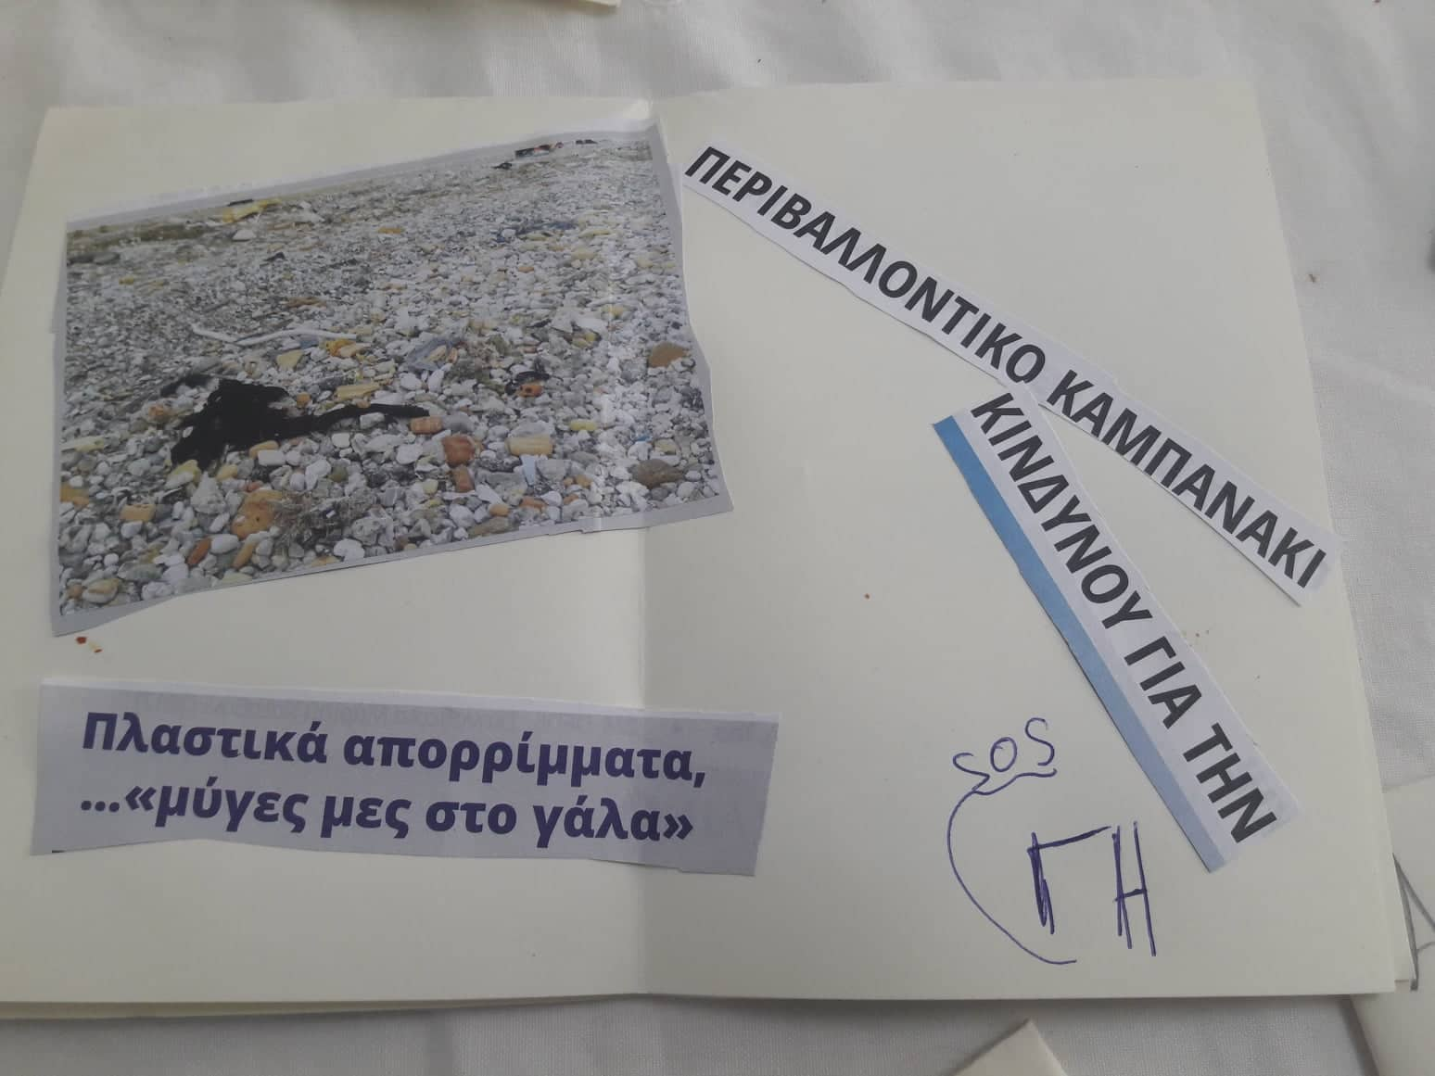
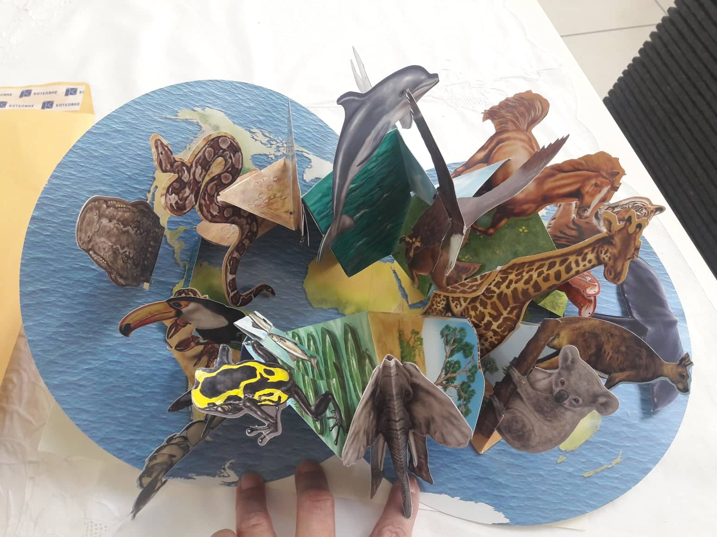
Who participated?
The older students of our school were involved in the project. They wrote slogans, made drawings and sticked pictures related to diverse environmental issues.

Slide 5
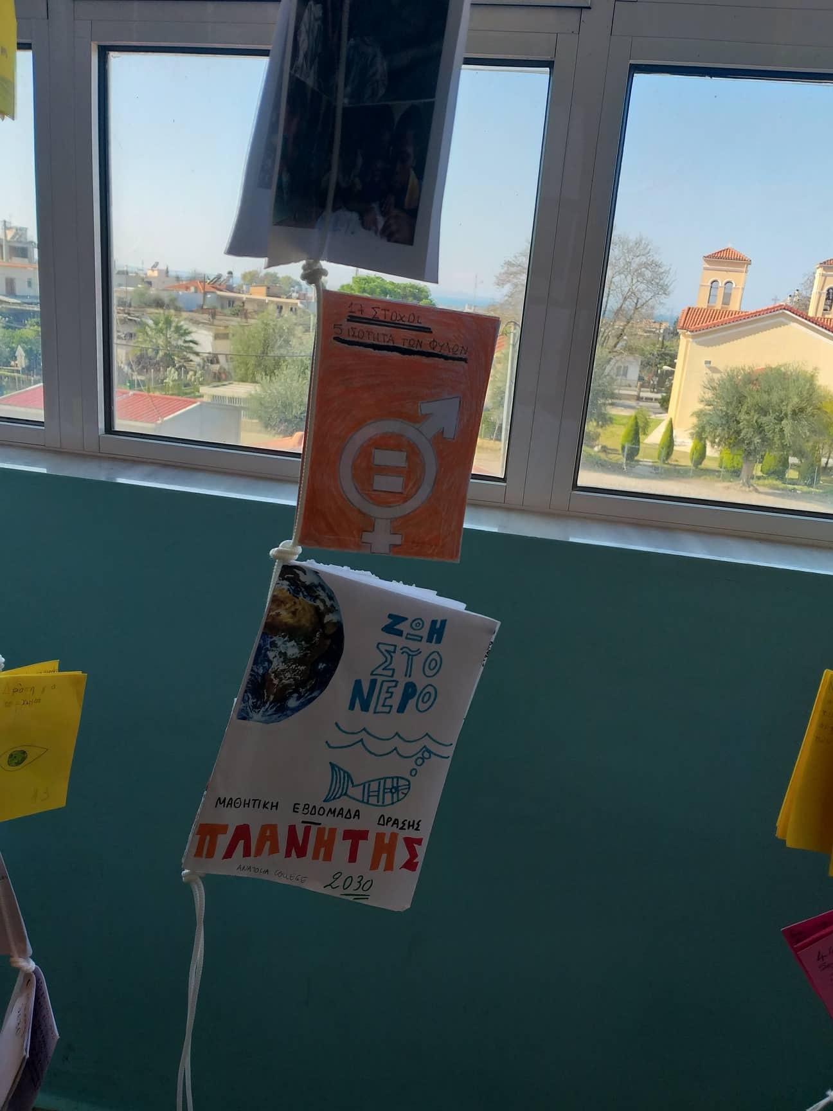
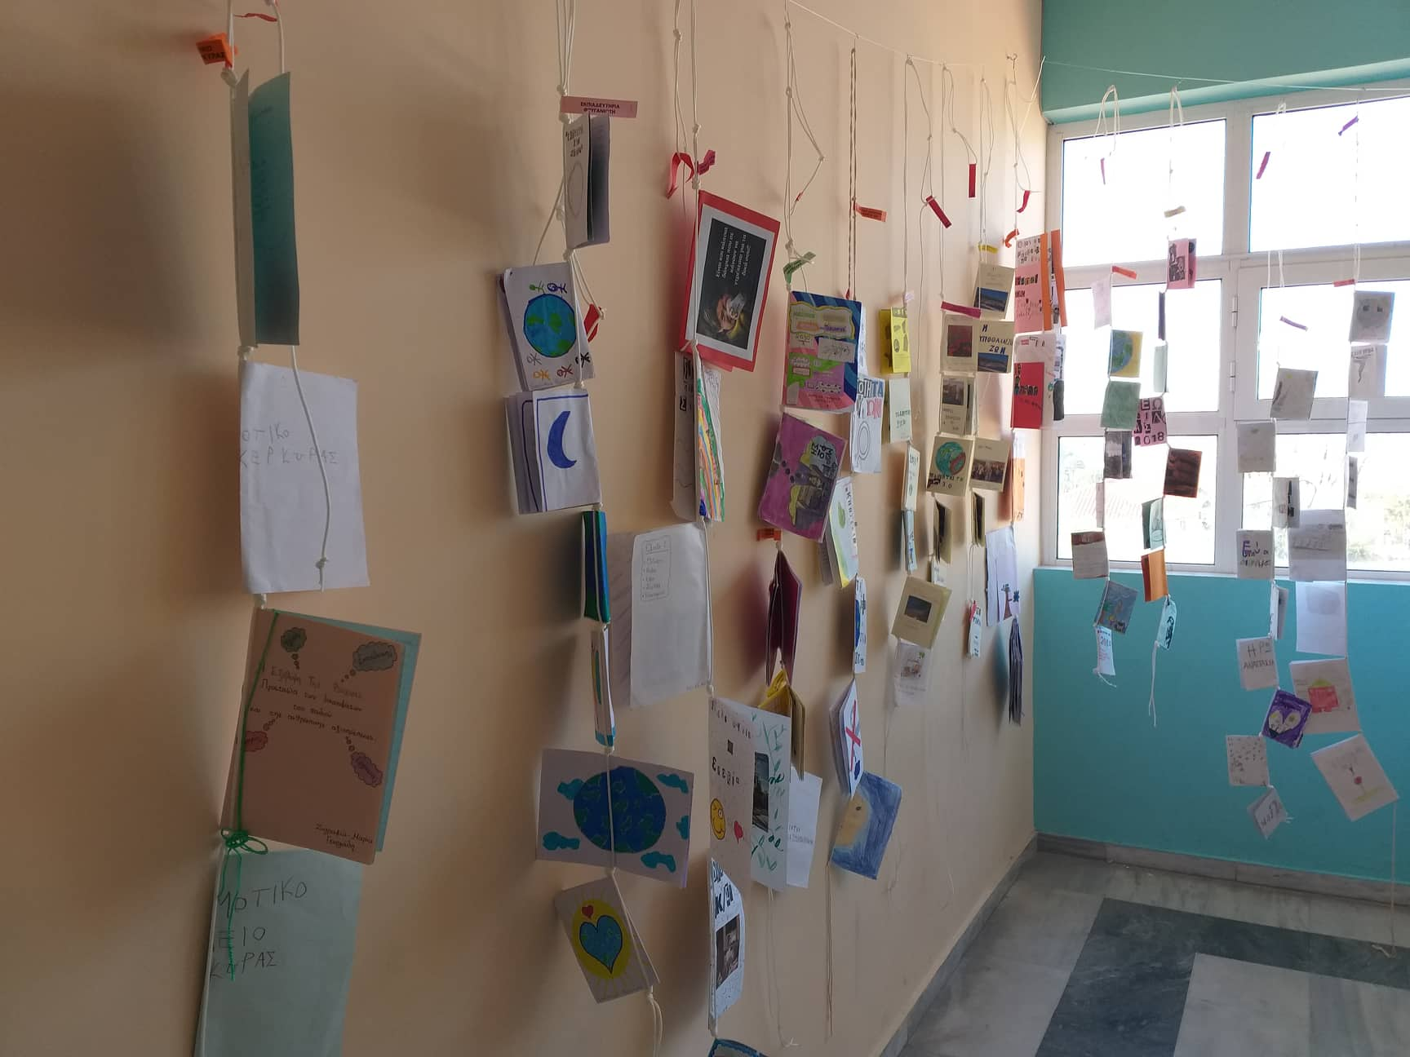
Where will the exhibition be held?
The exhibition at the moment is in our school. It includes more than a hundred fanzines produces by students from schools all over Greece. Next month it will travel to other schools in order to promote and embrace this initiative.

Slide 6
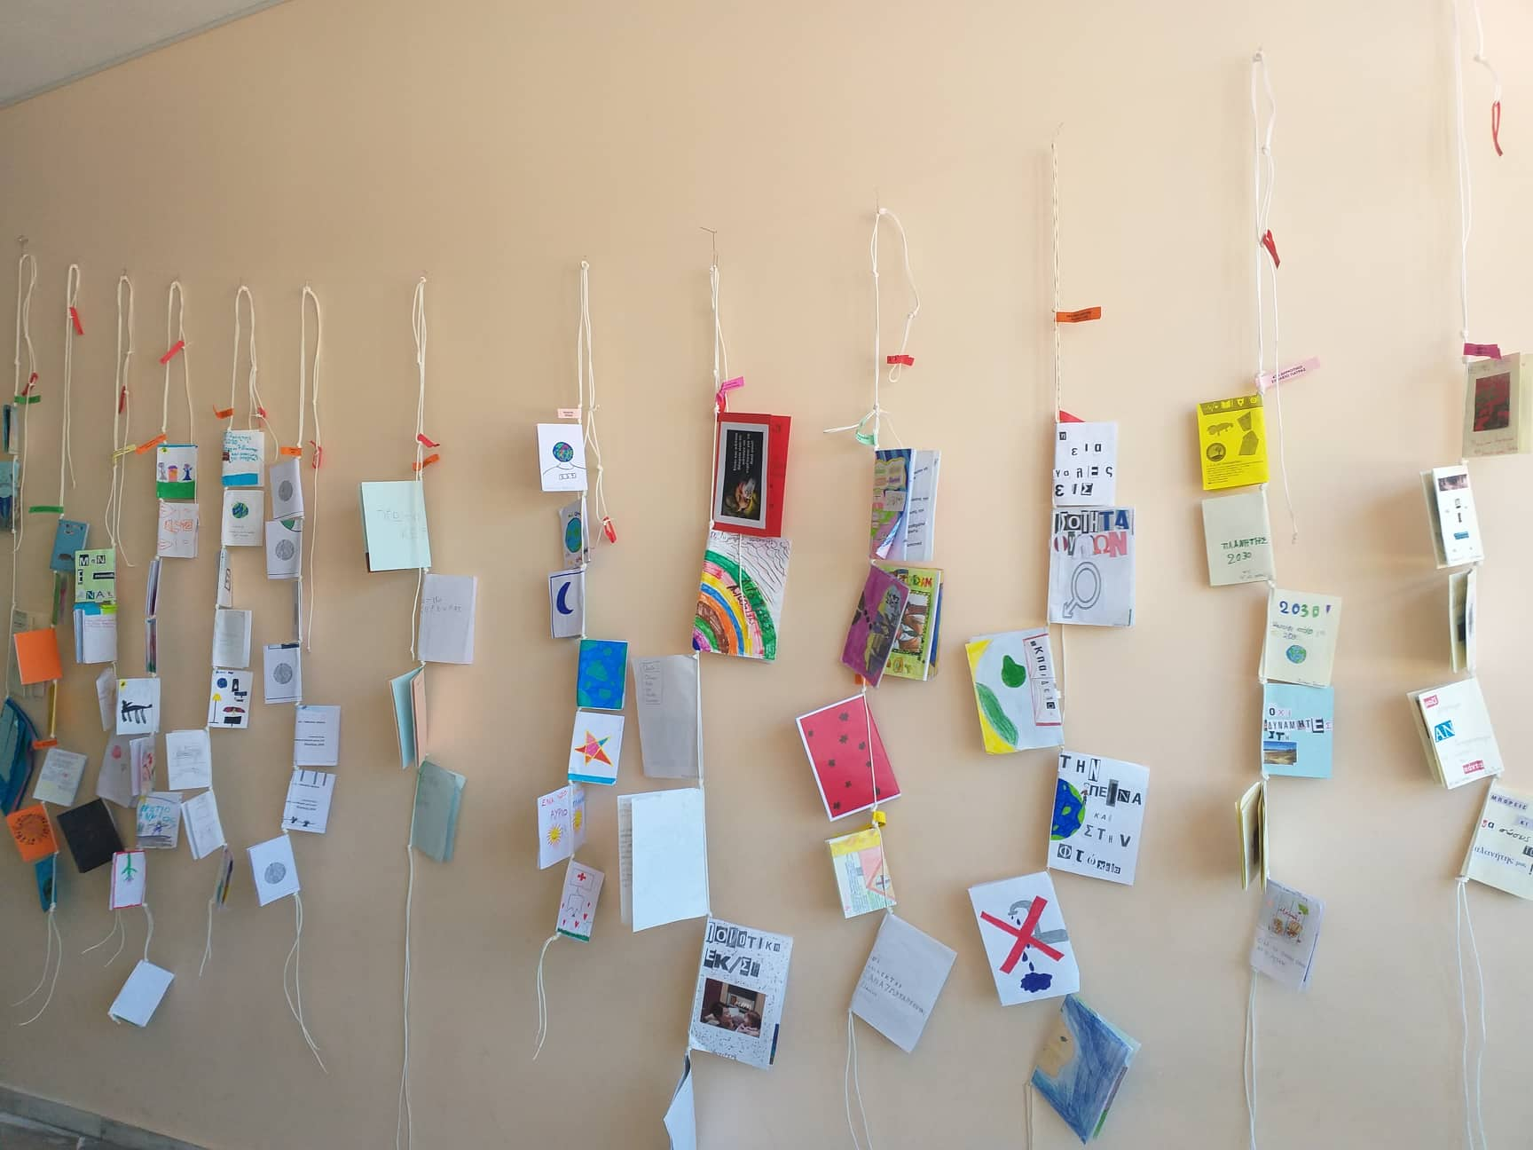
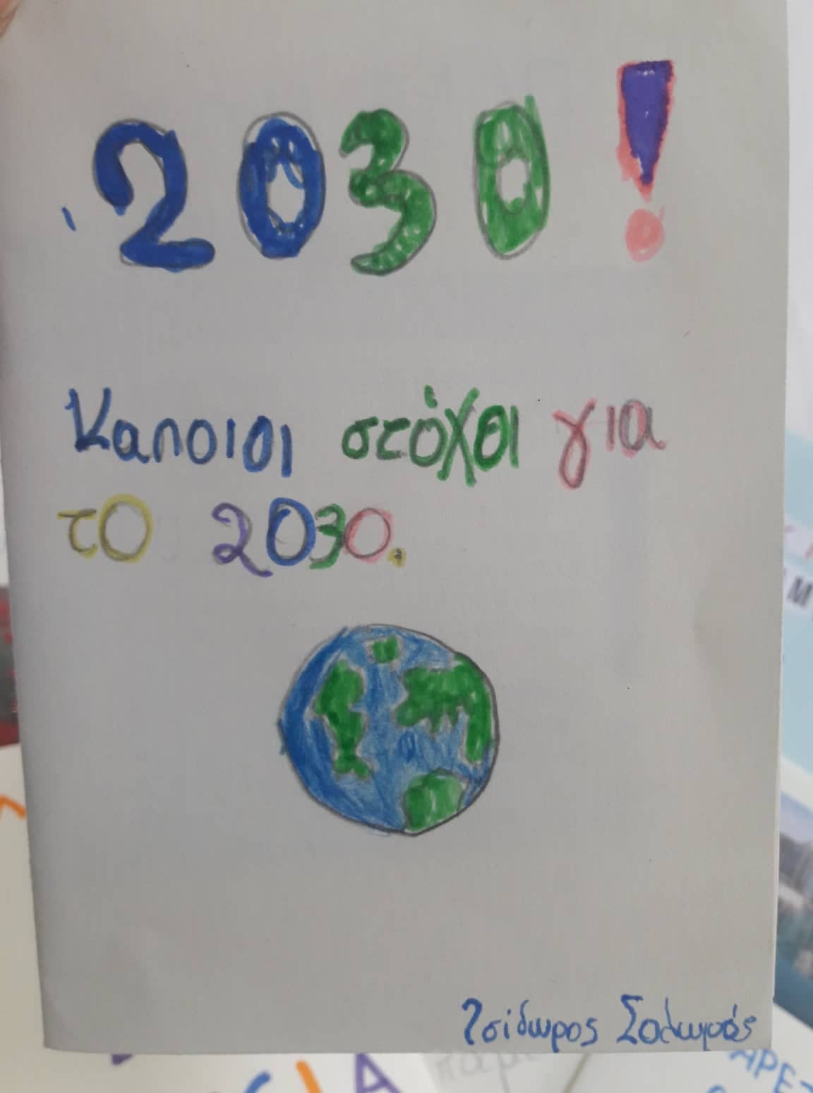

Slide 7
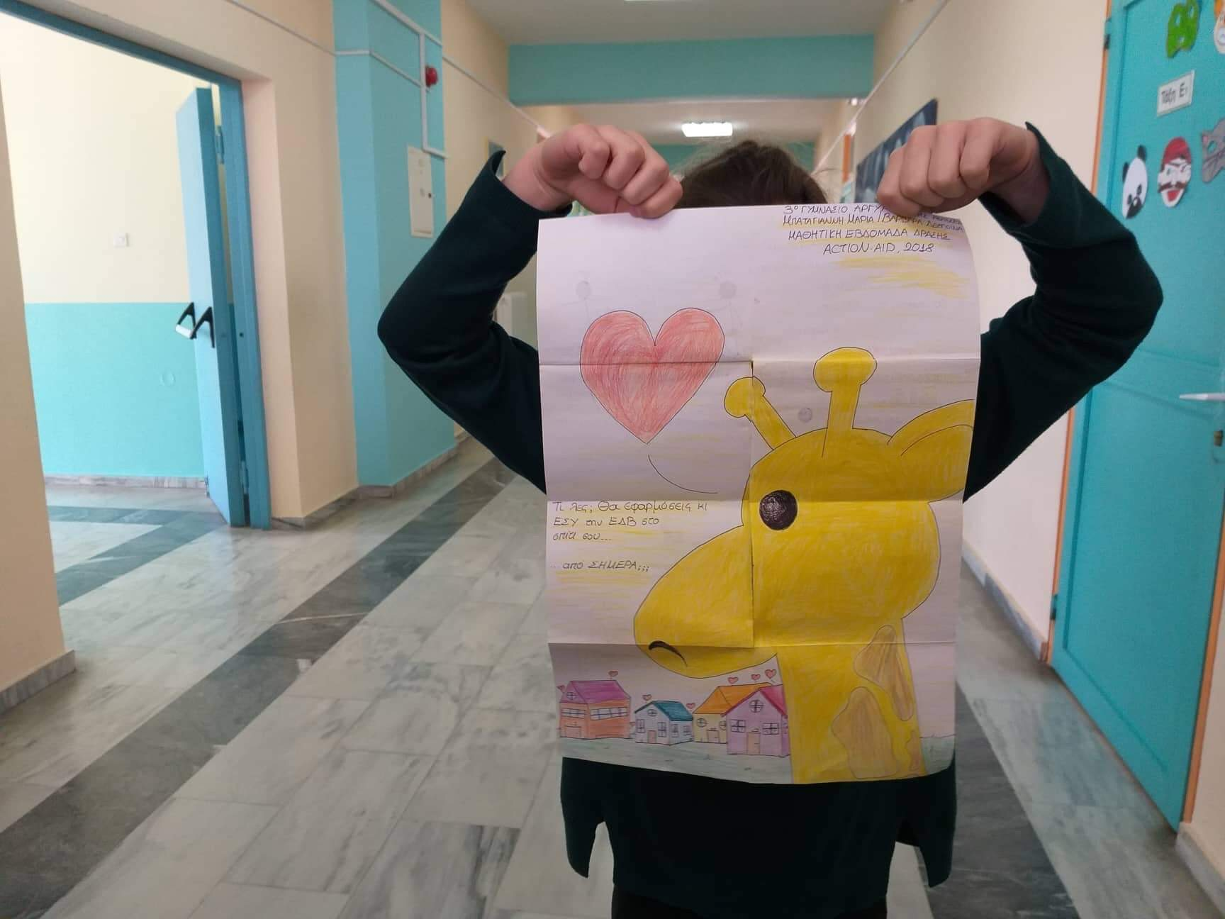
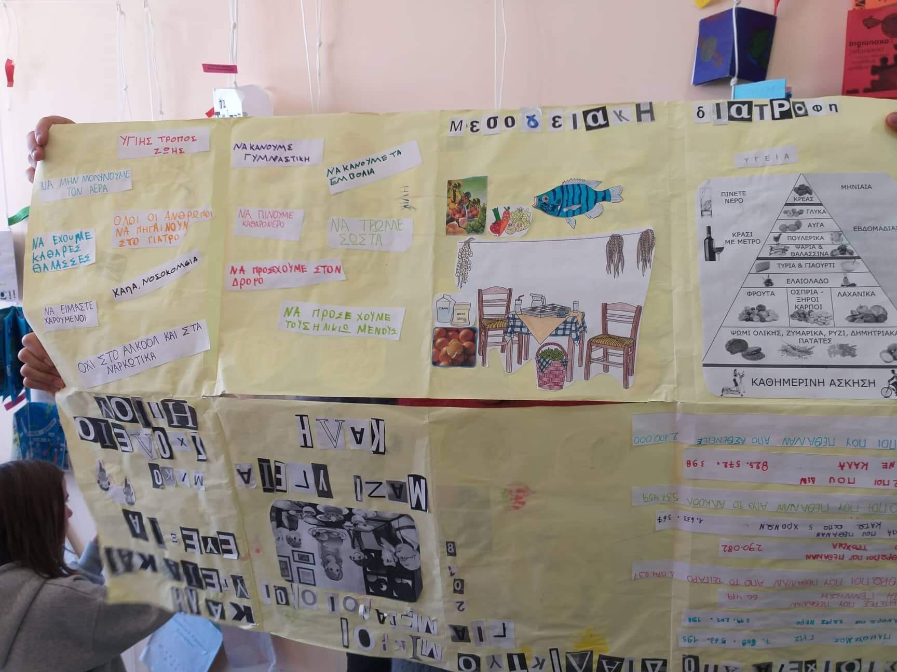

Slide 8
