Slide 1
Camping experience
Erasmus+ project
Learning through outdoor activities based on MI

Slide 2
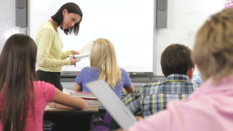
Lingustic intelligence Deals with individuals' ability to understand both spoken and written language, as well as their ability to speak and write themselves
Students found out about their tasks in camping experience;
They learnt about the aims of it.

Slide 4
MUSICAL intelligence it’s about rhythm, melody, and sound
They chose the music to which was appropiate for the atmosphere of the place, people, topic;
They worked with the music in the background.

Slide 6
Logical-Mathematical intelligence it’s about Categorizing and classifying working with abstract patterns and relationships.
Students had to Think conceptually, abstractly, and were able to see and explore patterns;
They had to plan camping experience carefully- how many people should be engaged, where to go, when, how to share the tasks….

Slide 7
Camping experience plan: 1. kayaking; 2. observing the nature – wildlife, weather, sky; 3. geography’ issues – geographical location, gps;
Project team was divided into groups which were responsible for: taking pictures, filming, making observations (with notes)and creating the camping diary.

Slide 12
Bodily-Kinesthetic intelligence it’s about Touching, moving, interacting with space Processing knowledge through bodily sensations Kinesthetic intelligence
-students communicated well through body language and physical activity;
- They used their bodies to emphasise certain sentences, especially while observing the wildlife;
They used gestures to express ther views, opinions.

Slide 14
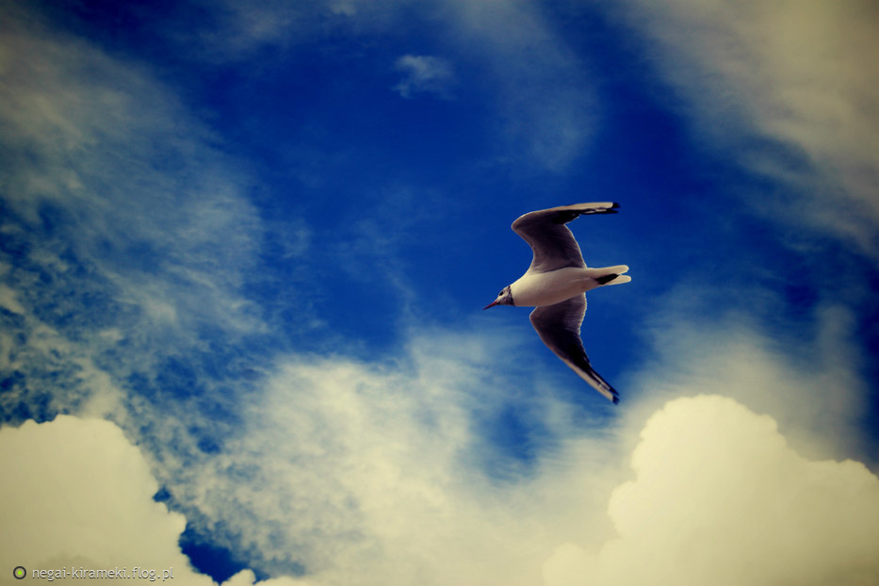
Visual-Spatial intelligence it’s about Visualizing, dreaming
Students had to visualise the activity and make the visualisation true;
They had to imagine what may happen and then act properly thanks to it;
They had to use mind’s eye.

Slide 16
Interpersonal intelligence it’s about Sharing, comparing, relating Cooperating Interviewing
Students had to interact with the others; DISCUSS THE PROBLEMs, MAKE A COMPROMISE;
They had to respect other people feelings, emotions;
They had to cooperate while doing the tasks;
They Understood and cared about people and liked to socialize;
They learnt how to work in groups.

Slide 18
Intrapersonal intelligence it’s about Working alone on individualized projects
Students had to work individually too; preparing for each task;
They learnt how to work to deadlines;
They had an accurate picture of personal strengths and limitations.

Slide 19
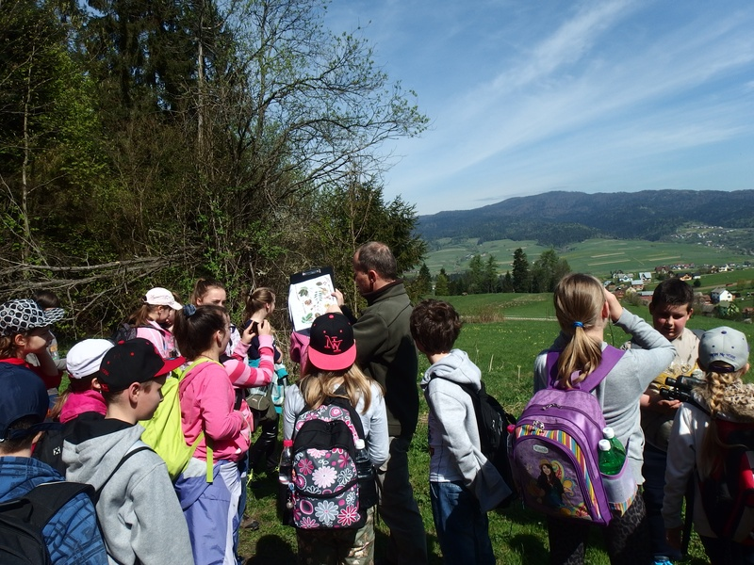
Naturalist intelligence it’s about Sensitivity to the world of nature
Students acted in nature, learnt a lot about it.

