Slide 1
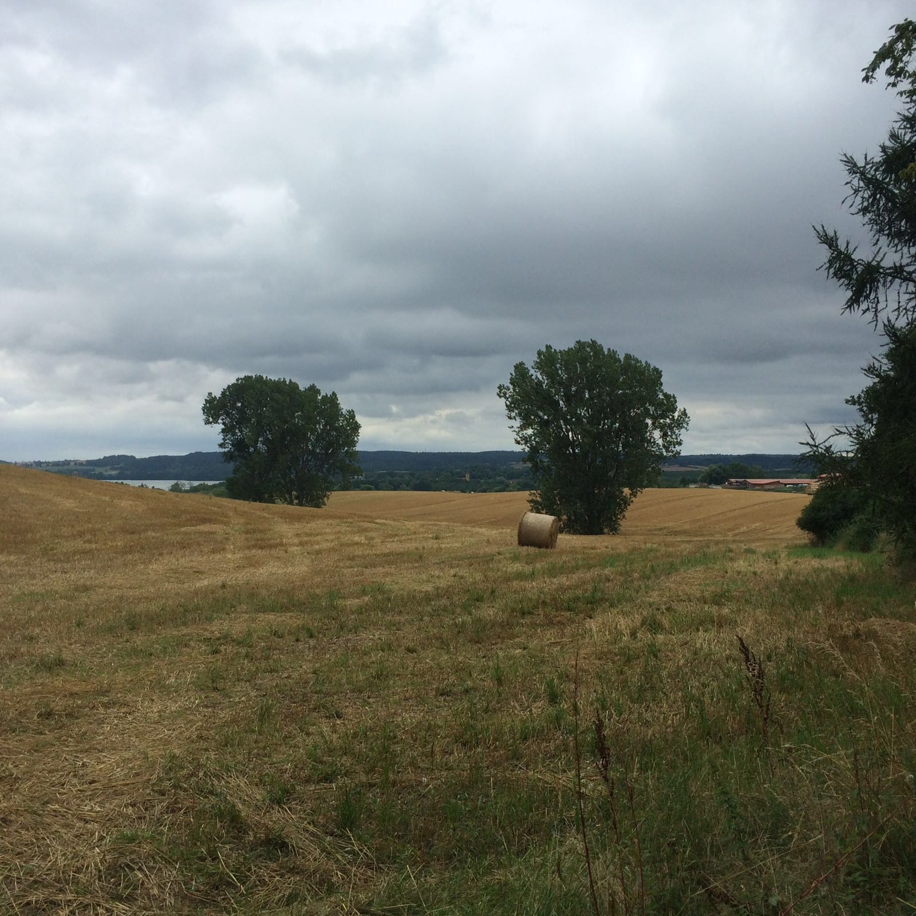
ERASMUS+ CAMPING EXPERIENCE
19th – 21th of July 2016

Slide 2
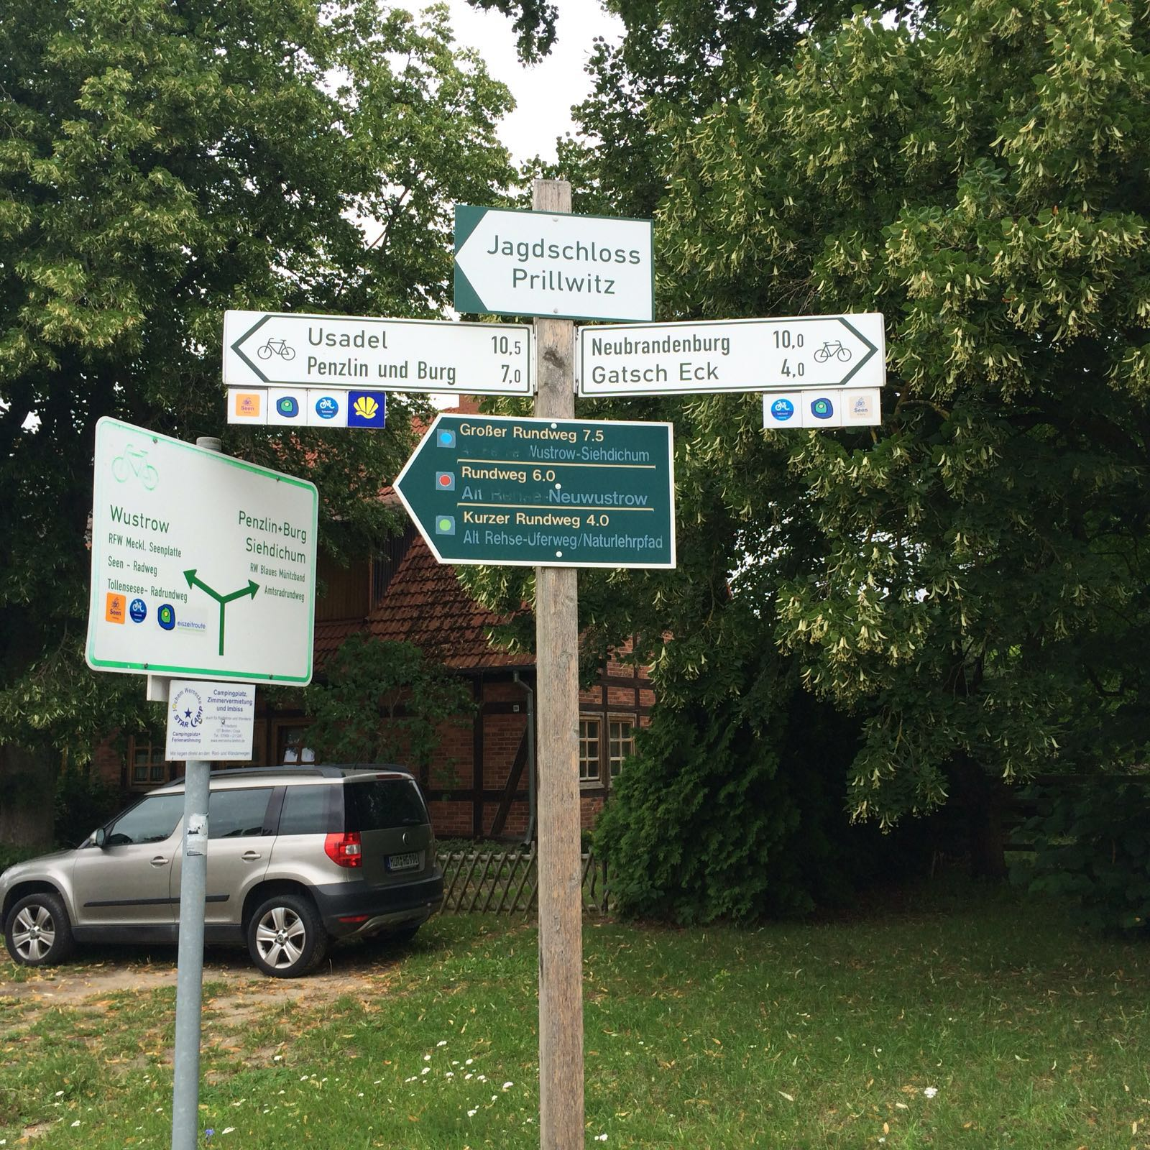
Day 1
I hope you all know about the fundament of the project "camping experience". Fifteen students and two teachers started riding bike on the 19th of July at nearly 10:00 am. Just three hours later we arrived at the campsite in Kratzeburg.

Slide 3
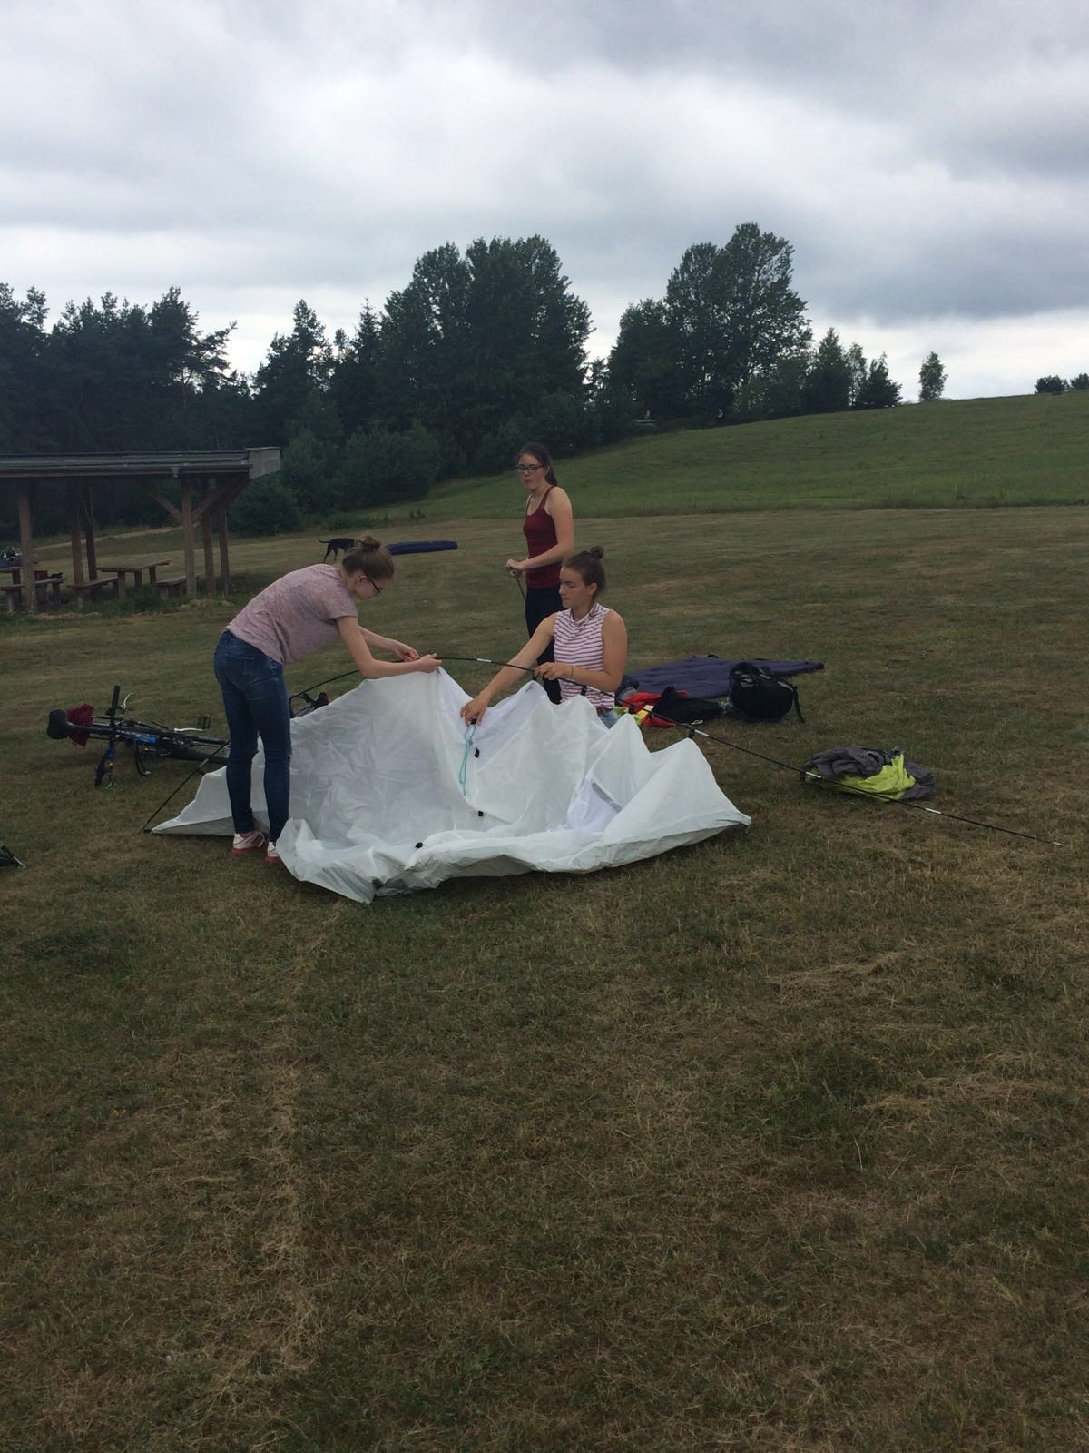
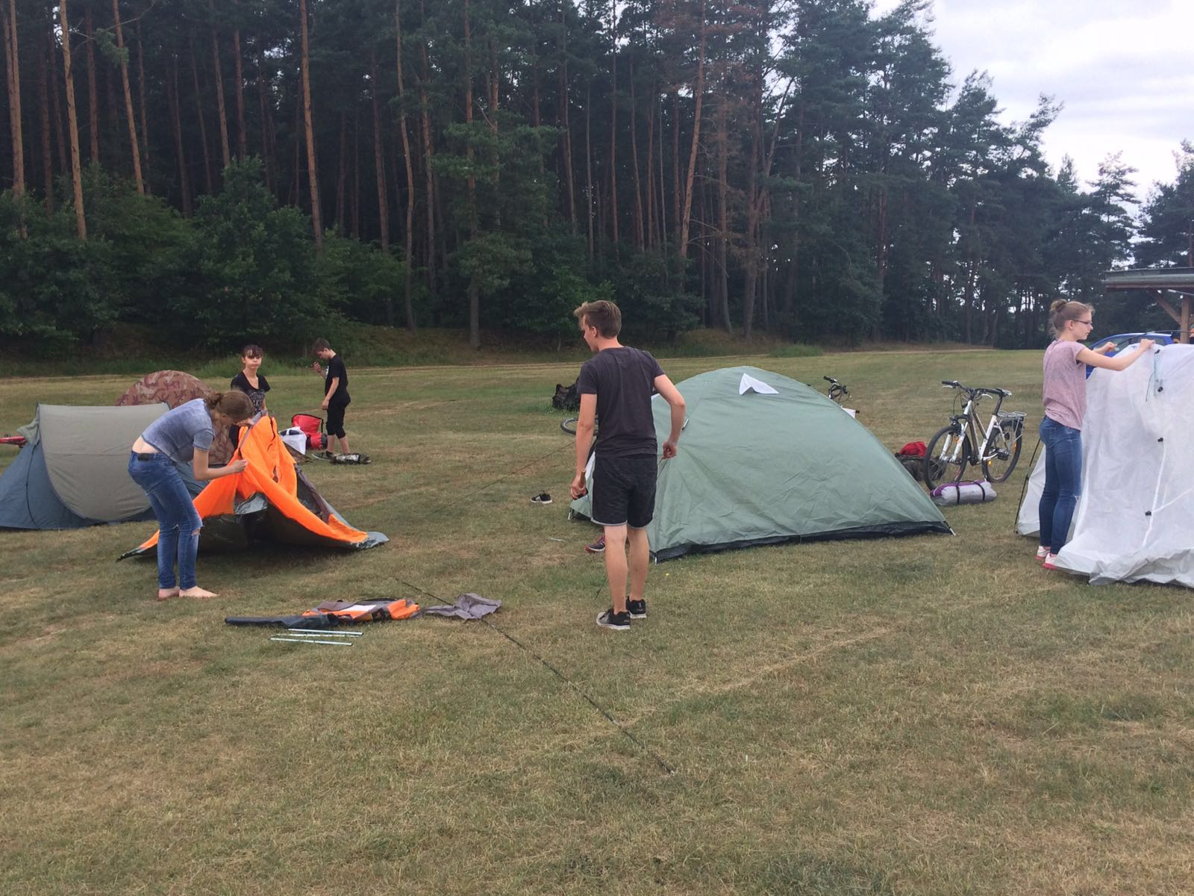
The next actions were building the tents up and collecting material for our campfire and the shelter.

Slide 4
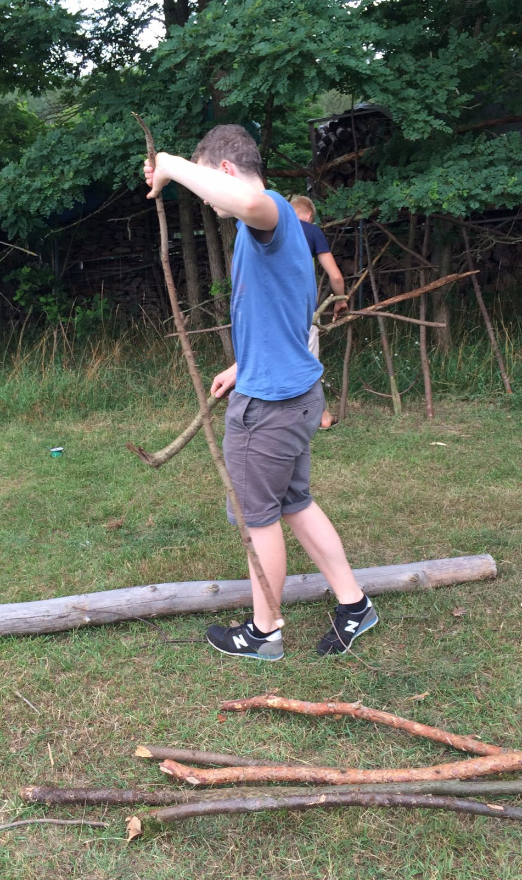
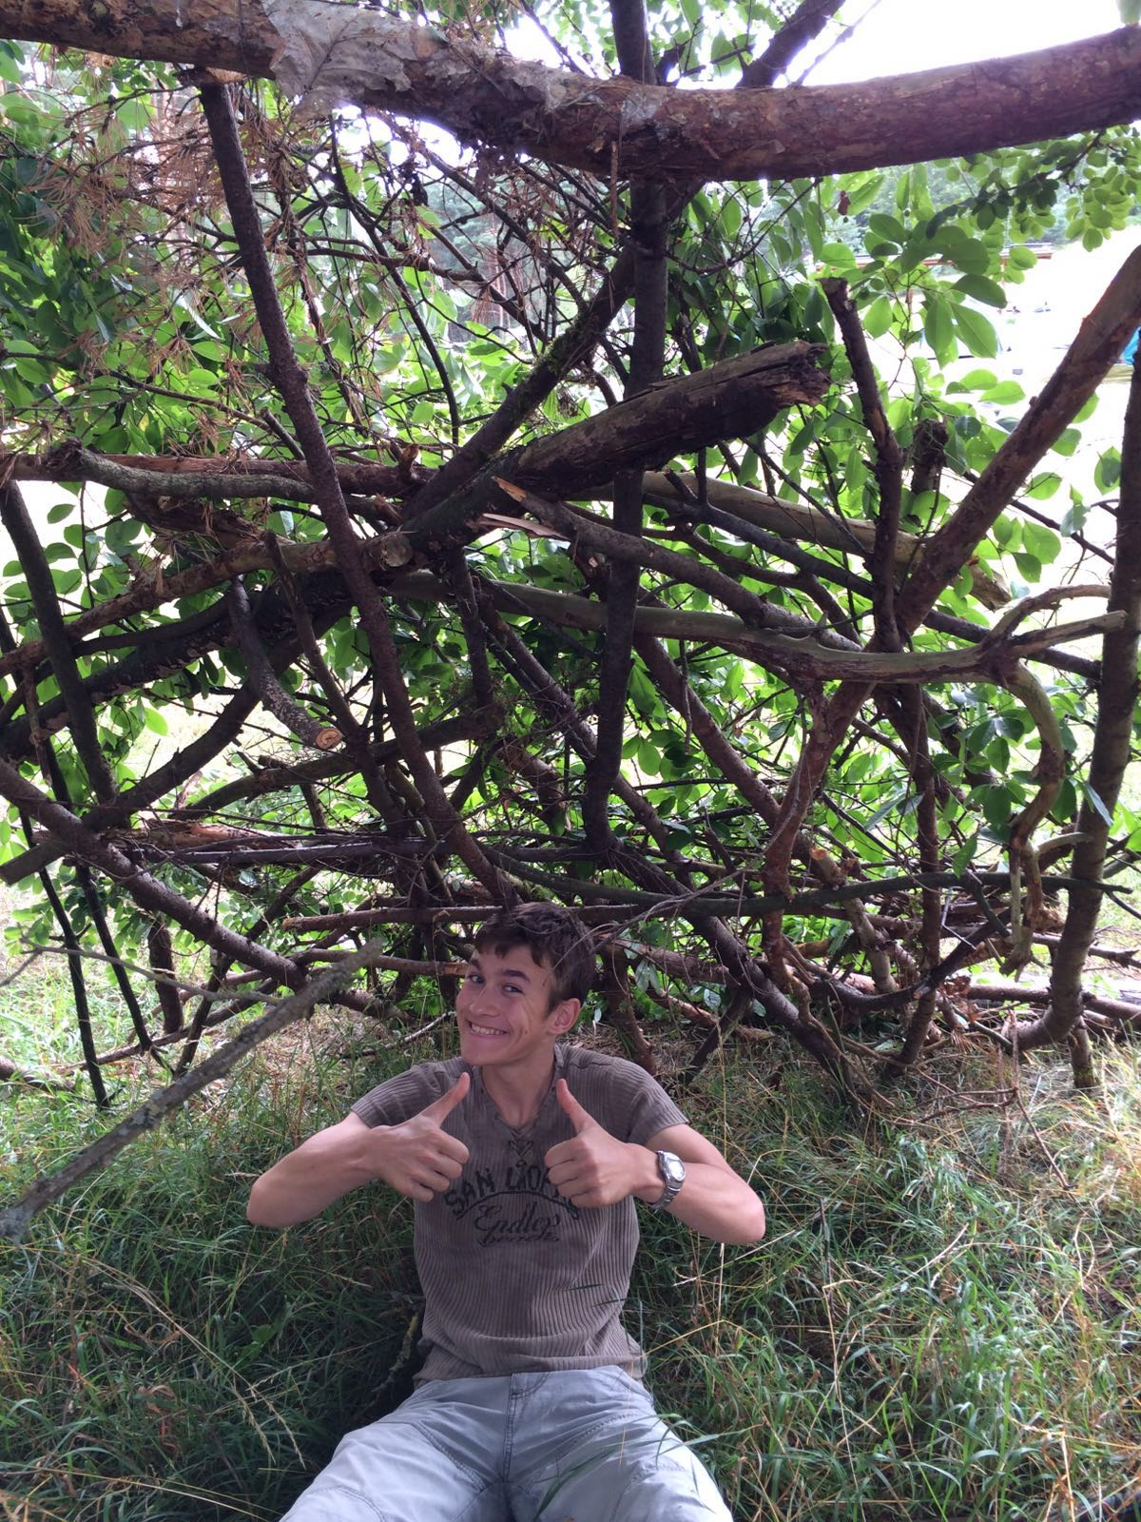
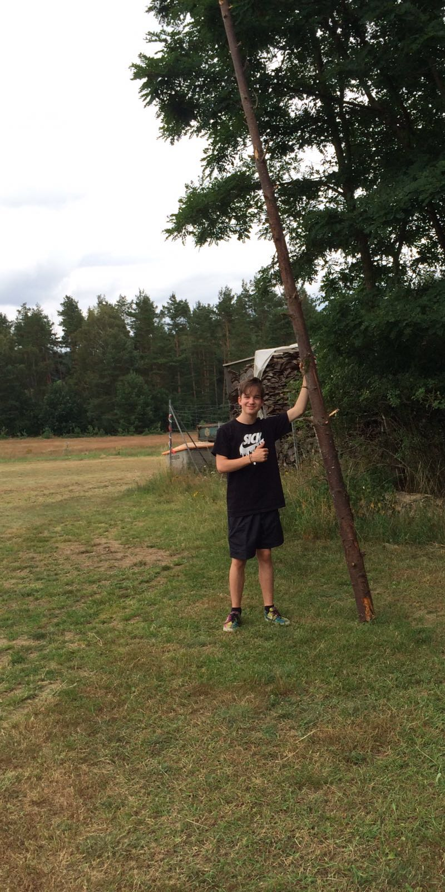
While the boys tried to build a construction with wood that looks like a shelter the girls chilled in the sun and played cards.

Slide 5
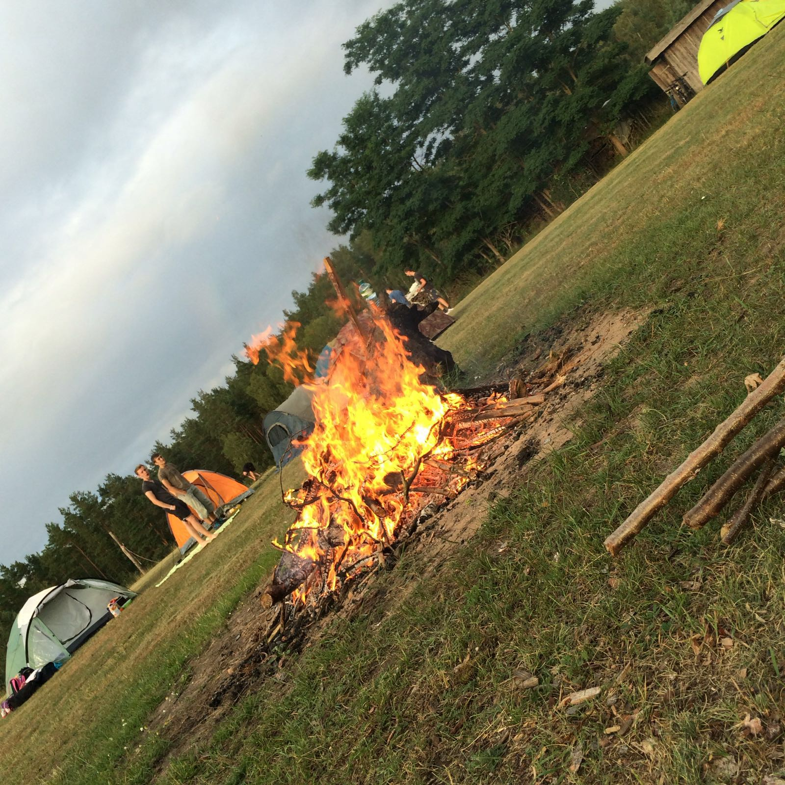
In the evening everybody sat on the large table and ate vegetables and meat. After cleaning up we played the game pantomime and laughed around the bonfire.

Slide 6
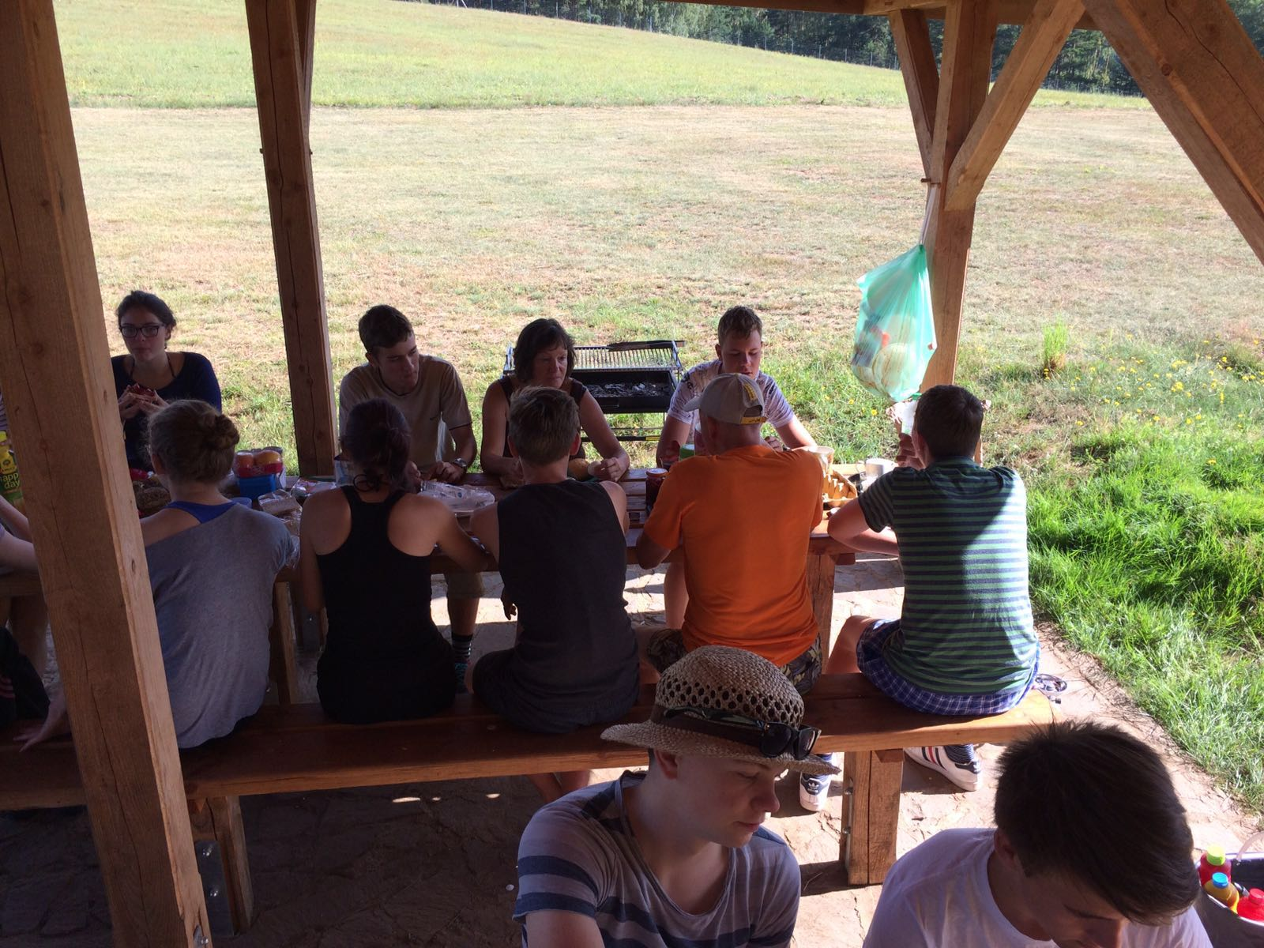
Day 2
After a tasty breakfast, our plan for this day was to canoe. We started splited us in groups of 4 people and started started to drive from lake to lake.

Slide 7
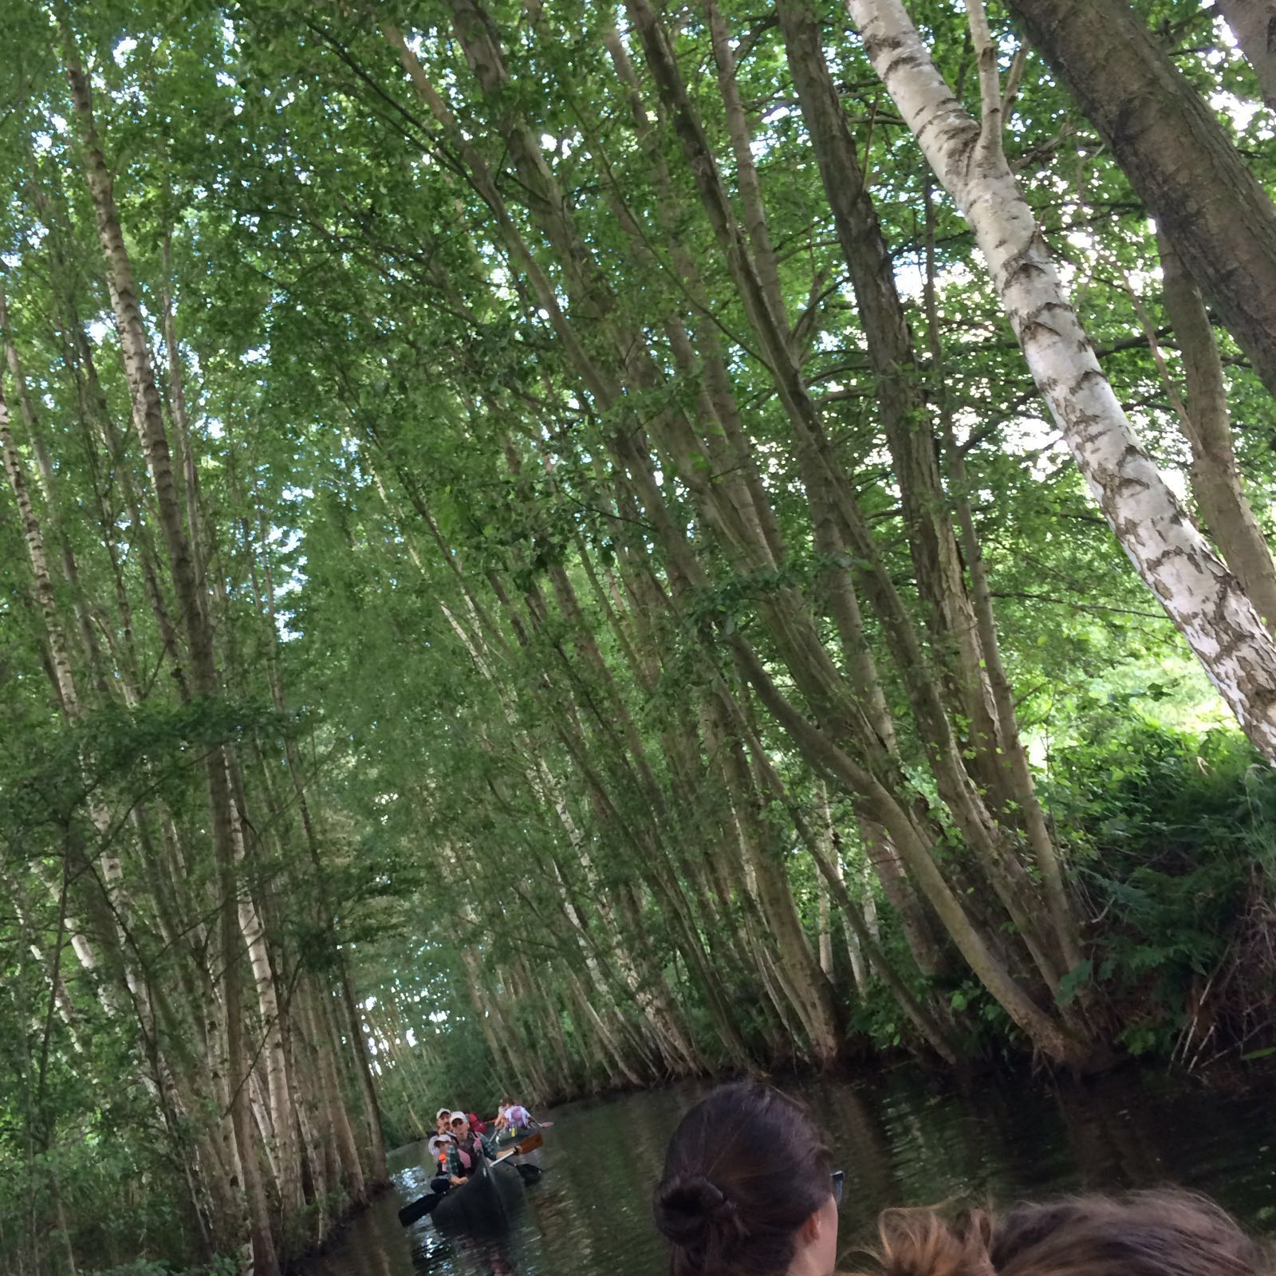
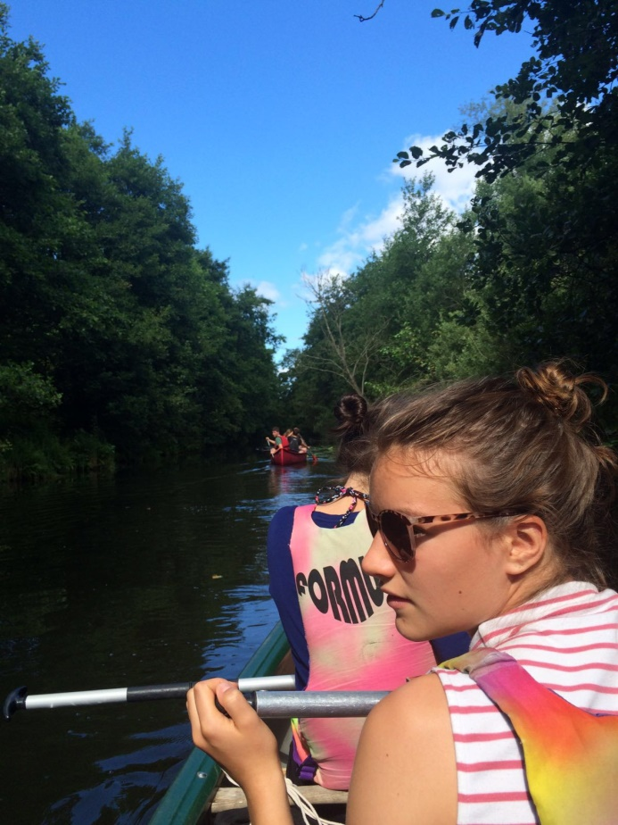
Beyond 15 kilometer we made a break and ate lunch. It was very funny in the canoe. The return path was a little competition of which one is the fast group.

Slide 8
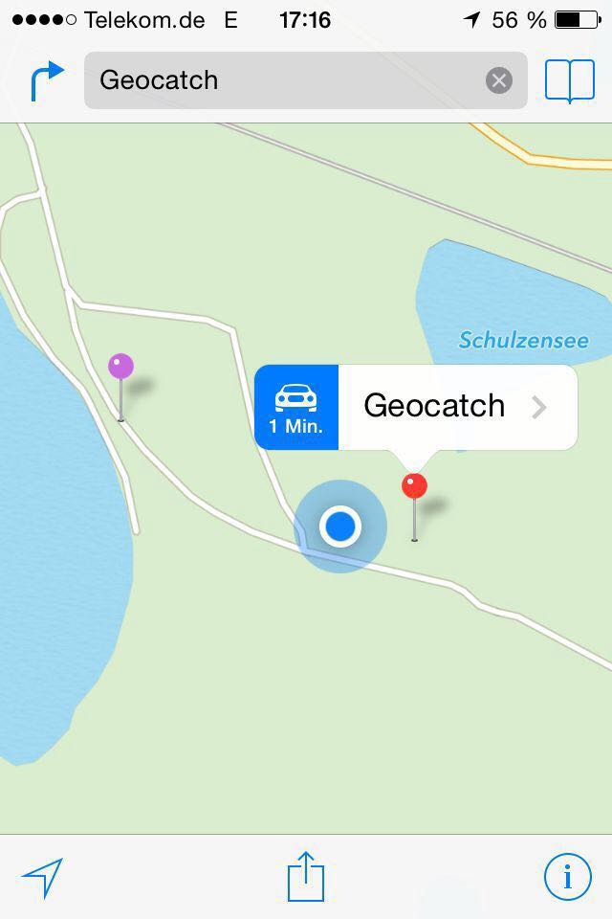
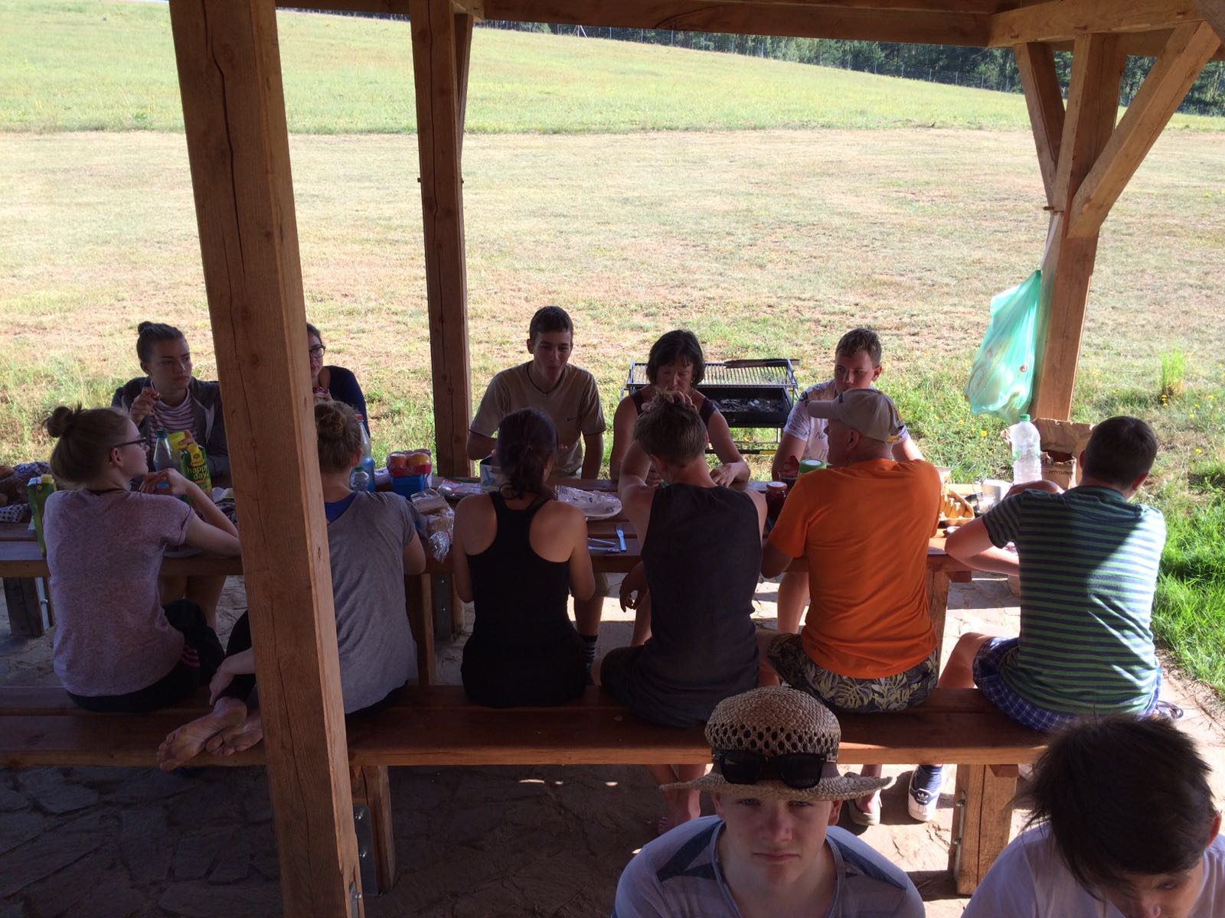
When we arrived some pupils went swimming in the lake and another group hiddened two Geocatches, a shoe and a bottle. In the evening the students searched the Geocatches and we made a barbecue, too.

Slide 9
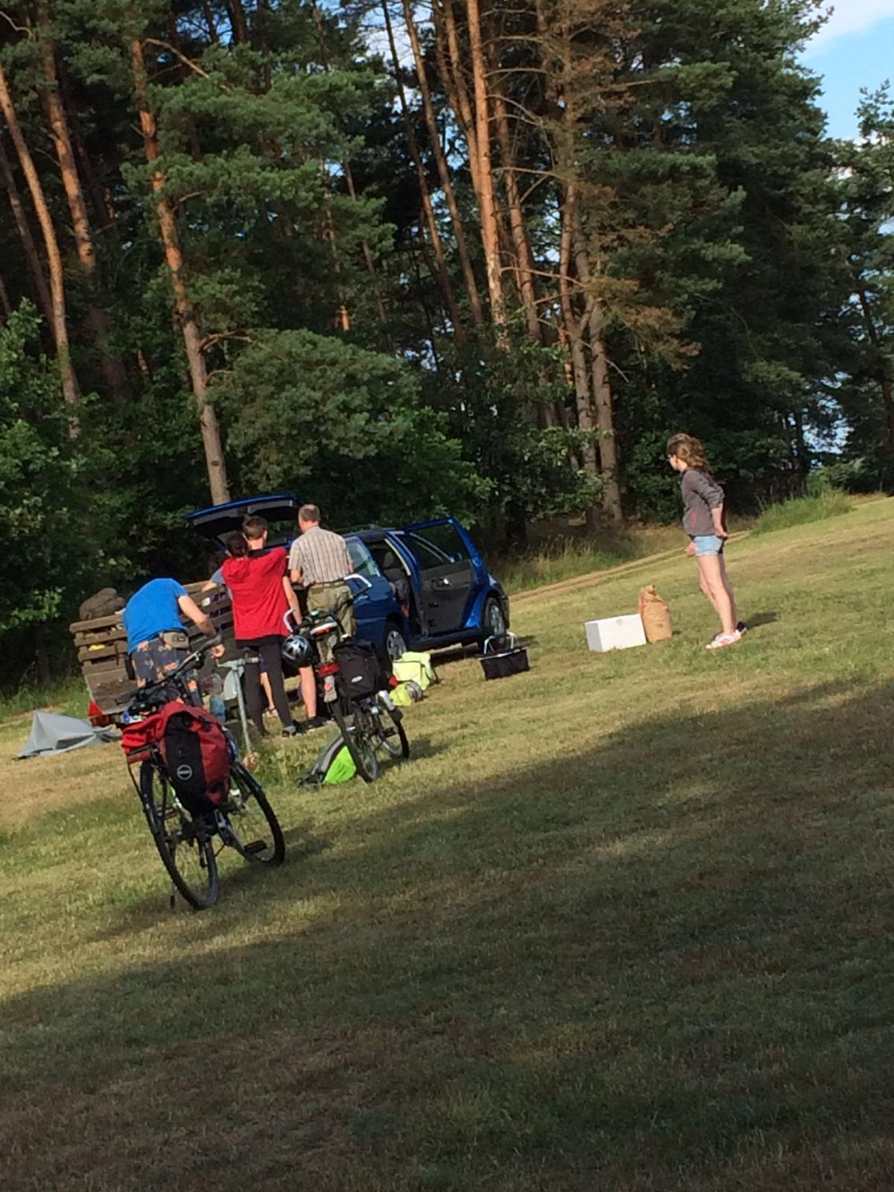
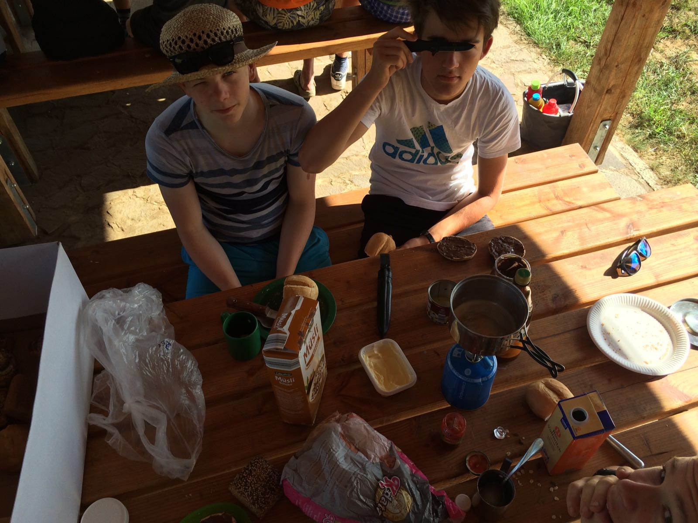
Day 3
On the 21th of July 2016 we dismantled our tents and then we made our breakfast.

Slide 10
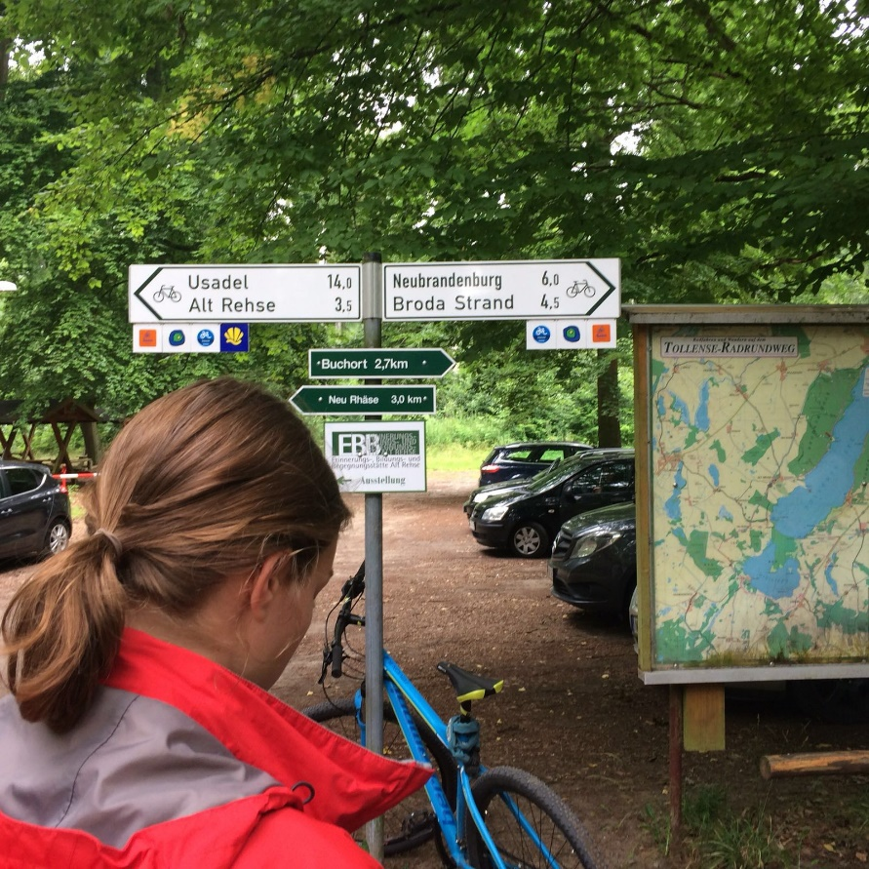
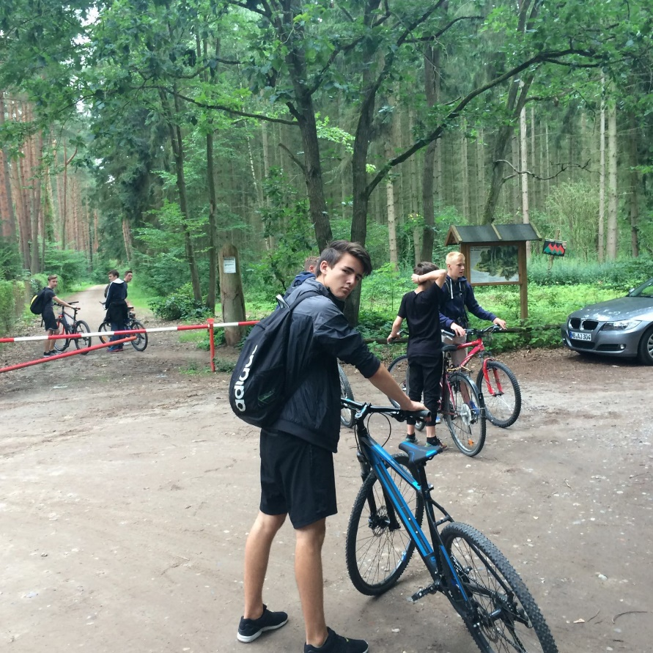
At half past nine, we started our return path and at 12 o’clock we arrived the school.

Slide 11
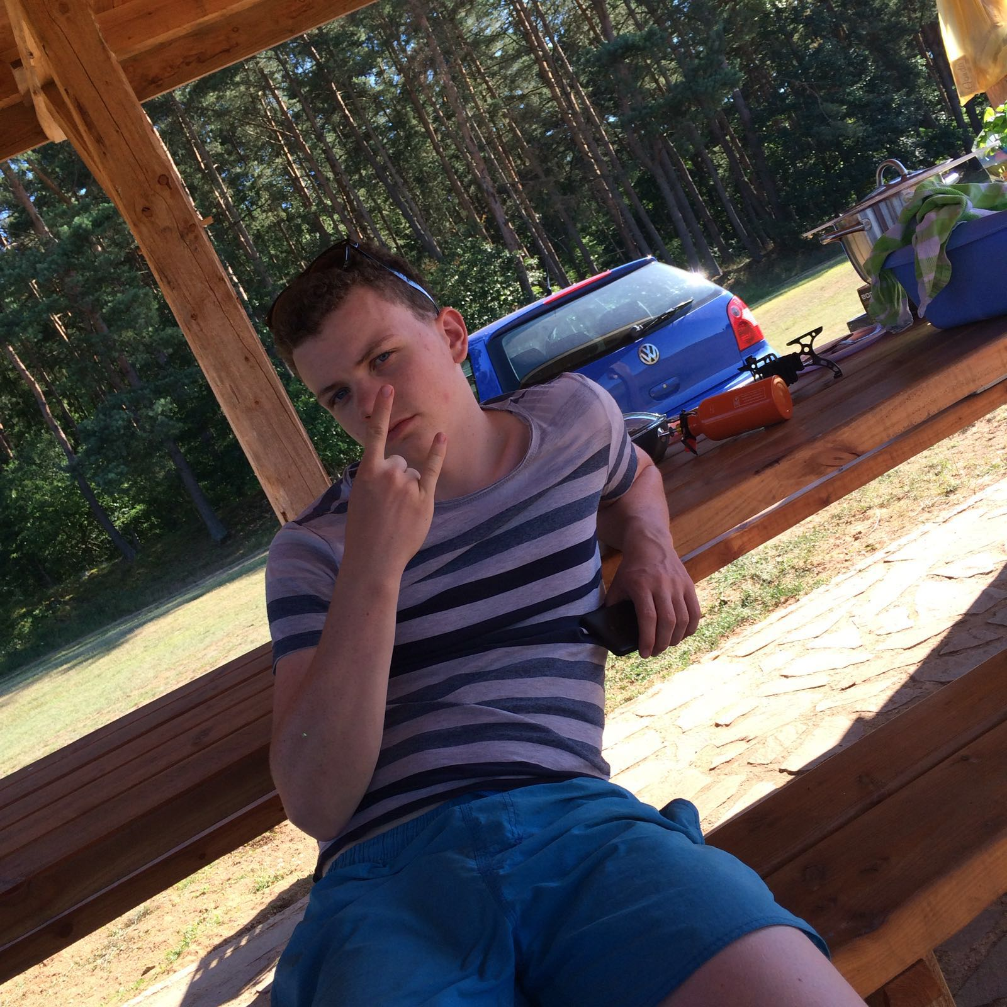
That was the end of our “camping experience” and it was pretty nice.☺

