Slide 1
ISTITUTO COMPRENSIVO D.LENTINI
City of Lauria – Basilicata - ITALY
Dublin 2017 : Presentazion of the school
Istituto Comprensivo “ D. Lentini” Lauria

Slide 2
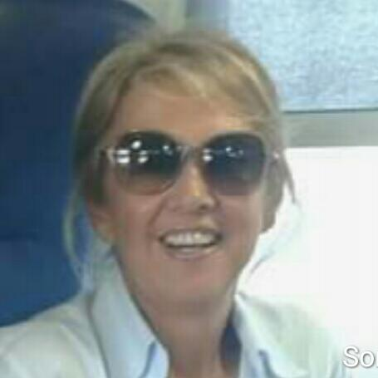
About me..
I’m an italian teacher , my name’s Maria Teresa.
I'm studying English recently (I started late unfortunately),
so I do not understand it fully, but my teacher colleagues will help me better understand everything you do in your school.
I teach in Lauria in a Primary school .
My students are 7 years and they frequent second class. I teach Maths, Geography, Technology,Science and Physical education.
I’m married and I have two children and three grandchildren.
I like very much teaching, reading, swimming, traveling and…
Istituto Comprensivo “ D. Lentini” Lauria

Slide 3
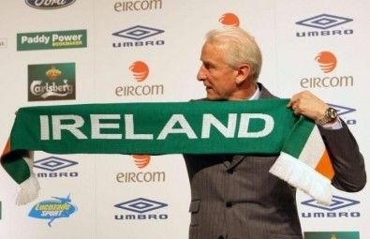
About me.. part two
..I like Ireland , Trapattoni ..
And I'm happy to be here with you
3

Slide 4
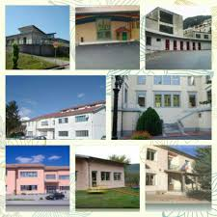
About The School
The school where I teach is the I.C. Lentini Lauria . The school is frequented by 715 students, aged 3 to 14 years, 110 teachers, 20 secretarial staff and cleaners.
The comprehensive school has five kindergartens, four primary schools, two secondary school.
Teachers work 25 hours to weekly .
The teaching-educational activities are spread over five days a week (from Monday to Friday).
Istituto Comprensivo “ D. Lentini” Lauria
4

Slide 5
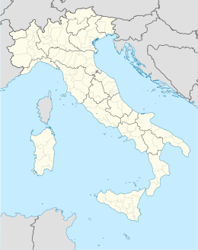
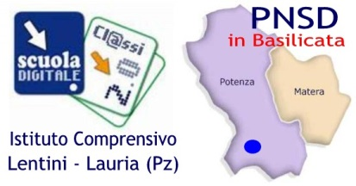
The region ( counties ) : La Basilicata
In Eire there are four counties:
Leinster , Connacht , Munster and Ulster
In Italy there are twenty regions (counties).
Our school is in Basilicata
Istituto Comprensivo “ D. Lentini” Lauria
5
5

Slide 6
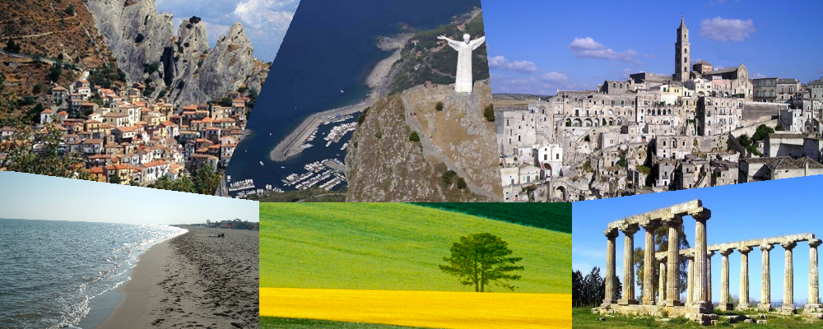
The region ( counties ) : La Basilicata
Region rich in natural resources with a population of 580,000 people
Famous place: Matera , Maratea , Melfi , Castelmezzano
Istituto Comprensivo “ D. Lentini” Lauria
6
6

Slide 7
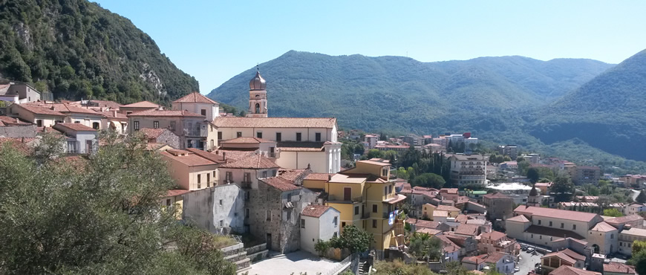
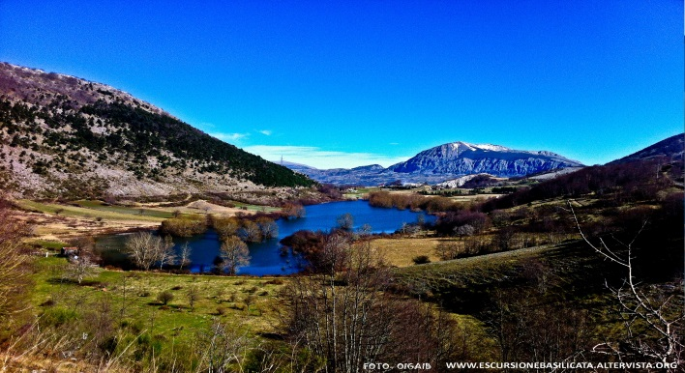
The city of Lauria
I teach in the city of Lauria but I live in the city of Maratea

Slide 8
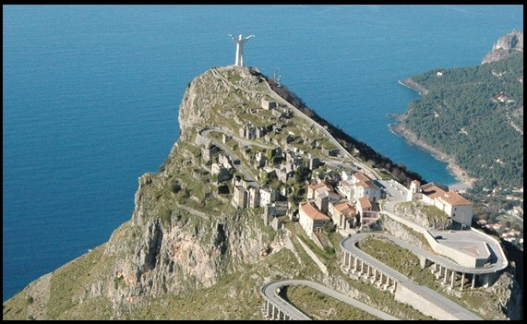
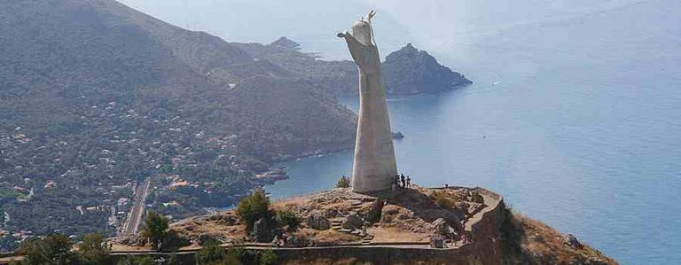
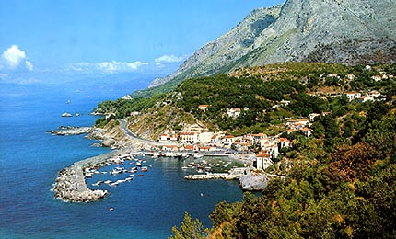
The city of Maratea
The Christ statue of Maratea and the fantastic crystal clear waters

Slide 9
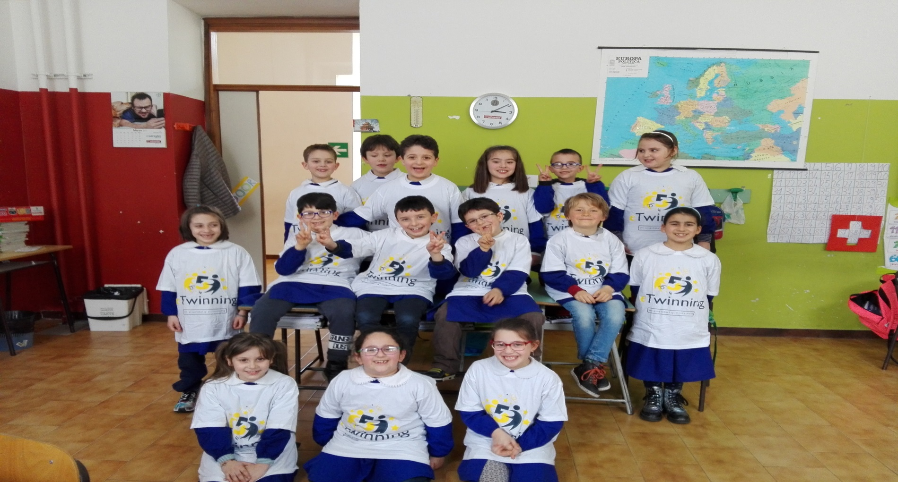
The classroom
This is my classroom whit my pupils. They are 17 student: 8 girls and 9 boys
Istituto Comprensivo “ D. Lentini” Lauria
9
9

Slide 10
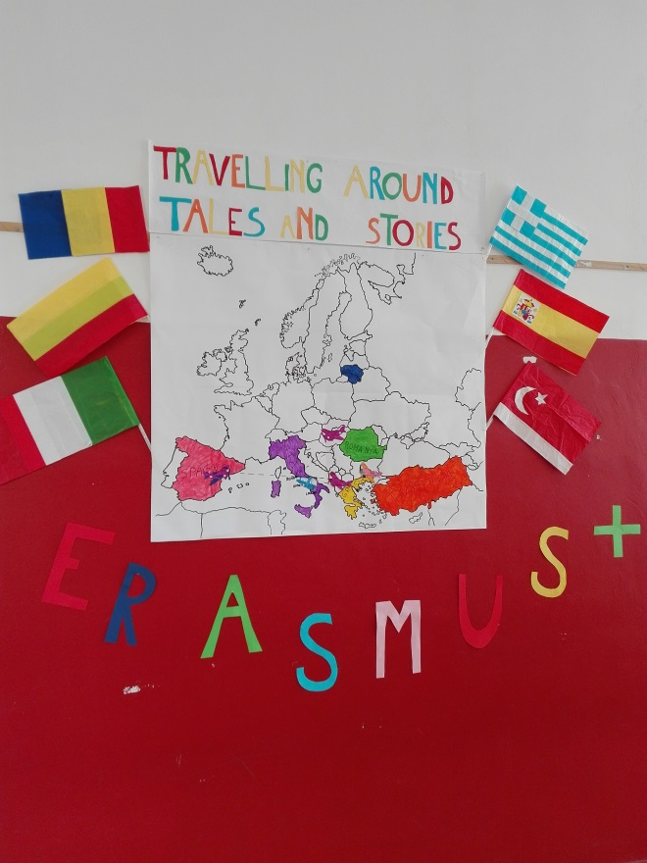
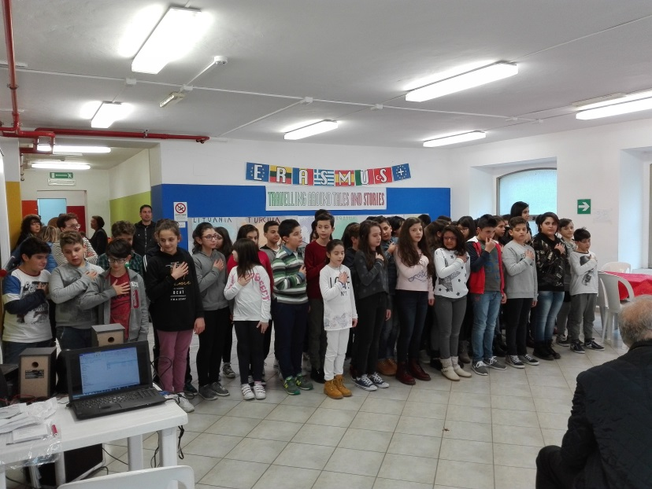
eTwinning and Erasmus
I.C.Lentini , develops European projects in Erasmus and eTwinning to develop key skills in an innovative, creative and motivating environment with the use of ICT. The project objectives are in continuity with our curriculum.
10

Slide 11
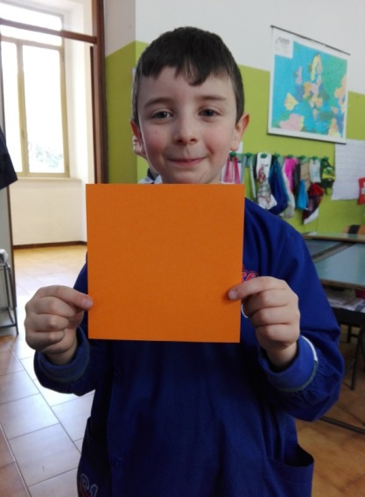
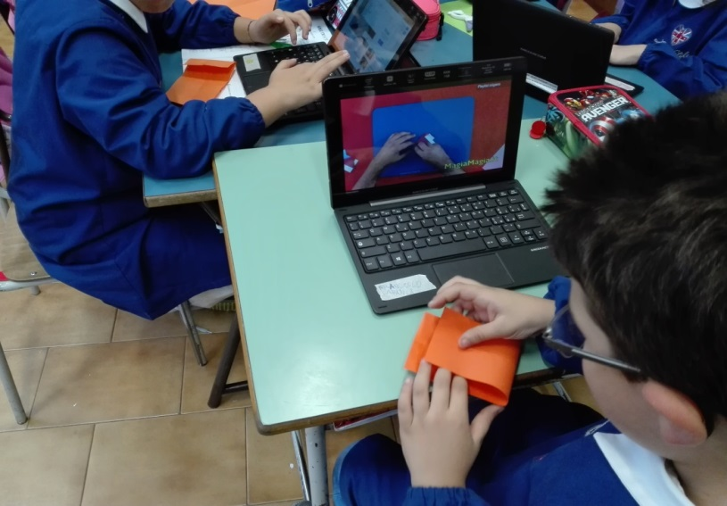
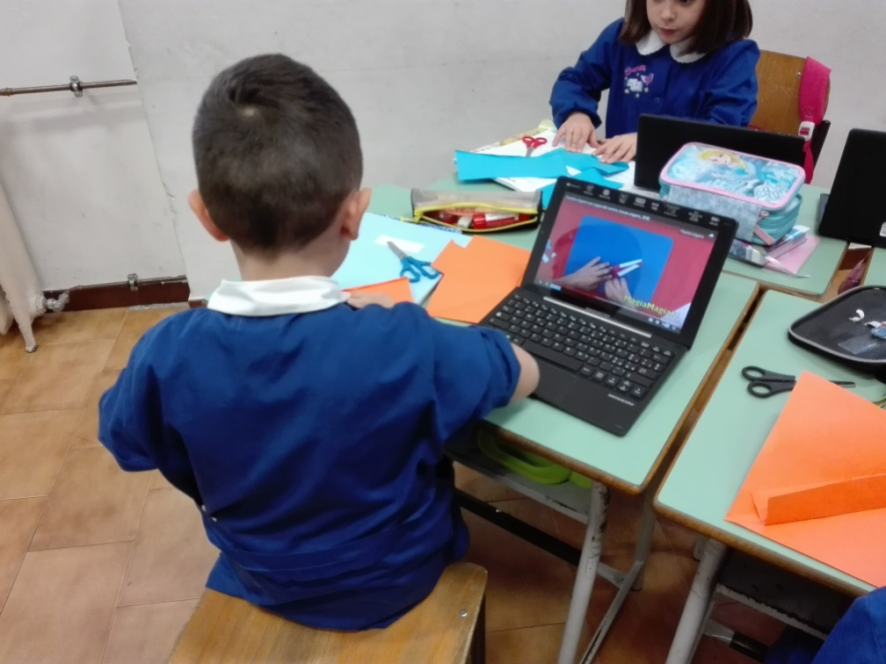
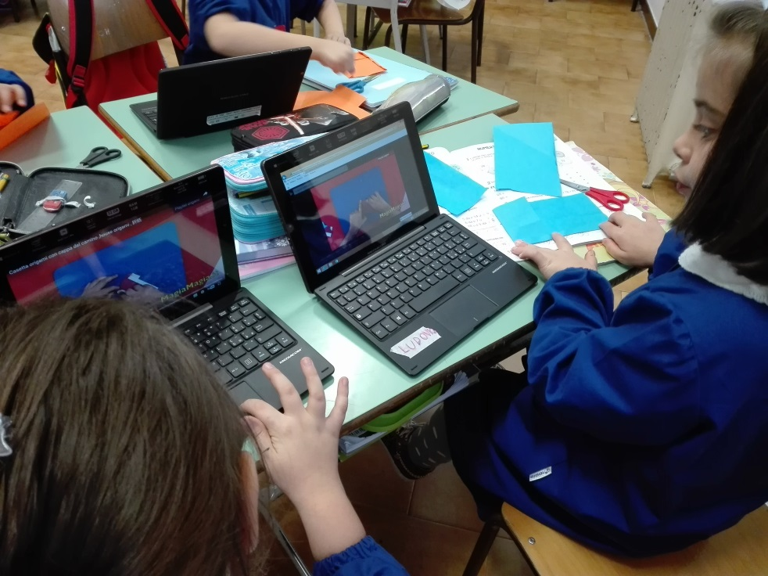
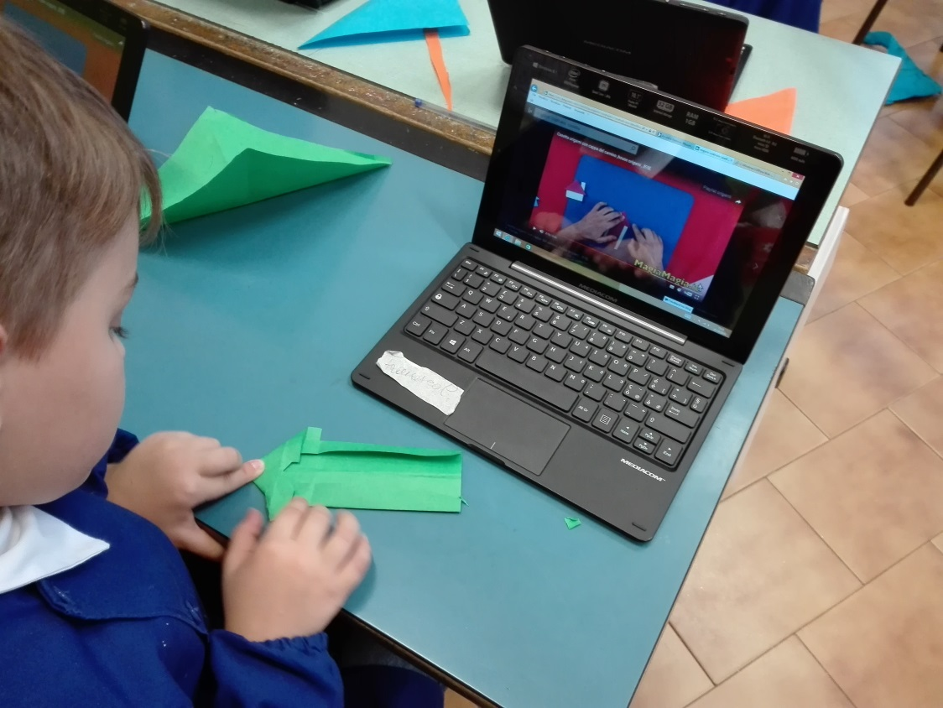
We use ICT as a facilitator tool for learning the disciplines
Geometry : the origami

Slide 12
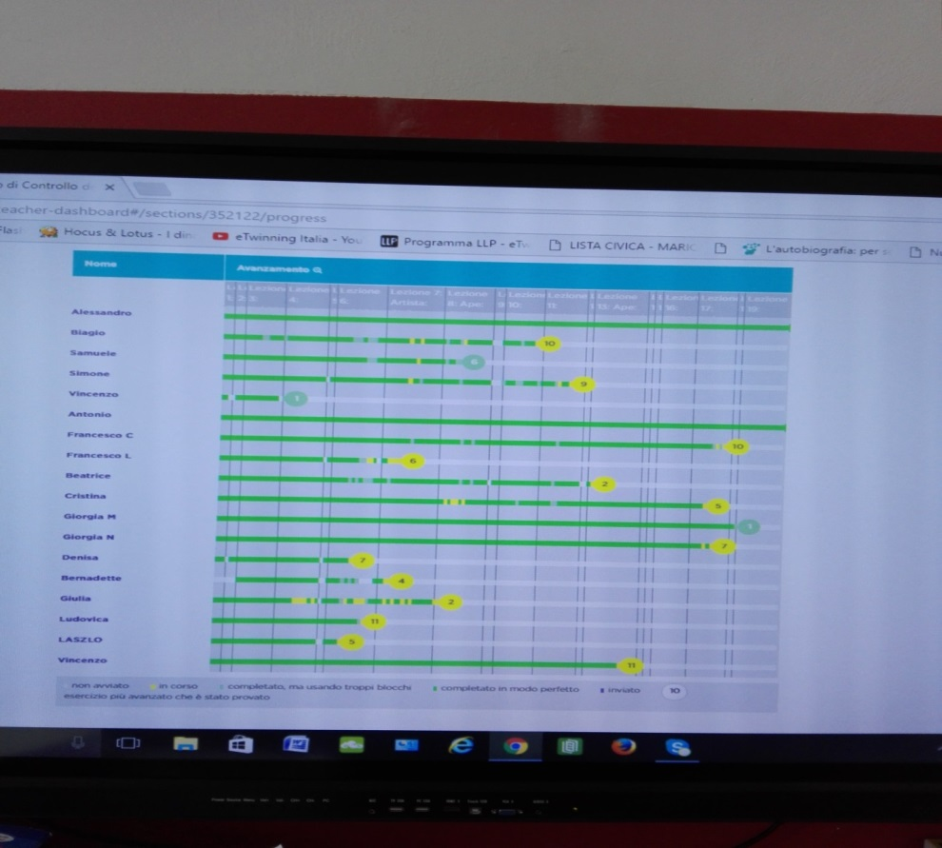
Computazional language
Many institute classes are entered in code.org platform.
Students really enjoy this activity and have fun.
12

Slide 13
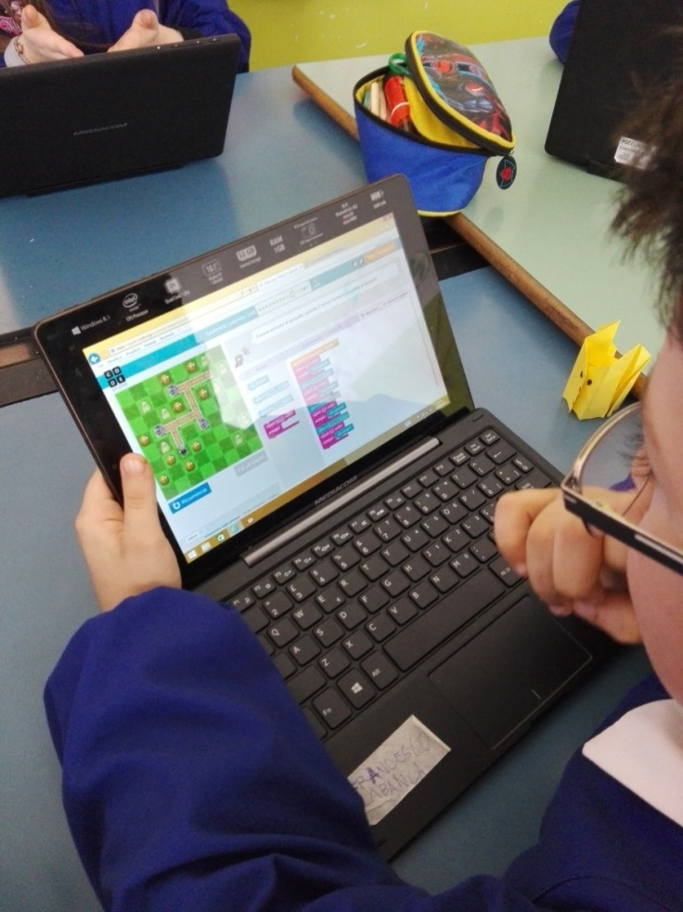
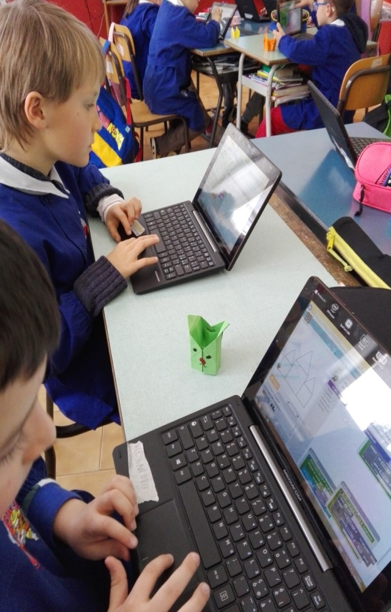
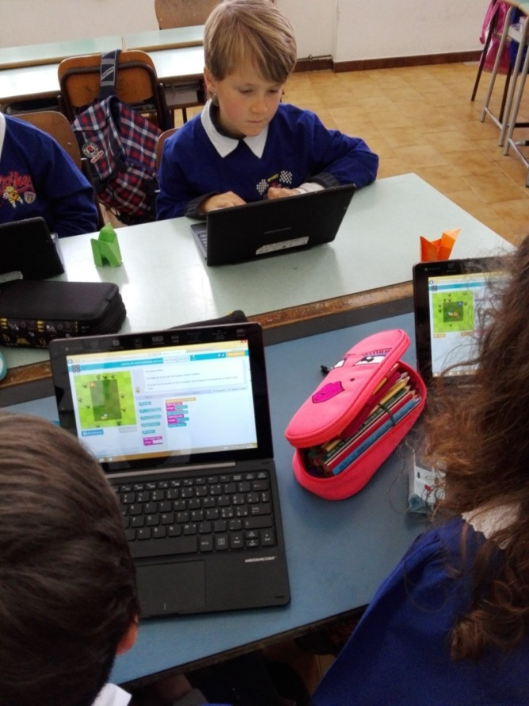
Computazional language
13

Slide 14
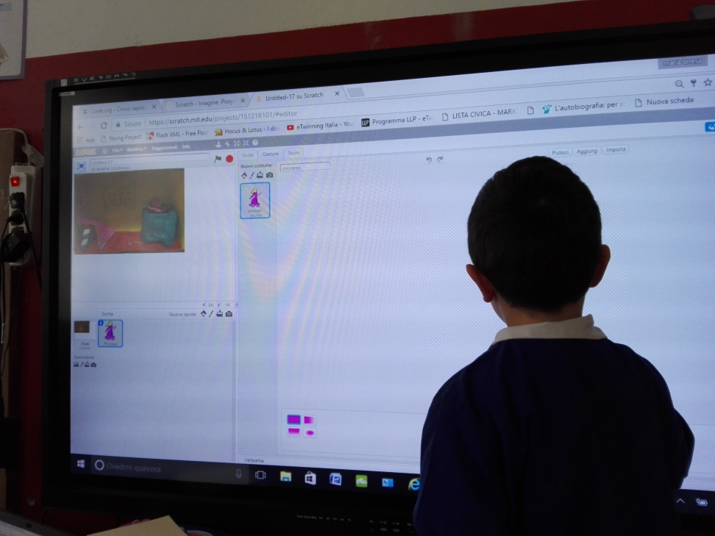
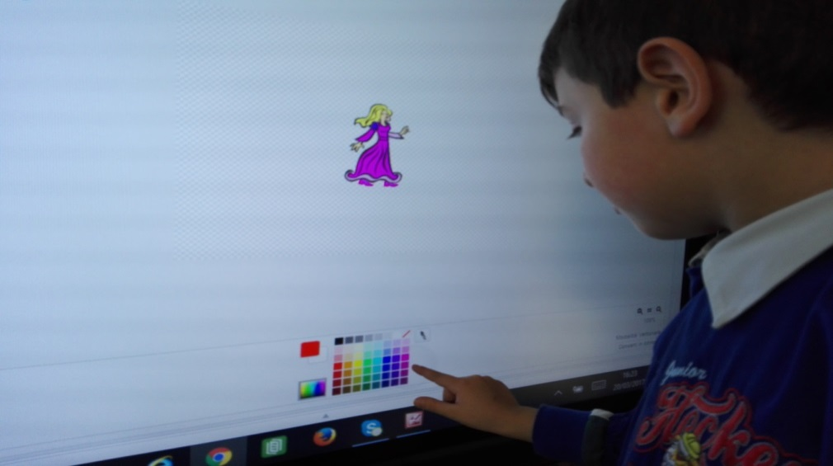
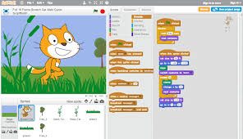
Scratch
We are building with the scratch program the story of «Biancaneve»

Slide 15
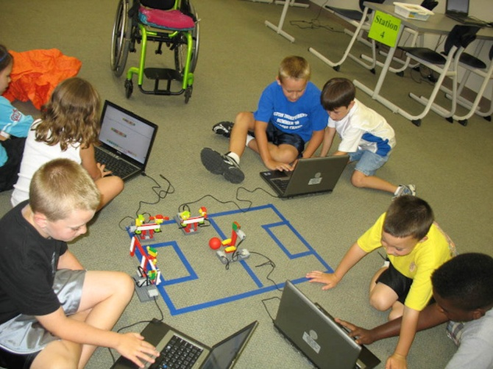
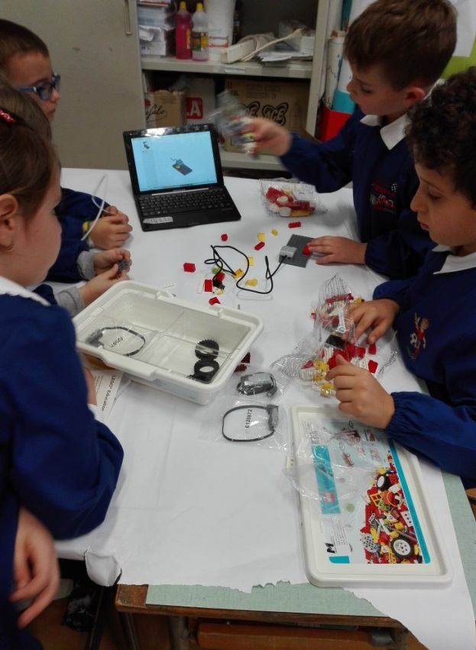
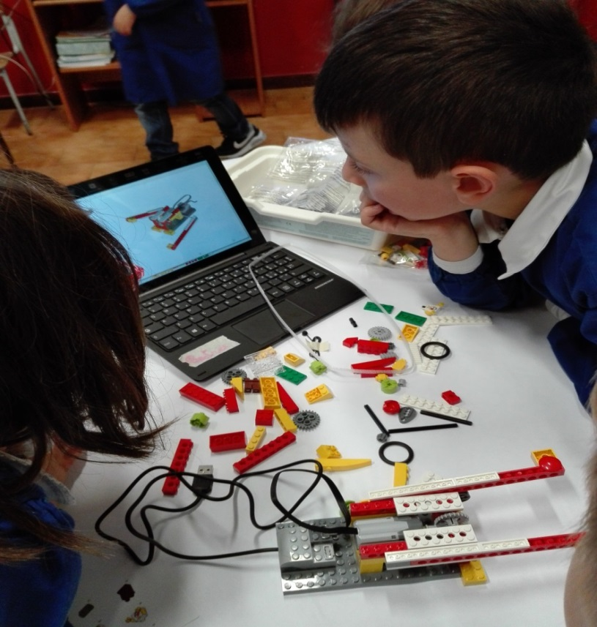
The robotics
The goal is not to teach robotics.
The goal is to improve teaching using robotics. In this way students are more involved in the study of scientific and technological subjects

Slide 16
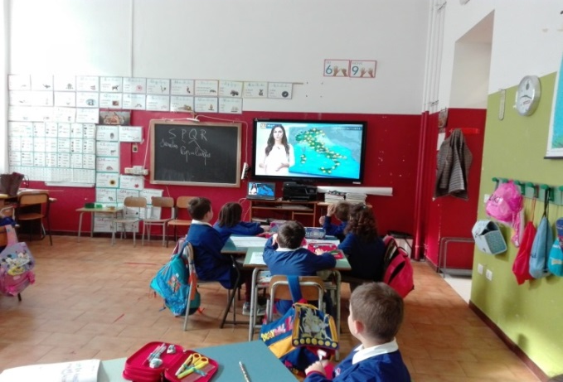
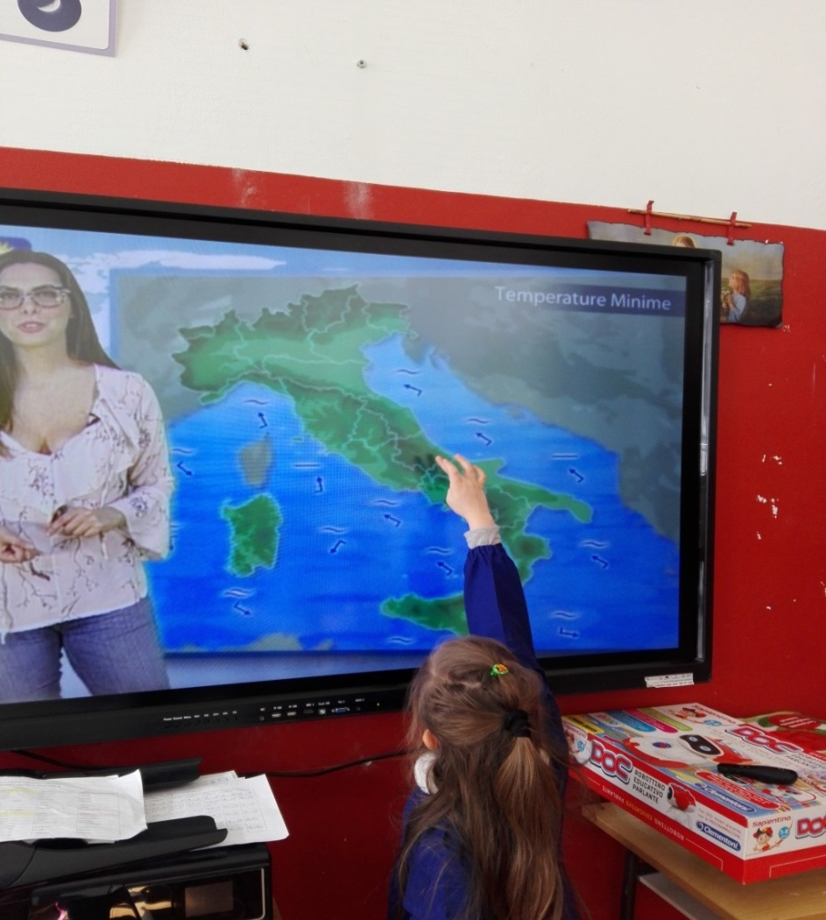
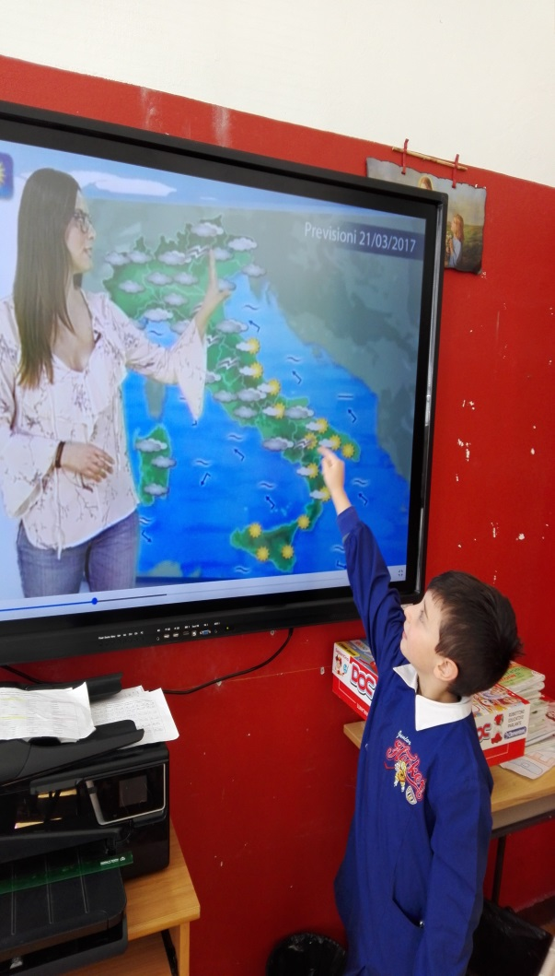
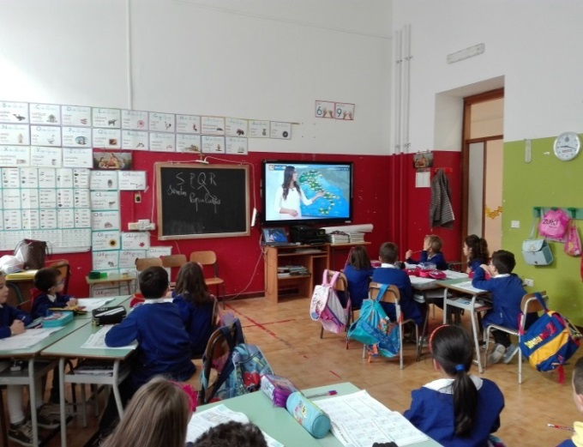
Geography
The Italian study through the weather forecast
16

Slide 17
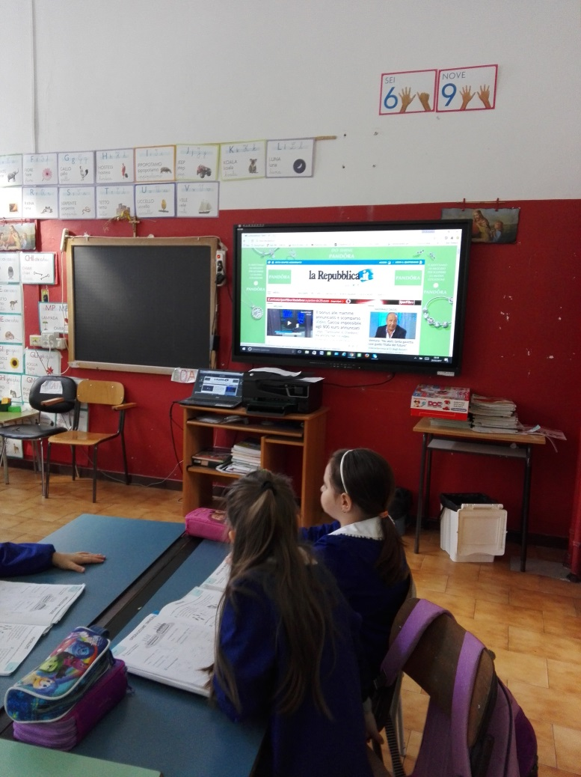
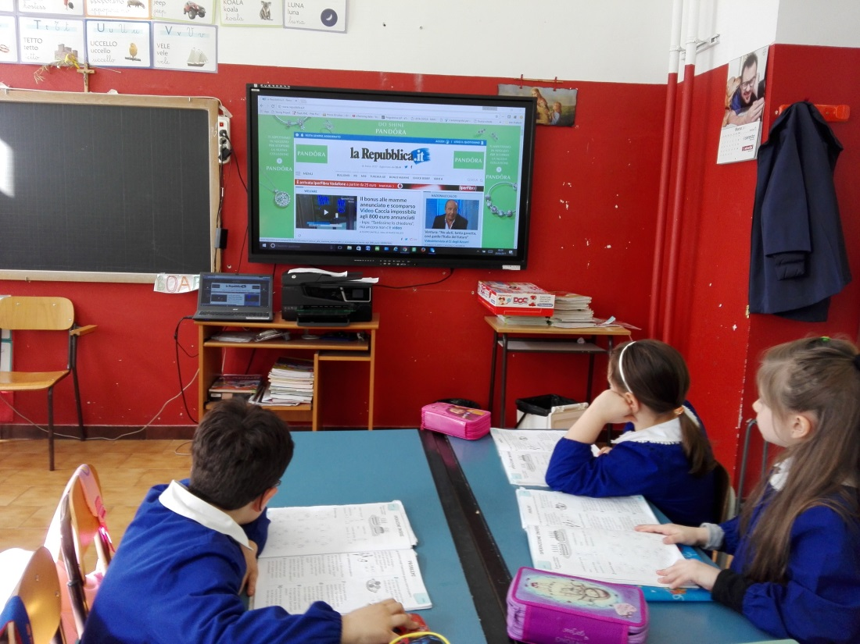
Reading the Newspaper
Every day we read in class daily and comment on the main news.
Related and informed responsibly

Slide 18
To be continued
Gamification , Simulation based learning , edugames , games based learning , Kahoot , direct pool , padlet , Learning apps and other…
Learning fun

Slide 19
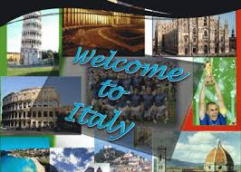
Conclusion
Thank you for your patience.
I'll be waiting in Italy to introduce my city

