Slide 1
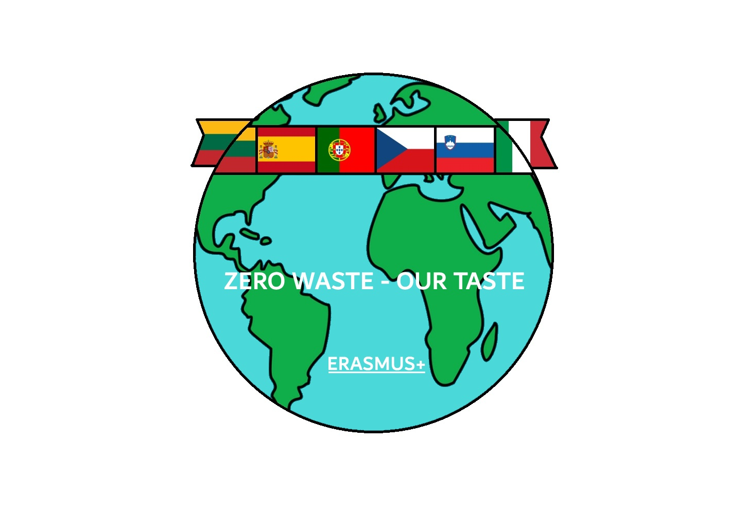
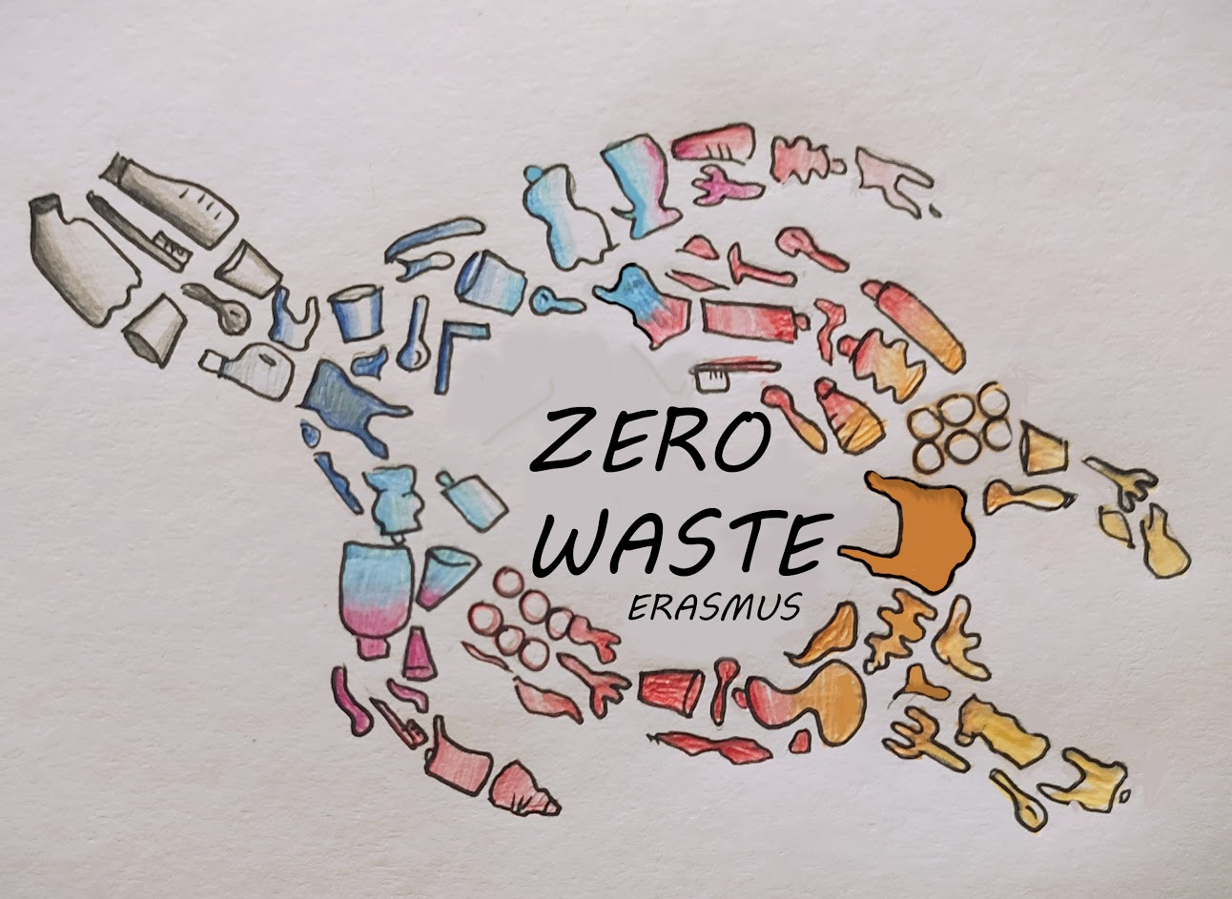
Ecological survey

Slide 2
Our survey
In November 2020, teachers at our school in cooperation with the pupils prepared a survey on waste sorting and ecology topic.
65 students from our school took part in our survey.
This survey shows that a large percentage of pupils and their families sort waste and try to behave ecologically.

Slide 3
Who are the respondents?
Most of the pupils who answered the questionnaire came from families of four or five. The respondents were between the ages of 9 and 15, and their parents could also answer prepared questions.

Slide 4
What do our pupils recycle?
Almost 99% of all respondents sort household waste. Families think that there are enough containers in our city to sort waste. Most containers are within 200 meters of the apartment or house.

Slide 5
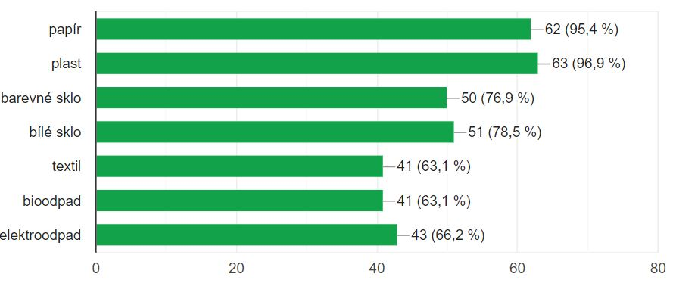
What kinds of waste do pupils sort?
In families, plastic, paper and white glass are the most sorted, textiles and biowaste the least. 82% percent know the use of sorted waste.

Slide 6
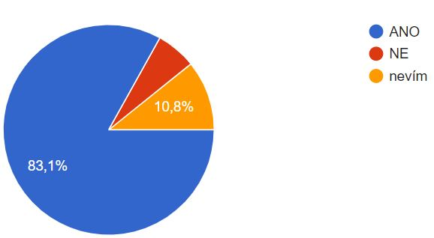
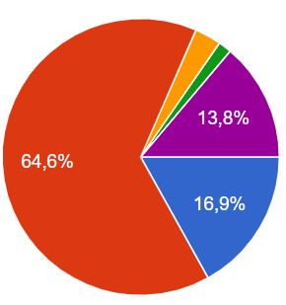
Waste sorting at school
83 percent of pupils sort the waste also at school. Nearly 65 percent of them clean trash when they see it lying on the ground.

Slide 7
72 percent of respondents do not know what happens to sorted waste at school.
So what happens to it?
Sorted waste is transported from our school by a waste processing company. Then it is processed and used to make paper towels and the toilet paper. Our pupils use them at our school.

Slide 8
How do pupils use leftover food at home?
Almost 59 percent of respondents feed the animals or sort the leftovers into biowaste.
Respondents usually meet with these types of recyclable products: exercise books, books, wrappers, food or toilet paper. They meet clothes as a type of recyclable product at least.

Slide 9
Conclusion
Almost all respondents are sure, that waste sorting is very useful.
Most of them haven´t participated in any public events related to cleaning the nature yet. We believe that this will change.

