Slide 1
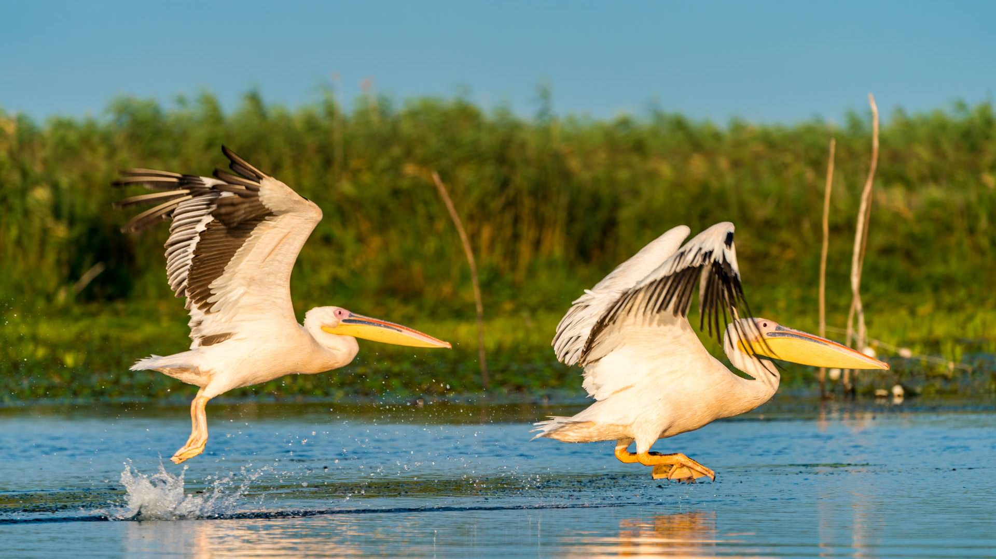
The natural and cultural heritage of Dobrogea
School: Spiru Haret Dobrogean high school
Student: Colesnic Theodora-Irina

Slide 2
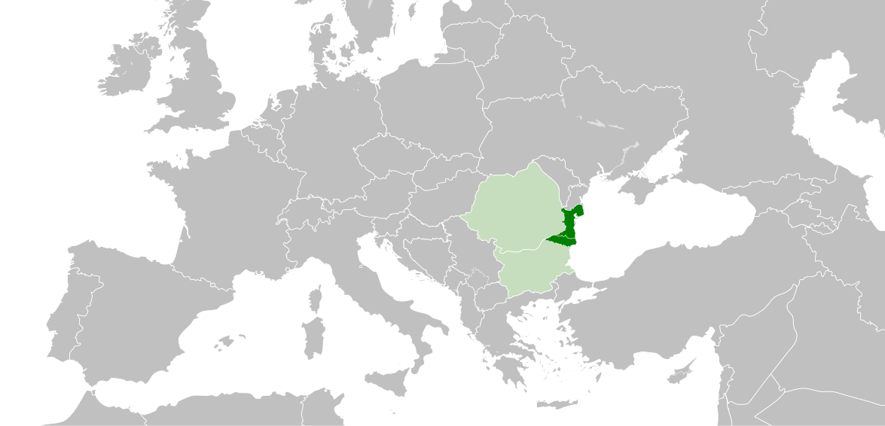

Slide 3
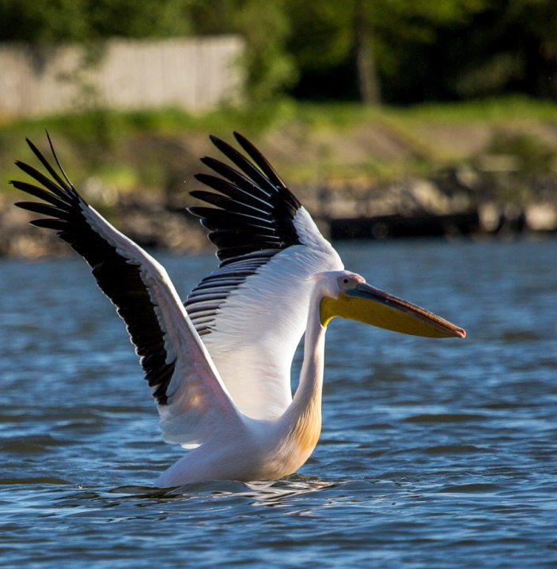
350 species of birds
45 of freshwater fish
1,700 of plants.

Slide 4
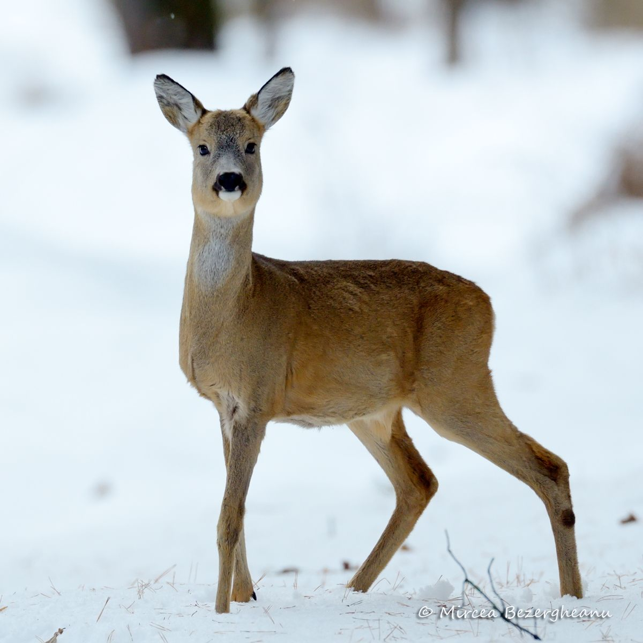
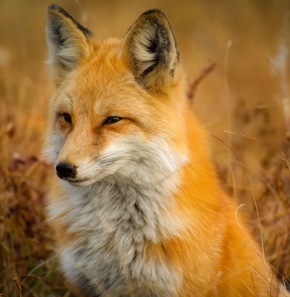
Besides birds, there’s also a rich ecosystem of wild animals

Slide 5
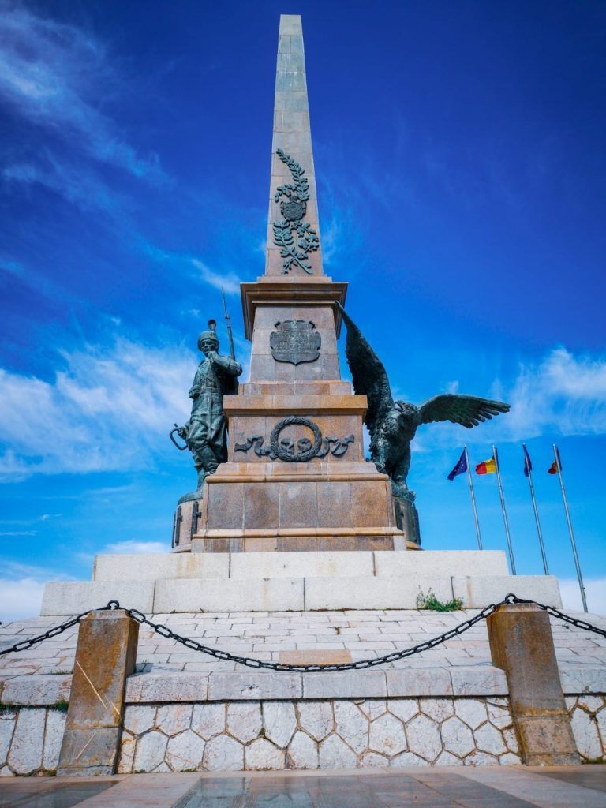
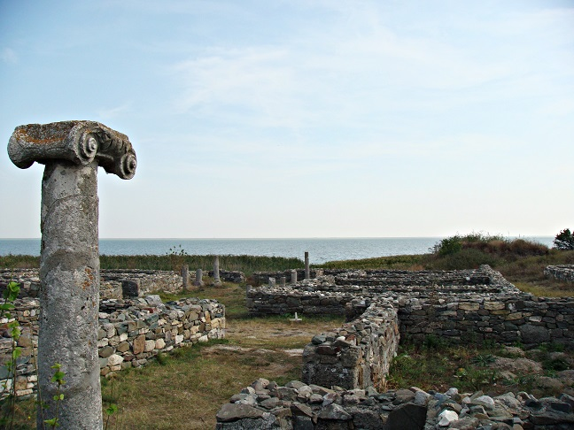
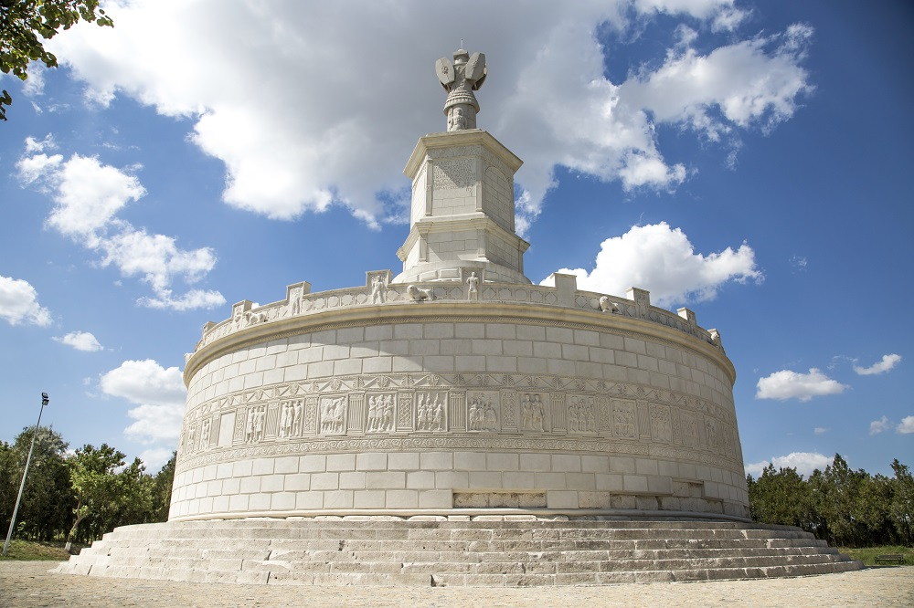
Cultural Heritage
Tropaeum Traiani
Histria citadel
Independence Monument

Slide 6
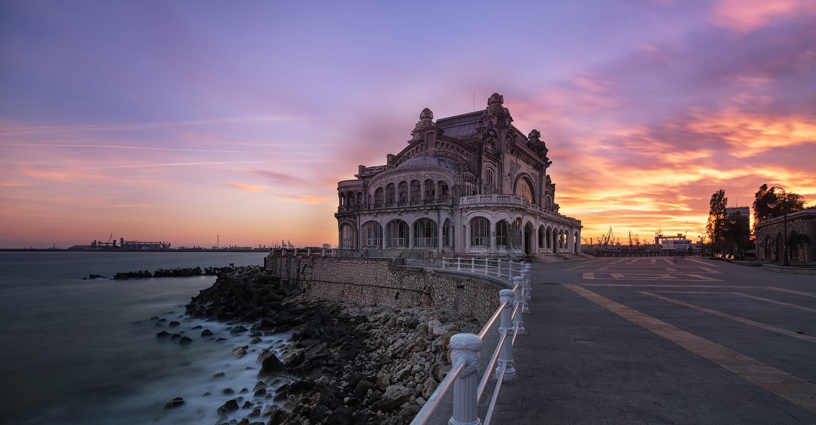

Slide 7
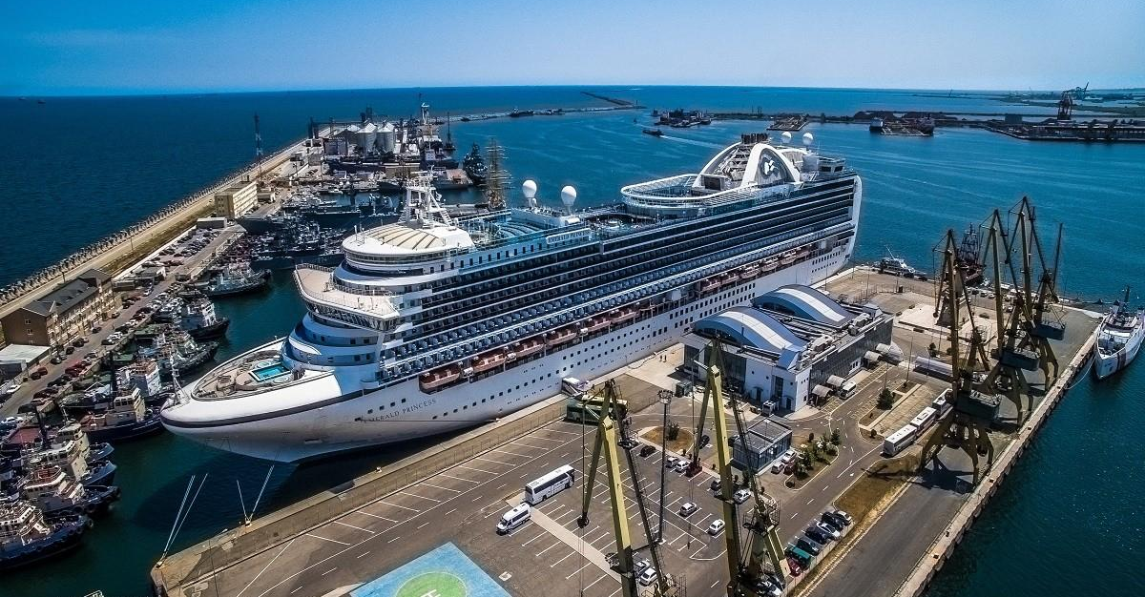

Slide 8
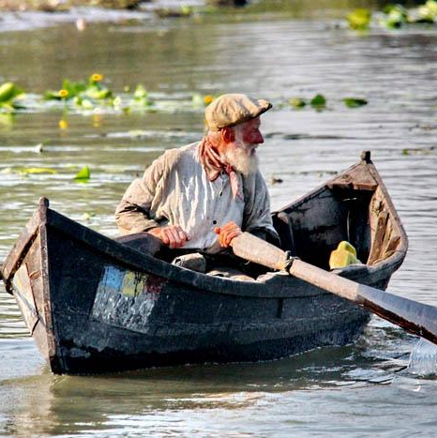
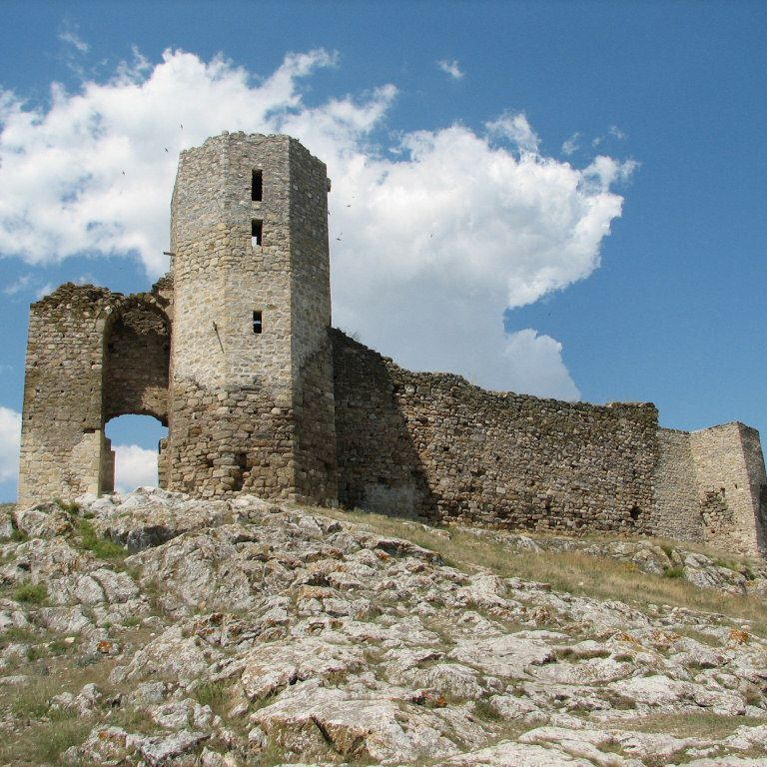
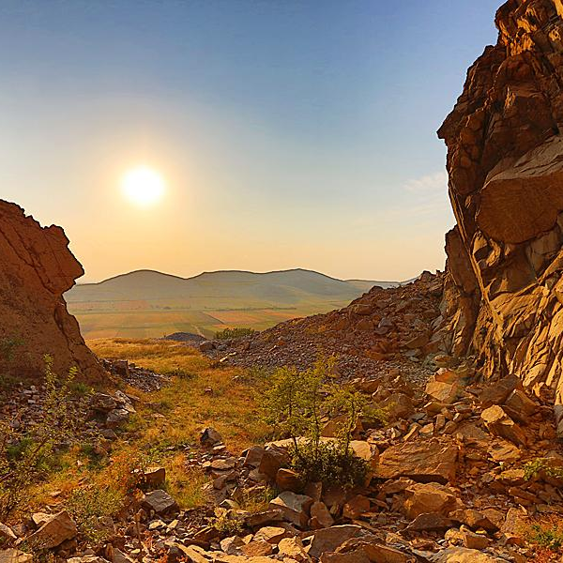

Slide 9
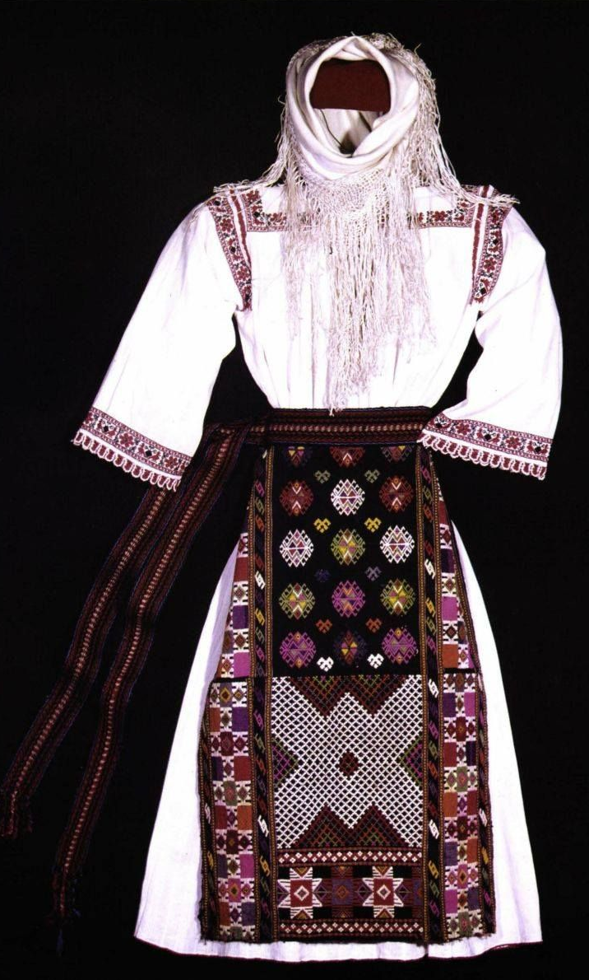
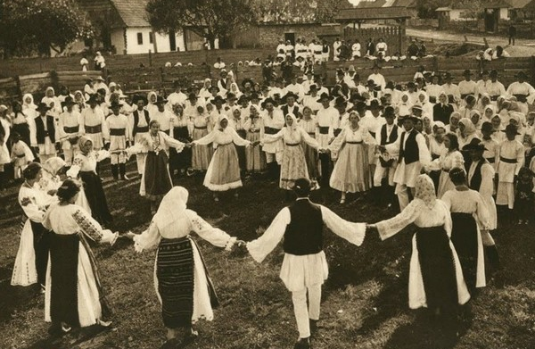
traditional clothing
traditional dance - hora dobrogeana

Slide 10
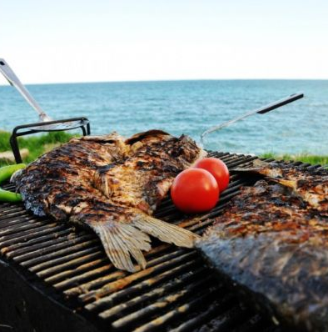
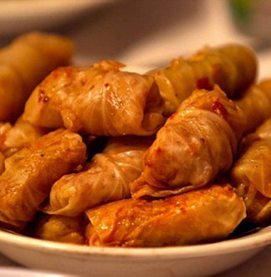
Dobrogean cuisine
a mix of Romanian, Greek, Turkish, Tartar and Bulgarian flavours and recipes.

Slide 11
Why is Dobrogea unique?
Dobrogea is the only territory in Romania located between the Danube and the Black Sea
Dobrogea has the largest ethnic, cultural and architectural mix in the Balkan area
The only region in the country with all forms of relief and the oldest mountains
The Danube Delta, the most diverse ecosystem in Europe

Slide 12
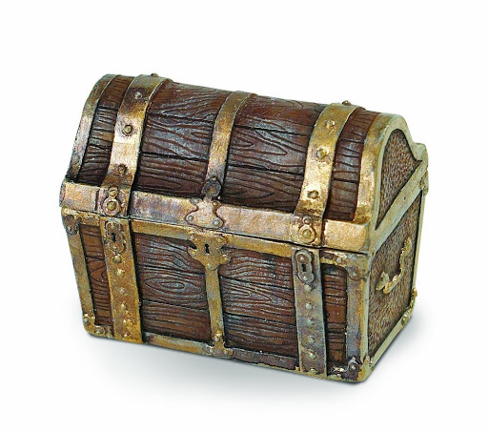
Heritage
The history, traditions,practices, of a particular society that exist from the past and continue to be important

Slide 13
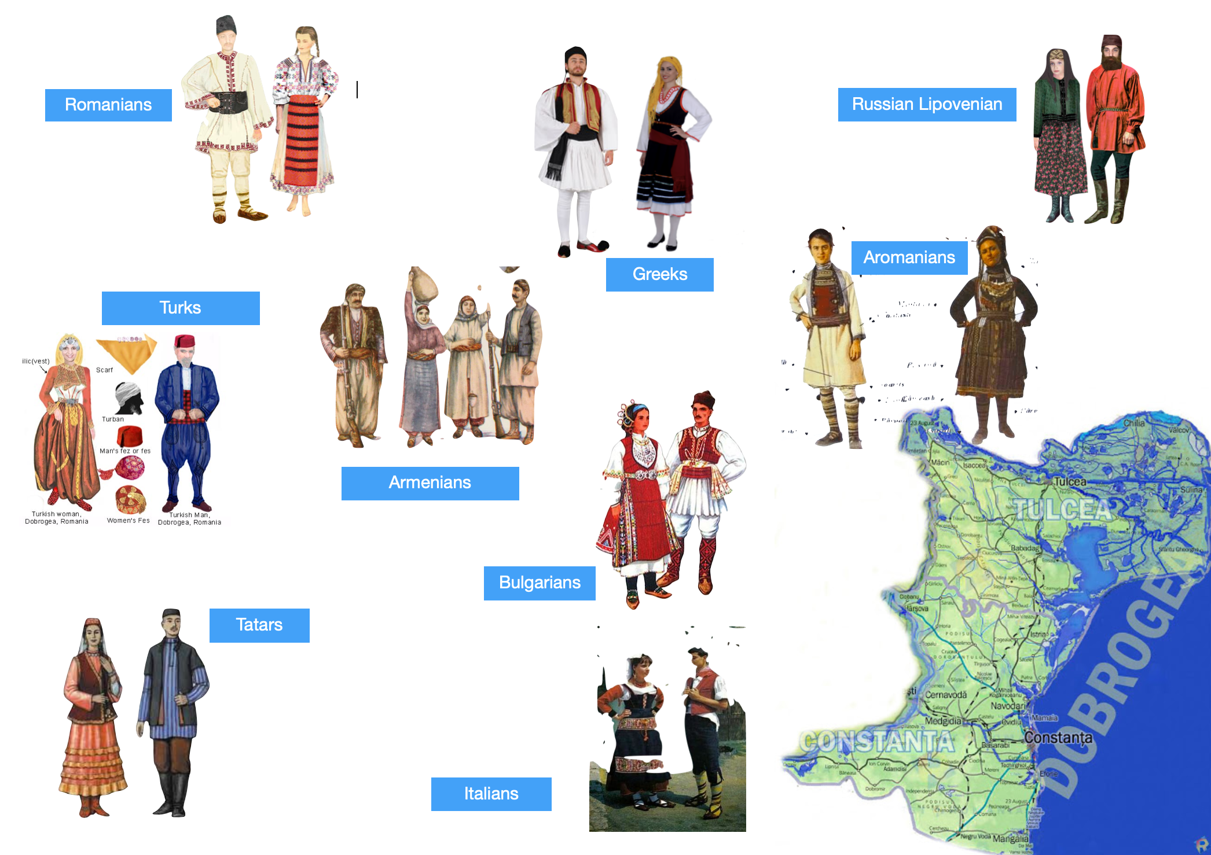

Slide 14
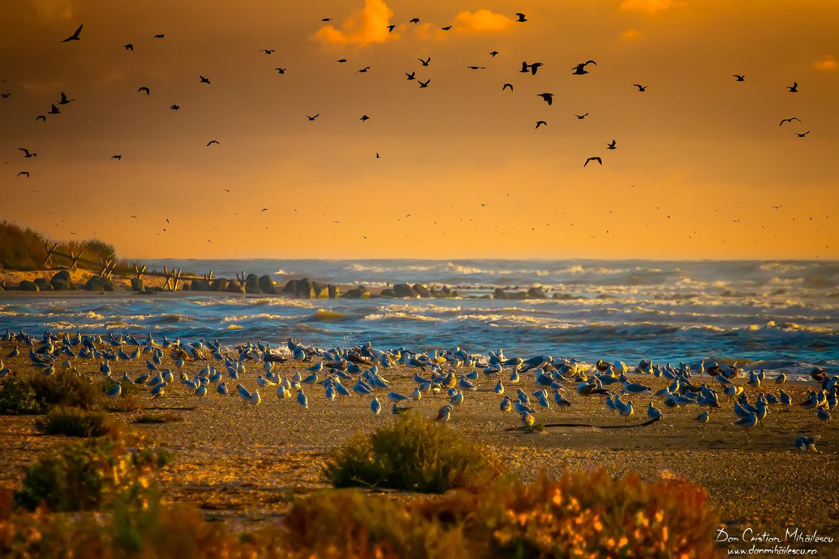
Thank you!

Slide 15
Bibliography
http://iscs.univ-ovidius.ro/presentations/center-for-the-dobrogea-natural-and-cultural-heritage-study/
http://www.cactus-journal-of-tourism.ase.ro/Pdf/vol18/5_Holostencu.pdf
http://ebridge.info/en/articles/the-archaeological-heritage-of-dobrudja
https://www.geoecomar.ro/website/publicatii/Nr.19-2013/13_anitai_web_2013.pdf

