Slide 1
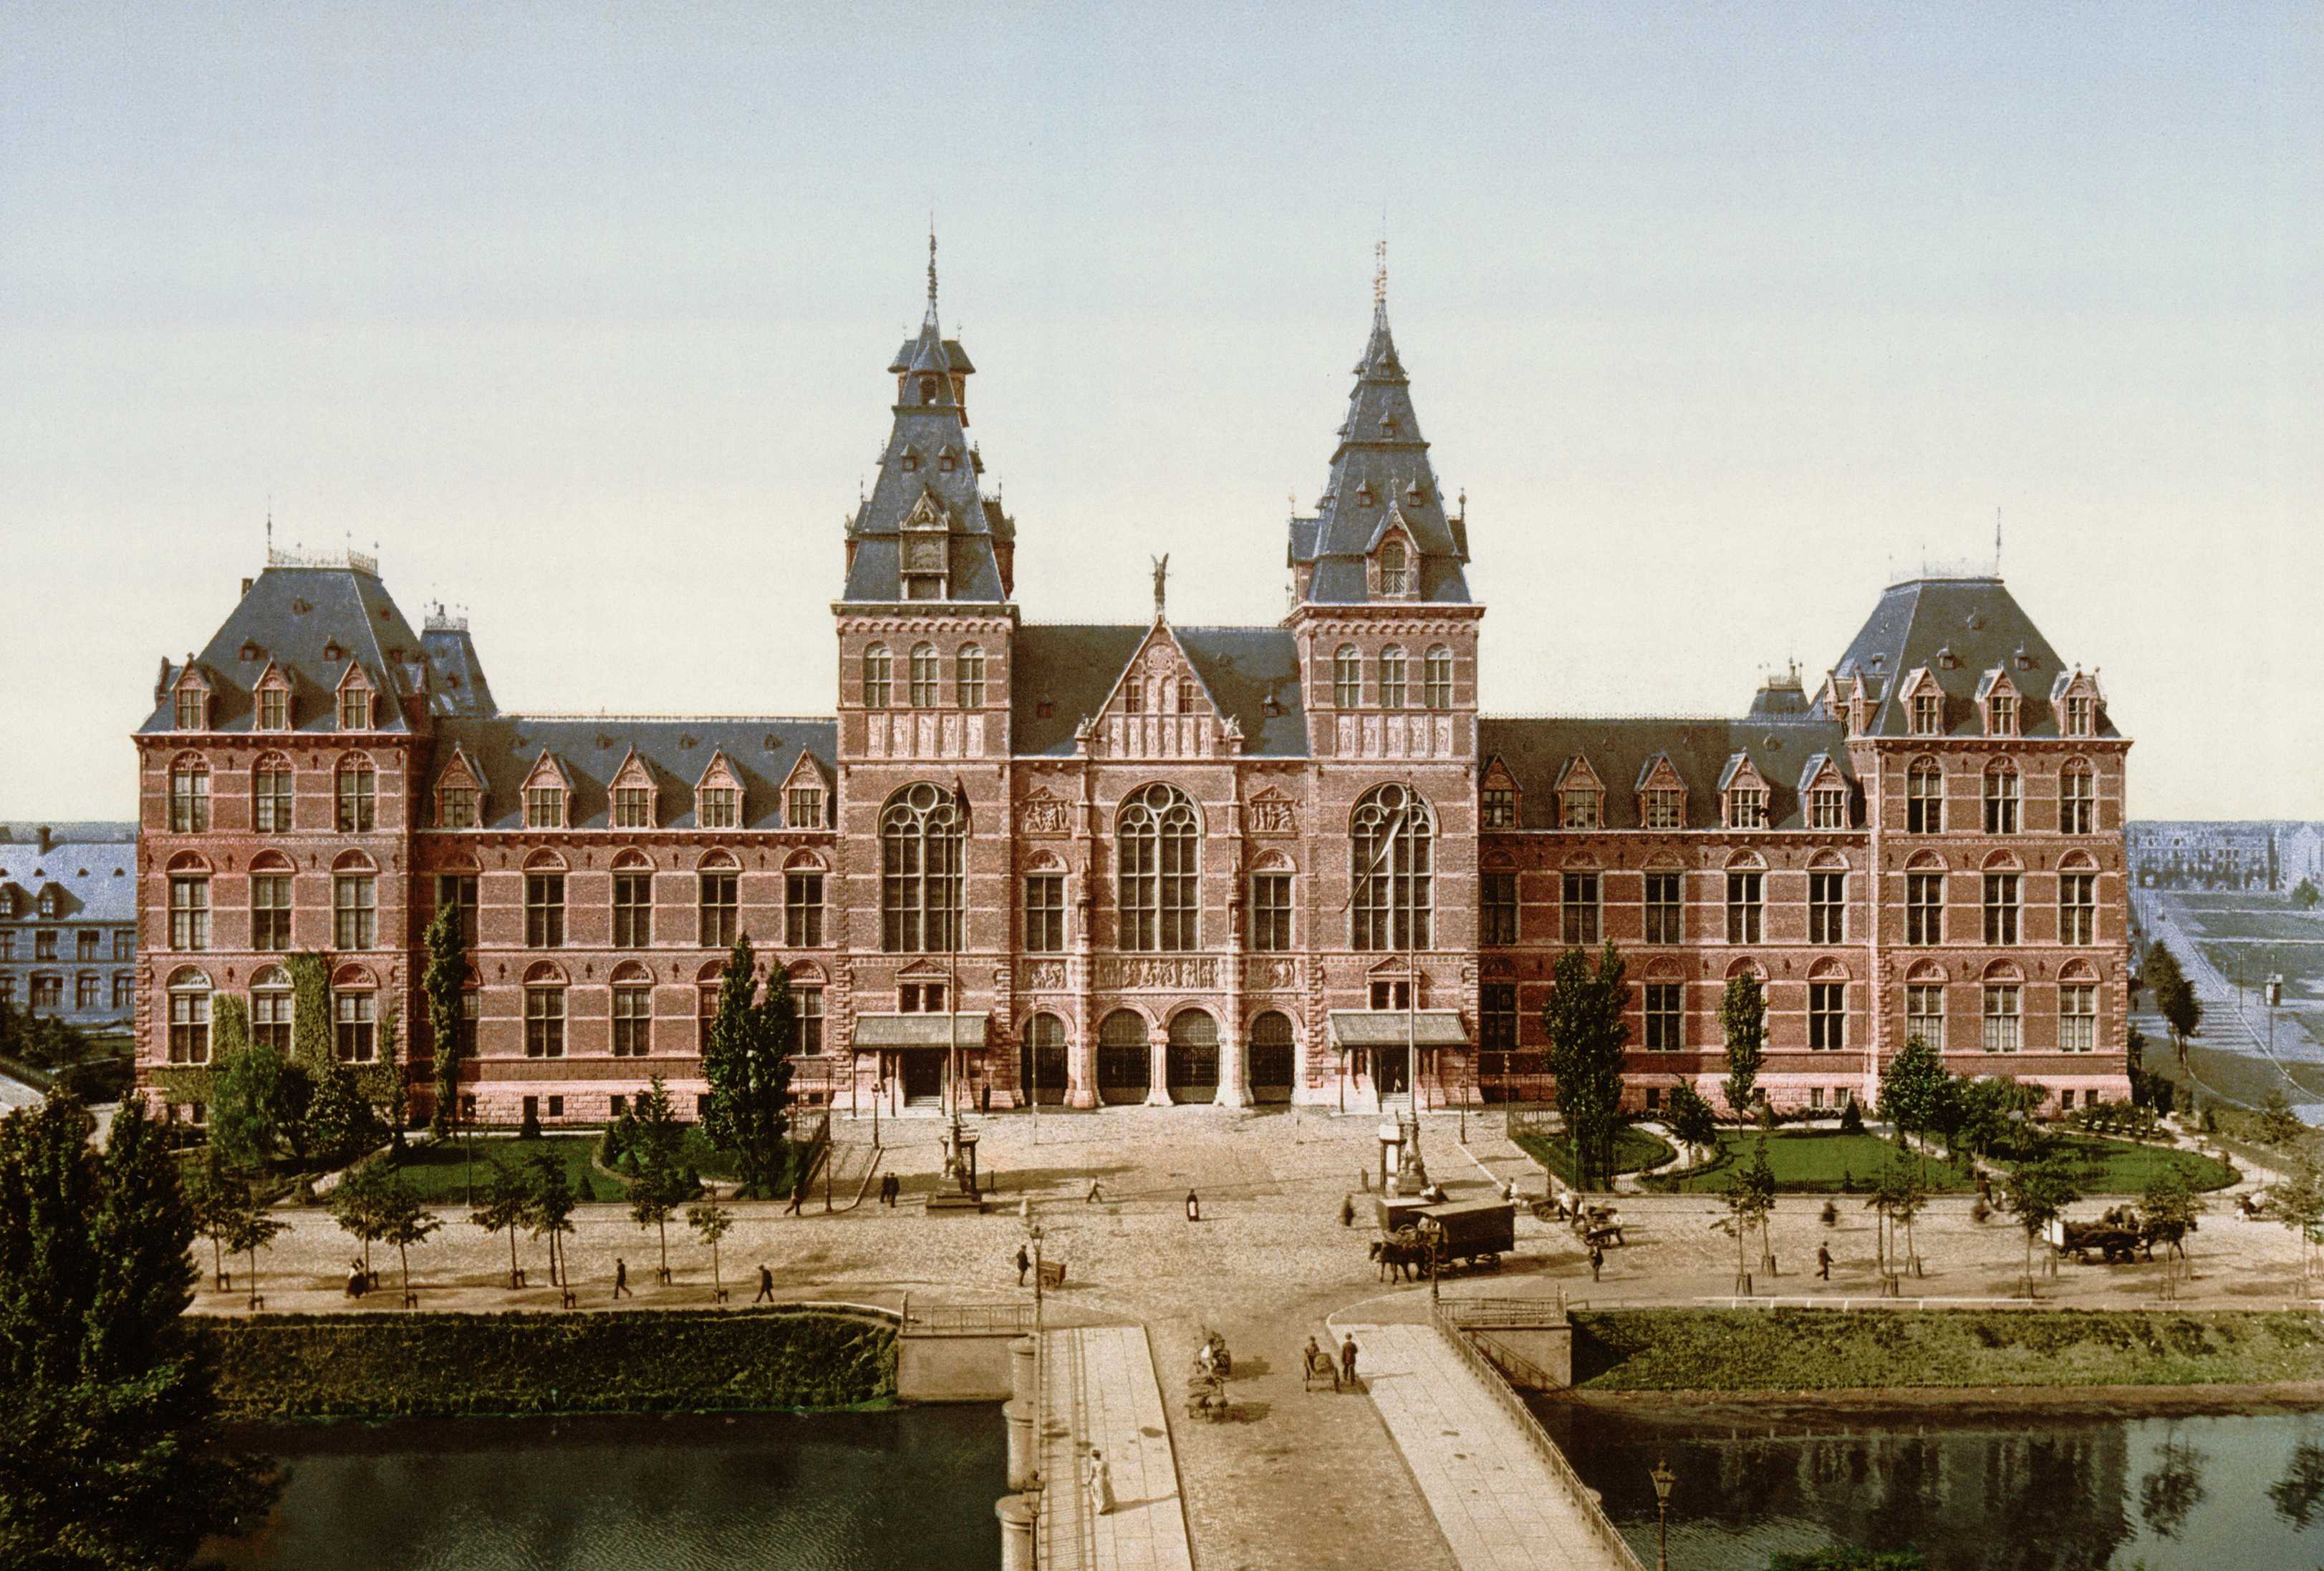
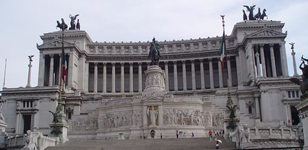
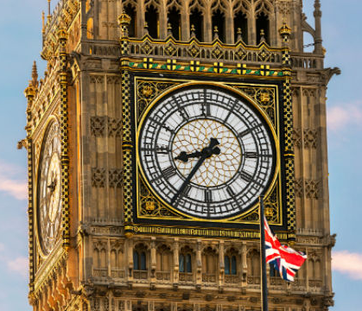
Patterns in the world

Slide 2
What do I already know?
I can name 9 colours
I can name 7 shapes
I can recognize a pattern
I can finish a pattern
I can use the words “pattern” “serie” “repitition”

Slide 3
At the end of this lesson…
I can recognize patterns on buildings
I can describe a pattern
I can let someone else create the pattern I describe

Slide 4
Introduction: Let’s play
The introduction takes place in the school garden or in the gym where the teacher makes a path on the ground to connect two points in space.
The pupils are involved in a game. The purpose of the game is to find out the correct path that connects two points in the space.
The goal is to activate previous knowledge and to give clearance on where the lesson is headed.

Slide 5
Short recap

Slide 6
Short recap
pattern

Slide 7
Short recap
series

Slide 8
Let’s travel!
Buildings with patterns

Slide 9
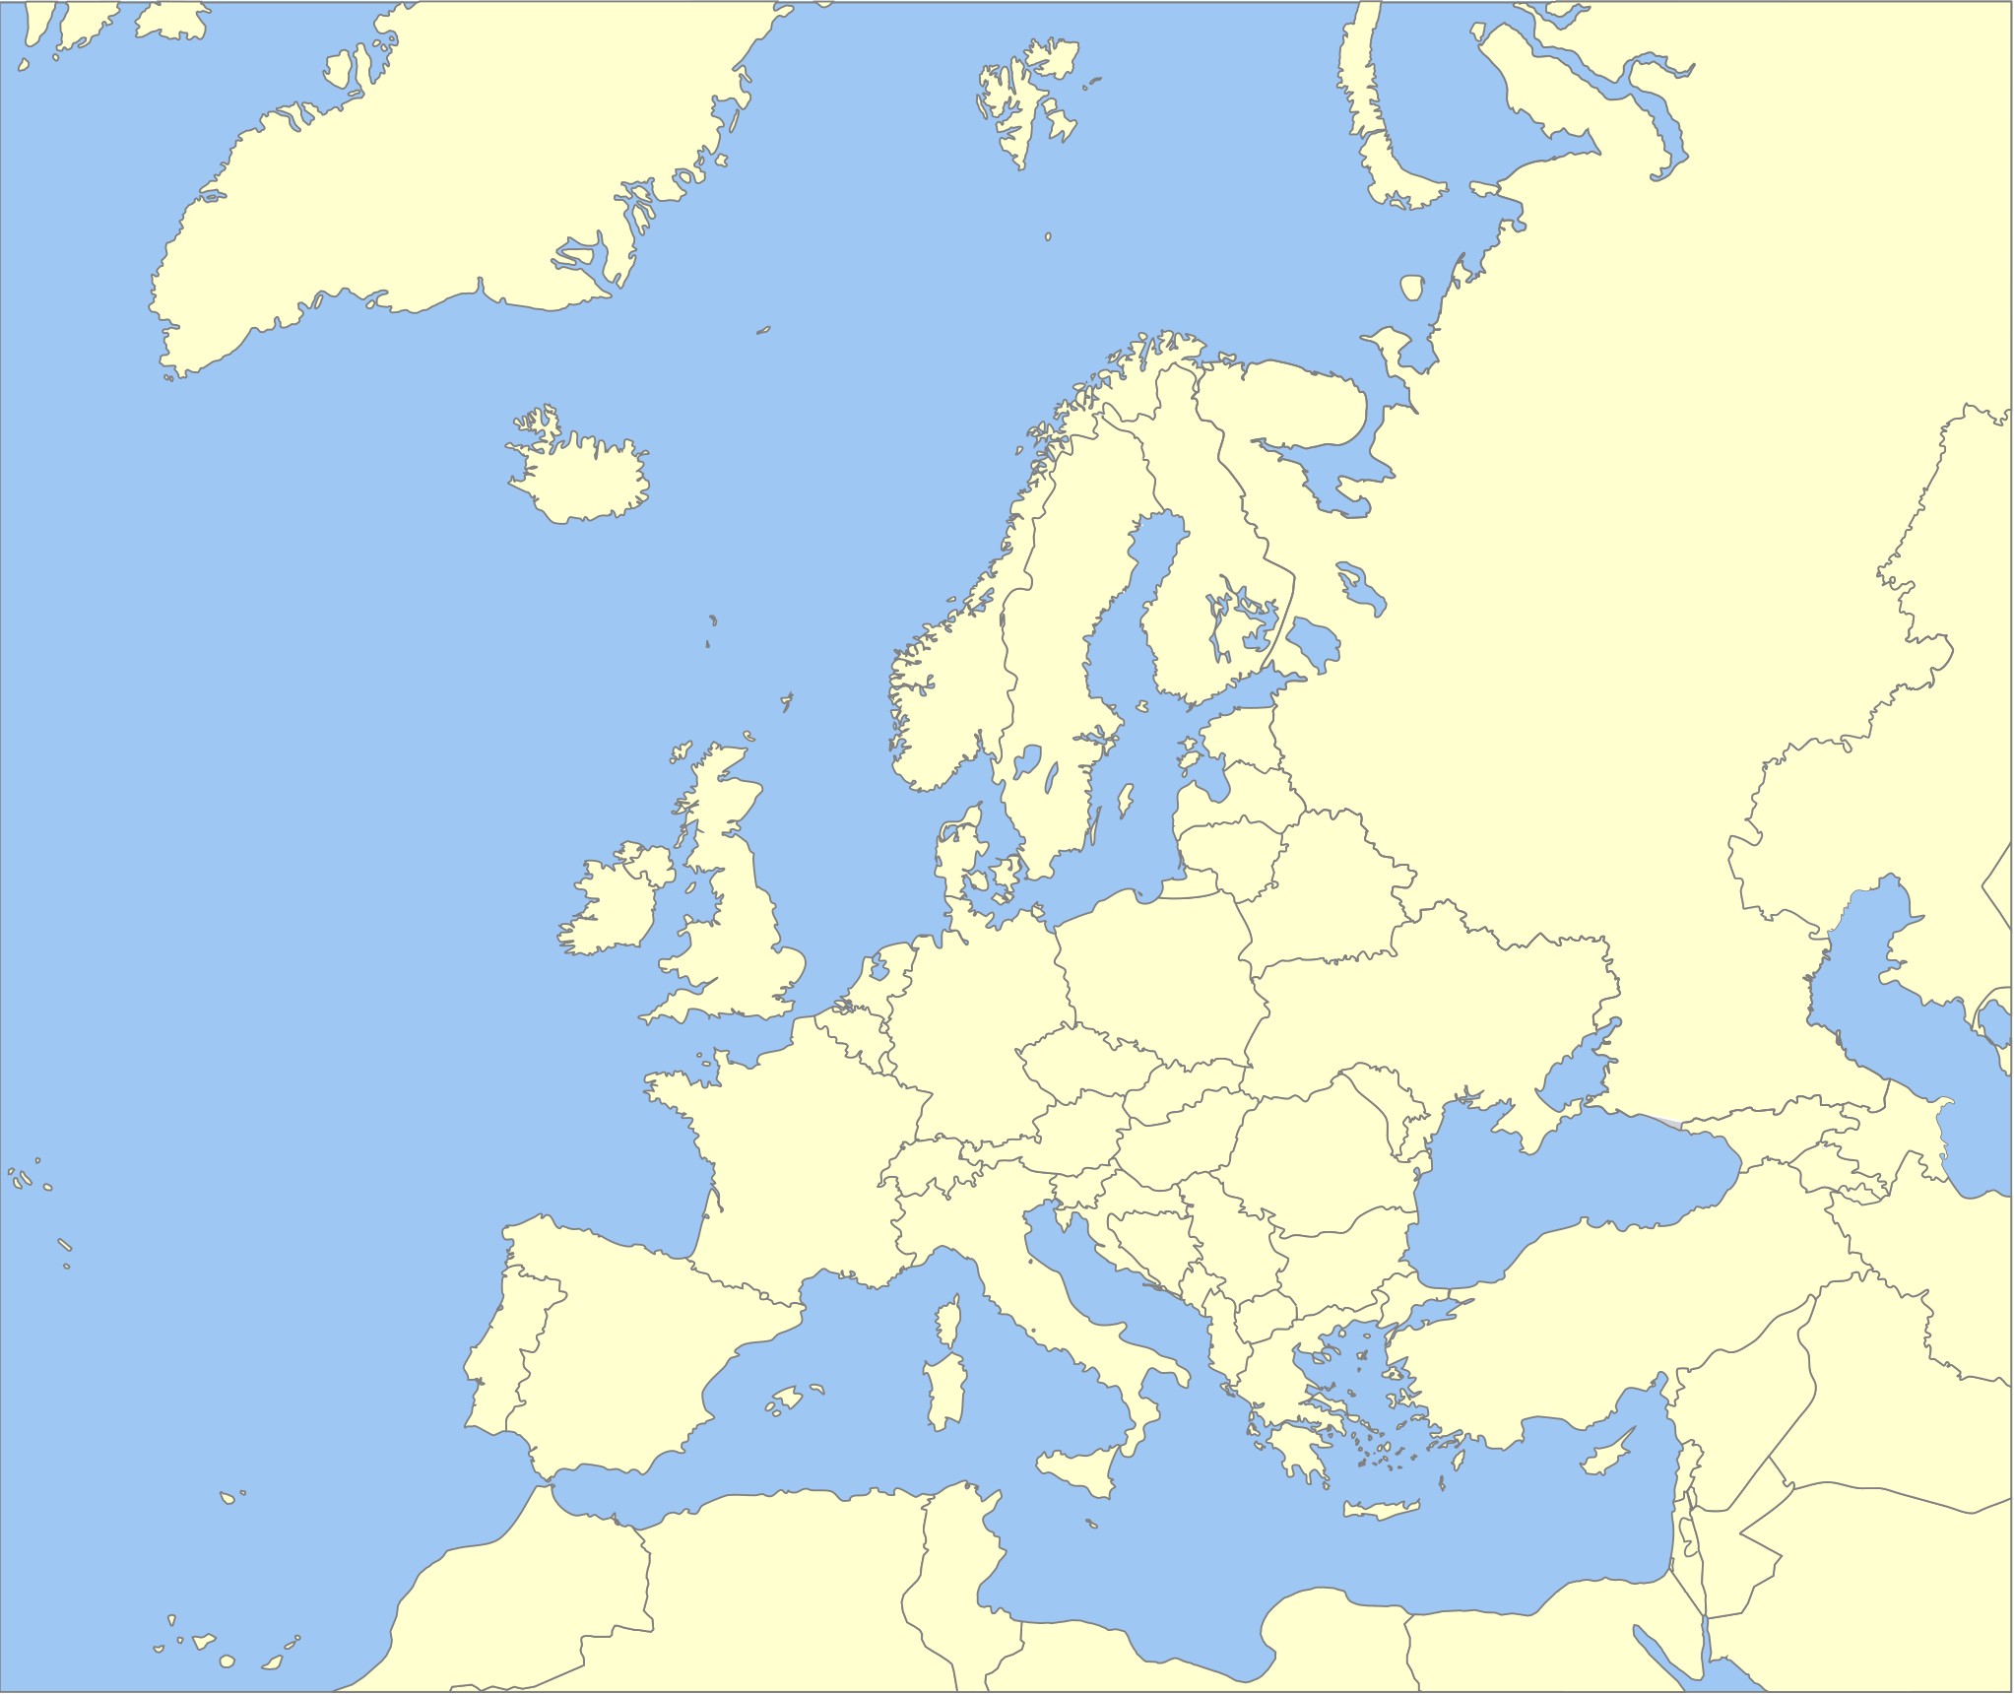

Slide 10
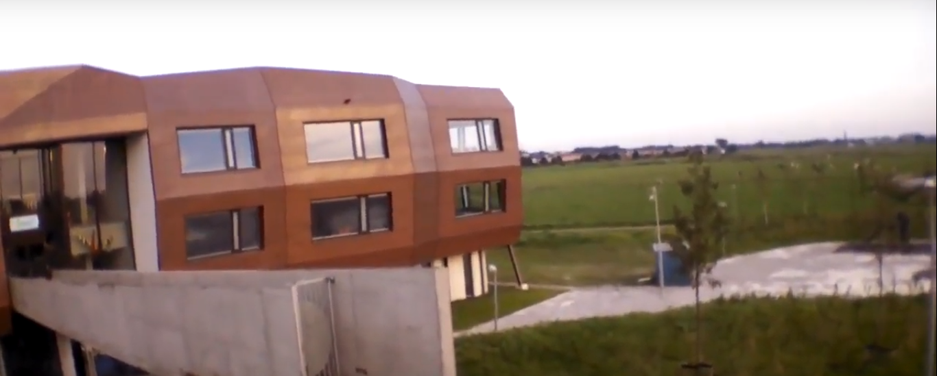
We start close to home

Slide 11
We start close to home

Slide 12
We start close to home
What is the
series?

Slide 13
We start close to home

Slide 14
We stare close to home
Complete the assignment

Slide 16
Do you see the serie?

Slide 17
Do you see the series?
Colour the repetition of this series
blue

Slide 22
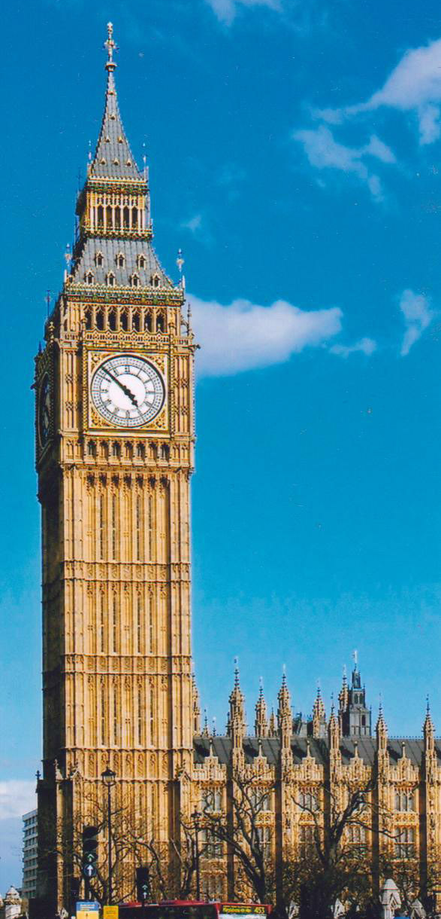

Slide 25
Several patterns

Slide 26
Several patterns
This is a series

Slide 27
Several patterns
This is the pattern

Slide 28
Describe a pattern to your peer
Requirements:
3 shapes for one serie
2+ series

Slide 29
Shape 1 is a green heart

Slide 30
How to give directions
Shape 1 is a green heart

Slide 31
Shape 1 is a green heart
Shape 2 is a red triangle

Slide 32
Shape 1 is a green heart
Shape 2 is a red triangle
Shape 3 is a yellow square

Slide 33
Shape 1 is a green heart
Shape 2 is a red triangle
Shape 3 is a yellow square
Repeat this series 3 times

Slide 34
Title of the Lesson Activity Patterns around the world |  |  | Age group; 7-8
The design team consists of: Laura, Jildou and Astrid |  |  | Time:
Learners’ interests, needs, motivation and prior knowledge Prior knowledge /skills /experience regarding this particular topic? The previous lesson they learned about patterns with geometrical shapes. They can distinguish a series in a small pattern. Learners’ learning needs? The learners need to get directions when it comes to giving a clear description of a pattern. How motivated and independent are they? They aren’t really independent. They are 6 years old. When they get the right knowledge and feel confident in the assignment, they are really motivated for English. How do topc/materials/activities connect to learners’ world? the windows of the school are build in a pattern. We start from this and than we journey around Europe
Lesson aims •I can recognize patterns on buildings •I can describe a pattern •I can let someone else create the pattern I describe |  | Lesson outcomes: (how you will know that aims are achieved): At the end of the lesson learners will be able to circle the pattern and the series of a pattern on a building. At the end of the lesson learners will be able to describe a pattern in a way that makes a classmate able to recreate it.
Global Citizenship What do you aim for the pupils to learn about other (cultural or national) viewpoints? the children get acquainted with patterns on buildings around Europe. The children develop a sense of their identity as European citizens by experiencing we all build using patterns.
Lesson materials list here and include materials such as worksheet, charts or presentation as appendix. powerpoint presentation worksheet

