Slide 1
Art activity : Discrimination
Our Art teachers asked us to draw what we feel about social and economic discrimination .
We drew the following set of pictures.
Some of them deal with ethnic or religious racism
Some about physical problems or diversity in various aspects
Some about bulliyng

Slide 2
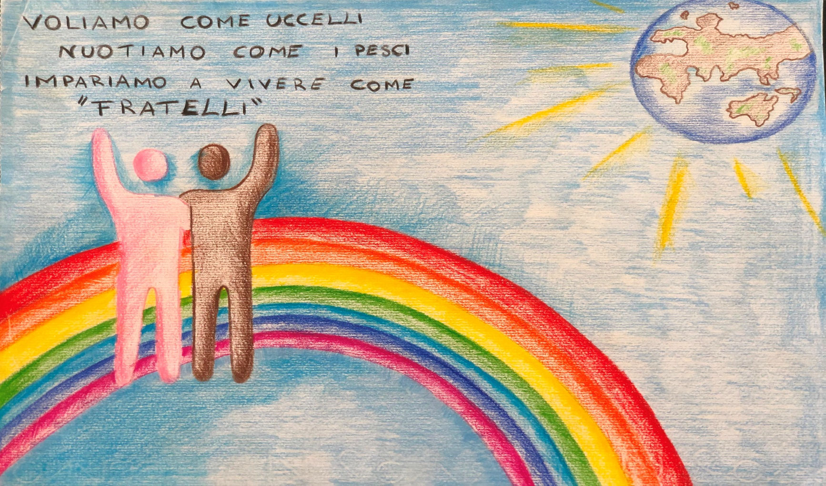
In this picture the student’s slogan expresses the hope to live all together as brothers, in a world where everything is possible to learn, to do and to reach,thanks to technology

Slide 3
This is a set of drawings against RACISM

Slide 4
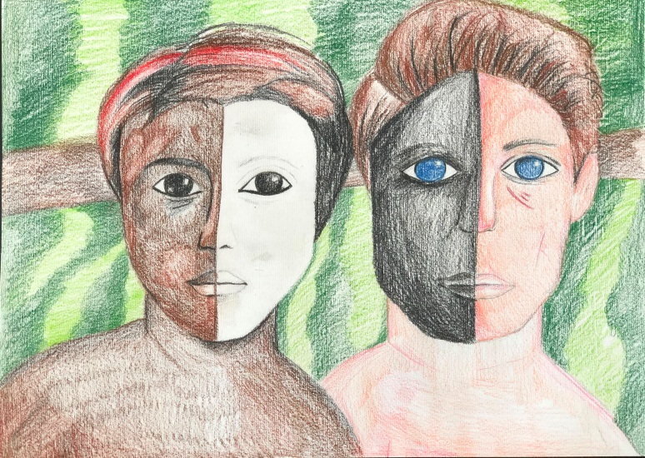
We want to condamn RACISM even though we are sometimes the principal guilties of it

Slide 5
Racism breaks people’s heart and causes pain and suffering

Slide 6
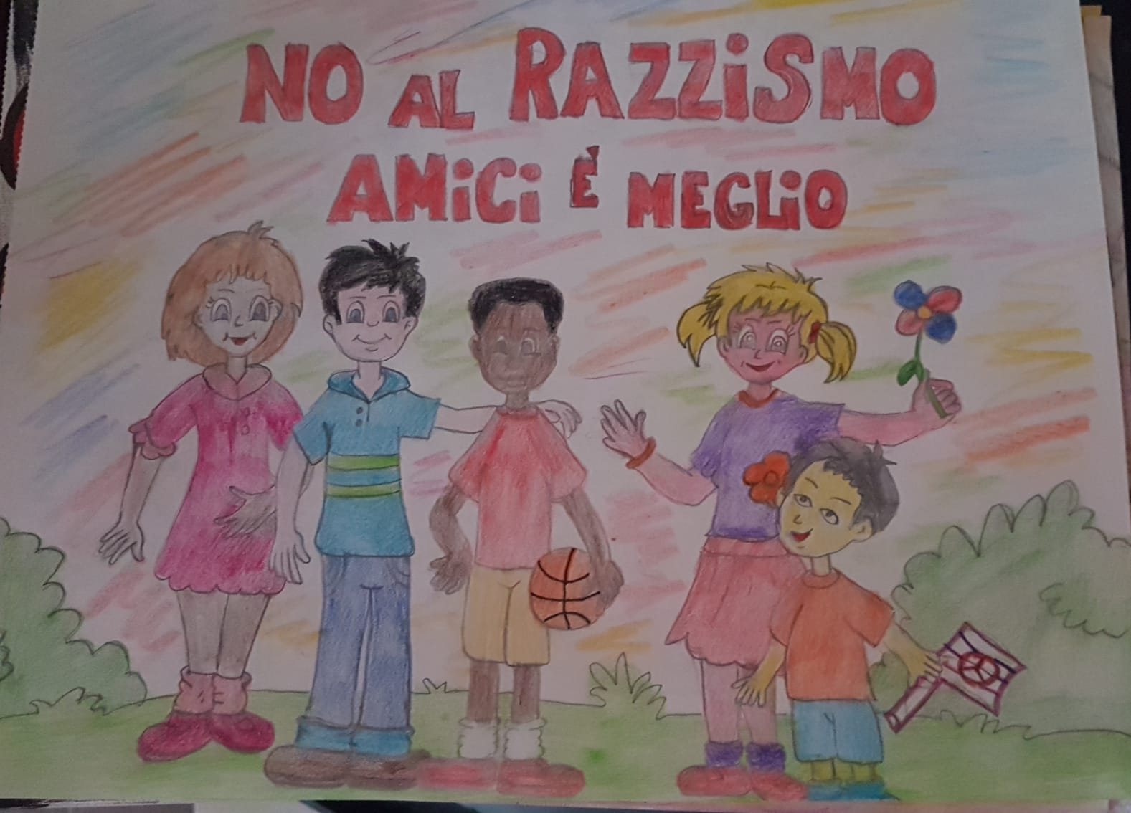
NO RACISM
IT’S BETTER
TO BE FRIENDS

Slide 7
These are drawings about BULLYING and its consequences

Slide 8
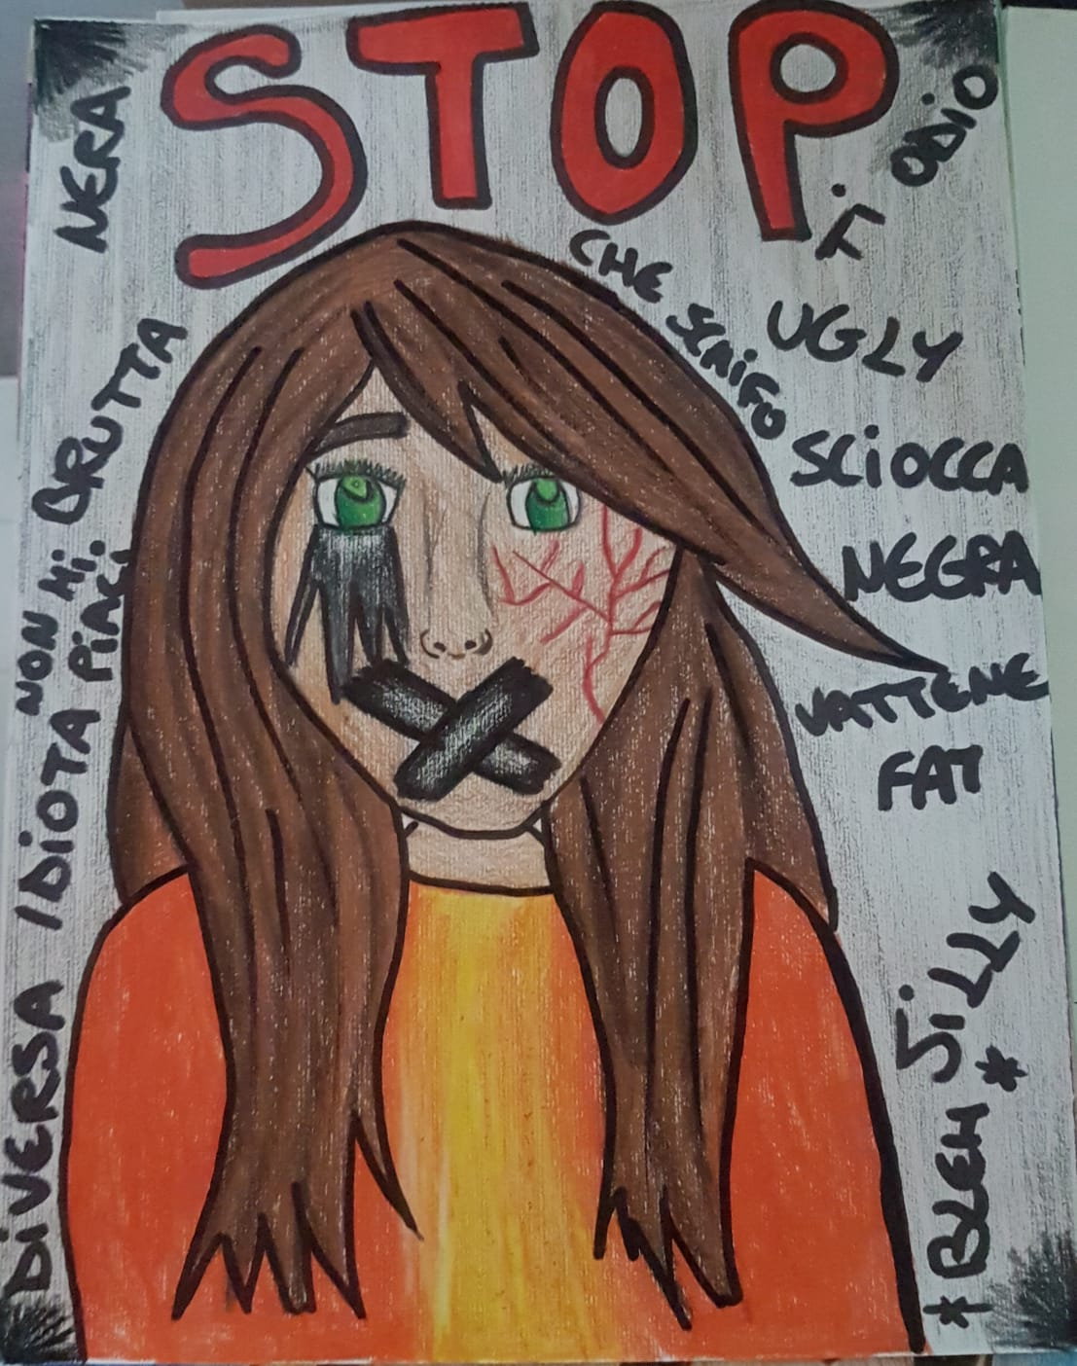
We are different but we have a soul inside and can feel the same pain
Only monsters can enjoy the others’
misfortunes

Slide 9
Pay attention !!! One day it coud be your turn

Slide 10
WE MUST STOP DISCRIMINATION

Slide 11
We can do something we can help our brothers

Slide 12
Together it’s better

Slide 13
DIVERSITY is not a defect it makes the world brighter

Slide 14
We must be like BUTTERFLIES: all different but all beautiful and happy to fly together

Slide 16
Our AGESCI GROUP, using salt on the ground, made some pictures about the importance of integration and peace

Slide 17
Their slogan is : LET’S DO OUR BEST
They believe in:
BROTHERHOOD
NO-VIOLENCE
SOLIDARITY
INTEGRATION
DIVERSITY

Slide 18
We must love and help each other

Slide 19
This is the only way towards INCLUSION AND PEACE

