Slide 1
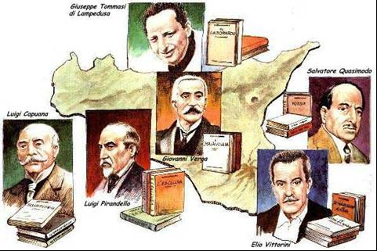
THE MOST FAMOUS
LITERATURE

Slide 2
Sicilian literature is a reflection of Sicily's cultural identity over the centuries.
Most historians and linguists agree that it was born in the twelfth century at the Norman and Swabian courts with the Sicilian language. Until then, most Sicilians spoke Byzantine Greek or Siculo-Arabic (or both), or perhaps Norman-French. The Normans and the Church of Rome brought to the island a Latin influence that had all but vanished with the fall of the Empire in the fifth century. Dante recognized the importance of the Sicilian School of poetry.

Slide 3
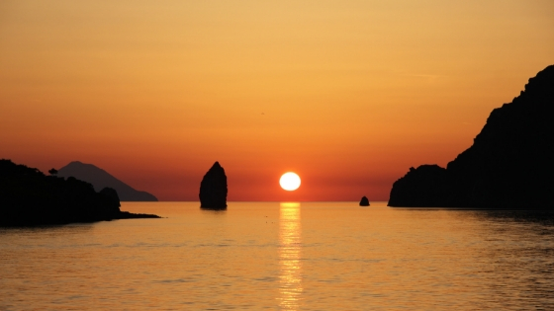
Sicilian authors
Luigi Pirandello. (Agrigento, 1867-1936) ...
Giovanni Verga. (Catania, 1840-1922) ...
Federico De Roberto. (Napoli, 1861-1957) ...
Giuseppe Tomasi di Lampedusa. (Palermo, 1896-1957) .
Luigi Capuana
Salvatore Quasimodo. ...
Vitaliano Brancati.
Leonardo Sciascia
Andrea Camilleri
Literature
is various, numerous, lengthy, and baroque but it cannot be called “Sicilian”, instead European

Slide 4
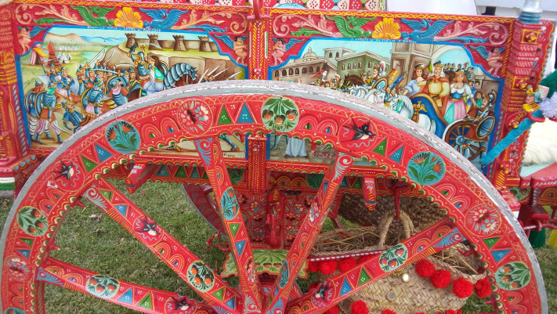
There are a lot of sicilian poets and writers well known all around the world
Those born in Sicily seem to suffer from a sort of “incontinence” of thought and writing which,
coupled with Sicilians’ historical pessimism or melancholy, makes this people disillusioned and resistant to change but curious about novelties and permeable to the influences carried by the wind!
Càlati iuncu ca passa la china!
(Lean over, little cane, as the river is in flood!)

Slide 5
• Giovanni Verga -
His plays have become a cornerstone of Italian culture. He reinvented Italian language with a taste of dialect, a language that animates, lives, rejoices and suffers with the characters of his works .
main works
Mastro Don Gesualdo
Cavalleria Rusticana
I MALAVOGLIA

Slide 6
LUIGI PIRANDELLO
• Luigi Pirandello - With their focus on psychology and characterization, his plays of the early twentieth century represent an important stage in the development of Italian drama. Pirandello also wrote seven novels. He won the Nobel Prize for Literature
Most popular works
Sei personaggi in cerca d’autore
(Six Characters in Search of an Author),
Il fu Mattia Pascal
(The late Mattia Pascal)
Uno, nessuno e centomila
(One , none, and hundred thousand )

Slide 7
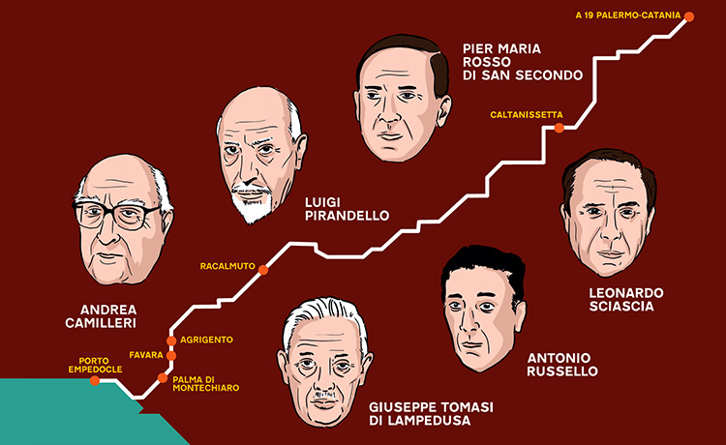
• Leonardo Sciascia -
Noted for its gritty, realistic depictions of Sicily's virtues and vices, Sciascia's work has withstood the test of time remarkably well. He was one of the first Siciliani authors to tackle the subject of the Mafia, not as a study in itself but as a factor in some plot lines.
• Salvatore Quasimodo -
He was Sicily's (and perhaps Italy's) best known poet of the twentieth century and, like most of the other authors listed here, something of a social commentator.

Slide 8
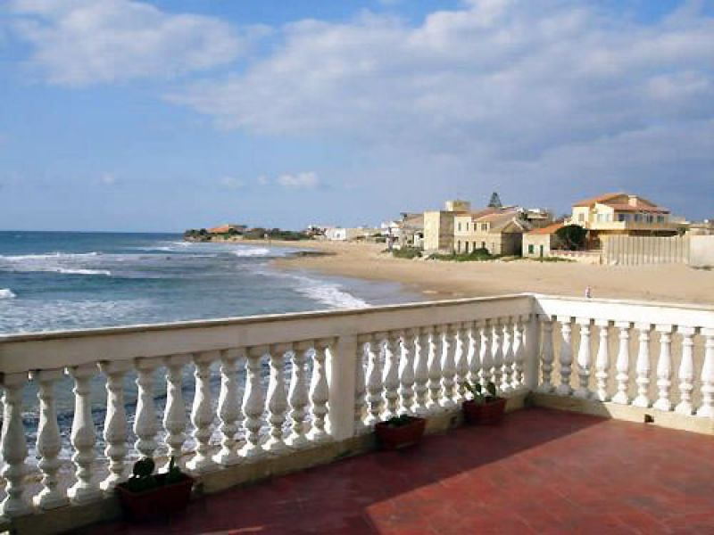
Andrea Camilleri he is a well known writer
• - His crime novels and (in Italy) the telefilms based on them have been wildly popular in Italy.
The Inspector Montalbano stories are set in Sicily.

