Slide 1
Christmas Traditions from Cyprus

Slide 2
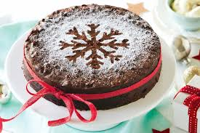
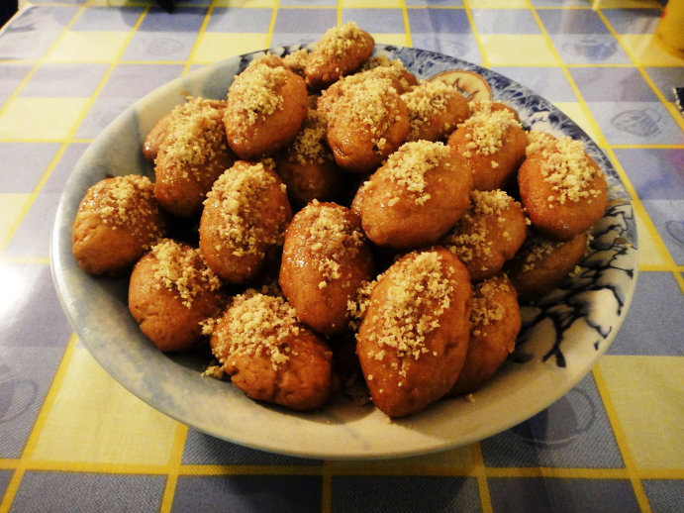
Christmas Traditions
The week before Christmas, in every house of the village, the housewives start the preparations for the Christmas day. Firstly they clean their houses from corner to corner and decorate the Christmas tree. After that they bake breads, cookies, melomakarona, kourambiedes and a lot of other kinds of sweets.

Slide 3
Christmas Traditions
On Christmas Eve, they cook soup with chicken for all the family. They eat this soup on Christmas Day, after they all return from church. At lunch time they all get together to a relative home, where they all eat together and have fun.

Slide 4
Christmas Traditions
Groups of children walk around from home to home, singing Christmas Carols and gathering tips, like money, chocolates, sweets e.t.c. When they finish visiting homes, they split equally their tips.

Slide 5
New Υear’s Traditions
In every house, usually at New Year’s Eve, housewives bake Vasilopita, a traditional cake, and hide inside the cake a coin covered with bake paper. They cut this cake the 1st day of the New Year. The member of the family that will find the coin in the piece of cake that is holding will be full of luck for all the coming year.

Slide 6
New Υear’s Traditions
The housewives, also, prepare the table in order to welcome Santa Claus. They put a glass of wine, cookies, nuts and their wallet on the table, so, when Santa will come to let the children’s presents, to bless them.

Slide 7
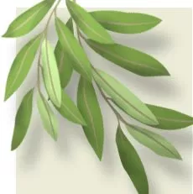
New Υear’s Traditions
At the night of New Year’s Eve, we all gather around the fireplace and play a traditional game with olive tree leafs. We throw inside the fire a leaf and we say a wish. If the leaf turns around on the burning coals, which means that our wish will come true. If the leaf burns, then it means that our wish will not come true!!!

Slide 8
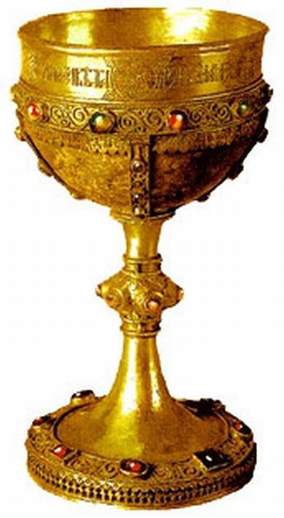
Epiphany traditions
At Epiphany day, everyone goes to church early in the morning, taking with a branch with fruits. The priest puts the Cross inside the Holy Font, blessing the water. After that everyone puts inside the will return the branch back home, taking also the bless with them…

Slide 9
Epiphany traditions
After church, the priest is visiting all the houses of the village, with some children. He is blessing the building, the people who live there, the animals, the garden e.t.c.

Slide 10
Epiphany traditions
The women are cooking a special cookie, which is called kserotiana. They use to throw some pieces on the roof of the house, to feed the bad spirits (goblins) and keep them away.

