Slide 1
SOLIDARITY
ITALIAN STATISTIC

Slide 2
VOLUNTEERING RADIOGRAPHY
OF THOSE
6,63 MILLION OF ITALIANS
VOTED FOR
THE COMMON GOOD

Slide 3
ISTAT DATA
In Italy there are
6.63 million
(12.6%) of people
active for the others
by municipality
Or associations
4.14 million (7.9%), 8%) individually

Slide 4
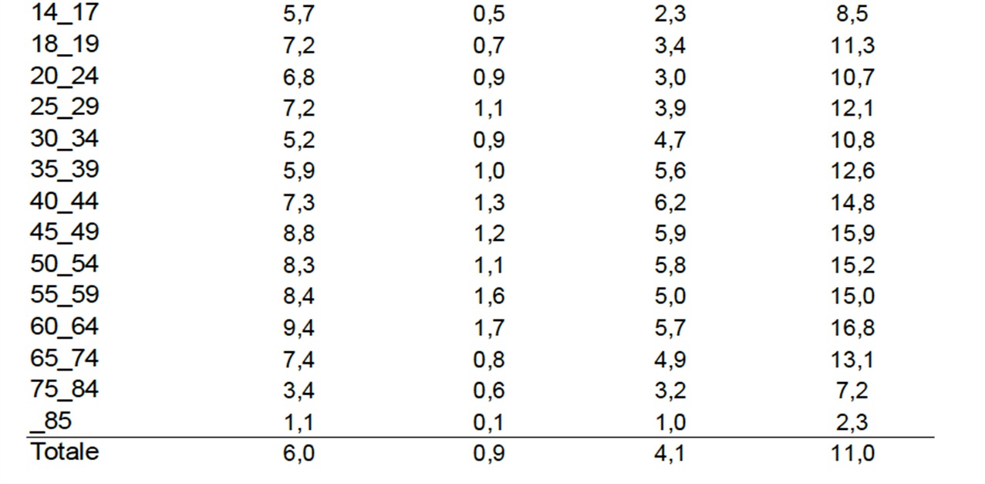
Form of Participation age organized both individual total associations

Slide 5
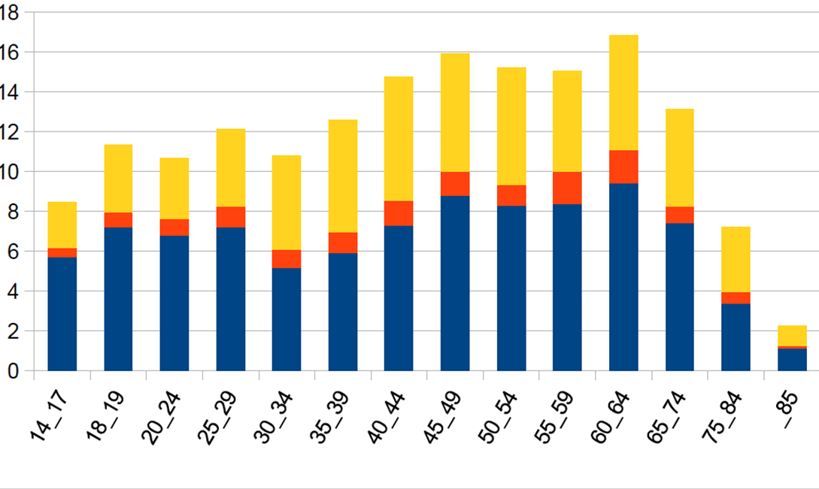
Form of Participation and age organized both individual
%

Slide 6
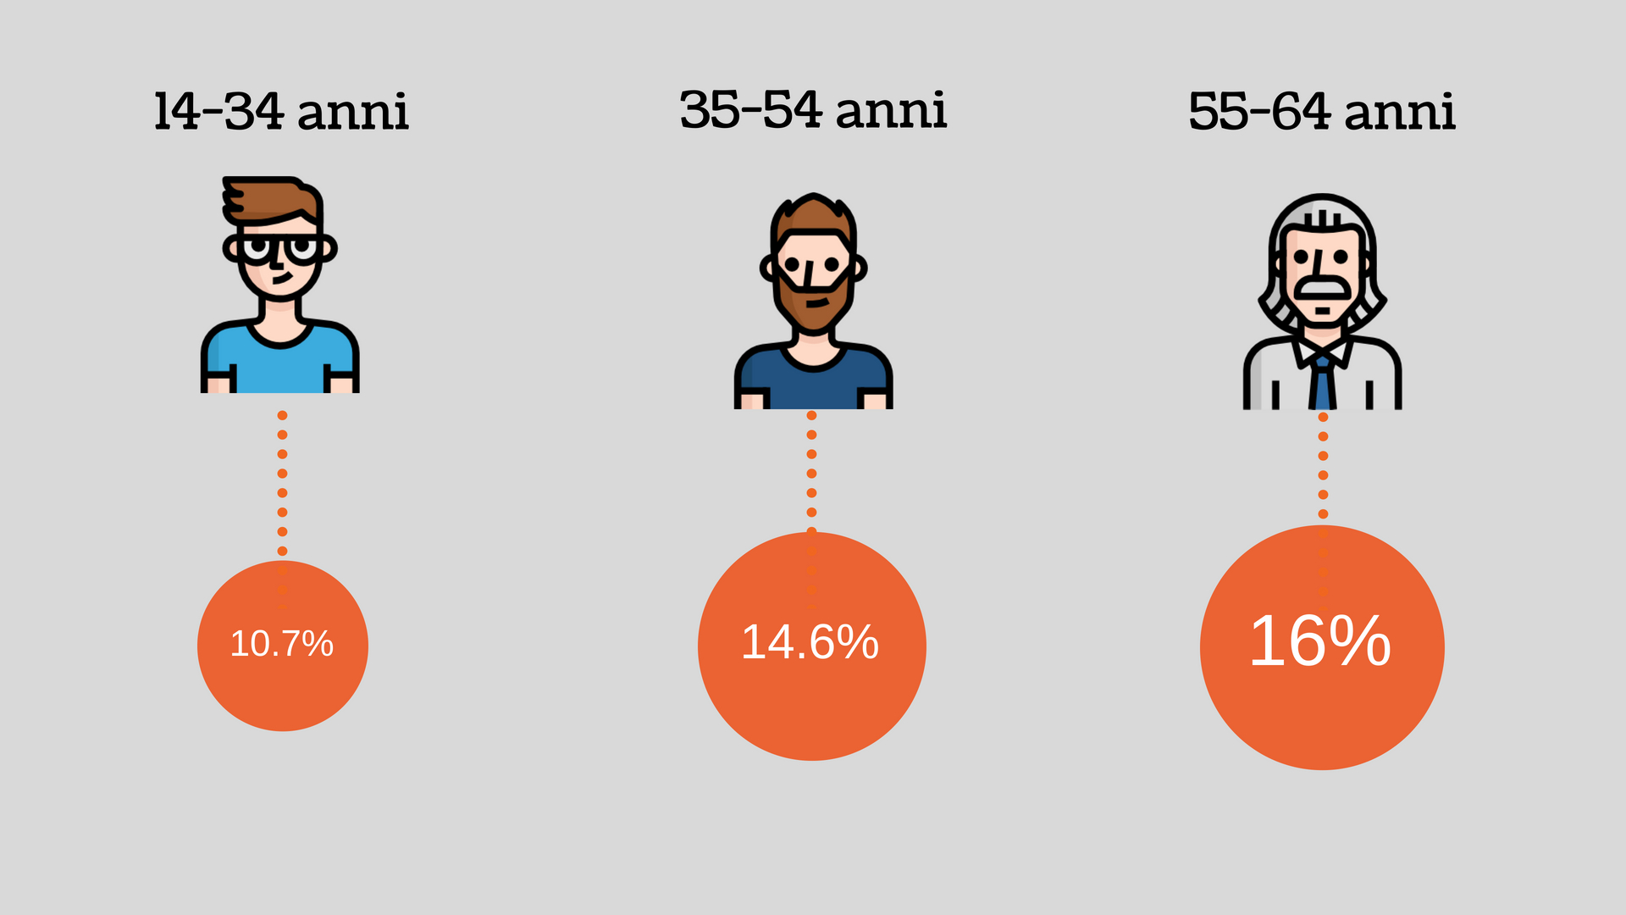
There are more volunteers among older people

Slide 7
Who are the people , The volunteers who carry out their activities within the associations????
It is an heterogeneous world in which seven profiles of volunteers have been distinguished:

Slide 8
1)the faithful of assistance (29.6% of organized volunteers, 1,228 thousand people),
2) educators of religious inspiration (25% of organized volunteers, 1,036 thousand people) ,
3) pioneers (13.6% of organized volunteers, 561 thousand people),
4) investors in culture (10.3% of organized volunteers, 427 thousand people),
5) sport volunteers (8.9% of organized volunteers, 368 thousand people),
6)blood donors (8% of organized volunteers, 333 thousand people)
7)representation workers (4.6% of organized volunteers, 190 thousand people

Slide 9
The share of volunteers is much higher than average in :
social groups with medium-high income and high educational qualifications,
among those belonging to
the ruling class (23.5 percent),
followed by
those of the families of employees
and
silver pensions (18.8% and 18.1% respectively)

Slide 10
The possibility of devoting one's time to free activities is very linked to the phases of the life cycle and the role played within the family, especially for women:
single people in active age are the people who participate more in associations ( 19.0 percent)
ceteribus paribus, female daughters participate more than sons.

Slide 11
Family commitments negatively affect female participation in associationism:
it is seen,
both among couples without active age children (men outnumber women with 18.3 versus 14.9%), and
when the presence of children
reduces the participation rates of both parents (15.0 against 11.9 percent

Slide 12
Do good to others is good for themselves,
to carry out free activities in groups or associations makes it possible to feel useful, to improve oneself, to increase one's own abilities and skills;
it also allows us to establish gratifying interpersonal relationships and
to expand our social networks.
The positive sense of self that underlies the individual psychological balance derives from being recognized as volunteers

