Slide 1
POLISH CULTURE Together we can
Zuzanna Rak IV a

Slide 2
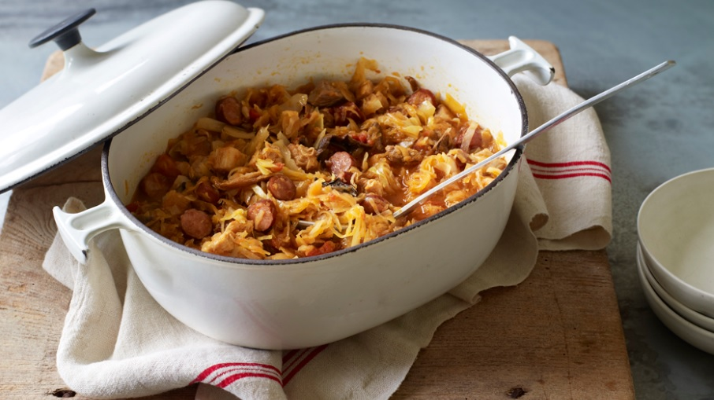
TRADITIONAL POLISH FOOD The most traditional Polish dishes are:
Bigos – typical ingredienst are: sauerkraut, white cabbage, mushrooms, pieces of meat or sausages

Slide 3
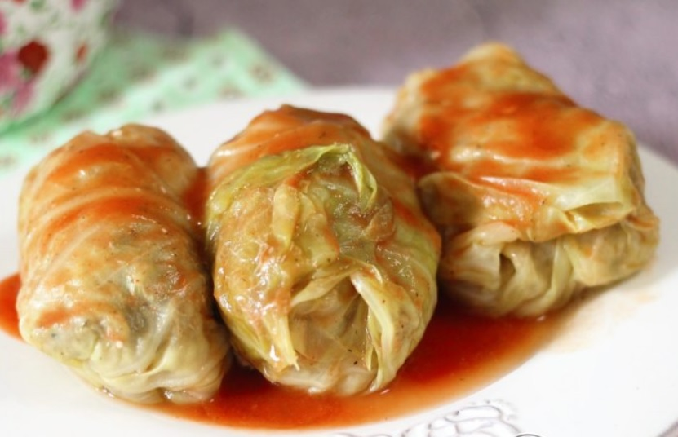
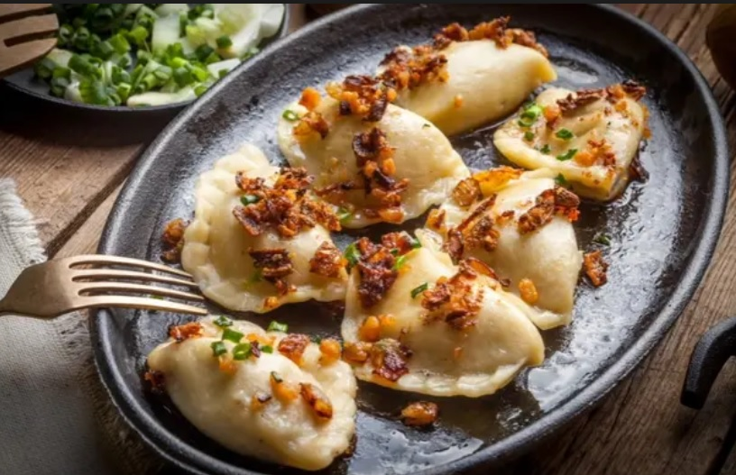
Gołąbki (cabbage rolls) made from lightly boiled cabbage leaves wrapped around a minced pork or beef and rice. Baked in tomato sauce
Pierogi - Polish dumplings

Slide 4
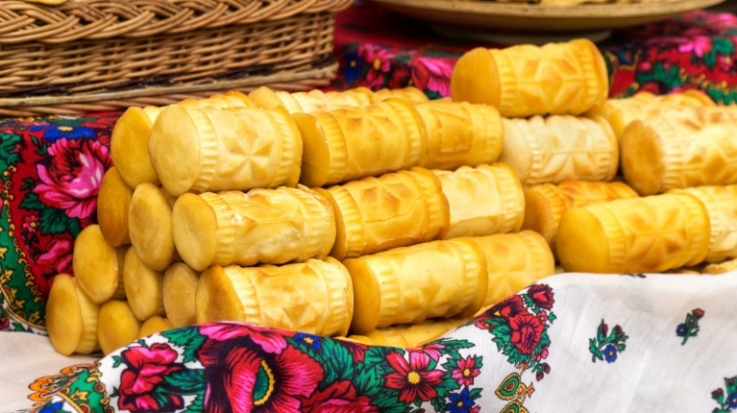
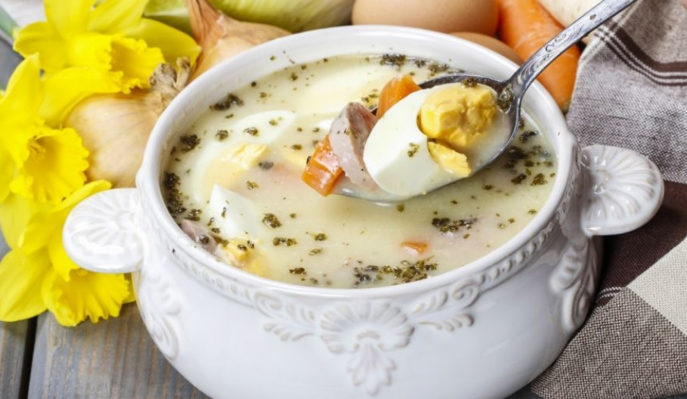
Oscypek - hard, salty cheese made in the Tatra Mountains
Żurek – soup made from fermented rye flour, with meat (white pork sausage, bacon or ham, eggs )

Slide 5
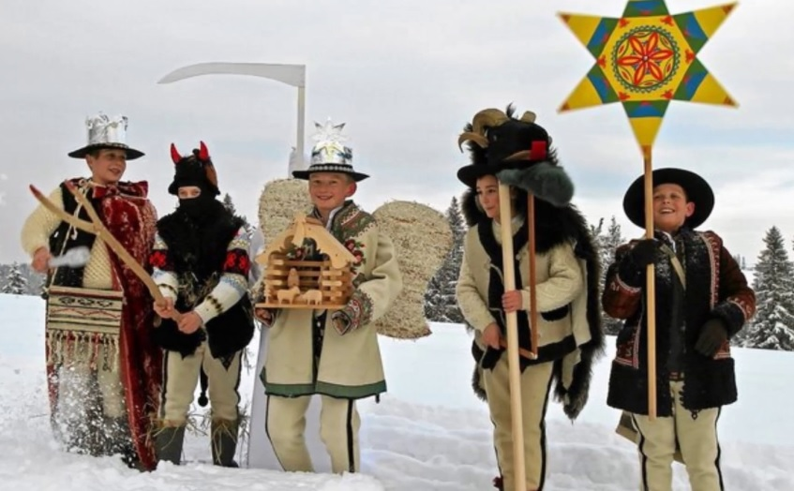
CELEBRATIONS AND TRADITIONS Christmas traditions
Carolers – group of children or teenagers dressed as: devil, angel, king Herod, St.Mary and/or other characters connected with the Birth of Jesus Christ

Slide 6
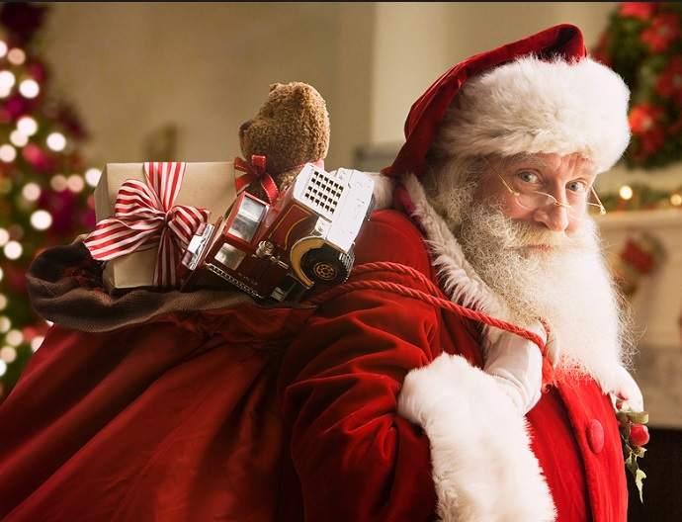
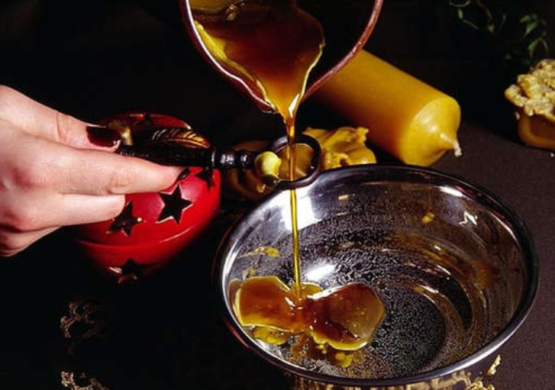
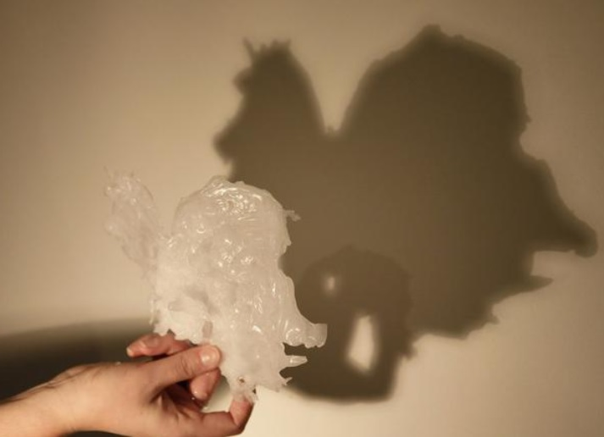
St. Nicholas Day – 6 December, gives gifts only for wellbehaving children
St. Andrew’s Day – 30 November, people pour the melted wax through keyholes and predict future from the shape of the wax

Slide 7
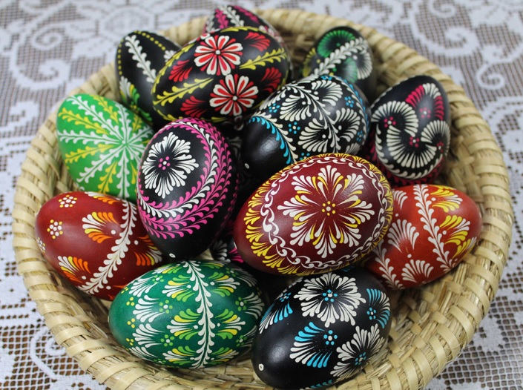
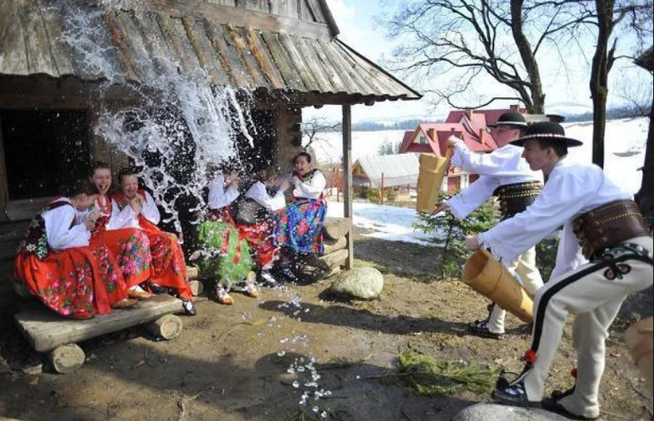
Easter traditions
Making Easter eggs – each region has own style and technique
Śmigus dyngus (Wet Monday) – Easter Monday, when boys pour water on girls

Slide 8
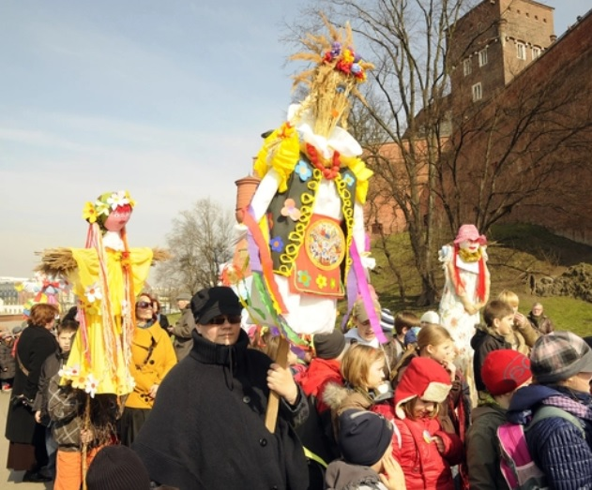
First day of spiring – 21 March, drowning or burning of „MARZANNA” – it is a big doll made from straw or rags, bits of clothing and decorated with colorful stuff. Children sink it in the river or burn it in the fire. It symbolizes the end of winter.

Slide 9
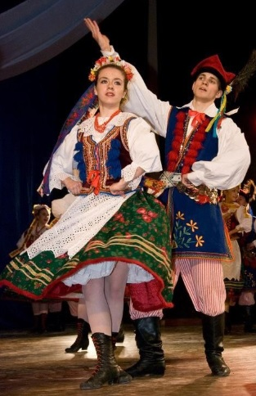
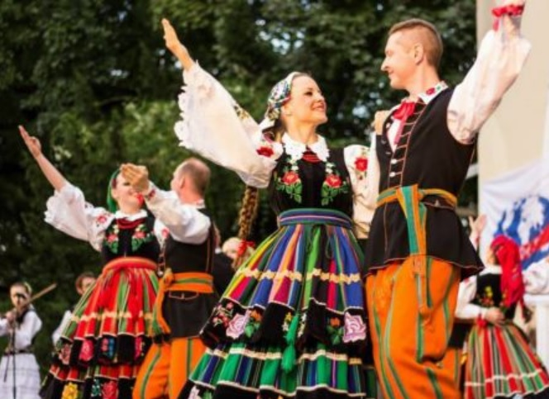
National dances
Krakowiak - the oldest national dance
Kujawiak

Slide 10
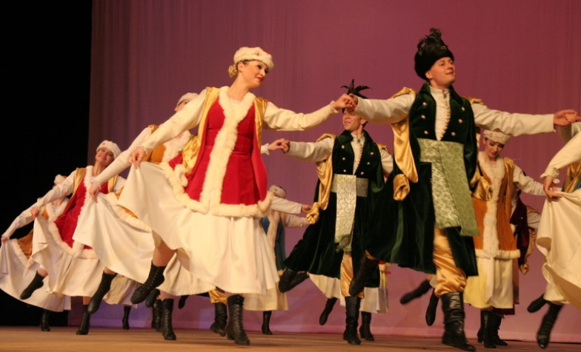
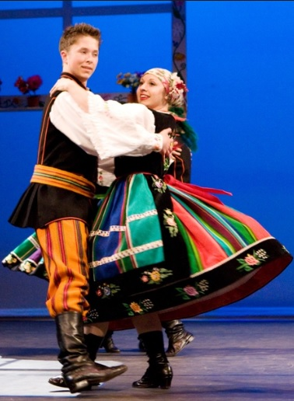
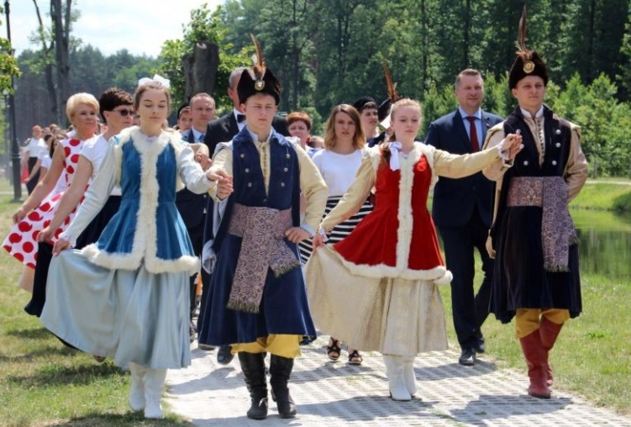
Mazur
Oberek
Polonez

Slide 11
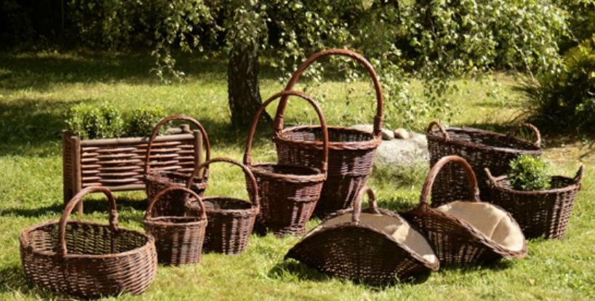
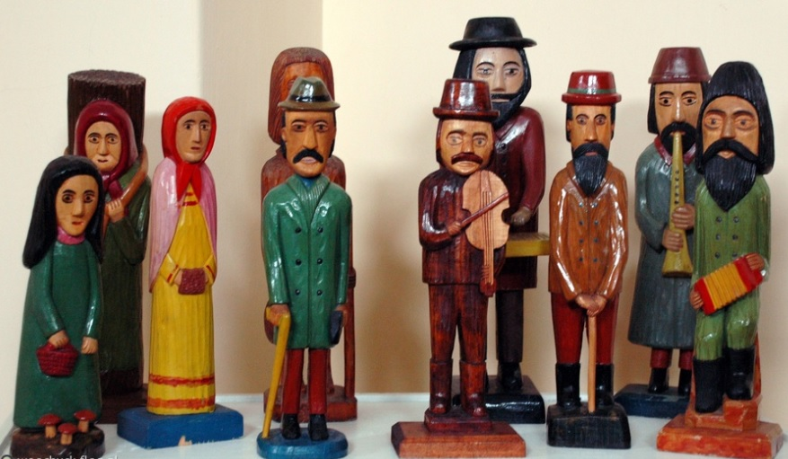
TRADITIONAL POLISH HANDICRAFTS
Plaiting
Wood sculpture

Slide 12
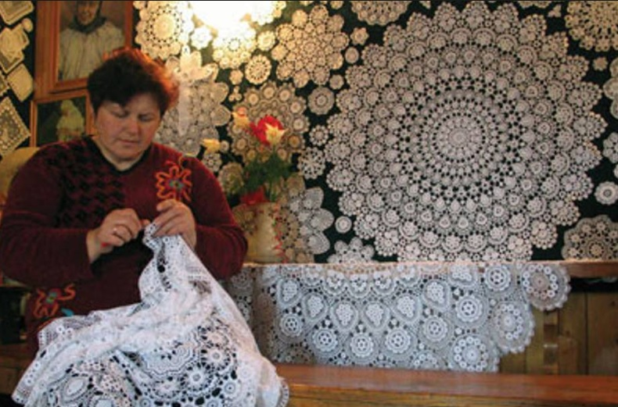
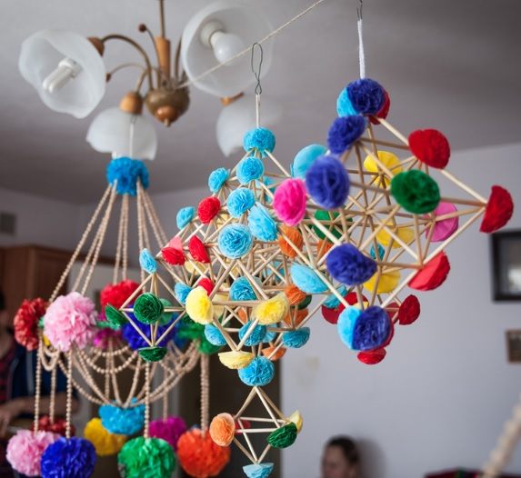
Traditional paper handicraf
Embroidery and lace-making

Slide 13
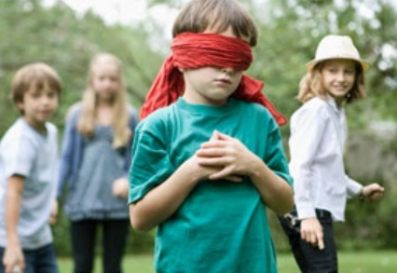
Traditional Polish games
Ciuciubabka - BLIND MAN’S BLUFF
Zabawa w chowanego - HIDE AND SEEK
Głuchy telefon - CHINESE WHISPERS

Slide 14
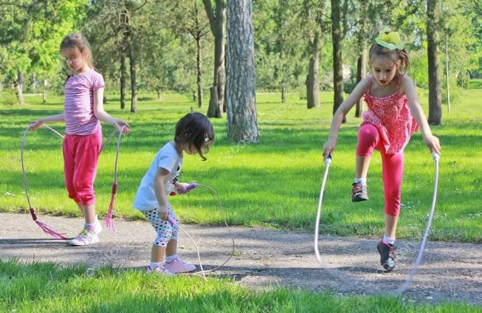
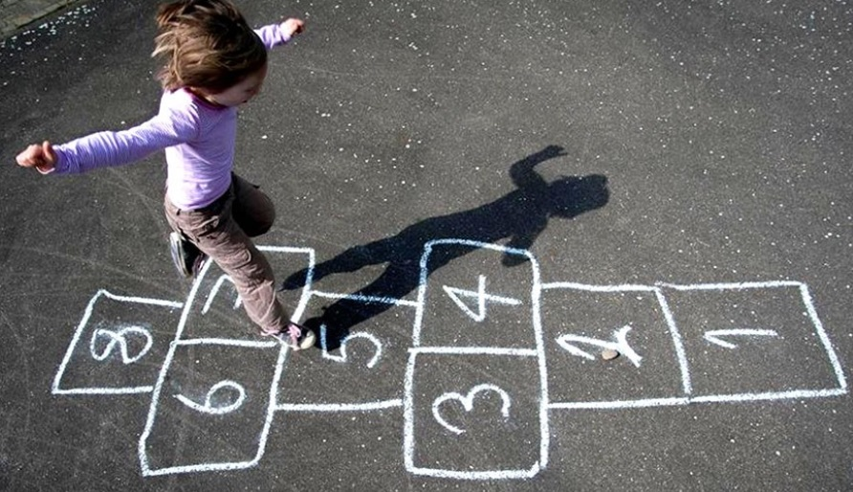
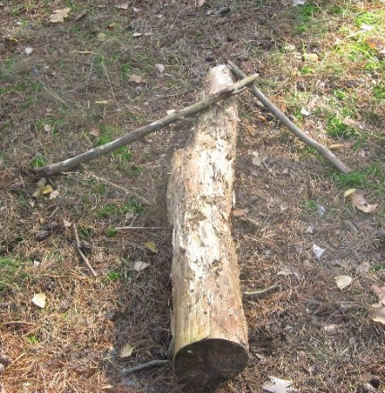
Skakanka - SKIPPING ROPE
Class
Podchody - PAPER CHASE

Slide 15
Thank you for your attention
☺

