Slide 1
Sicily
Socio-economic activities
People’s life

Slide 2
The regional flag of Sicily, recognized since January 2000, is also the historical one of the island since 1282. It is divided diagonally yellow over red, with the trinacria symbol in the centre. "Trinacria" literally means "three points", it is most probably a solar symbol even though lately, it has been considered representative of the three points of the island. The head shown on the Sicilian trinacria is the face of Medusa. The trinacria symbol is used also by other regions like the Isle of Man.

Slide 3
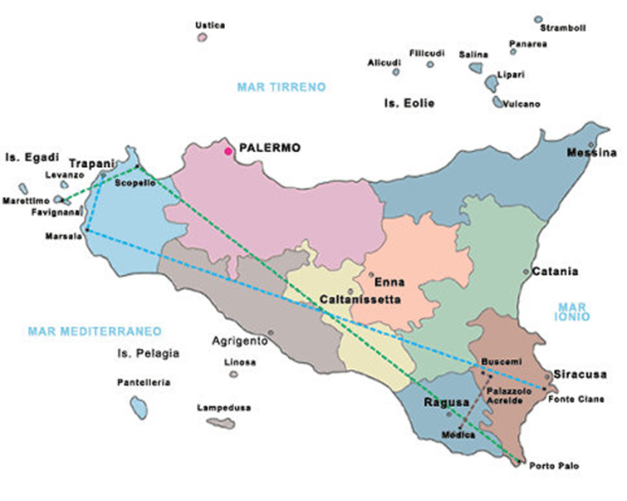

Slide 4
Basical Information
Capital | Palermo
Number of Cities | 390
Number of Provinces | 9
Resident population
Total | 4.866.202
Density | 198 ab./kmq
Annual demografic increase: | 0,5%
Rate of birth-rate: | 12,9%
Middle dimension of the families: | 3,2 persone

Slide 5
Sicily ( Σικελία in Greek) is an autonomous region of Italy and the largest island in the Mediterranean Sea.
Sicily is adjacent to the region of Calabria via the Strait of Messina to the east and it is connected to the Italian peninsula by the national railway, though trains are loaded onto ferries for the crossing from the mainland.

Slide 6
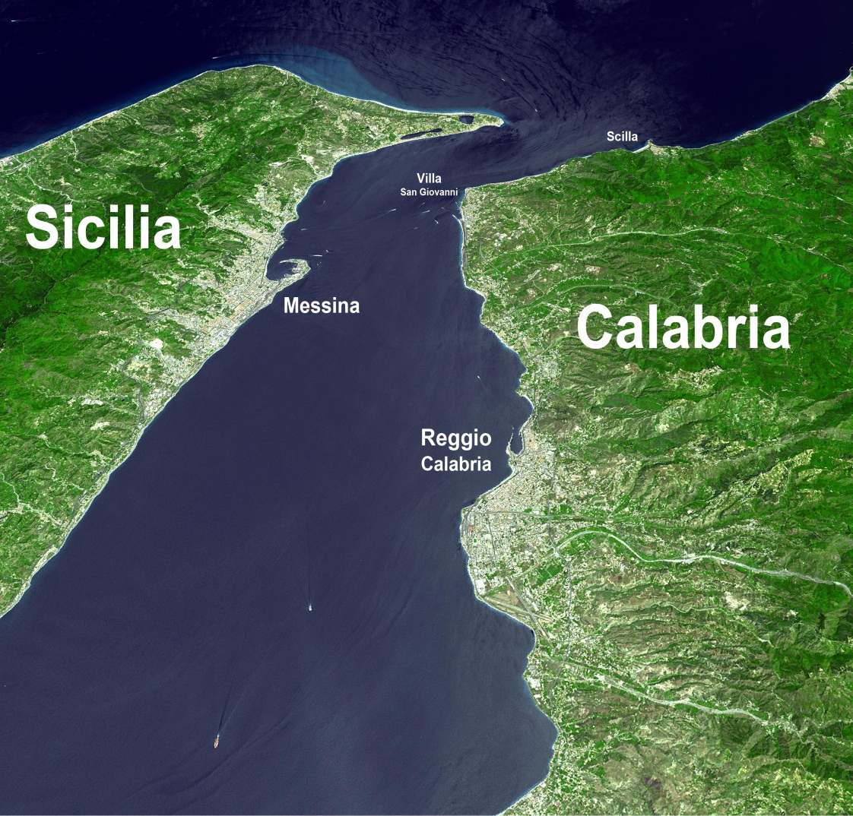
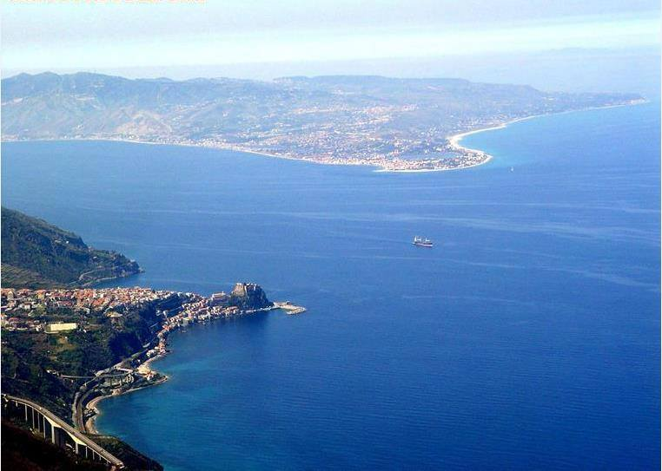

Slide 7
Sicily's principal cities are:
Palermo, (the regional capital)
Catania
Messina
Syracuse
Trapani
Enna
Caltanissetta
Agrigento
Ragusa

Slide 8
Sicily
has long been noted for
its fertile soil
and for two two thousands of years as a grain-producing territory
thanks to its pleasant climate.

Slide 9
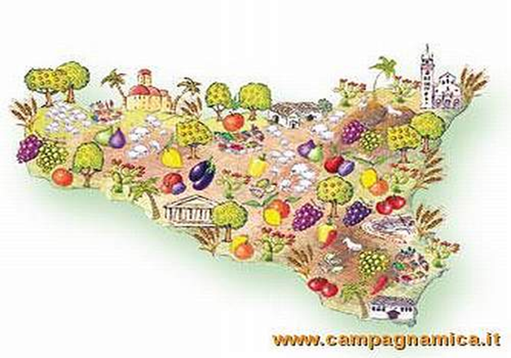
Agriculture is the chief economic activity
but has long been hampered by absentee ownership, primitive methods of cultivation and inadequate irrigation.
The chief agricultural products are wheat, barley, corn, olives, citrus fruit, almonds, wine grapes, and cotton.

Slide 10
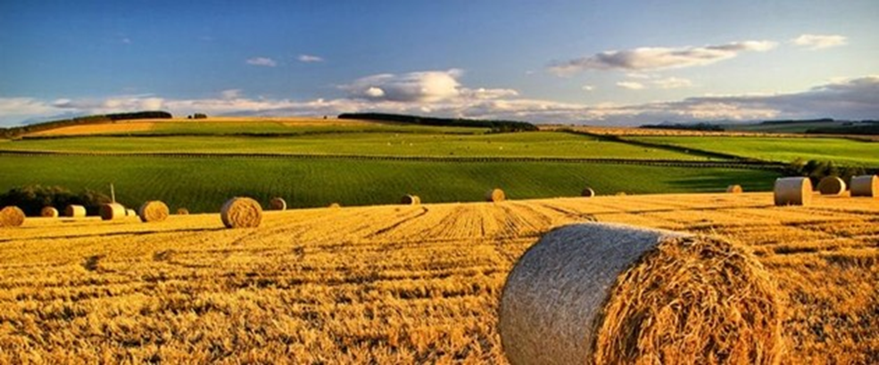
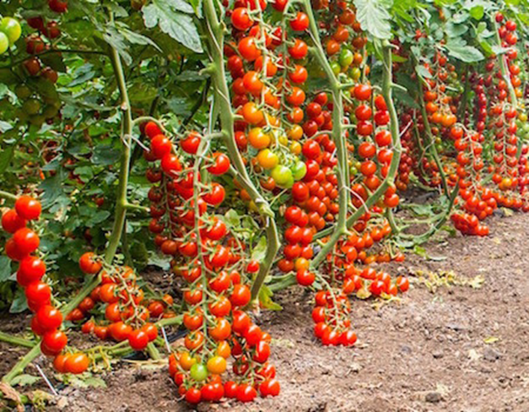

Slide 11
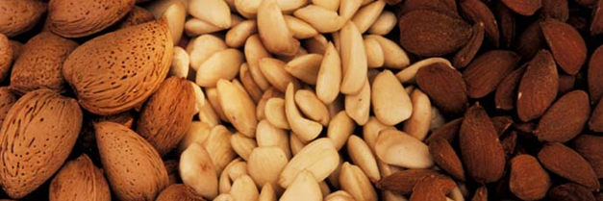
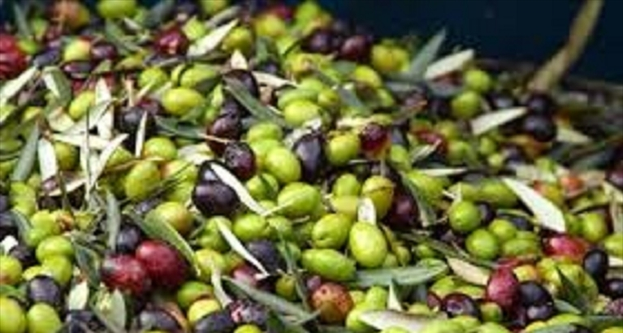

Slide 12
The establishment (1950)
of the now-defunct
Cassa per il Mezzogiorno
(Southern Italy Development Fund)
by the national government
led to land ownership reforms,
an increase in the amount of land available for cultivation and
the general development of the island's economy.

Slide 13
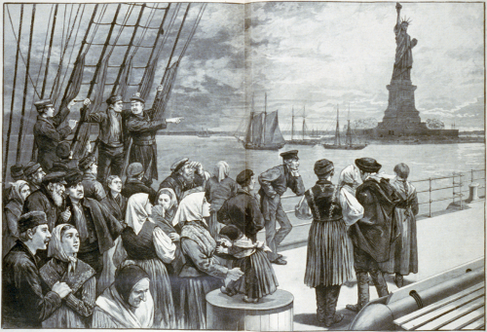
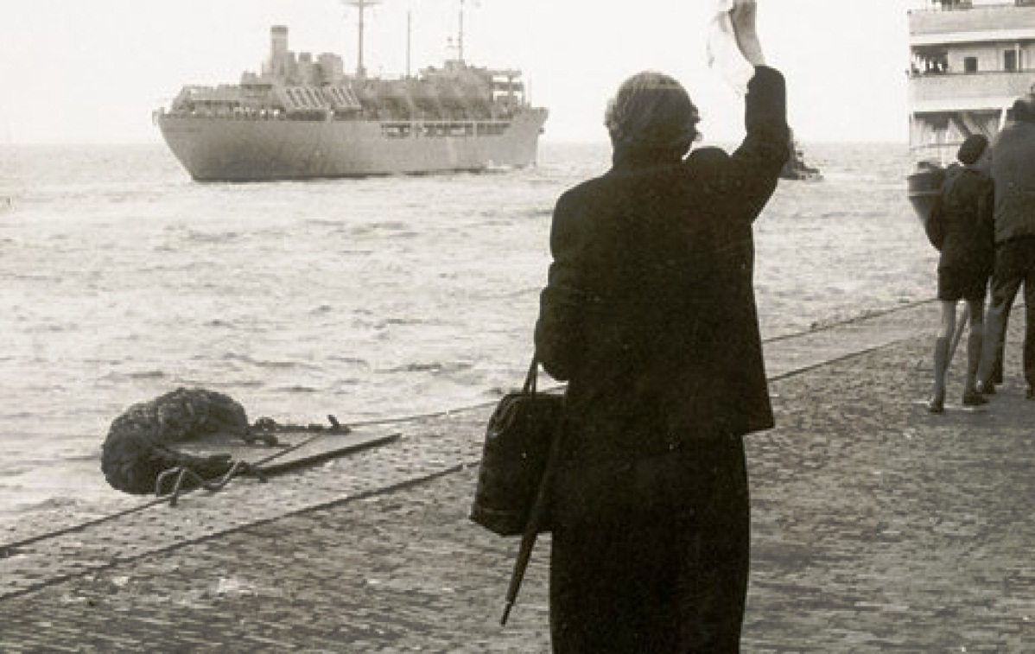
But in the sixties
Working conditions were horrible and incomes not enough to live
A lot of people were obliged to emigrate
looking for a better condition of work !!!!!

Slide 14
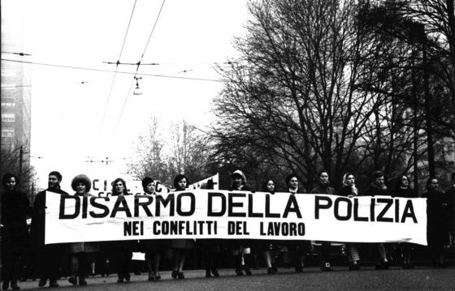
December 2, 1968: “ Avola massacre” shakes consciences

Slide 15
During a demonstration in support of the struggle of the labourers for the renewal of the contract, the police opened fire and killed Giuseppe Scibilia and Angelo Sigona. Millions of workers, peasants and students expressed their protest throughout the country
Two deaths and numerous serious injuries –
writes Rassegna, this is the tragic result of an aggression by the public force against agricultural workers, in a joint struggle for the renewal of the employment contract in the province of Syracuse.
Tear gas bombs and gunfire violently repressed a popular and trade union demonstration caused by the provocative attitude of the agrarians, who on Friday had not even presented themselves to the negotiations called by the prefect.

Slide 16
Strikes and demonstrations to better working conditions
Millions of workers, peasants and students expressed their protest , participating throughout the country in a powerful and unitary way;
the movement demonstrated how deeply the Avola massacre has shaken the conscience of the workers and has strengthened in them the determination to stop the bloody attacks and police violence
we briefly mention:
the strikes in all the Sicilian provinces;
the great day of struggle proclaimed by Federbraccianti on December 4, which recorded peaks of 90% and 100% and strong demonstrations, particularly in Emilia Romagna , in Rovigo and in the Veneto, in Tuscany, in Campania and in the agricultural centers of Puglia;
the strikes of the Milanese workers, from Turin –
with the significant 90% registered at Fiat, the highest percentage after 1951

Slide 17
Sicily’s economy today
Agriculture remains an outstanding source of income and job;

Slide 18
The hard work of generations of peasants and farmers, intense works of deforestation and reclamation over the centuries have resulted in a modern agriculture with high output and income levels.
The technological development of the last years has been also fundamental to the economy.

Slide 19
Craft
It is also a field of recognized importance; it includes Traditional activities such as :
pipe making (making use of Erica Arborea briar),
confectionery (notably the torrone),
glass processing and decoration,
wood working
food service industry,
embroidery.

Slide 20
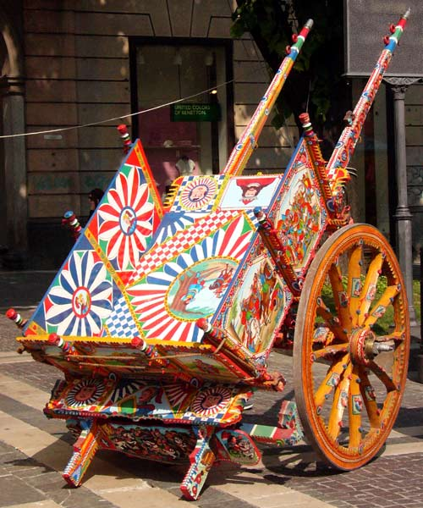
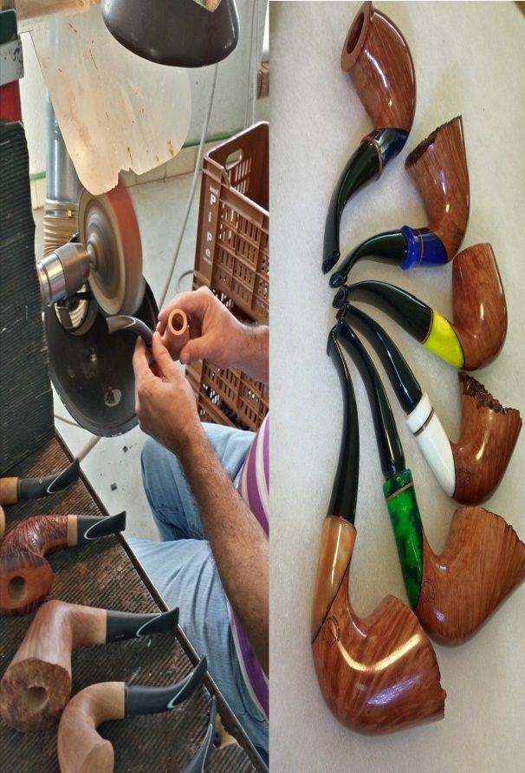
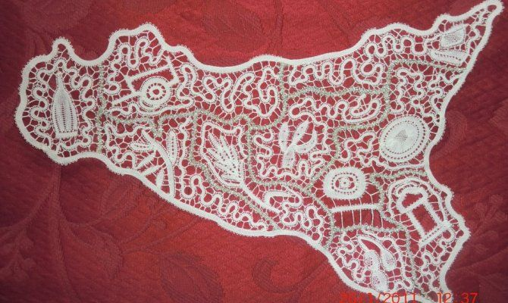
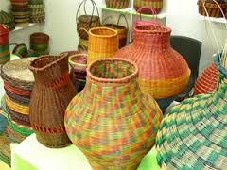
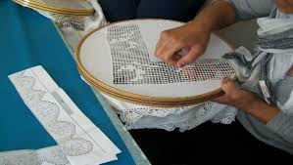
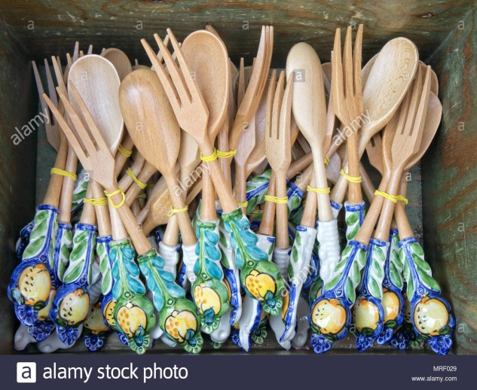
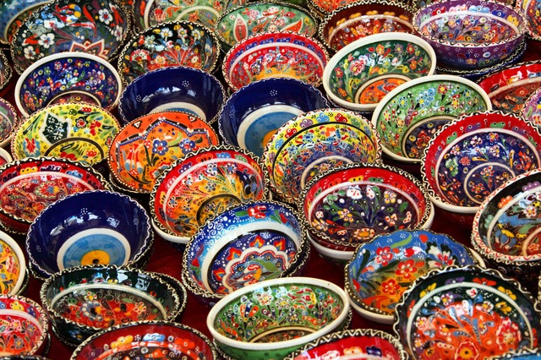
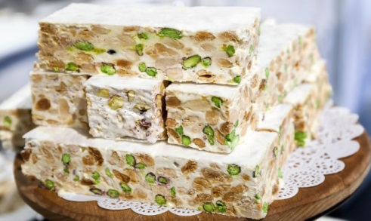

Slide 21
An intense mining activity was recorded in the past century, notably related to
sulphur extraction.
The mines of the Enna and Caltanissetta district became a leading sulphur-producing area in the 19th century, but have declined since the 1950s.
Oil – most drilled off Marina di Ragusa’s shore – it is refined at the petrochemical plant in Gela,
its output accounting for a considerable percentage of the internal consume.

Slide 22
The industry,
in Sicily it has only recently developed in comparison with the rest of Italy,
It has been played an increasingly important role and today, it represents a considerable source of income and employement.
The main industrial activities are those involved in processing and marketing the agricultural products.
Thus, a great number of
oil and flour mills, cheese, confectionery and wine factories are spread across the entire territory.
The building (notably stone, asphalt, and black-stone factories),
The mining industry (oil is extracted in the area of Marina di Ragusa), have been growing rapidly.

Slide 23
Wine industry is one of ancient traditions, dating from the earliest Greek colonization of the area .
Today it is a leading economic industry .
Most of production consists of table wines.
Most vineyards are located in the hilly hinterland.
the major labels, especially renowned, are:
Marsala,
Bianco d’Alcamo ,
Passito di Pantelleria and
the Nero d’Avola ,
the Mamertino,
the Malvasia of the Aeolian Islands
the Faro
very much appreciated, are also:
the Inzolia grape Grillo
the spumante wines, Grecanico Brut.

Slide 24
TOURISM
Tourism plays an important role in today’s economy, thanks to archaeological artistic and naturalistic richness of the country, as well as for its historical and cultural heritage. The last decade ,tourism is remarkably developed and has seen an outstanding growth, with the construction of new touristic facilities.;
Etna volcano, offers opportunities for excursions or sky vacations and the splendid Ionian shore, featuring amazing sports, resorts and fishing villages are really a paradise.

Slide 25
AVOLA AND NOTO HISTORICAL , ARTISTIC AND TOURISTIC PLACES
NOTO
Is famous for
ARTISTIC MONUMENTS
IN BAROQUE STYLE
NOBLE PALACES
CHURCHES
AND
THE MOST BEAUTIFUL AND FAMOUS
Flowery Feast , the Infiorata,
as they say around here, will start on May 19th.
You have just a weekend to get the chance to see the Baroque streets of Noto with a unique look, completely covered by shiny springtime colours.
AVOLA
IS FAMOUS FOR
BEACHES,
ORIENTED RESERVE OF CAVA GRANDE
ALMONDS,
WINE

Slide 26
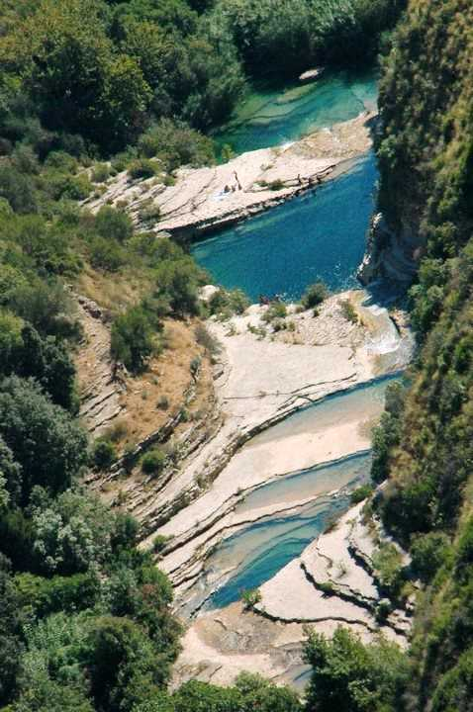
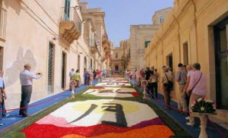

Slide 27
Tourism has given work to a lot of young unemployed people
Besides
restaurants, bars, pubs, supermarkets shops and
all kind of activities connected to tourism have doubled their income
Recently, people have restructured their houses
have opened B&B,
little family Hotels
campings
for tourists’ accomodation

Slide 28
Today
Families income is increased
Unemployment is decreased
Young people
try to find a job in tourism industry
avoid emigrating to the north Italy or abroad.
The Government and local authorities try to assist and help poor people ,
In particular, all children and all students are integrated and are given the same opportunities

