Slide 1
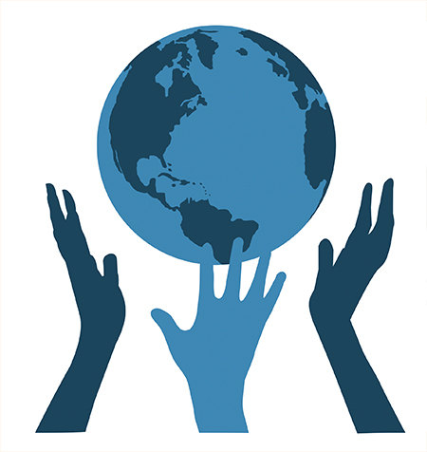

Slide 2
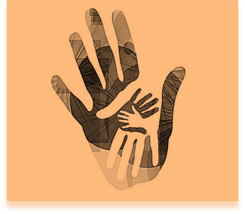
Solidarity
Every hand,
however small,
leaves an imprint in the World.
is all about being united, working together and producing common ideas!

Slide 3
SOLIDARITY
Empathy
Free love
Help the other
Brotherhood
Support
Spirit of sacrifice

Slide 4
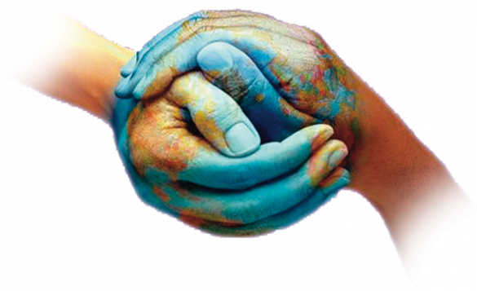
«SOLIDARITY IS THE GREATEST WEALTH OF HUMANITY»
Adolfo Pèrez Esquivel
«SOLIDARITY IS THE ONLY INVESTMENT THAT NEVER FAILS»
Henry David Thoreau
"By looking at yourself you can discover joy, but it is only by helping others that you will know true happiness.“
(Sergio Bambarèn)
Every little gesture of a human being is sacred
Cit. anonymous

Slide 5
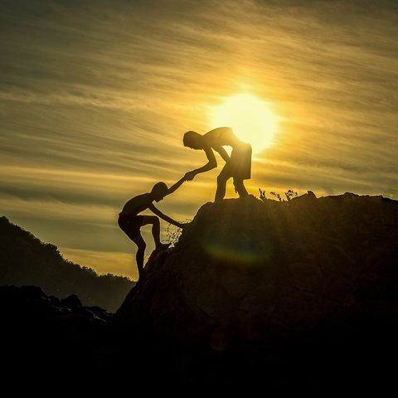
WE MUST RISE
NOT TO OVERWHELM,
BUT
TO HELP OTHERS TO RISE.
(Amedeo Rotondi)
Sometimes you do not need someone to get up from the ground, but someone who lies by your side until you are able to get up.

Slide 6
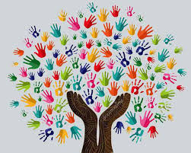
Solidarity is a free gesture.
Solidarity is a gesture for people alone.
Solidarity is a gesture for people who need help.

Slide 7
You can help at a distance…

Slide 8
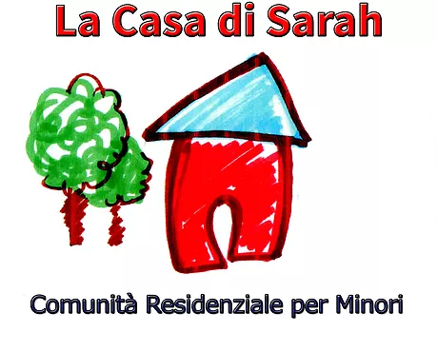
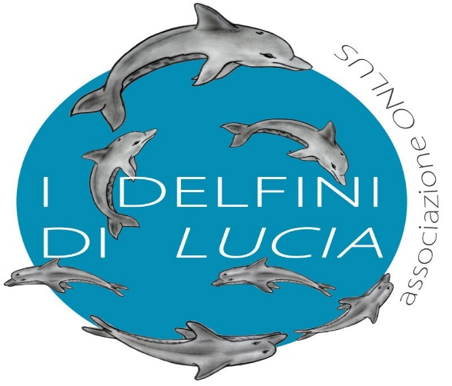
or near………
METER ONLUS SUPER ABILI LA CASA DI SARAH AVO
I DELFINI DI LUCIA AVIS

Slide 9
Donation
Every year, millions of people have to resort to blood transfusions, during surgery or after an accident or because they have blood diseases. With the voluntary blood donation you can help to help them!
A living donor is a subject who, still alive, donates an organ or a tissue to another person (recipient) who needs it.
There are many donations made by living donors, some very risky.
Donors such as missionaries do solidarity, give a piece of their body to make people survive.
I prefer to define this act with the phrase: they take their happiness and give it to people who have completely lost their hope. I really admire the donors because even if they are at risk they do not think twice about donating a piece of themselves.
“Donating blood or organs is the greatest act of life that anyone can do”
Cit.Margaret Chan

Slide 10
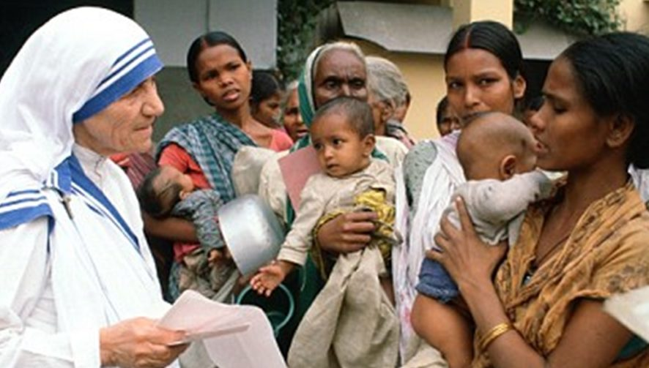
Missionaries
The missionaries belong to a congregation which was founded by Mother Teresa of Calcutta who was forced to live in misery but always with the smile on her face.
The sisters are dedicated to various works of moral and material assistance to the poor. Being a missionary is to make solidarity because you love at first and endure misery and pain. They put others before themselves and that's how we all should live.
“What we do is just a drop in the ocean, but if we did not do it the ocean would have one drop less”
cit. Mother Teresa of Calcutta

Slide 11
Clown Therapy
Clown therapy, also known as smile therapy, is a supportive therapy technique practiced by people who choose the clown to alleviate the state of anxiety and suffering and believe that the smile is the most powerful weapon we have.
A smile can not only improve our day, but also our life.
In my opinion Clown therapy makes patients understand that life is unique and it has to be lived to the fullest, smiling. This is also a great act of solidarity.
“I've been a street clown for thirty years and I've tried to make my life a funny life. Not in the sense in which this word is used today, but in the original sense. "Funny" meant good, happy, blessed, lucky, kind and a bearer of joy. Wearing a rubber nose wherever I go has changed my life”
Cit.Patch Adams

Slide 12
Volunteering
Volunteering is a free and spontaneous help to people in conditions of need or in need of assistance or to face occasional emergencies or by associations established for specific beneficial purposes.
Here in Italy there are many volunteer centers that help the weakest, from canteens to the help of the immigrants.
Even if we do not have time we can volunteer by donating money to the associations.
In my opinion, volunteering does not only serve to help people, but also serves to develop our empathy, serves to get in touch with them, to improve our culture.
“We never forget that true power is service. We must protect people, take care of every person, with love, of children, of old people, of those who are more fragile and who are in the periphery of our heart”
Cit.Pope Francesco

Slide 13
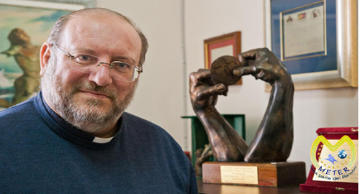
Don Fortunato Di Noto, is the priest and founder of the
Meter Association
Born in Avola (SR) by the will of Don Fortunato Di Noto. Meter is a Greek word meaning "mother" and, in a broad sense, "welcome and womb". This name stems from the need to root and promote the culture of children's rights in ecclesial and non-church realities.
In the field of child protection, in the fight against pedophilia and online child pornography, the association represents a significant reference point in Italy and is recognized worldwide as one of the highest authorities (from China to Japan, from the USA to Europe) in prevention of child discomfort and the planning of interventions aimed at a concrete help to the victims of sexual abuse.
it is one of the most important association IN my town which takes care of children

Slide 14
I
The work of Meter consists in the denunciation, in the prevention and in the help of children victims involved in the ugly phenomenon of
abuse, violence, mistreatment
It is a "voice that gathers the cries of the innocent"
who need international attention and assistance ".

Slide 15
pedophilia is a "crime against humanity "
Children are reduced to goods, objects of exchange in the hands of unscrupulous criminals.
For this reason we can not remain silent, and who has a conscience and the tools to change this drama must do everything possible

Slide 16
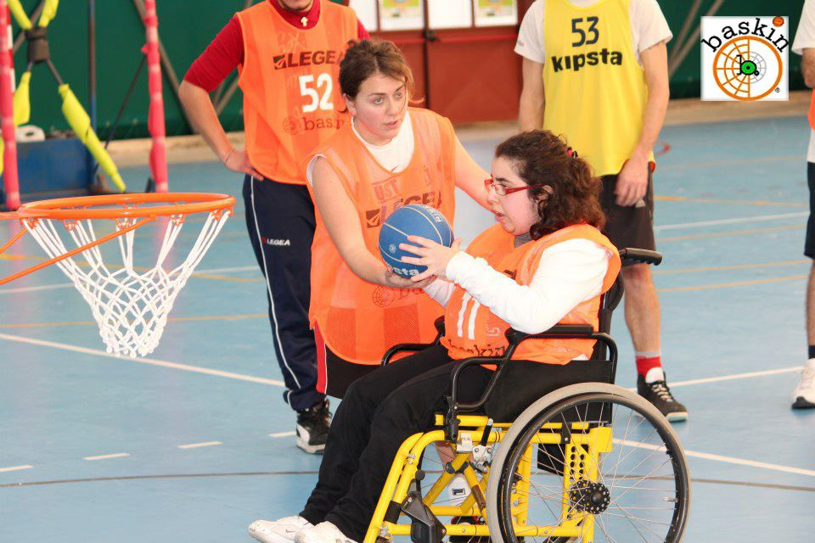
BASKIN: A SPORT FOR EVERYONE

Slide 17
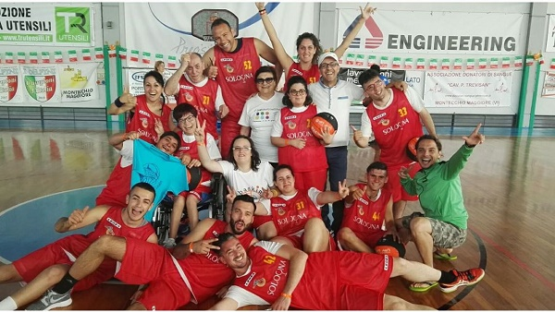
WHAT IS BASKIN ?
Baskin is a sport. To play we are divided in teams and each team has
a disable person who pulls the ball in the basket.
Each player has a number.
The person with disability
who is in the area to shoot
has the number 2.

Slide 18
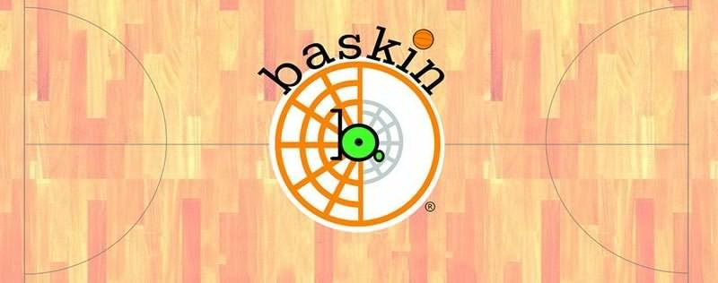
Benedetta Vaccarisi, an Erasmus student in Portugal, explains her experience. She says:
«My solidarity’s experience is playing baskin with disabled and able-bodied people.
Playing with them is a big emotion because you can see great happiness in their eyes.
They feel like us.»
If we win, it is thanks to them too!

Slide 19
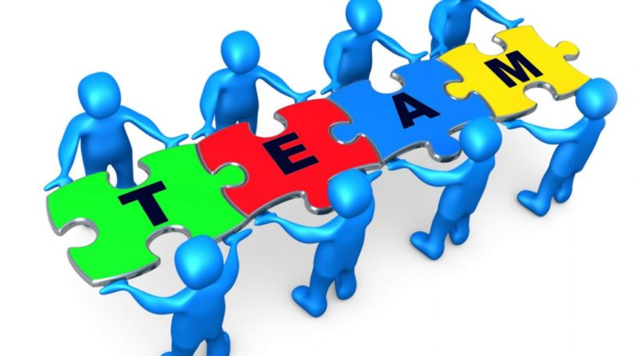
«WE ARE A TEAM AND ONLY TOGETHER WE CAN WIN.
We do a lot of competitions against Noto, Augusta, Messina…
Many disabled players have won prizes
for being «THE BEST SHOOTER».

Slide 20
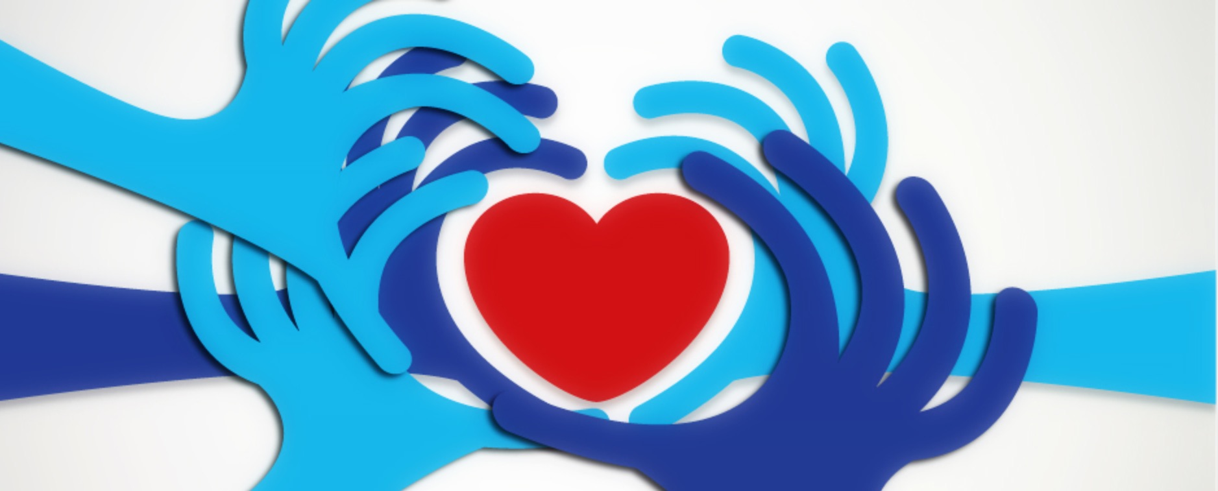
We have to play our part
If we are able to understand the problems of others in the world around us,
we can become good people and we can dream of a fairer world where people care for each other

