Slide 1
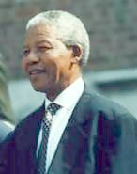
Nelson Mandela
Nelson Mandela was Born: July 18th, 1918 in South Africa
and died: December 5th, 2013 in Johannesburg,
He was a civil rights leader in South Africa. He fought against Apartheid, a system where non-white citizens were segregated from whites and did not have equal rights.
He served a good portion of his life in prison for his protests, but became a symbol for his people.

Slide 2
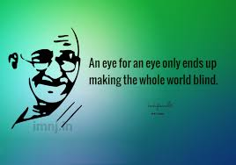
What did Nelson Mandela do?
Nelson Mandela became a leader
in the African National Congress (ANC).
At first he pushed hard for the congress and the protesters to follow Mohandas Gandhi's non-violence approach.
At one point, he started to doubt that this approach would work and started up an armed branch of the ANC.
He planned to bomb certain buildings, but only the buildings. He wanted to make sure that no one would be hurt.
He was classified as a terrorist by the South African government and sent to prison.

Slide 3
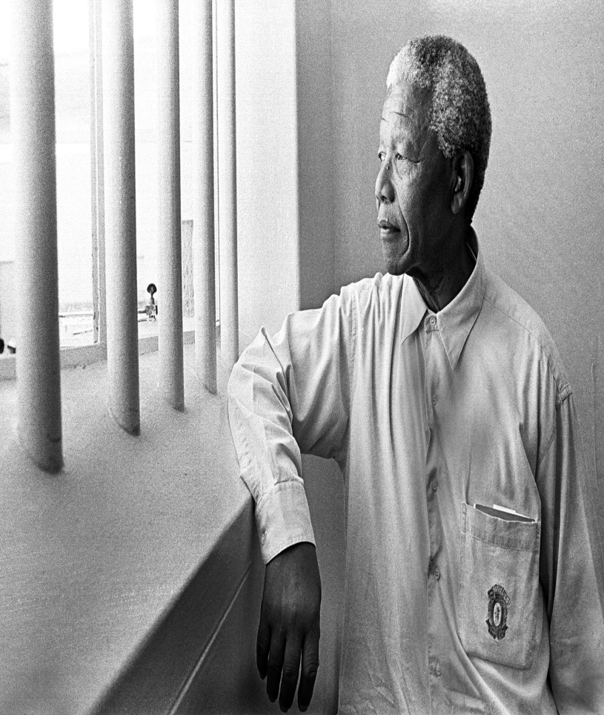
Mandela would spend the next 27 years in prison.
His prison sentence brought international visibility to the anti-apartheid movement.
He refused to bend on his principals in order to be released and stated that he would die for his ideals.
He was finally released through international pressure in 1990.
Once released from prison, Nelson continued his campaign to end apartheid.

Slide 4
He wanted all people of all races to have equal rights in South Africa.
Mandela was awarded the Nobel Peace Prize in 1993.
July 18th is Nelson Mandela day.
People are asked to devote 67 minutes to helping others. The 67 minutes represent the 67 years Mandela spent serving his country.

Slide 5
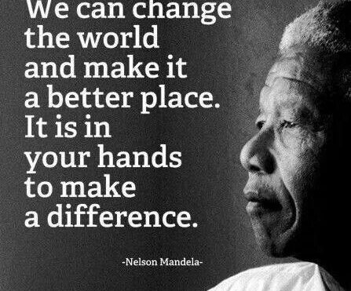
.
His hard work and life long effort paid off when all races were allowed to vote in the 1994 election
Nelson Mandela won the election and became president of South Africa.

Slide 6
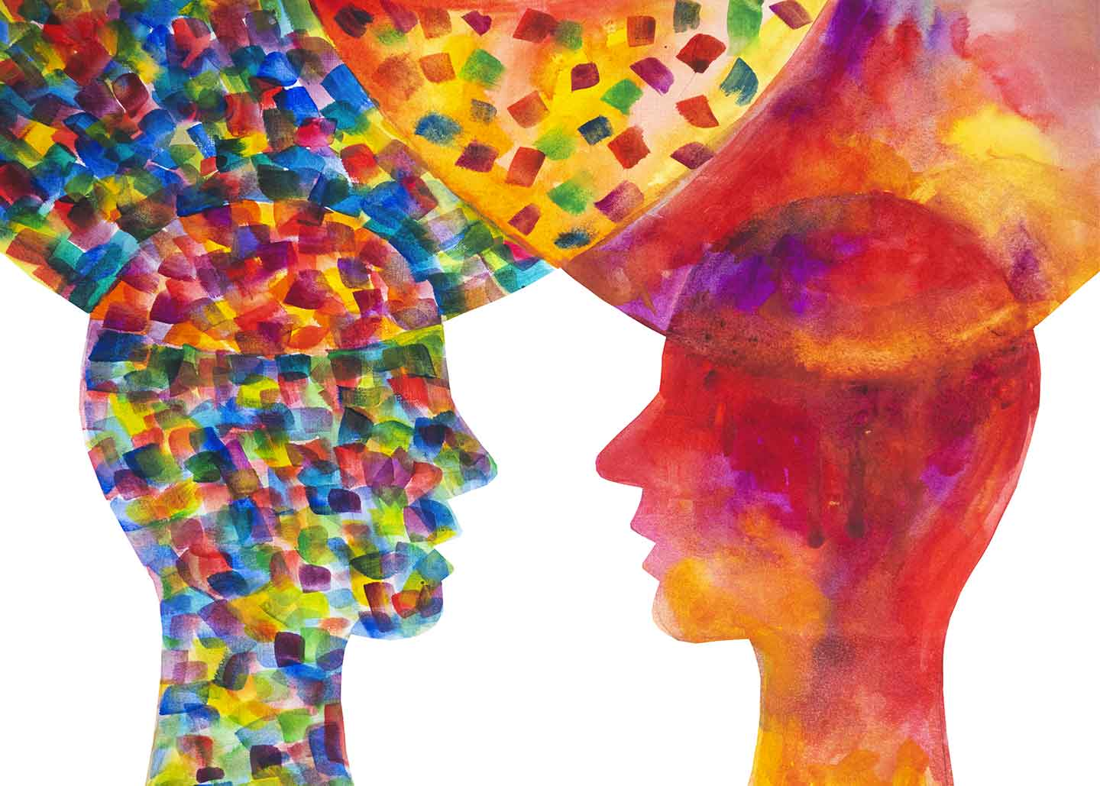
The musical, we are going to watch ,deals with Mandela’s life
The title UBUNTU wants to recall the African philosophy in which all forms of life, from the simplest to the most complex, are connected.
Ubuntu means love, truth, peace, happiness.,
Ubuntu is the essence of human beings:
When you suffer, I suffer. When you thrive, I thrive.

Slide 7
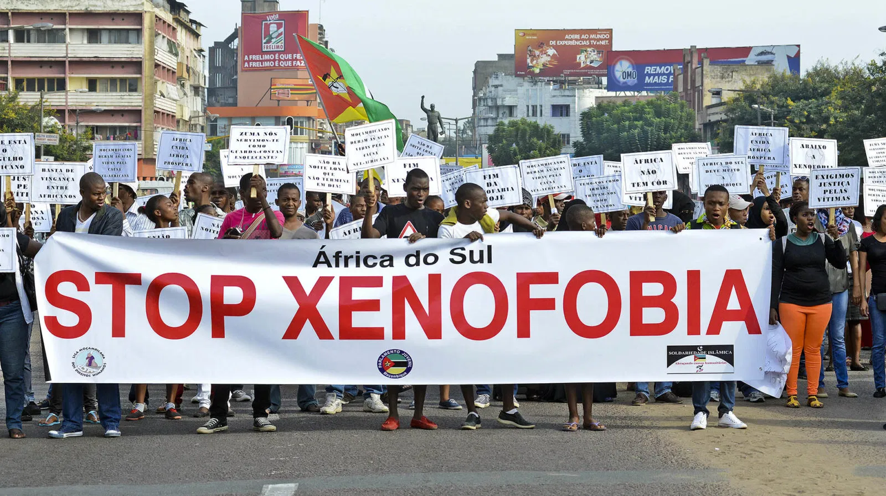
Discrimination against Migrants
Xenophobia against migrants, constitutes one of the main sources of
contemporary racism.
Migrants are often discriminated against in housing, education, health, work or social security.
It is a global issue affecting the countries of origin, the countries of transit and the countries of arrival.
Today, one of the key obstacles to migrants’ integration and equal access to human rights in host societies is persistent anti-migrant sentiments and discriminatory practices.
Such sentiments and practices are often reinforced by legislation, regulations and policies to restrict migratory flows,

Slide 8
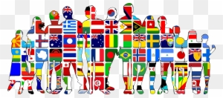
Cultural identity/cultural diversity
Everyone has a cultural identity, of which they are often unconscious because it is so much a part of them. However, in countries with ethnic, religious, linguistic or cultural minorities it often becomes a human rights issue, especially when a more powerful group seeks to impose its culture on less powerful groups.

Slide 9
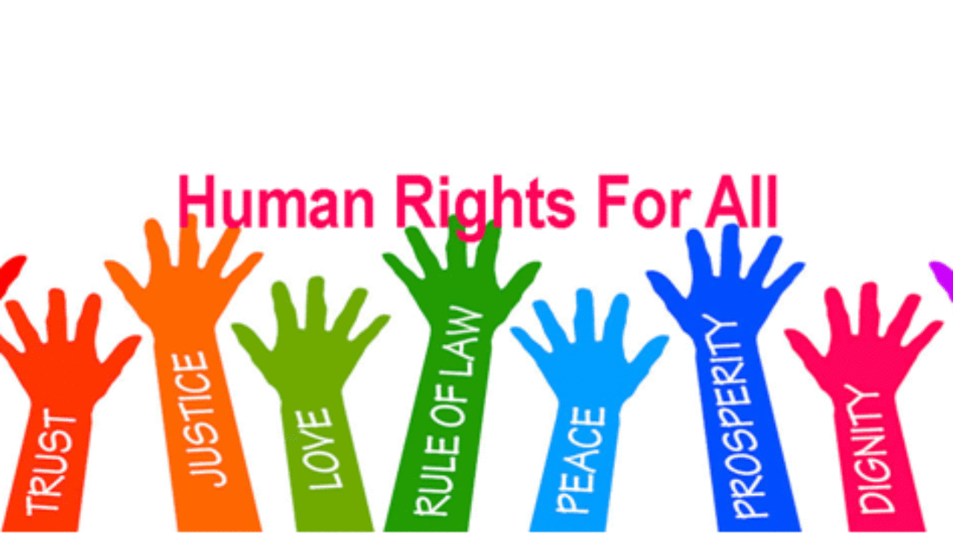
The Convention on the Rights of the Child
pays particular attention to a child’s right to his/her cultural identity.
It guarantees children of minority communities an education, the right to enjoy their own culture and practise their religion and language
UNESCO’s Universal Declaration on Cultural Diversity emphasizes the link between cultural identity and diversity: "This diversity represents a source of exchange, innovation and creativity,
Cultural diversity is as necessary for humankind as biodiversity is for nature .

Slide 10
Examine your own community
-Are there cultural minorities?
-Is their culture respected?
-Do they participate freely and publicly in their culture, or are they expected to do so only privately or not at all?
-Does your school encourage respect for the culture of minority groups?
-Why is the right to cultural identity so important?
-Why is it important to preserve, develop and appreciate different cultures?
-Why do dominant groups often seek to impose their culture on minority groups?

Slide 11
Thanks for your attention
Students; Alice Rossitto, Laura Ventura and Mauro Listo
Teachers: Daniela Scifo and Maria Rita Raeli

