Slide 1
Catherine Cornaro Stella Kyriakidou
Gender equality and their great contribution…
Dimotiko Scholeio Daliou 3
Erasmus+ KA2
Together We Can

Slide 2
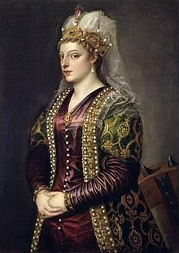
Catherine Cornaro

Slide 3
Catherine Cornaro
She was born in 1454, in Venice.
She married James II, at age 14 and became Queen consort of Cyprus.
Due to a sudden illness, her husband died, while she was pregnant with their son.
According to James’s II will, Caterina, became regent of Cyprus at age 18.
Finally, she became monarch of Cyprus, when their infant son James III died in August 1474, before his first birthday.
It was rumored that he had been poisoned by Venice.

Slide 4
Catherine Cornaro
She ruled Cyprus from 1474 until 1489.
The island was controlled by Venetian merchants.
At 14th of March 1489 she was forced to abdicate and sell the administration of the country to the Republic of Venice.

Slide 5
Catherine Cornaro
On 15th of February1489 the queen exited from Nicosia in order to go to Famagusta, to leave Cyprus.
When leaving Cyprus, her and many people’s eyes as well, never ceased to shed tears.
In February 1489, the Venetian government persuaded Catherine to cede her rights as ruler of Cyprus, as she had no heir.

Slide 6
Catherine Cornaro
Catherine was allowed to retain the title of Queen.
She was made Lady of Asolo, a county of the Republic of Venice, in 1489.
She died on July 10th in 1510, at the age of 54.

Slide 7
Catherine Cornaro
After Catherine Cornaro passed away there was no other Queen or King in Cyprus. The Ottomans started invading Cyprus and captured it in 1571.
Catherine Cornaro was loved by the people of Cyprus and it was no surprise that everyone felt very sad when she died.
She managed to become a Queen and rule the whole country, at times when women were just wives, mothers, peasants, artisans or nuns.
The very concept of “woman” changed in a number of ways during the Middle Ages, when Catherine Cornaro ruled, and women’s roles were influenced significantly during that period.

Slide 8
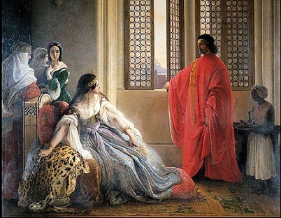
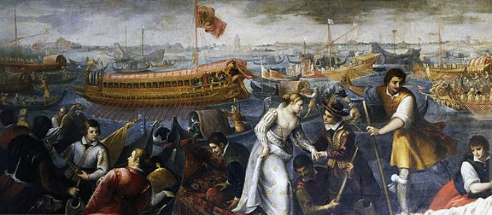
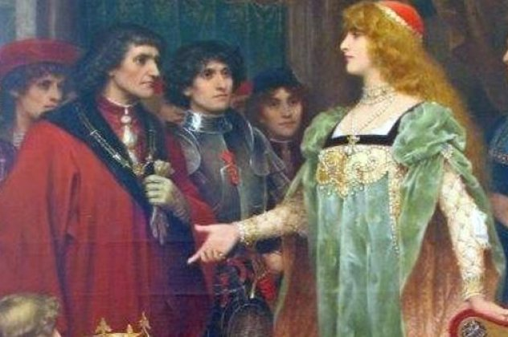
Catherine Cornaro

Slide 9
Stella Kyriakidou

Slide 10
Stella Kyriakidou
She was born in 1956, in Nicosia Cyprus.
She graduated from the University of Reading and graduated with a Psychology degree.
Then she obtained a Masters degree in Child Maladjustment from Manchester University.
She worked as a clinical psychologist for the Cypriot Ministry of Health (1976-2006).

Slide 11
Stella Kyriakidou
She suffered from breast cancer in 1996. She was cured and she was diagnosed again with breast cancer in 2004.
Because of this personal experience she was involved in the local and European movement helping other women to face breast cancer.
In 1999 she was appointed president of the First Breast Cancer Movement in Cyprus.
From 2004 until 2006 she was president of the European Breast Cancer Coalition Europa Donna.

Slide 12
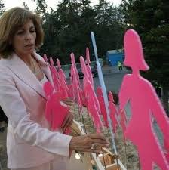
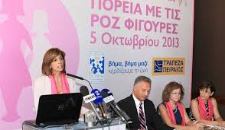
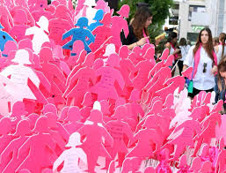
Stella Kyriakidou

Slide 13
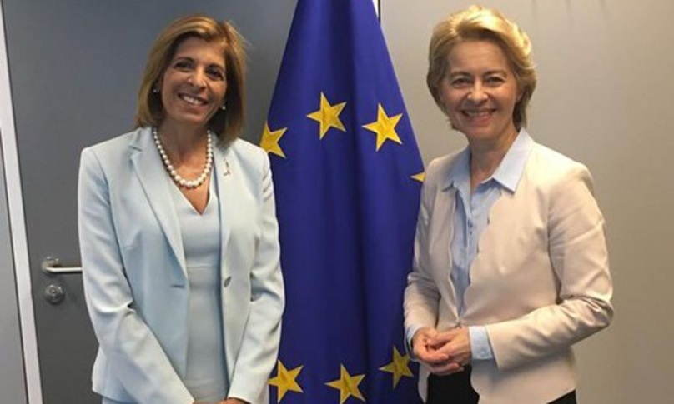
Stella Kyriakidou
Since 2013 she is a vice-president at the Conservative Democratic Rally party.
In 2019 she serves as a European Commissioner and was given the Health Portfolio.
She works to change legislation regarding health policy issues.

Slide 15
Gender Equality
Even though the gender gap in education opportunities is eliminated there is still a lack of gender equality at work in the EU countries.
Women are paid less to work for the same hours and at the same positions with men.
It is difficult to find women in key positions like CEOs or Presidents, Managers etc.
There are less women in key positions in political parties and European decision making bodies. In November 2018 women were 36,4% of the 749 members of the European Parliament. No Cypriot woman was elected.
The election of Stella Kyriakidou as a commissioner is a true honor for our country and for women in Europe.

