Slide 1
Italian Women
Of The Past
kidnapped and raped
Important Events
FIGHTING against MALE SUPREMACY
SOCIAL PREJUDICE and INJUSTICE
FIGHTING for the RIGHT TO VOTE

Slide 2
We are going to talk about great women and important events worth to be remembered.

Slide 3
Franca Viola
the woman who defied the Italian tradition by refusing to marry her rapist, 1966
Franca Viola became
the first Italian woman to refuse a
“rehabilitating marriage” with her oppressor after suffering kidnapping and rape.

Slide 4
Viola grew up in Alcamo, Sicily in a farming family.
In 1963, at the age of 15, Viola was engaged to Filippo Melodia, nephew of a local mafia member, but he was arrested for theft and Viola’s father insisted she broke off the engagement. But, when Melodia returned to Alcamo, he tried unsuccessfully to re-enter Viola’s life, stalking her and threatening her father.
On 26 December 1965, Melodia and a group of 12 armed companions kidnapped Franca.
She was held for 8 days in Melodia’s sister’s house and she was repeatedly raped.
Melodia told her that now she would be forced to marry him so as not to become a “dishonored” woman, but Viola replied that she had no intention of marriage and, moreover, that she would report him for kidnapping and rape.

Slide 5
According to traditional social code, this choice would make her a “donna svergognata“: a “woman without honour” (literally: a “shameless woman“), as she had lost her virginity without getting married.
These concepts were not exclusive to Sicily or rural areas; to some extent, they were also implicit in the Italian Penal Code of the time, namely Article 544,
It compared rape to a crime against “public morality” rather than a personal offence, and formalized the idea of a “rehabilitating marriage” (matrimonio riparatore), stating that a rapist who married his victim would have his crime automatically extinguished.

Slide 6
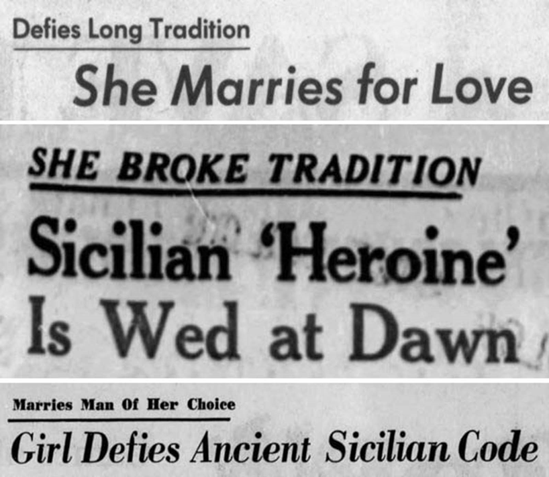
The trial had a wide resonance in Italy, as Viola’s behaviour clashed with the traditional social conventions in Southern Italy.

Slide 7
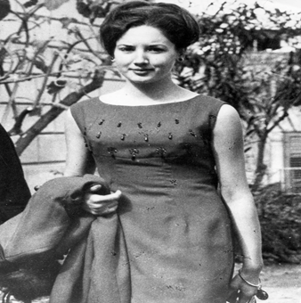
The trial was a sensation in Alcamo and beyond.
Crowds flocked to debates about the trial, which were later relayed by the New York Times.

Slide 8
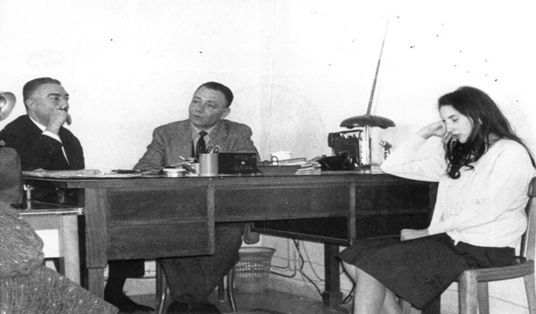
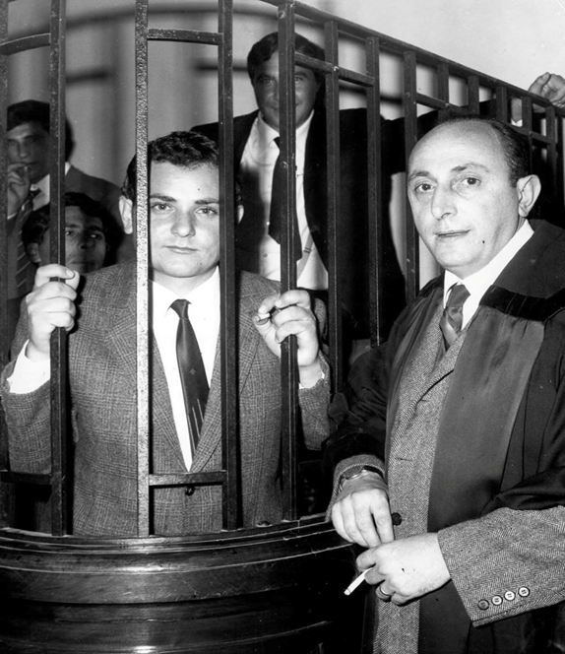
Melodia was ultimately found guilty and sentenced to 11 years in prison.
Melodia was released from prison in 1976 and banished from Sicily for his mob ties. He was shot dead in Modena two years later.

Slide 9
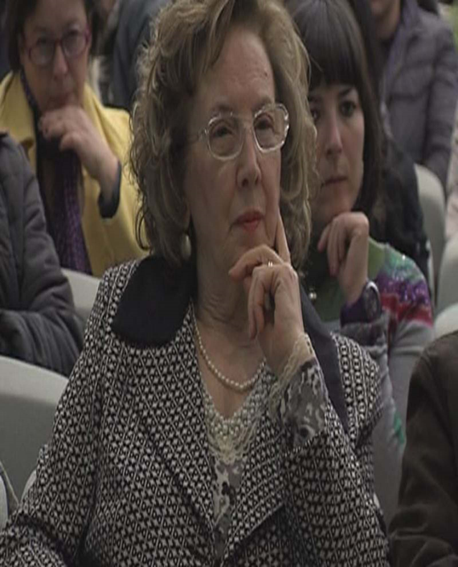
The article of law whereby a rapist could extinguish his crime by marrying his victim was not abolished until 1981.
Sexual violence became a crime against the person (instead of against “public morality”) only in 1996.
Franca Viola married Giuseppe Ruisi in December 1968, and she still lives in Alcamo with her husband.

Slide 10
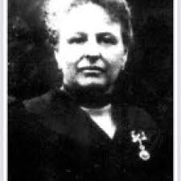
The right to vote Almost in the same period, movements for women's emancipation were born all over the world. In Italy there were many women who, long, fought for the right to vote. Among the first of them, there was Anna Maria Mozzoni (1837-1920)

Slide 11
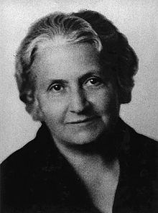
1906: The National Committee for female suffrage proposed a new petition written by Anna Maria Mozzoni to the Parliament and signed by over 10,000 women, including Maria Montessori. Maria Montessori (1870-1952) contributed with her commitment to women's emancipation. She was Italy's representative at the International Women's Congress in Berlin in 1896 and in London in 1899.

Slide 12
After long years of dictatorship and the Second World War, on February 1, 1945, a legislative decree finally granted women the right to vote. The first time Italian women voted was in the local elections of 10 March 1946. At the national political level, women voted for the first time on June 2, 1946 to elect the constituent assembly and choose between monarchy and republic. The Italians chose the republic.

Slide 13
Women to the vote
Queues to the polling stations

Slide 14
We conclude this discussion with a sentence from a journalist of the time which sums up what the vote represented for women in 1946 We tighten the voting papers like love cards Stringiamo le schede come biglietti d’amore

