Slide 1
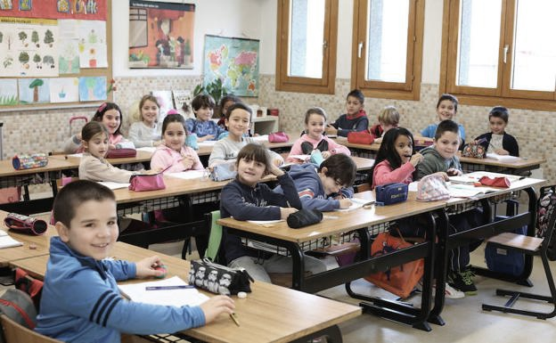
SPANISH EDUCATIONAL SYSTEM

Slide 2
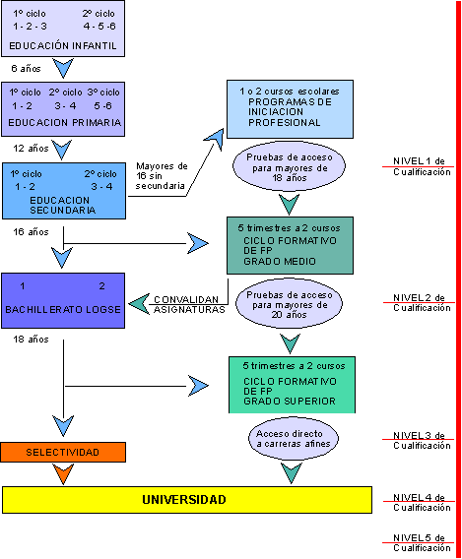

Slide 3
Compulsory education
CHILD EDUCATION
3 a 6 years
3 levels
PRIMARY EDUCATION
6 a 12 years
6 levels
SECONDARY EDUCATION
12 a 16 years
4 levels

Slide 4
Obligatory education
Vocational training
High school
UNIVERSITY

