Slide 1




3rd Mobility - Cyprus

Slide 2

1. PRESENTATIONS ABOUT OUR COUNTRY, TOWN AND SCHOOL
Focus on the people’s life and activities

Slide 3
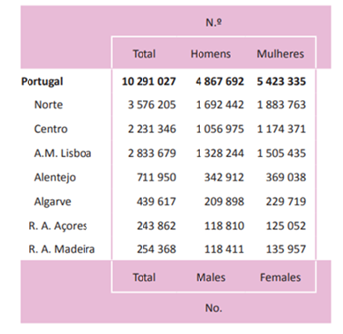

OUR COUNTRY
Resident Population in 2017, according to sex by region

Slide 4
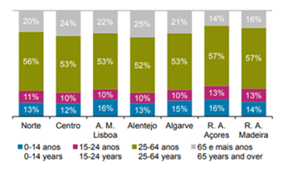
DISTRIBUTION OF THE PERCENTAGE OF RESIDENT POPULATION ACCORDING TO AGE GROUPS, IN 2017, BY REGION

Slide 5
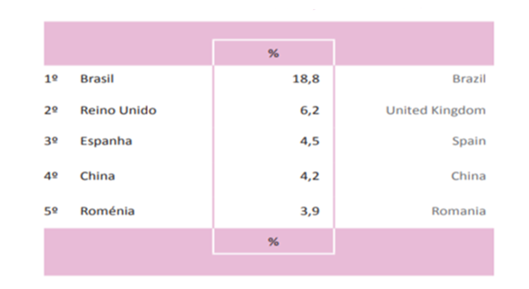
MOST REPRESENTATIVE NATIONALITIES OF FOREIGN POPULATION
WHO HAVE BEEN GRANTED RESIDENCE TITLE, PORTUGAL, 2017

Slide 6
EMPLOYED POPULATION:
TOTAL BY SECTORS OF ECONOMIC ACTIVITY (IN THOUSANDS OF INDIVIDUALS)

Slide 7
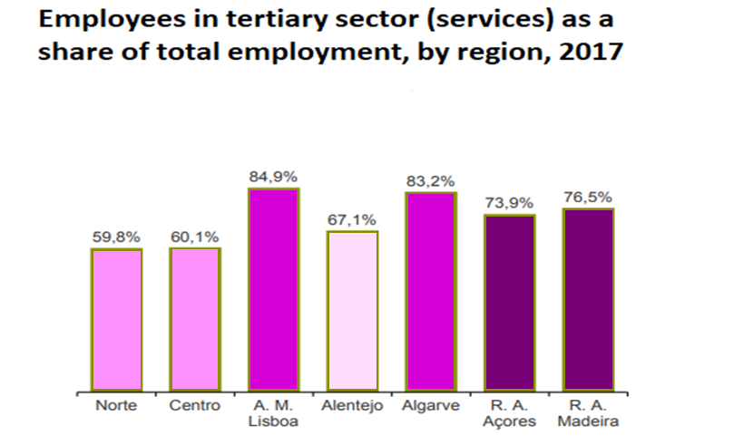

Slide 8
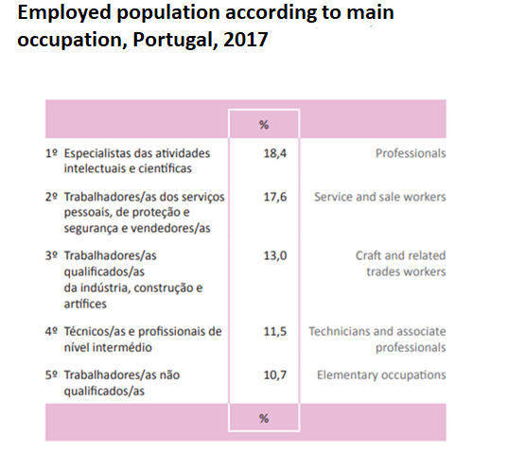

Slide 9
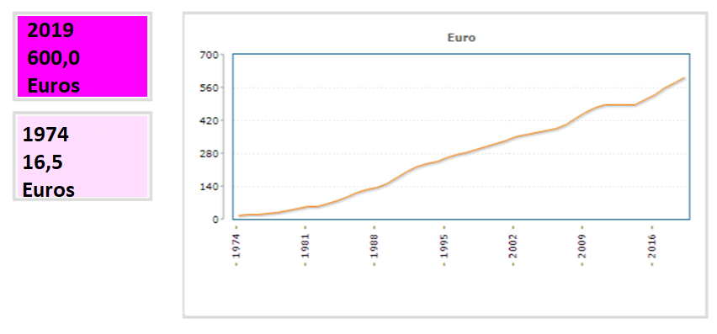
NATIONAL MINIMUM WAGE/MONTH

Slide 10
In 2017, the number of receipients of unemployment allowance was...
406 thousand people.
The unemployment rate stood at...
8,9% in 2017.
In February 2019 this percentage has drop...
to 6,5%

Slide 11
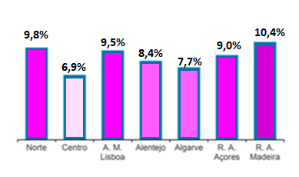
UNEMPLOYMENT RATE BY REGION, 2017

Slide 12
PEOPLE RECEIVING SOCIAL INTEGRATION INCOME ACCORDING TO SEX, PORTUGAL, 2017

Slide 14
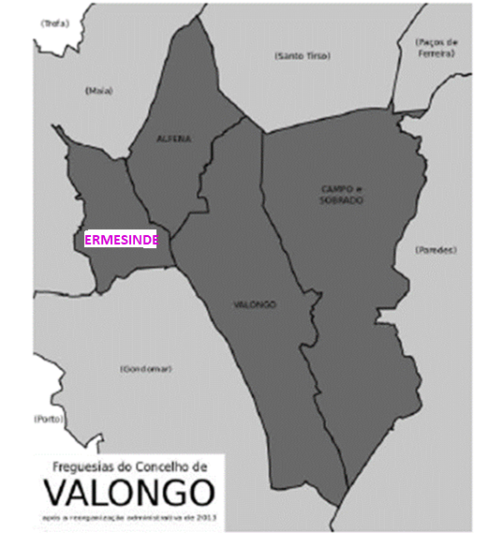
OUR TOWN

Slide 15
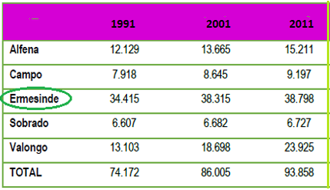
RESIDENT POPULATION IN THE
MUNICIPALITY OF VALONGO (1991-2011)

Slide 16
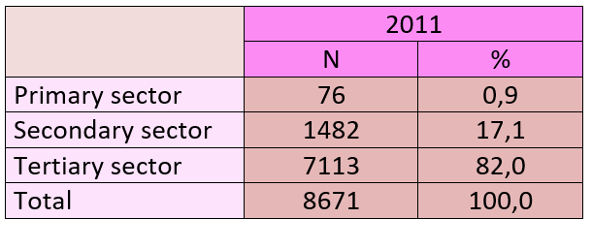
JOB MARKET
NUMBER OF COMPANIES LOCATED IN VALONGO
BY ACTIVITY SECTOR...

Slide 17
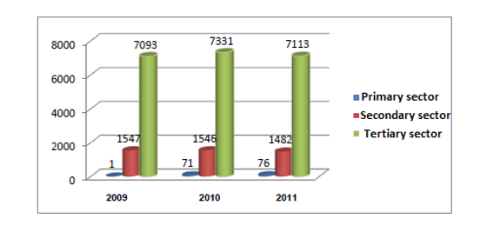
NUMBER OF COMPANIES LOCATED IN VALONGO
BY ACTVITY SECTOR...

Slide 18
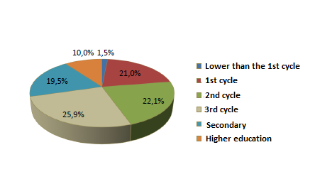
LEVEL OF SCHOOLING OF WORKERS IN THE MUNICIPALITY OF VALONGO

Slide 19
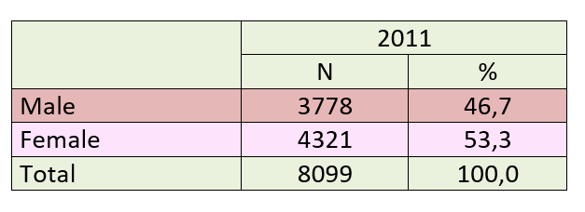
UNEMPLOYED IN VALONGO
BY SEX (2011)

Slide 20
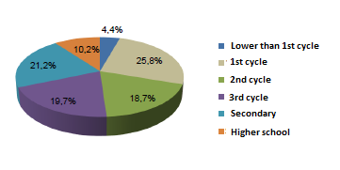
UNEMPLOYMENT
BY LEVEL OF EDUCATION

Slide 21
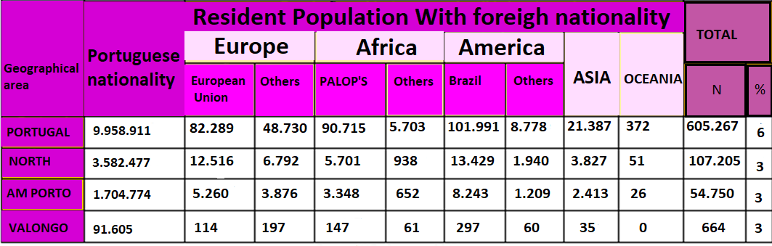
RESIDENTS OF FOREIGN NATIONALITY
IN THE MUNICIPALITY (2011)

Slide 22
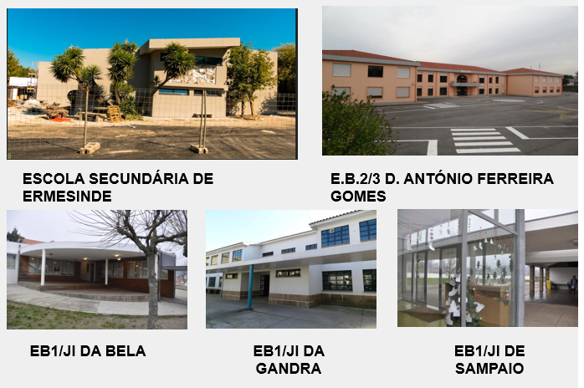
ERMESINDE’S GROUP OF SCHOOLS

Slide 23
Our Agrupamento de Escolas de Ermesinde-AEE (Ermesinde’s Group of Schools) is made up of five different schools.
THE GROUP HAS ABOUT:
2.325 STUDENTS
239 TEACHERS
AND
79 AUXILIARY STAFF

Slide 24
STUDENTS WHO BENEFIT
FROM STATE SUPPORT
- 40% of the students receive financial contributions from the state for food, books and school supplies
- These students come from economically disadvantaged families, who work mostly in the tertiary sector.

Slide 25
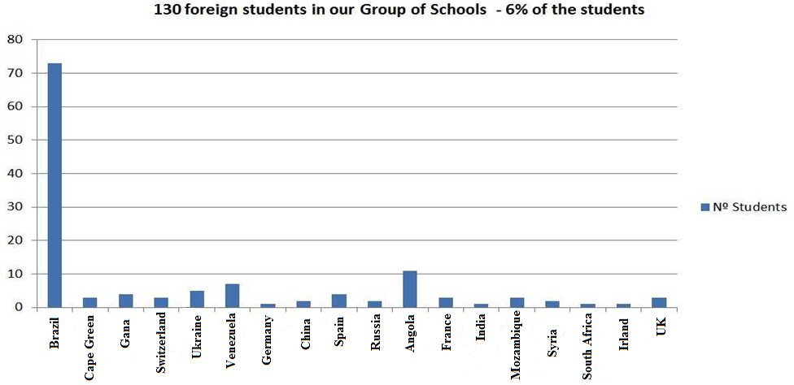
FOREIGN STUDENTS IN THE AEE
(This number has been increasing in the last two years)

Slide 26
STUDENTS WITH SPECIAL NEEDS
IN THE AEE THERE ARE
83 STUDENTS
WITH SPECIAL NEEDS
4,0% OF THE STUDENTS

Slide 27
ACTIVITIES IN OUR GROUP OF SCHOOLS TO PREVENT SOCIAL AND ECONOMIC DISCRIMINATION
“THE HUMAN LIBRARY”
Aim:
To facilitate a constructive and informal dialogue between young students and real people who are often subject of prejudice.
These people who come to school, act as Human Books, and the students listen to their life stories.
Ethnicity, religion, immigration, sexual orientation, disability, and mental illness were some of the stereotypes worked on.

Slide 28
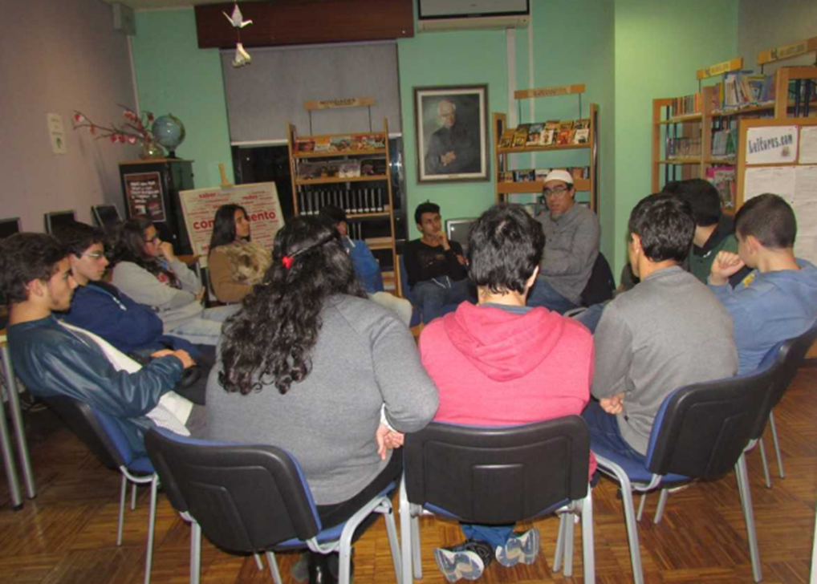

Slide 29
PORTUGUESE LANGUAGE FOR FOREIGN STUDENTS
Not speaking the Portuguese language is the first obstacle to social inclusion and many foreigners, even after a few years of presence in Portugal, do not have the proper knowledge of the language.
So, in our schools we offer Portuguese Language classes for foreign students, to promote the integration process.

Slide 30

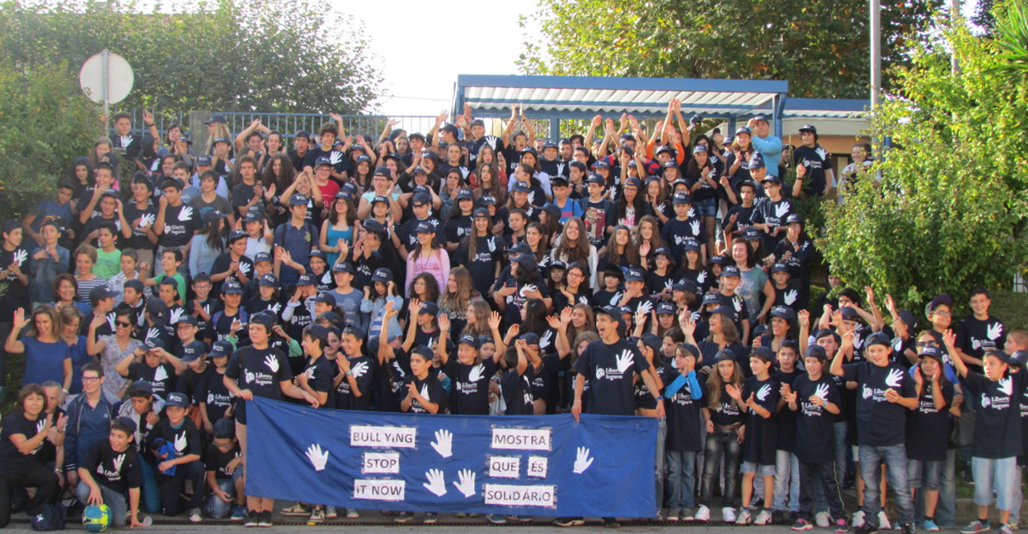
ACTIONS AGAINST SCHOOL DROPOUT AND VIOLENCE
“BULLING PREVENTION”

Slide 31
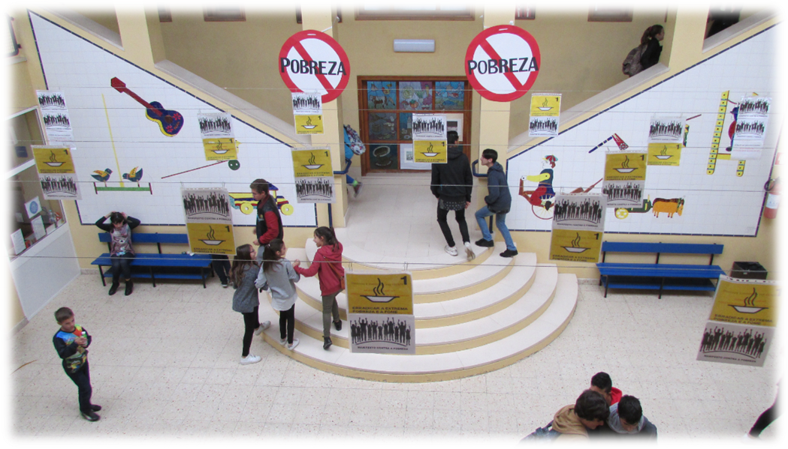
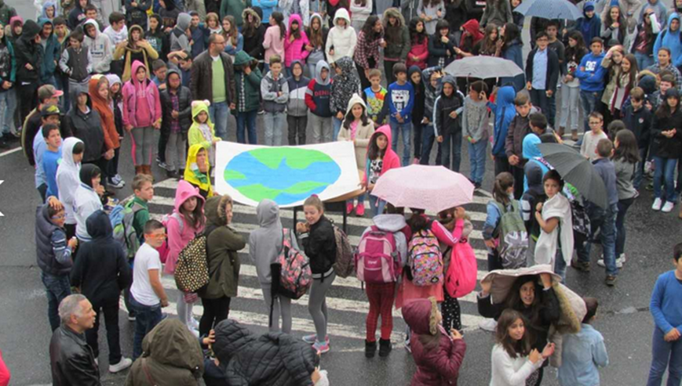
ACTIONS AGAINST ERADICATION OF POVERTY

Slide 32

THE G.U.N.A.S
The G.U.N.A.S. (United Group for Solidarity Help) are a group of students who run different activities to gather funds in order to buy food products, that then are delivered to the families of needy students. They also support other solidarity causes in our schools.

Slide 33
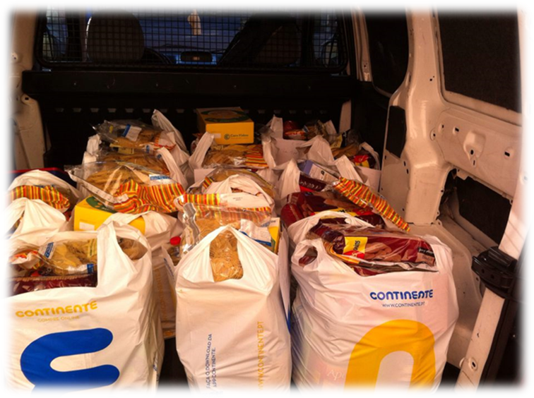
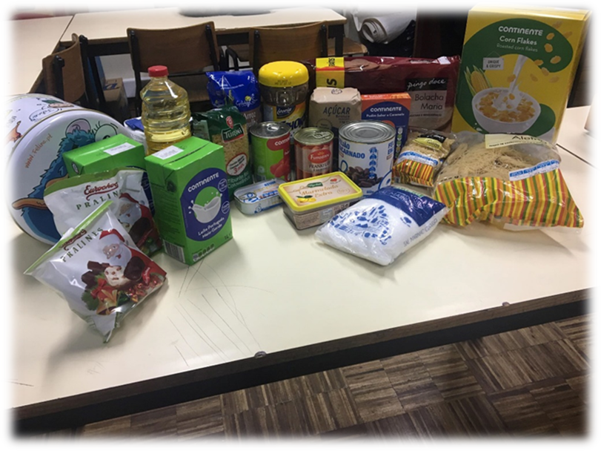
FOOD SUPPLIES DELIVERED BY THE G.U.N.A.S

Slide 34
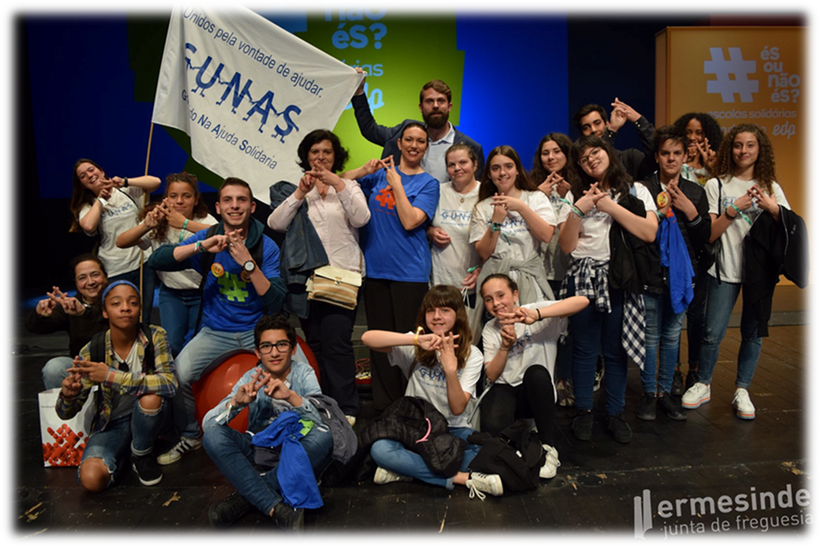
The G.U.N.A.S. have won several national prizes for their work on solidary help and they have also won for our Group of Schools the title of SUPER SOLIDARY SCHOOL.

Slide 35
THANK YOU
FOR YOUR
ATTENTION

