Slide 1
The righteous among the nations
Giorgio Perlasca
(1910 - 1992)

Slide 2
Giorgio Perlasca was an Italian Hero struggling for justice and solidarity. Giorgio was a meat merchant who, during the convulsive years of the II WORLD WAR, risked his life to save thousands of Jews from deportation and death. Thanks to his diplomatic skills and great courage, in Hungary he tried by every means to save entire families of Jews from the ferocity of the Nazis.
His great effort and fundamental role in helping people in danger and mainly jews was late recognized. Rediscovered by silence after 50 years, his history has been brought to light in 1987, thanks to the recognition of a group of survivors and Deaglio’s book of 1985.

Slide 3
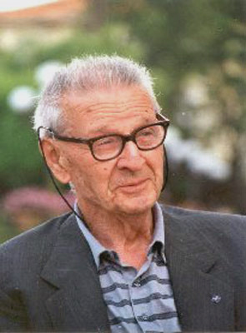
Perlasca Giorgio
Giorgio Perlasca (1910-1992) a native of Como, living in Padua, Italy, with his family, moved to Hungary in 1942, where he worked as the representative of an Italian beef exporter. Although he was a pro-fascist, and had fought in the mid 1930s in the Spanish Civil War on the side of General Franco, he was not willing to recognize the Salò Republic, which took power in part of Italy in September 1943, with the help of the Germans. He refused to cooperate with the German actions. After the German invasion of Hungary, Perlasca was sent to a detention camp. He escaped in mid-October 1944 and returned to Budapest. After a while, he found refuge in the Spanish embassy, thanks to his acquaintance with its authorized representative, Angel Sanz Briz. Around the time Perlasca returned to Budapest, the Arrow Cross Party rose to power in Hungary. Murders on the streets, in the houses of the ghetto, and on the banks of the river Danube, as well as death marches were daily scenes. Hundreds of thousands of Jews were still alive in the embattled city of Budapest, or in the military labor-service companies. International organizations and embassies tried to come to the aid of these remaining Jews by giving them documents declaring that they were under their protection.

Slide 4
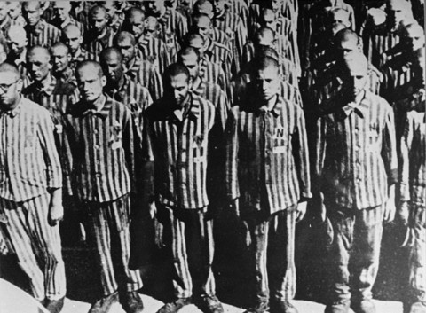
They also designated “protected houses” where the Jews could live.
However, the efficacy of this arrangement depended on the courage of individual diplomats, and was measured in their willingness to stand up to the Arrow Cross gangs, who regularly entered protected houses to attack Jews. The Spanish embassy gave some 3,000 letters of protection to Jews who had some connection to Spain, or to Jews in general, and set up a number of protected houses. However, in December 1944, Sanz Briz left Hungary. In the absence of an ambassador, the responsibility for the Spanish embassy affairs fell on the Swedish ambassador, Carl Danielsson, who stayed in his post until the end of the war.

Slide 5
Then came Perlasca’s finest hour. With the cooperation of the embassy’s advisor Dr. Farkas, and an activist in the underground named László Szamosi, Perlasca simply pretended to be the representative of Spain. He changed his name to Jorge, and signed letters issued by the diplomatic corps calling for the end of anti-Jewish persecutions. He presided over negotiations with the authorities and promised, in Spain’s name, to recognize the authority of the Arrow Cross. Perlasca even went to the torture chambers and jails of the Arrow Cross to get Jews released, and personally, or with the help of his aides, distributed letters of protection to those who were being deported on the death marches. Thanks to these documents many Jews were allowed to return from the marches, or from the border. Perlasca and those who worked with him provided shelter and food for the Jews who were in the Spanish protected houses. More than once he coolly used his false identity to throw Arrow Cross gangs out of the houses, when they entered and threatened to murder or deport the Jewish residents. He acted with great courage until the liberation. After the war, Perlasca returned to Italy. Dozens of those he had saved accompanied him to the train station and saw him off with an emotional farewell.
He did not talk about his actions in Hungary to anyone, including his family, and came back to his humble life. In 1987, a group of Hungarian Jews whom he had saved finally found him, after searching for him for 42 years in Spain. There was publicity at the time, and Perlasca became noted for his heroic deeds.

Slide 6
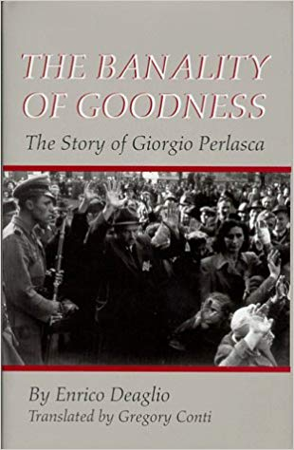
Enrico Deaglio wrote a book about his life and remarkable value: ‘The banality of goodness: the story of Giorgio Perlasca’ (2002) which became a bestseller.
The book was adapted as a made-for-TV film, Perlasca – Un eroe Italiano (2005) by the RAI national television cooperation.
Perlasca received an award at Yad Vashem in the presence of representatives of Italy, Spain, Hungary and Israel. Perlasca died in Padua on August 15, 1992.
On June 9, 1988, Yad Vashem recognized Giorgio Perlasca as Righteous Among
the Nations. According to his wish, on his tomb it was inscribed in Hebrew
“ Righteous Among the Nations.”

Slide 7
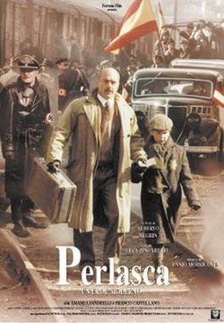
UN EROE ITALIANO (English: Perlasca, an Italian Hero)
It is the real story of Giorgio Perlasca (Luca Zingaretti). During the 1920s
He was an Italian Fascist supporter, fighting in Africa and in the Spanish civil
war where he deserved a safe conduct for Spanish embassies. After some
years, disillusioned by fascism, he is a fresh supplier for the Italian army.
In the war years he is in Budapest for his business. He lives an easy life
there, well introduced into the Hungarian high society, without any
problem coming from the war situation.
When the Nazi occupied Hungary, in 1944, instead to leave (Italy had
already surrendered to the Allies) he escaped to the Spanish embassy
in Budapest using his old safe conduct and becoming a Spanish citizen,
changing name into Jorge Perlasca. He starts working as a diplomat here.
When Sanz Briz (Geza Tordy), the Spanish consul, is removed, Perlasca
immediately substitutes him, like if he was officially appointed from
Spanish authorities. All the Nazi, the Hungarian authorities believe him. In his new fake assignment, he starts immediately to hide, shield and feed a lot of Jews (thousands!) issuing Spanish (fake of course) safe conducts for the Jews of Sephardic origin. He is in contact with another Hero of that time, Raoul Wallenberg. The two, together with other volunteers, running incredible risks had saved thousands of Hungarian Jews from a tragic death. Incredibly Perlasca succeeded to save two boys directly from the hands of Adolf Eichmann at the train station. This hero, after the war, was completely forgotten, and his story comes out just in the 1980s because some of the Hungarian Jews wanted to meet him again.

Slide 8
Perlasca – Un eroe Italiano (English: Perlasca, an Italian Hero also known as Perlasca, The Courage of a Just Man) is a 2002 Italian drama, directed by Alberto Negrin, about Giorgio Perlasca, an Italian businessman working in Hungary for his government. After Italy surrendered to the Allies, he took refuge in the Spanish Embassy. Aware of the threat to Jews, he first began to help them find shelter in Spanish safe houses.
After the Spanish ambassador moved to Switzerland, Perlasca posed as the Spanish consul, tricking Nazi officials and saving the lives of more than 5,000 Jews in Hungary in 1944 during the Holocaust. The film was made by Rai Uno and aired as a two-part TV film. The Village Voice deemed this account as "more courageous than Spielberg."[citation needed]
Contents
1 Background
2 Plot
3 Cast
3.1 Main
3.2 Secondary
4 Reception
5 Awards
6 See also
7 References
8 External links
Background
The movie is adapted from the book, La banalità del bene – Storia di Giorgio Perlasca (2002) by Enrico Deaglio, about the achievements of an Italian man in saving Jews in Hungary in 1944. During World War II, Perlasca worked at procuring supplies for the Italian army in the Balkans. In the autumn of 1943, he was appointed as an official delegate of the Italian government with diplomatic status and sent to eastern Europe with the mission of buying meat for the Italian army. On October 8, Italy surrendered unconditionally to the Allied forces. Italian citizens in Hungary were then considered the enemy of the Hungarian Government, which was allied with Germany, and were at risk of arrest and internment. During this period, the Hungarians had forced Jews of Budapest into a ghetto, and they began deporting them to Nazi death camps, even as the Russians advanced on the eastern front.
Some of the film's scenes feature other historical persons. For instance, Perlasca rescued two children from deportation and certain death while observed by Adolf Eichmann, who was in Hungary overseeing deportation of Jews to concentration and death camps. The film refers to Raoul Wallenberg, a Swedish diplomat who issued papers to protect tens of thousands of Jews.
After the war, Perlasca returned to his home in Padua. In post-war Italy Perlasca spoke of his efforts and wanted to receive recognition, but was largely ignored due to his fascist connections (He had fought on the side of fascism in Spain, for example).
Plot
The film starts in a Budapest Hotel with a narrative introduction by Perlasca. His chambermaid warns him of a raid of Hungarian Arrow Cross storm troopers coming to arrest him. He escapes and manages to get to the railway station, where he tries to sneak onto a sheep transport wagon. Discovered by a local officer named Glückmar, he is arrested (as Italy has surrendered to the Alllies, Italian citizens in Hungary are considered enemies). While he is being taken away, an Allied air strike hits the station and Perlasca escapes.
He goes to an upper-class party to get information from Contessa Eleonora about Resistance members who can help him leave the country. Another squad of troopers, led by Captain Bleiber, arrive on the scene and arrest some guests, including Italian military officers. The contessa uses her Hungarian social rank to get Perlasca out safely and sends him to Professor Balázs, a doctor. Perlasca finds he is sheltering Jews who have left the ghetto, at a time when they are being deported to Nazi death camps.
Perlasca spends the night at his clinic, but the place is investigated by Bleiber and his Lieut. Nagy. Escaping the immediate threat, the Jews leave the house in fear and most are caught and killed by Bleiber and his forces, who had been waiting outside. Perlasca survives with Magda, a young Jewish woman, and her daughter Lili. They reach the Spanish Embassy where, thanks to a safe-passage letter signed by Francisco Franco, he gains an audience with the ambassador Sanz Briz. He sends them to a Spanish safe house, protected by embassy sovereignty. They are accompanied by a local Hungarian Jewish lawyer working for the embassy.

Slide 9
At the safe house, Perlasca meets more refugees from the clinic, and Eva and Sándor, a Jewish couple. He leaves the house for a drink but upon his return he recognizes that the house was indeed cleaned up illegally by the Arrow Cross soldiers. He begins searching for Magda first in the railway station where the fascists have already started to gather and load the Jews to wagons ready to roll out.
For the second time, he confronts Glückmar, who helps him. Perlasca is sent to the SS-Führer of the station who is easily bribed and thus lets him compile a list of Jews needed by the Spanish Embassy. He cheats with the list and actually calls more people to his truck than it is permitted, except Magda, who isn't on the train. He then visits an Arrow Cross Interrogation base, where he finds a lot of executed Jews but saves those few who survived the torture with Magda among them. Returning to the Embassy, Briz tells him that the Spanish are withdrawing from Hungary and ceasing to operate. This is the point where Perlasca decides to take on the role of a so-called consul and to lie, saying he is of Spanish nationality and have others call him "Jorge". He refuses to let the Arrow troopers in and acts as if the Embassy is still functioning and is therefore a sovereign territory. He organizes education, alert duty and supplies within these buildings. He visits Gábor Vajna, the Arrow Cross Interior Minister of Hungary as consul and claims that the Jews housed by the Spanish are Sephardi Jews. Meanwhile, Lt. Nagy – according to the local rules – forces the protected Jews to the streets to clear debris caused by air raids. He then attempts to escort the group to the railway station for deportation, but is stopped again by a dispatch reporting Perlasca's and Vajna's agreement.

Slide 10
He then falsifies 5000 'Schutzbriefs' (protection letters) when he is informed of his own Spanish passport waiting for him at the Hungarian border. He still chooses to stay because Magda's life is in danger. A final raid on the safehouse results in Nagy taking all the Jews (except a half dozen of them who remain in hiding) to the Danube bank, while Perlasca is attending a ball where he tries to borrow a train-wagon for his protégés to be sent to Switzerland.
While running away from the safehouse, Magda's father is shot on sight by a young militiaman, who tries to test him by asking him to recite the prayer, "Our father, who art in ... ". As a Jew he can not do so, and the soldier yells, "Where is our father?" When Sándor responds, "I don't know where he is," he is shot immediately. Perlasca and the few remained Jews find shelter at Professor Balázs' flat. At the Danube river the 1944/45 Danube executions take place and despite recruiting aid from Major Glückmer, Perlasca arrives too late to the scene. He manages to save only Eva. Upon hearing the news of plans to burn down the Budapest ghetto and its inhabitants, he decides to convince the Jewish community to take up arms and to fight if necessary. He also makes his final visit to Vajna's office and, with a successful bluff, he convinces him to let the ghetto stand and thus be freed by the Red Army days later. In the final scenes, Cpt. Bleiber is seen hanged in the street and Perlasca leaves the city with the help of Glückmer, who was originally ordered to arrest him because of his previous fascist affiliations

Slide 11
Decorations and honors
In 1987 Perlasca was made an honorary citizen of Israel and was honored by the Yad Vashem Holocaust Memorial Museum with a stele and a 10,000 tree forest.
Perlasca has been designated by Israel as a Righteous Among the Nations in 1989 for his efforts
Star of Merit, Hungary, 1989
Knesset Medal, Israel, 1989
Town Seal of Padova, Italy, 1989
Wallenberg Medal, United States, 1990
Medal of Remembrance of the United States Holocaust Memorial Council, USA, 1990
Invitation to lay the first stone of the Holocaust Museum in Washington, USA, 1990
Knight Grand Cross, Spain, 1991
1st Class, Knight Grand Cross (Italy), 1991
Gold Medal for Civil Bravery (Italy), 1992
A bust of Perlasca was created in Budapest.
Many streets and schools were named after Perlasca
As part of its Righteous Among the Nations project, the Raanana Symphonette Orchestra commissioned an original orchestral piece, "His Finest Hour", from composer Moshe Zorman in tribute to Perlasca. The piece was premiered on December 10, 2014 in Raanana in the presence of Perlasca's son Franco and daughter-in-law Luciana Amadia.

Slide 12
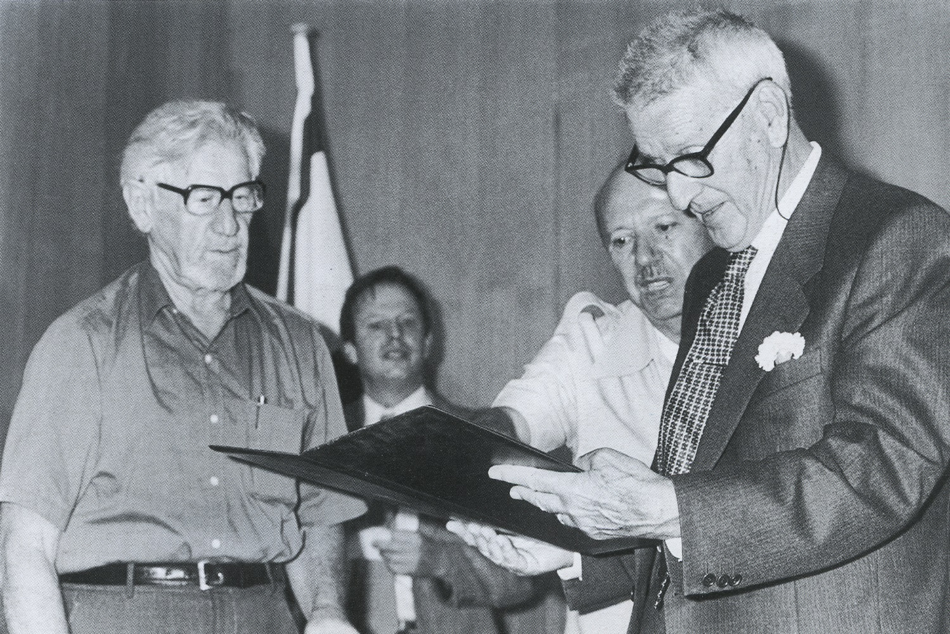
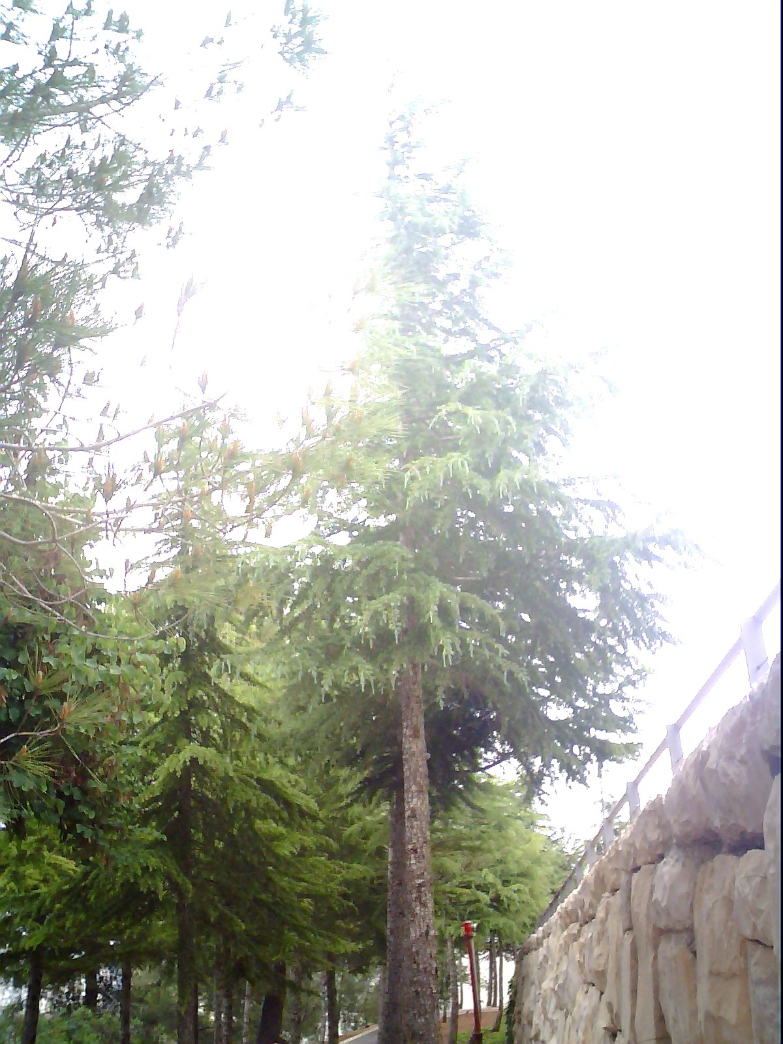
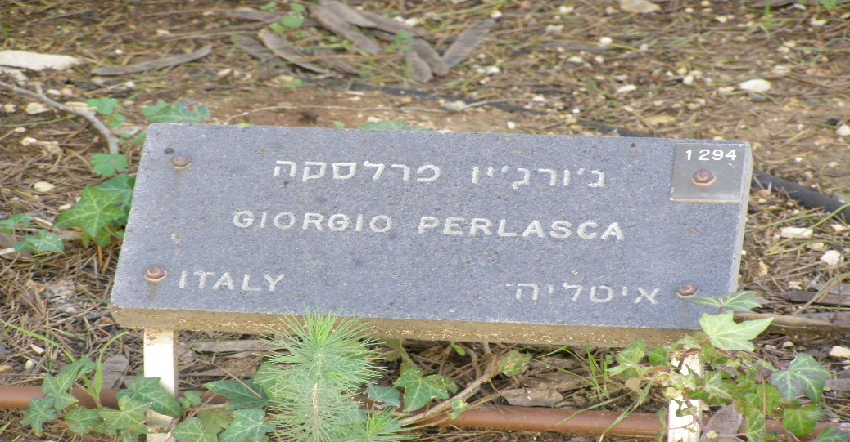

Slide 13
GINO BARTALI
We also have to mention two other important Italian heroes:
Gino Bartali, Cavaliere di Gran Croce OMRI (18 July 1914 – 5 May 2000), nicknamed Gino the Pious and (in Italy) Ginettaccio, was a champion road cyclist. He was the most renowned Italian cyclist before the Second World War, having won the Giro d'Italia twice (1936, 1937) and the Tour de France in 1938. After the war he added one more victory in each event: the Giro d'Italia in 1946 and the Tour de France in 1948. His second and last Tour de France victory in 1948 gave him the largest gap between victories in the race.
In September 2013, 13 years after his death, Bartali was recognised as a "Righteous Among the Nations" by Yad Vashem for his efforts to aid Jews during World War II.

Slide 14
THE WAR
Bartali carried fake documents inside his bicycle to help the Jews get a new identity. This activity was born from the collaboration of the rabbi of Florence Nathan Cassuto and the archbishop of the city Elia Angelo Dalla Costa.
Forced to work as a bicycle wheel repairer, between September 1943 and June 1944, wearing the uniform of the GNR, Bartali worked in favor of Jewish refugees as a member of the underground organization DELASEM making numerous trips on his bike from Terontola-Cortona station to Assisi, transporting documents and photo cards hidden in the tubes of the bicycle frame so that a secret print shop could falsify the documents necessary for the escape of refugee Jews, so that, in 2006, the President of the Republic Carlo Azeglio Ciampi awarded him the gold medal for civil merit for saving «around 800 Jewish citizens» during the Second World War. Wanted by the police, he evacuated to Città di Castello, where he remained five months, hidden by relatives and friends.
HIS ACTIVITY IN FAVOR OF THE JEWS
In May 2005 the President of the Republic, Carlo Azeglio Ciampi, handed to Bartali's wife, Adriana, the gold medal for civil valor posthumously. Moreover, on 2 October 2011, Bartali was included among the Righteous in the Garden of the Righteous Among the Nations, located on the Mount of Remembrance in Jerusalem, always for the help offered to the Jews during the Second World War.

Slide 15
RIGHTEOUS AMONG THE NATIONS
On 23 September 2013 he was declared Righteous among the nations by Yad Vashem, the official Israeli memorial to the victims of the Holocaust founded in 1953, recognition for the non-Jews who risked their lives to save that of even one Jew during the Nazi persecutions . In the Yad Vashem statement, we read that Bartali, "a devout Catholic, during the German occupation in Italy was part of a rescue network whose leaders were the rabbi of Florence Nathan Cassuto and the archbishop of the city cardinal Elia Angelo From the Coast. "
This extraordinary activity in favor of the persecuted has been described in the book "Gino Bartali, mio ​​papà" by Andrea Bartali. The son of the champion has done a long work of research of testimonies and, together with his daughter Gioia, has continued to keep alive the image of Gino.
On May 16, 2017, on the eve of the start of the 11th stage of the Giro d'Italia (from Ponte a Ema to Bagno di Romagna), the Cycling Team Israel founded by Ron Baron organized a race starting from the same Bridge to Ema up to Assisi, on the same route that 'Ginettaccio' travelled many times to help the persecuted Jews
On April 22, 2018, Yad Vashem's spokesperson, Simmy Allen, confirms the news, anticipated by the site "Hebrew Pages", according to which Gino Bartali received the posthumous appointment to honorary citizen of Israel, during a ceremony held on 2 May of the same year, two days before the departure of the Giro d'Italia from Jerusalem.

Slide 16
ERNESTO TEODORO MONeTA
And……..…
Ernesto Teodoro Moneta (September 20, 1833 in Milan, Lombardy – February 10, 1918) was an Italian journalist, nationalist, revolutionary soldier and later a pacifist and Nobel Peace Prize Laureate. He adopted the motto In varietate unitas! which later inspired the Motto of the European Union.
At age of 15, Moneta participated in the "Five Days of Milan" (1848 uprising against Austrian rule). He later attended the military academy in Ivrea. In 1859 he joined Garibaldi's Expedition of the Thousand, and also fought in the ranks of the Italian army against the Austrians in 1866.
Subsequently, he became an international peace activist, despite his strong Italian nationalism. Between 1867 and 1896 he was editor of the Milan democratic paper Il Secolo, published by Edoardo Sonzogno.
In 1887 he founded the Lombard Association for Peace and Arbitration (Unione Lombarda per la Pace e l'Arbitrato), which called for disarmament and envisaged the creation of a League of Nations and Permanent Court of Arbitration. He won the Nobel Peace Prize in 1907.
In the last years of his life, however, Moneta's Italian nationalism reasserted itself and got the better of his pacifism. He expressed public support for both the Italian Conquest of Libya in 1912 and Italy's entry into the First World War in 1915.

Slide 17
Activities in the peace movement
During the last years of the 19th century Moneta devoted himself to collecting material for his work The Wars, Insurrections and Peace in the 19th century, which he published in four volumes in 1903, 1904, 1906, and 1910. The first volume contains a timely description of the development of the international peace movement during the course of the century.
Almanac for Peace
In 1890 he began to publish an annual almanac called The Friend of Peace. In 1896 he abandoned the position of director of Il Secolo, although he continued to contribute to his columns from time to time and to republish many of his articles in manifestos and periodicals.
In 1898 he founded the magazine La Vita Internazionale, which was quite successful, so much so that it was published on a regular basis for many years.
The Society for International Peace and Justice
In 1887 he founded the Lombard Union for Peace and the Society for International Peace and Justice. In 1890 with La Vita Internazionale his investigation and his commitment took on a cosmopolitan breath that projected him decisively into the European scenario, creating the premises for the awarding of the Nobel Peace Prize.
In 1895 Moneta became the Italian representative in the Commission of the International Peace Bureau.
President of the Congress for Peace
In 1906 he planned and built a pavilion for peace at the international exhibition in Milan, during which he led the 15th International Congress on Peace as President.

Slide 18
Nobel Peace Prize
In 1907 Ernesto Teodoro Moneta received the Nobel Peace Prize together with the French jurist Louis Renault. The original diploma is now preserved by descendants of the first-born branch of the family. In 1909 his speech on the need to combine pacifism and patriotism was published in Oslo, at the Nobel Peace Institute and it had widespread circulation.
He expressed his favor for the Italian intervention in Libya in 1912 and for the entry into the war of Italy in 1915 in the First World War.
Some European pacifists even asked for the Nobel Prize to be withdrawn.
Death and burial
Tomb of Moneta in Missaglia (LC)
From 1900 until his death Moneta suffered from glaucoma, and underwent numerous eye surgeries that barely prevented total blindness. moneta died of pneumonia in 1918, at the age of 84.

