Slide 1
Together we can Cyprus 14 – 17 may 2019

Slide 2
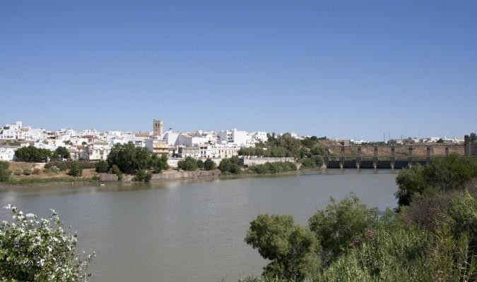
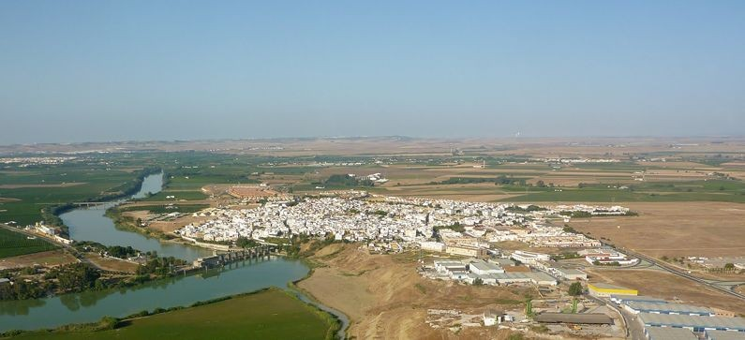
Where do we come from?
Our high school is a public school located in Alcalá del Río, 13 Kms from Sevilla.
It is the only secondary education school in this town.
We have around 800 pupils each year. 450 pupils study CSE level The area is considered economically and socially disadvantaged.

Slide 3
How are our students?
Regarding students’ traits, there are some general features to be highlighted:
Social, cultural and economic inequalities.
Extensive ethnic diversity: immigrants, Roma, Saharan students.
The rate of absenteeism and school drop-out is above the average of other high schools with a similar ISC.

Slide 4
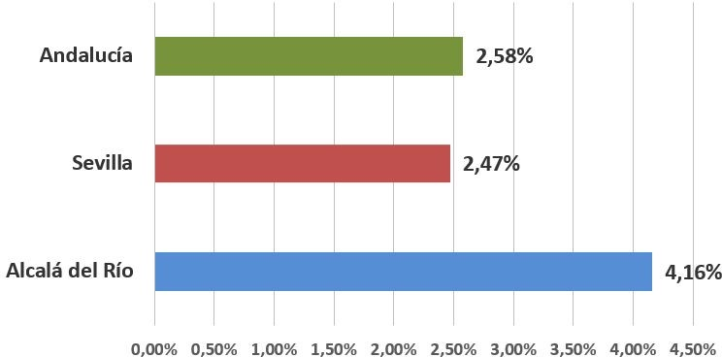
Social, cultural and economic inequalities.
The economic inequalities are reflected in a 24.29% of unemployment in our town, a high index of illiteracy and a
Comparative ratio of illiteracy
moderate rate of school drop-out
-Around 40% of the families have an average socio-educational level and do not present visible problems
- Almost 60% of the families have unemployment problems, scarce economic resources, little interest in education, or are broken families.

Slide 5
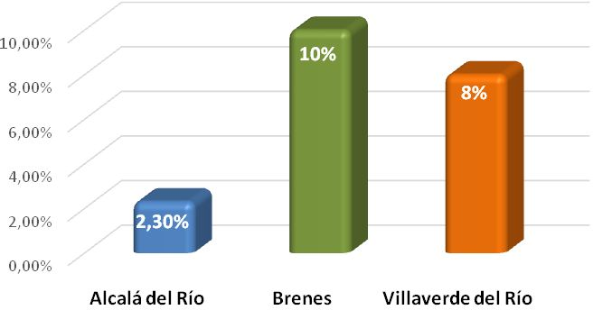
Extensive ethnic diversity: immigrants, Roma, Saharan students.
The number of foreigners in Alcalá is not high: 271 people out of a total of 11,825, a
2'3%.
In our school, it fluctuates between 15 and 20 students from different nationalities
More than a half come from Romania and it is an integrated population, without presenting problems of coexistence
The rest are from Latin America, Sahara or China
The Roma students usually attend 1st and 2nd year of ESO, without reaching the CSE degree
Foreing population. Alcalá del Rio.

Slide 6
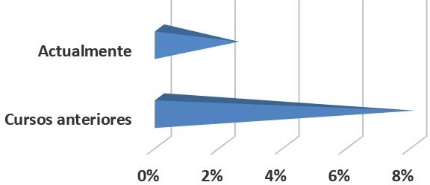
Absenteeism rates and school drop-out
Absenteeism rate 2013 vs 2019
-The degree of absenteeism in children under 16 years was 8%. Currently it has been reduced by the actions taken, standing at around 2 - 3%.
-School drop-out is above the average of other high schools with a similar ISC, around 2’8%

Slide 7
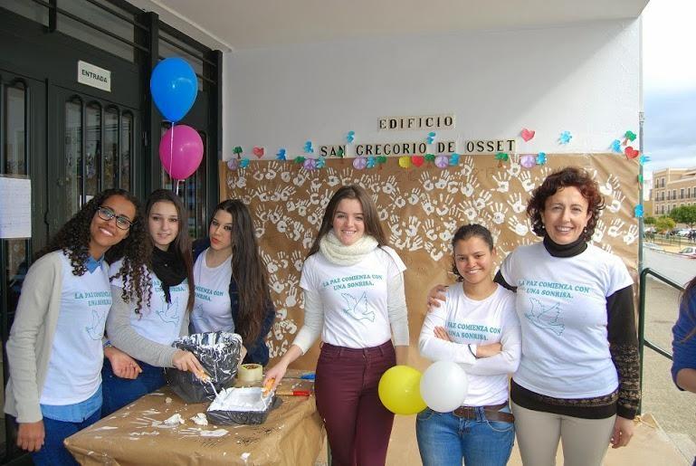
Which are the problems of our school?
Taking into account our needs, based on approved indicators, which are:
Improvement in Compulsory Secondary Education results
Absenteeism and school drop-out
Coexistence

Slide 8
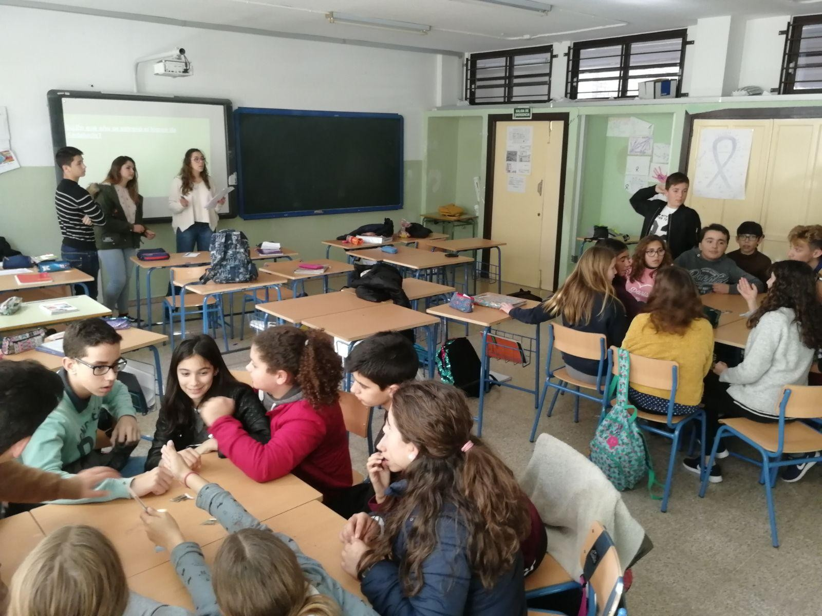
ACTIONS AGAINST DISCRIMINATION
What do we do in our school to help families at risk of socioeconomic discrimination ?:
WITH THE STUDENTS
-Involving activities of all students
-All groups include students of different characteristics, providing integration and equality
-Attention through the Guidance Department, the Tutors, and Mediation Room
-Attention in educational reinforcement programme during and after school hours
- Psychological help through the individualized attention programme

Slide 9
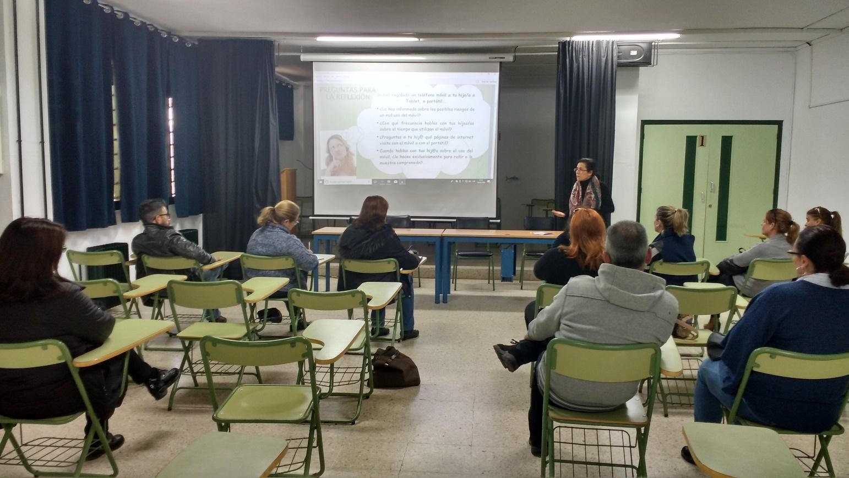
ACTIONS AGAINST DISCRIMINATION
What do we do in our school to help families at risk of socioeconomic discrimination?
WITH FAMILIES
Workshops for parents: prevention of additions, study assistance, use of internet, guide to treat adolescents at home ...
-Financial help to buy school materials or to afford school trips
Individualized attention in the Department of Orientation
Exhaustive monitoring of students´absenteeism

Slide 10
SOCIAL POLICIES
ANDALUSIAN GOVERNMENT, EDUCATION OFFICE
-Guarantee of school place in public institutions for every student, regardless of race, origin, social or economic level or religion.
-Free education from 3 to 16, or until the student finishes CSE.
-Free textbooks in the previously mentioned stages.
-Inclusion of students with special educational needs in ordinary schools and classrooms.
-Free school transport for those students who live at least 2 kilometres far from the school.
-Transport, instructional material and compensation grants for post-compulsory education students.

Slide 11
SOCIAL POLICIES
LOCAL AUTHORITIES (TOWN COUNCIL)
-Local Social Affairs Office manages:
*Economic aid for families through serious difficulties
*Alimentary Security Plan for disadvantaged families
*Home care for those families who have problems to attend to their children
*Temporary contracts to carry out maintenance works in town spaces
-Contributing Organizations: Cáritas and Religious Brotherhoods
*Food and clothes collection campaigns
*Management of supportive housing and retirement homes

Slide 12
And now…. some pictures of our school

Slide 13
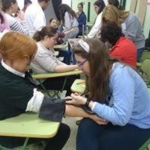
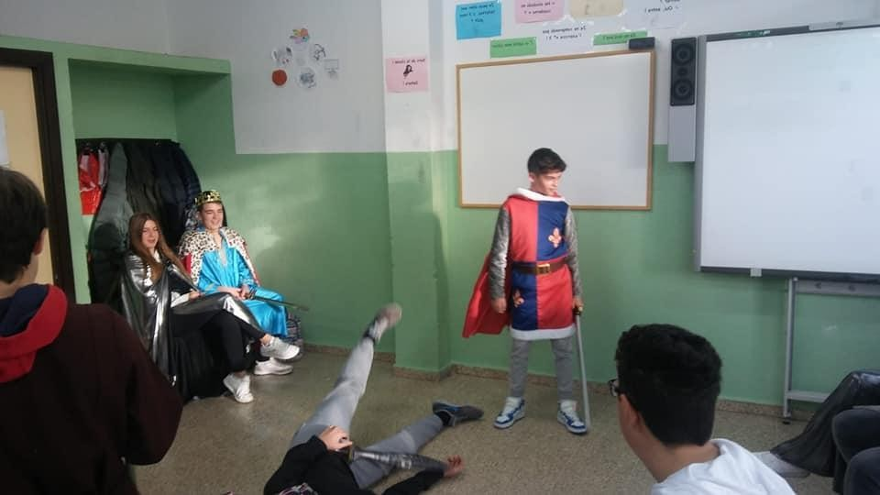
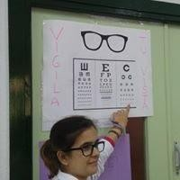
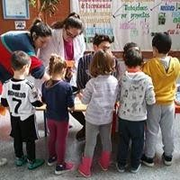
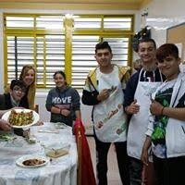
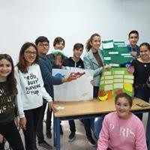
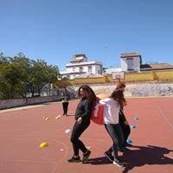
INTEGRATION AND MOTIVATION ACTIVITIES

Slide 14
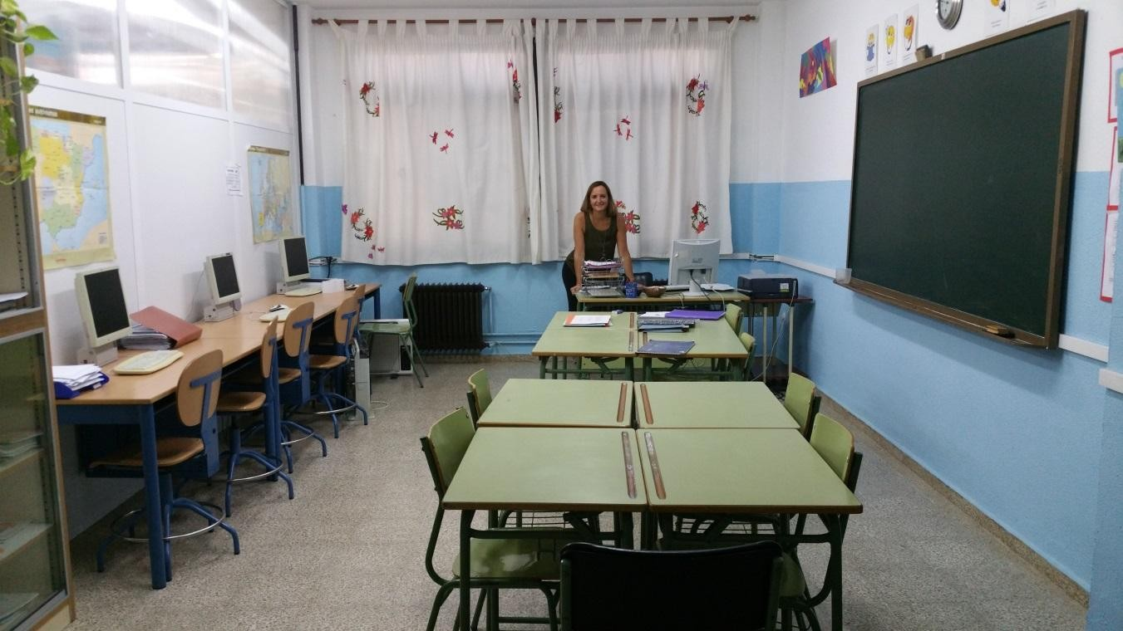
INTEGRATION SUPPORT CLASSROOM

Slide 15
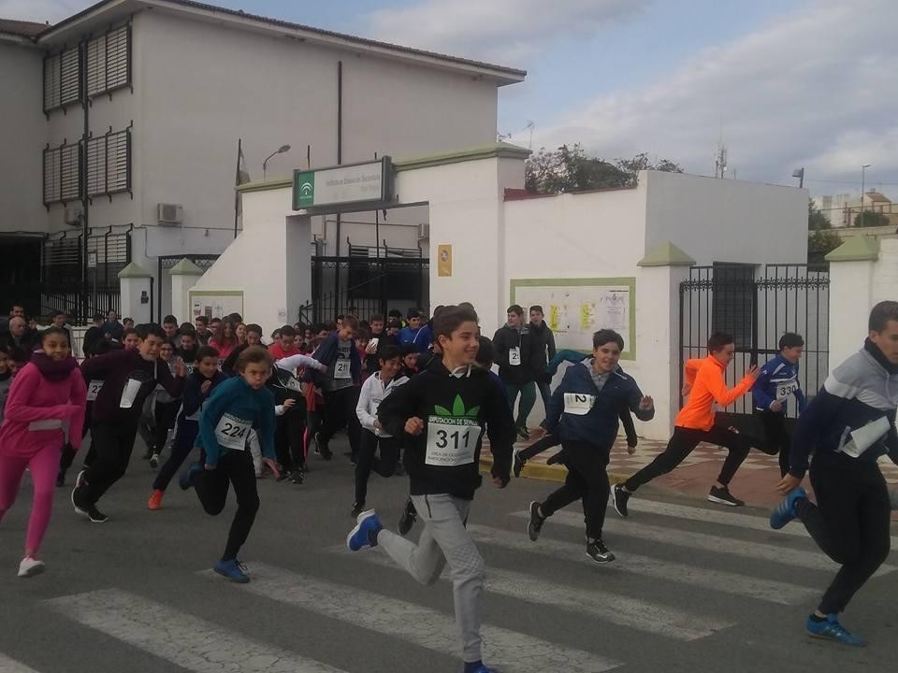
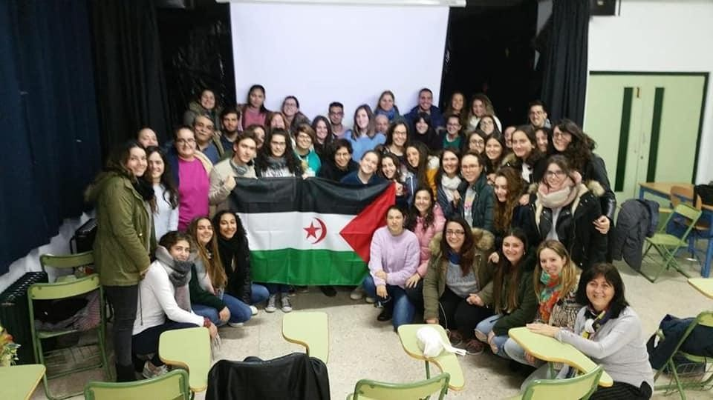
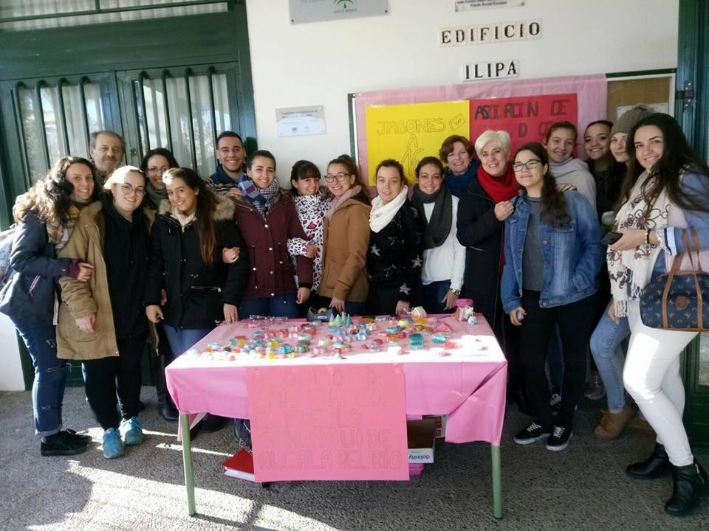
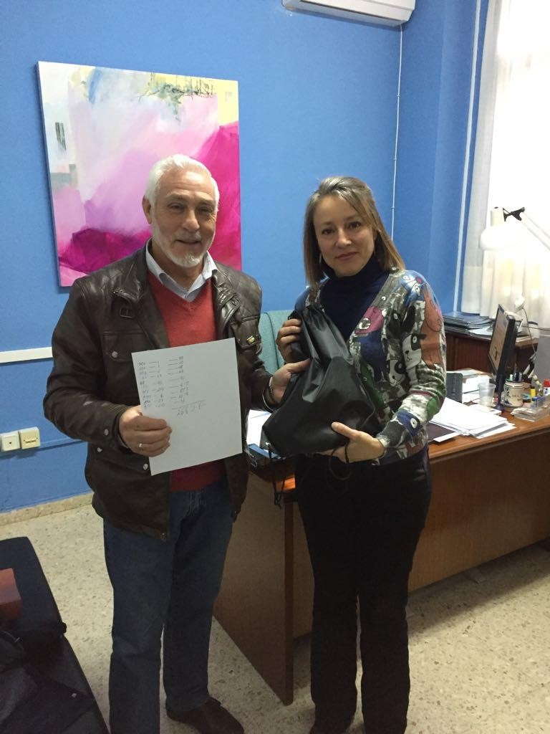
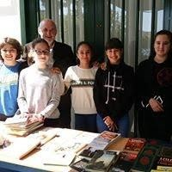
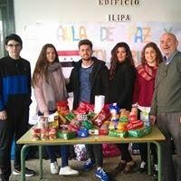
SOLIDARITY ACTIONS

Slide 16
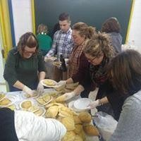
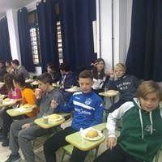
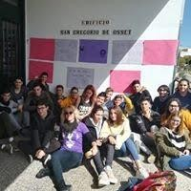
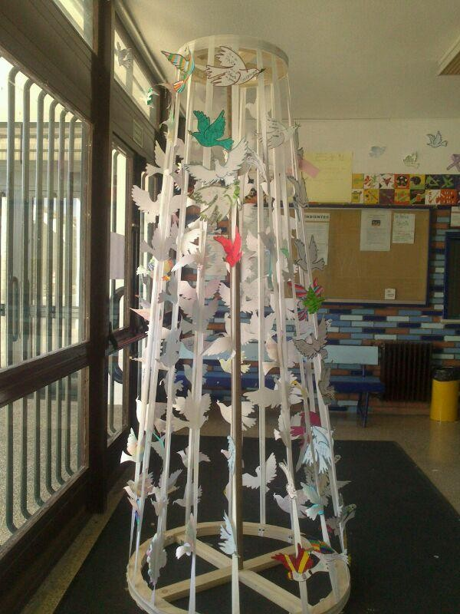
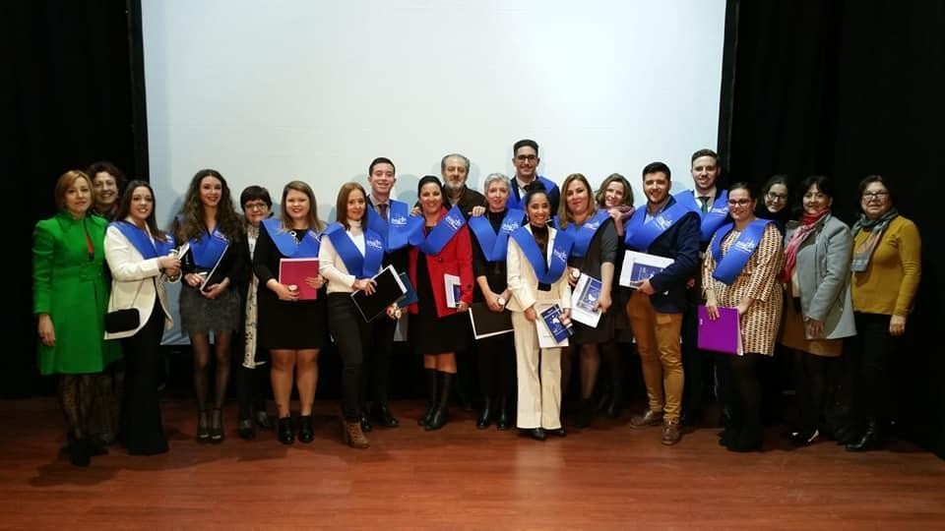
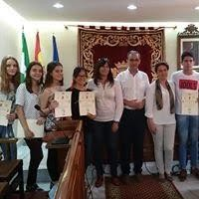
CULTURAL EVENTS AND SIGNIFICANT DATES

Slide 17
Thanks for your attemption!! We hope you liked it

