Slide 1
VIRTUAL MEETING – ITALY 3rd day
Dimotiko Scholeio Daliou 3
Erasmus+ KA2
Together We Can

Slide 3
1. Are there cultural minorities?
ANTREA
Yes, there are a lot of cultural minorities in my country. We have minorities from different countries, languages and religions. [Syria, India, Pakistan, Romania, Poland]
VASILIS
Yes, there are cultural minorities, because when groups of people move to a foreign country they usually keep their culture.

Slide 4
2. Is their culture respected?
ELENI
I believe that in Cyprus we largely respect the culture of migrants. The main reason is that Cypriots know what it means to be a migrant and how difficult it is to lose your home, to leave your homeland but to maintain your identity, your customs.
DEMETRIS
Minorities in Cyprus are not respected by everybody. I think some people should try to respect the culture of minorities more.

Slide 5
3. Do they participate freely and publicly in their culture or are they expected to do so only privately or not at all?
MICHAELA
Yes, they participate freely. This freedom is protected by Cyprus constitution. Cypriot and Cypriot culture are tolerant and acceptive to different culture expressions.
ALESSANDRO
In general, in my community I think that minority cultures are expected to keep to themselves and very rarely the locals participate in cultural events of minorities

Slide 6
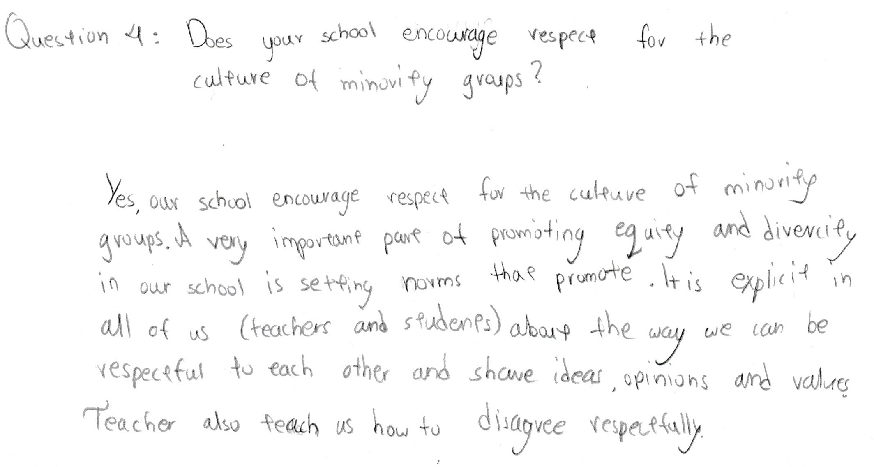
4. Does your school encourage respect for the culture of minority groups?
MARIA

Slide 7
4. Does your school encourage respect for the culture of minority groups?
ALTHEA

Slide 8
4. Does your school encourage respect for the culture of minority groups?
ORESTIS
In our school, we have students from different countries, such as Syria, Romania, Poland, Bulgaria, and others. All students are treated equally and their language religion and customs are respected by everyone in our school.

Slide 9
5. Why is the right to cultural identity so important?
VASILIS
The right to cultural identity is very important because if you try to change someone’s customs you’re taking their identity away from them.​
Also, when people leave their homeland, they take with them all the habits their family taught them. These habits make them happy. When they practice these habits in the new country they feel secure.​
It’s also important to show respect to their religion, language, food, costumes, behavior etc.

Slide 10
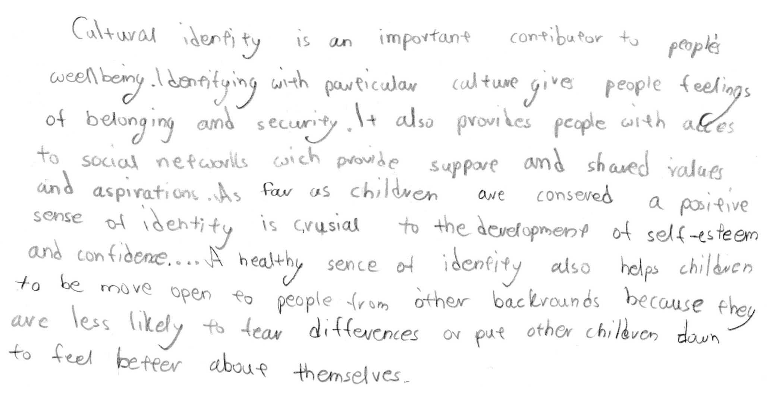
5. Why is the right to cultural identity so important?
MARIA

Slide 11
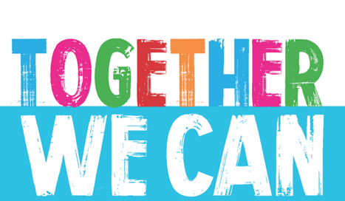
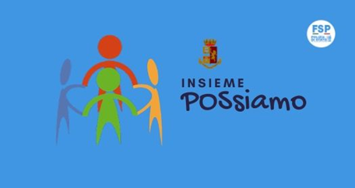
5. Why is the right to cultural identity so important?
ANTREA
The right to cultural identity is really important because it adds to people’s wellbeing. It gives people the feeling of belonging to the society and provides security. It also provides access to social network.

Slide 12
6. Why is it important to preserve, develop and appreciate different cultures?
ELENI
It is important to preserve, develop and appreciate different cultures because being different is the charming of life especially when it is respected from all people. We might have different color, religion, culture, language but we are all equal. We have to remember that as we assume migrants are different from us, at the same time they believe the same for us. But at the end we all have the same rights and we need to be respected.

Slide 13
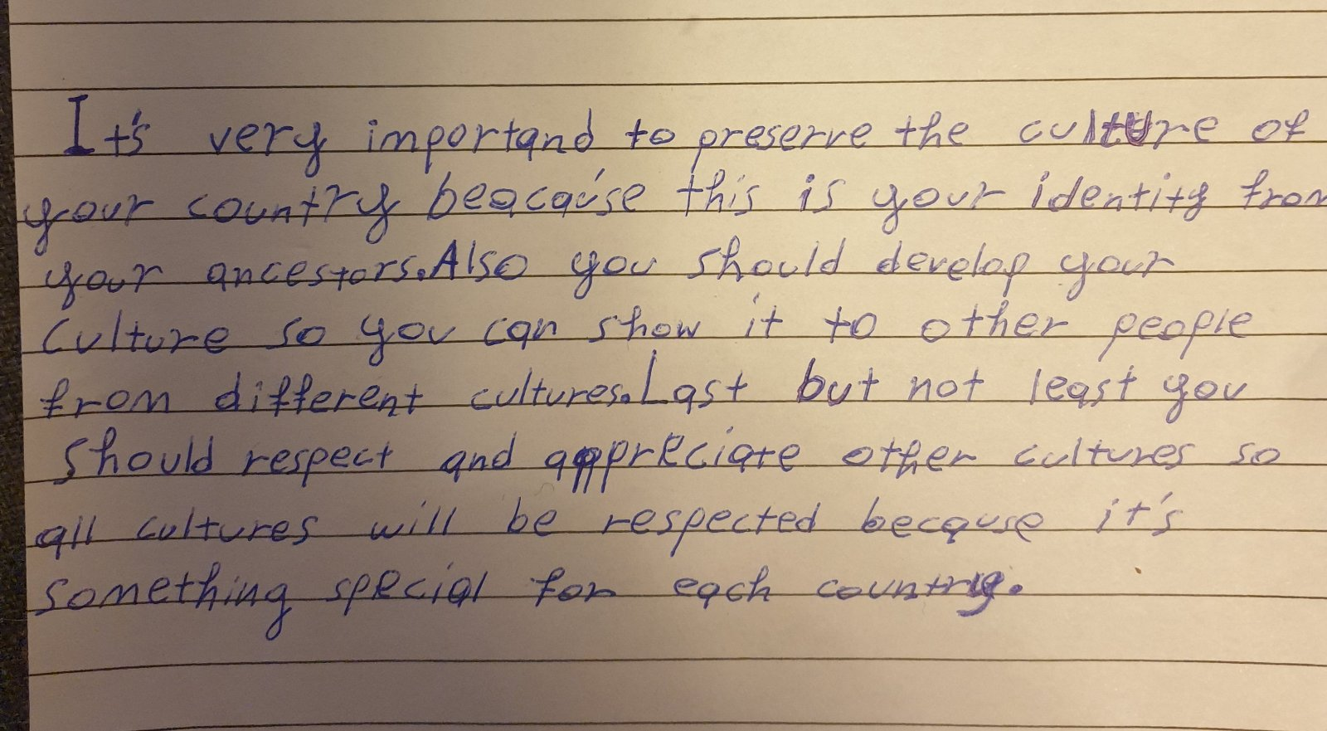
6. Why is it important to preserve, develop and appreciate different cultures?
DEMETRIS

Slide 14
6. Why is it important to preserve, develop and appreciate different cultures?
ALTHEA

Slide 15
7.Why do dominant groups often seek to impose their culture on minority groups?
ORESTIS
Many times, the local communities impose their culture on minorities out of fear or insecurity. This is not something positive, because it happens without respecting the minorities culture. The local communities must show solidarity and cooperation spirit with the minorities, and respect to their habits.

Slide 16
7.Why do dominant groups often seek to impose their culture on minority groups?
MICHAELA
Sometimes majorities are afraid that incorporating minorities , will eventually bring changes to their culture. This kind of behaviour up to a point is understood but when leads to extreme situations is not accepted. In general majorities tend to be negative in any type of change.

Slide 17
7.Why do dominant groups often seek to impose their culture on minority groups?
ALESSANDRO
In my opinion, dominant groups often seek to impose their culture on minority groups because of the fear that their own culture will be “lost” or become less significant if minority cultures are celebrated or given importance.
People tend to reject and be hostile to those that are different from them either in religion, color, language, etc. They are afraid that the different beliefs and morals of migrant minority cultures will have a negative effect on the local culture and even corrupt it. So, instead of celebrating what is different, in the end they reject it.

