Slide 1
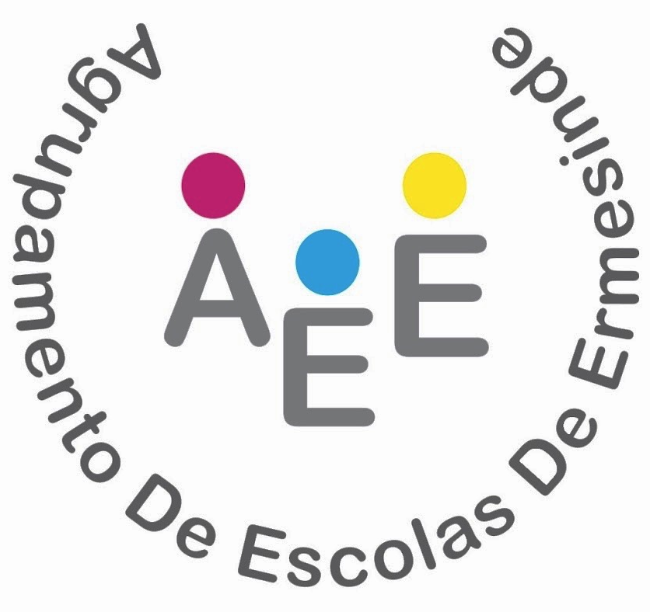
3rd Mobility - Cyprus

Slide 2
POLICY ABOUT ECONOMIC AND SOCIAL DISCRIMINATION PREVENTION

Slide 3
1 - SOCIAL AND ECONOMICAL PROFILE OF OUR STUDENTS
Most of our students come from economically and socially disadvantaged backgrounds. In our schools, the State finances food, books and school material, according to the levels of family income. Students with grade A are entitled to free lunch, books and school supplies, and students with grade B pay half the value of lunch, and are entitled to books and half the value of school supplies.

Slide 4
NUMBER OF STUDENTS
WHO BENEFIT FROM STATE SUPPORT
IN OUR SCHOOLS
NUMBER OF STUDENTS WITH GRADE “A” AND “B”
Grade A | Grade B | TOTAL
530 | 387 | 917
23% | 27% | 40%

Slide 5
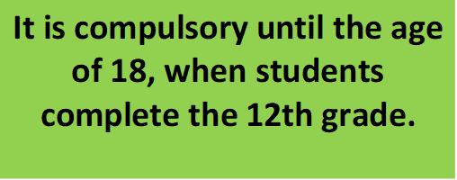
2.POLICY ABOUT ECONOMIC AND SOCIAL DISCRIMINATION PREVENTION WITHIN OUR SCHOOLS
EDUCATION:
It is free – not paid!

Slide 6
A democratic school is more than access to free education. It is the school that guarantees that everyone learns. According to our Constitution, it is the responsibility of the State to ensure that students of all colors, of all socioeconomic backgrounds, of different ethnic groups, migrants and refugees have the same opportunities to learn.

Slide 7
NEW EDUCATIONAL POLICIES IN PORTUGAL:
This idea of an inclusive school implies looking at the specificities of each one and find strategies to bring students to school, to motivate, engage, interact with the community, build relationships with families that have no ties to the school, explore different ways of learning.
When we talk about curriculum flexibility today, we are talking about an instrument that offers schools the freedom to test and implement the best strategies to include.
In Portugal, (as in other countries) school failure is strongly associated with the families' socioeconomic context. Some groups are particularly affected by failure and school dropout and therefore require positive discrimination, special attention and dedicated work, enabling them to grow with others.

Slide 8
3 - ACTIVITIES IN OUR GROUP OF SCHOOLS TO PREVENT SOCIAL AND ECONOMIC DISCRIMINATION
“THE HUMAN LIBRARY”
Aim:
To facilitate a constructive and informal dialogue between young students and real people who are often subject of prejudice.
These people who come to school, act as Human Books, and the students listen to their life stories.
Ethnicity, religion, immigration, sexual orientation, disability, and mental illness were some of the stereotypes worked on.

Slide 9
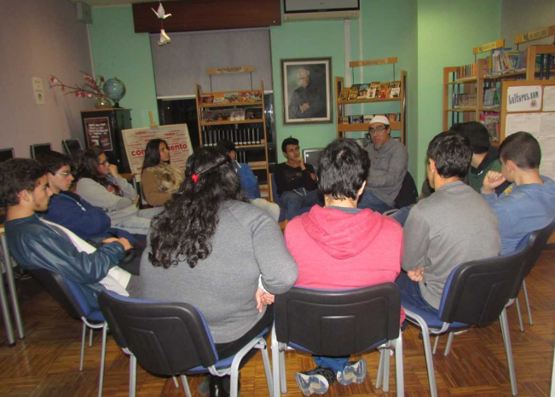

Slide 10
PORTUGUESE LANGUAGE FOR FOREIGN STUDENTS
Not speaking the Portuguese language is the first obstacle to social inclusion and many foreigners, even after a few years of presence in Portugal, do not have the proper knowledge of the language.
So, in our schools we offer Portuguese Language classes for foreign students, to promote the integration process.

Slide 11
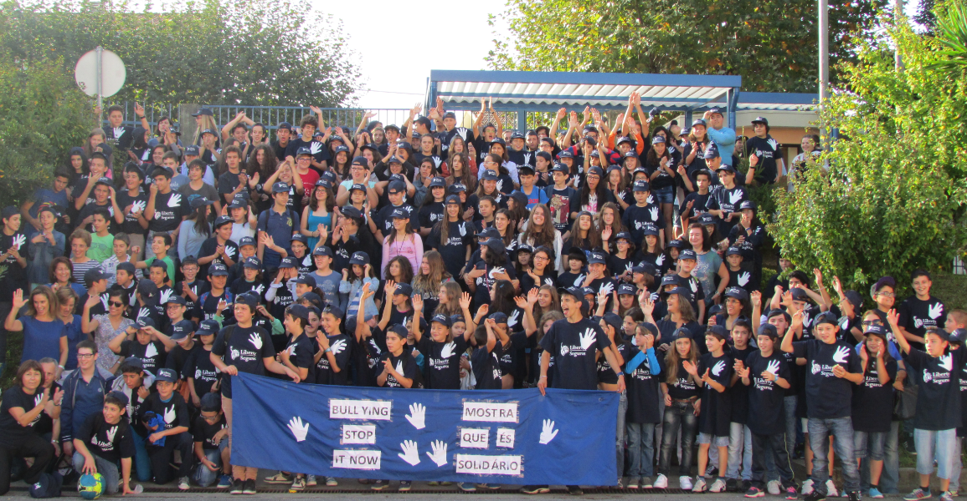
ACTIONS AGAINST SCHOOL DROPOUT AND VIOLENCE.
“BULLING PREVENTION”

Slide 12
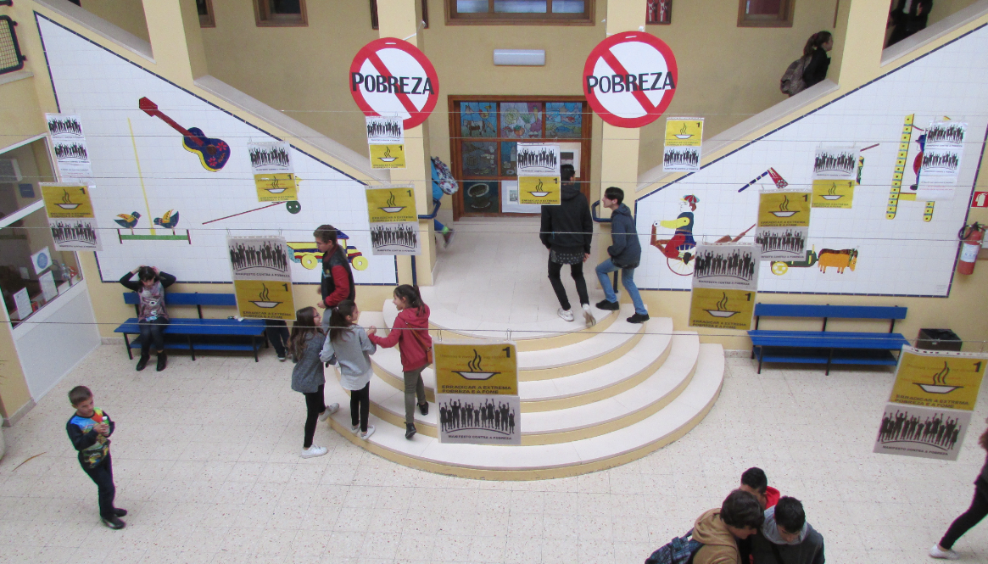
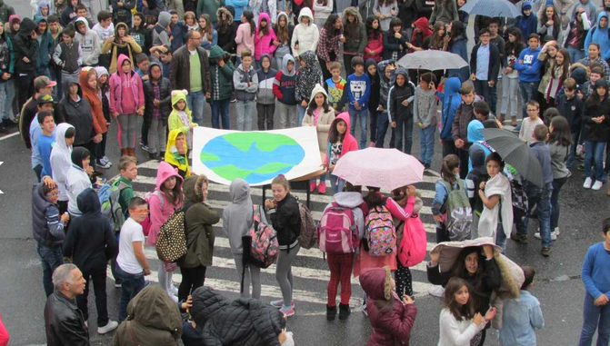
ACTIONS AGAINST ERADICATION OF POVERTY

Slide 13
THE G.U.N.A.S
The G.U.N.A.S. (United Group for Solidarity Help) are a group of students who run different activities to gather funds in order to buy food products, that then are delivered to the families of needy students. They also support other solidarity causes in our schools.

Slide 14
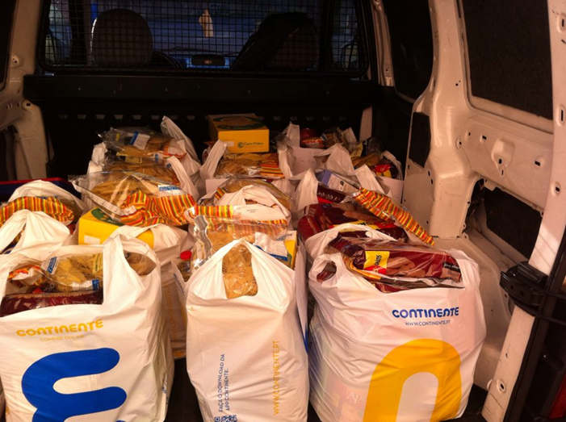
FOOD SUPPLIES DELIVERED BY THE G.U.N.A.S.

Slide 15
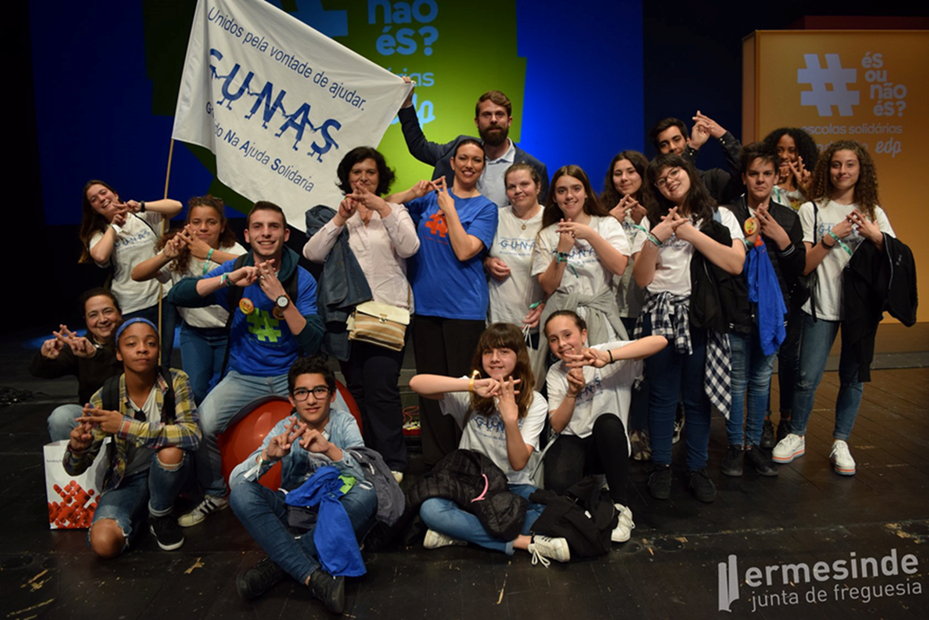
The G.U.N.A.S. have won several national prizes for their work on solidary help and they have also won for our Group of Schools the title of SUPER SOLIDARY SCHOOL.

Slide 16
4.POLICY ABOUT ECONOMIC AND SOCIAL DISCRIMINATION PREVENTION IN OUR COUNTRY
The Constitution of the Portuguese Republic stipulates that "the State promotes the democratization of education and other conditions so that education, carried out through the school and other educational means, contributes to equal opportunities, overcoming economic, social and cultural inequalities , the development of personality and the spirit of tolerance, mutual understanding, solidarity and responsibility, for social progress and for democratic participation in collective life. "

Slide 17
Our Basic Education Law (LBSE) reinforces this design.
These principles have been achieved through various measures of educational policy and the development of projects and actions in the field of intercultural education, inclusive education and school autonomy. several initiatives are currently underway to precisely expand the capacity of schools to develop this work. At the international level, it will be worth remembering our commitment to the Universal Declaration of Human Rights.

Slide 18
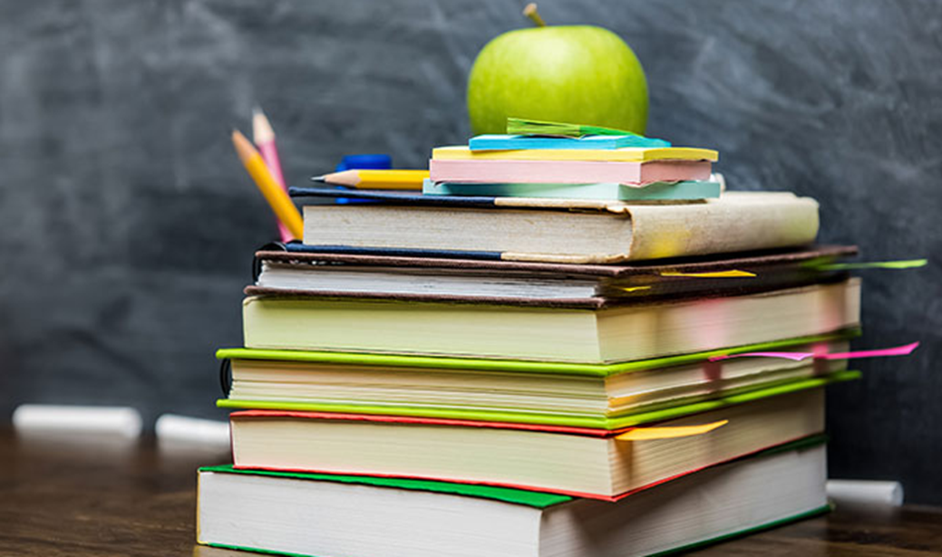
TEXTBOOKS POLICY
This programme began two years ago and in the present school year, the free textbook and reuse program will extend to the 3rd cycle of basic education (7th, 8th and 9th grades) and to secondary education (10th, 11th and 12th grades), covering all compulsory schooling.
This way, in the next school year, free textbooks will be distributed to students from the 1st to the 12th year.
Students who benefit from economic support must deliver their books in good conditions at the end of the school year so that other students can reuse them.

Slide 19
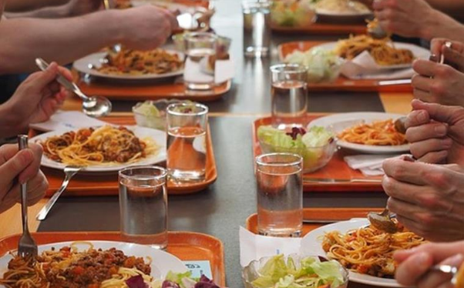
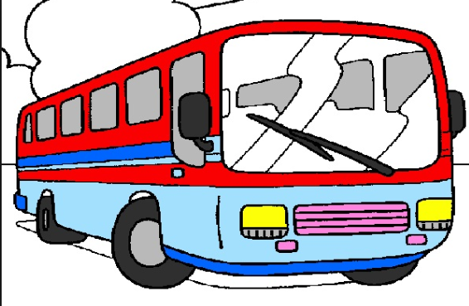
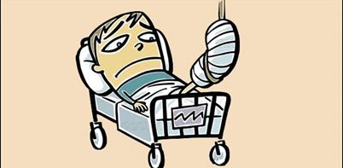
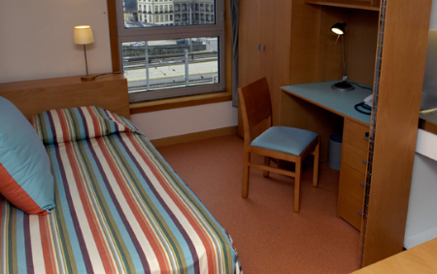
The School Social Policy is translated into a set of measures aimed at guaranteeing socio-educational support for students whose economic situation determines the need for financial contributions.
This financial contributions cover:
Feeding
School insurance
Accommodation
Economic aid
Transports

Slide 20
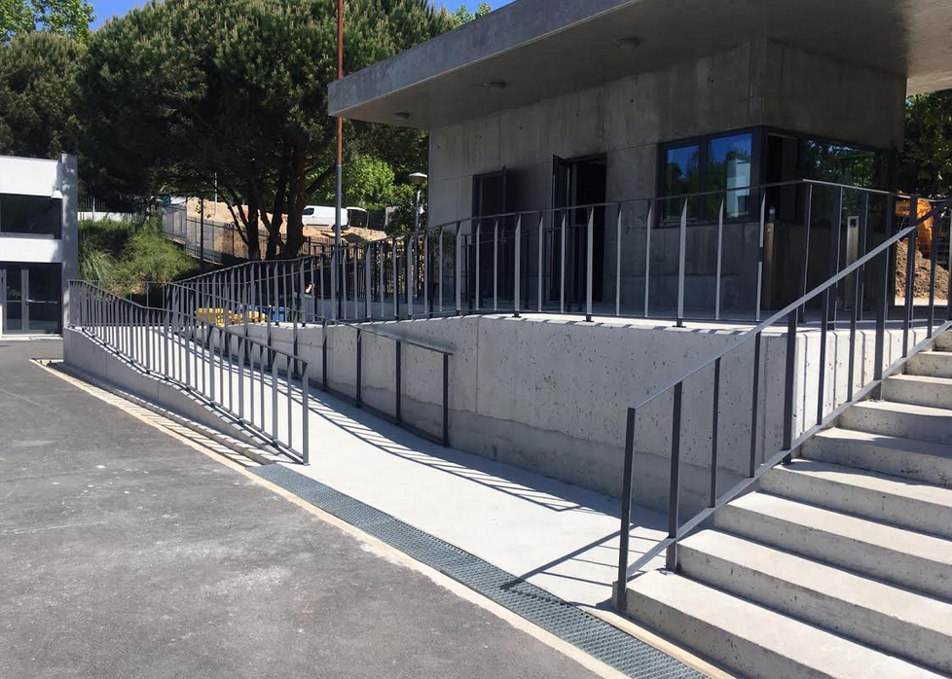
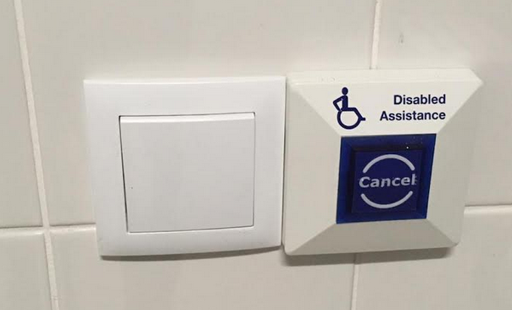
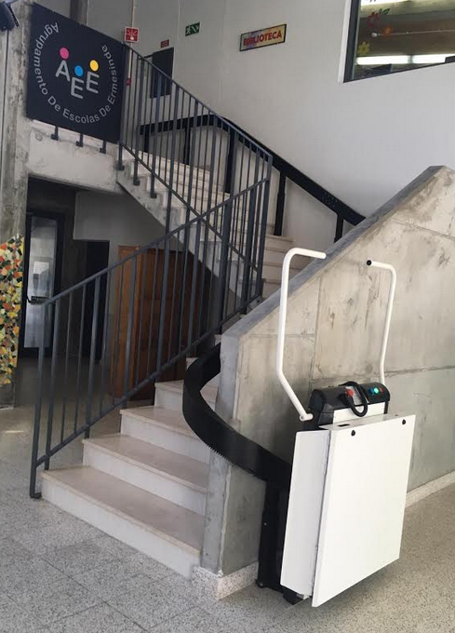
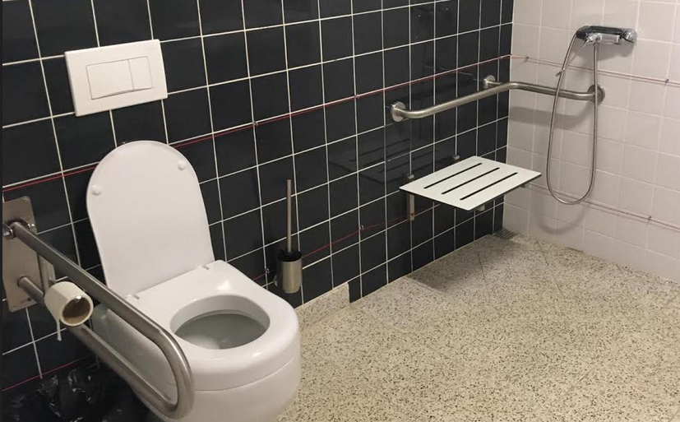
ABOLITION OF PHYSICAL BARRIERS FOR THE DISABLE : A SCHOOL PRIORITY

Slide 21
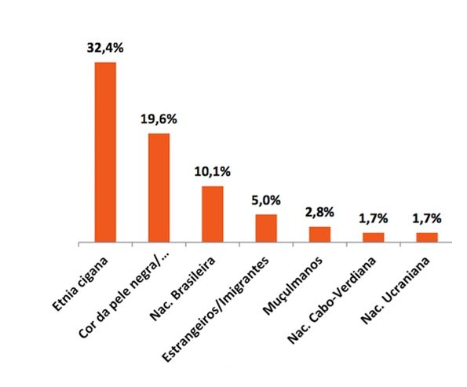
DISCRIMINATION FACTORS IN PORTUGAL – ACCORDING TO THE HIGH COMMISSION FOR MIGRATION
(DATA FROM 2017 AND 2018)
32,4% - Roma ethnicity
19,6% - The skin colour (black people)
10,1% - Brazilian nationality
5,0% - Foreigns and immigrants
2,8% - Muslins
1,7% - Green Cape nationality
1,7% - Ucranian nationality

Slide 22
THANK YOU
FOR YOUR
ATTENTION
3rd Mobility - Cyprus

