Slide 1

TOGETHER WE CAN

Slide 2

PORTUGUESE EDUCATIONAL SYSTEM

Slide 3

It is free – not paid!
It is compulsory until the age of 18, when students complete the 12th grade.
It is regulated by state through the Ministery of Education.
There is a system of public education and also many private schools at all levels of education.

Slide 4
EDUCATIONAL SYSTEM IN PORTUGAL
Pre-school | Starts when children are 3 years old till they go to Basic School (6 years old). Its attendence is not compulsory.
Basic School | 1.^{st} cycle | 1.^{st} grade 2.^{nd} grade 3.^{rd} grade 4.^{th} grade | Compulsory
 | 2.^{nd} cycle | 5.^{th} grade 6.^{th} grade
 | 3.^{rd} cycle | 7.^{th} grade 8.^{th} grade 9.^{th} grade
Secondary School | Secondary | 10.^{th} grade 11.^{th} grade 12.^{th} grade
Higher Education | Polytechnic | Bachelor+ Master
 | University | Bachelor+ Master PhD

Slide 5
THE STATE IS RESPONSIBLE FOR:
General education policies; Educational law; National Curriculum guidelines; Publication of educational materials; Nationally coordinated examinations; Assessment of schools; Teacher education and inservice training; School development-funding;

Slide 6

PRE-SCHOOL EDUCATION

Slide 7
PRE-SCHOOL EDUCATION
NURSERY Until children are three years old. The large majority of nurseries are private. Other nurseries are run by the Portuguese Social Security and are partly financed by state (parents pay according to their income). KINDERGARTEN For children between the age of 3 and the start of basic education (6 years old). Attendence is optional. 25 hours a week. The state doesn’t have the necessary number of kindergartens for all the children yet. It is provided in both state-run and private kindergartens. State-run kindergartens are free of charge.

Slide 8
AIMS OF PORTUGUESE EDUCATIONAL SYSTEM
To stimulate the children’s skills, and encourage their developement.
To promote integration of different social groups.
To develop communication skills.
To encourage hygienic and healthy habits.
To detect early signs of dysfunctions, special needs and talents.

Slide 9

Basic Education: First Cycle

Slide 10
BASIC EDUCATION: FIRST CYCLE
4 years: children aged from 6 to 9 years old. Basic skills in Portuguese, Maths, Social Studies, Arts and Crafts, Physical Education and Music are taught by a specific teacher (there is a curricular teacher per class). English (3.^{rd} grade and 4.^{th} grade) are taught by specialized teachers. 25 hours a week.

Slide 11

BASIC EDUCATION: SECOND AND THIRD CYCLE

Slide 12
BASIC EDUCATION: SECOND AND THIRD CYCLE
Students have several teachers, several subjects and multidisciplinar areas of study; Marks from 1 to 5. About 32 hours a week. Students should finish basic education at the age of 15; At the end of basic education (third cycle), students are obliged to do external assessement in Mathematics and Portuguese (national exams).

Slide 13
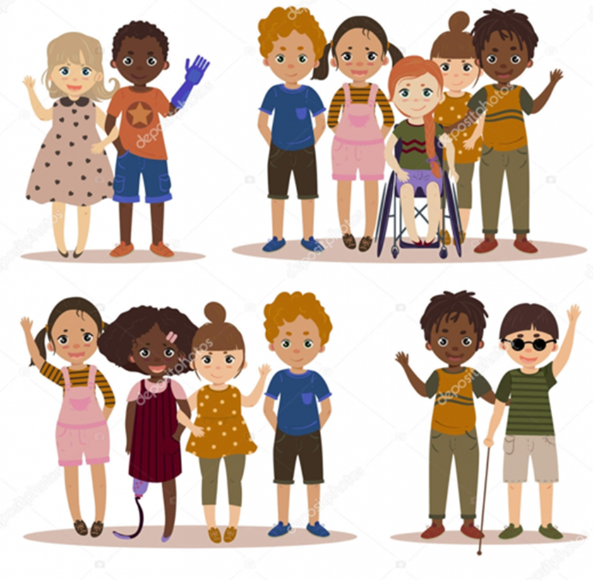
BASIC EDUCATION:AIMS
The aim is not only to convey knowledge, but also to promote personal development. Great emphasis on developing practical skills and attitudes, on creativity and critical evaluation. Promotes values like tolerance and freedom of thought, equal rights, responsibility and participation in decision-taking. Promotes cooperation but also independence and personal responsibility! A school for all-inclusive education: Special Educational Needs; Ethnical and Cultural minorities.

Slide 14

SECONDARY EDUCATION

Slide 15
SECONDARY EDUCATION: AIMS
To consolidate and enhance students’ personal autonomy; To consolidate, extend and master the knowledge, skills and working methods; To help students define their own interests and motivation as to educational and vocational options; To foster values and practical attitudes, which will prepare young people for consciously playing their role in society.

Slide 16
SECONDARY EDUCATION
3 years. Marks from 1 to 20. It is organized into: General courses, for students who want secondary level instruction, with a view to pursue higher education studies: scientific-humanistic courses; Professional courses – enhances the development of competences for the exercise of a profession, in articulation with the local business sector. Specialized artistic courses - provide training in the areas of visual arts, audiovisuals, dance and music. Technological courses - are professional qualifying courses.

Slide 17
Education and Training Courses
The Education and Training Courses (CEF) are an opportunity to complete compulsory schooling, through a flexible and adjusted course. It’s a project of a professional training that allows the entry into the active life, or the continuation of studies.
These courses are preferably aimed at young people aged 15 or over who are at risk of dropping out or who have dropped out before the end of their 12th grade.

Slide 18
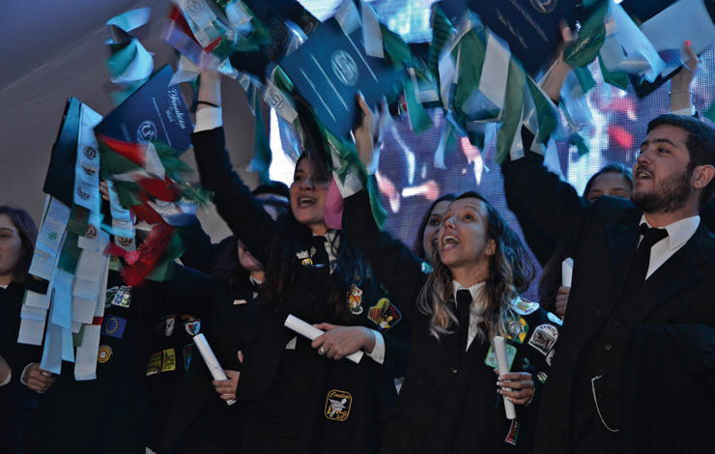
HIGHER EDUCATION

Slide 19
HIGHER EDUCATION
UNIVERSITY education and POLYTECHNIC education Stronger academic content Mostly professional programs Access is subject to number restictions (numerus clausus) and admission is done by competition. Students must have a diploma of secondary education and pass national exams in specific subjects to access higher education.

Slide 20
PORTUGUESE SCHOOL CALENDAR
The school year begins on September 1st ;
Classes start around September 15th ;
Activities take place between September and June;
Interruptions:
Christmas – 2 weeks;
Carnival – 3 days;
Easter – 2 weeks
Summer holidays – July and August.

Slide 21
Made by: Erasmus Club, Agrupamento de Escolas de Ermesinde, novembro de 2018

