Slide 1
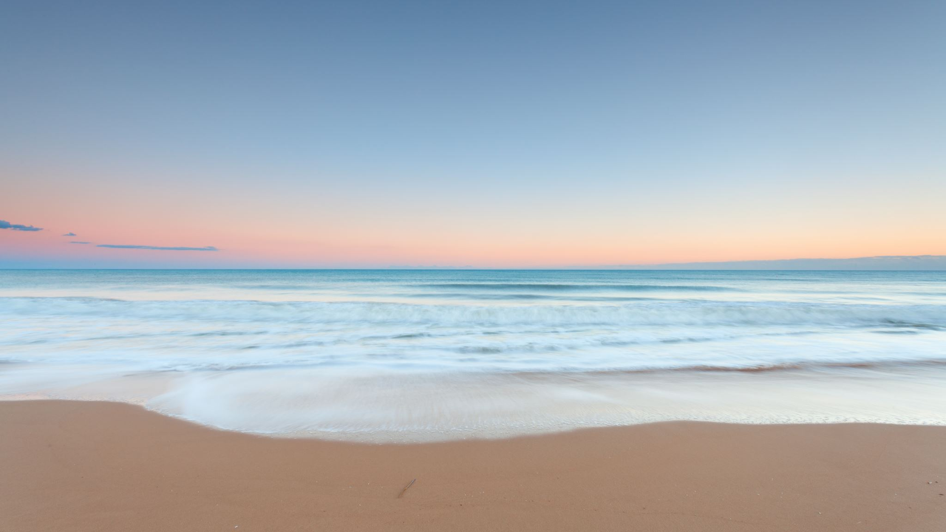
29th of January: 3rd day’s activity
drawing competition Theme: «migration»
Cyprus’ drawing presentation

Slide 2
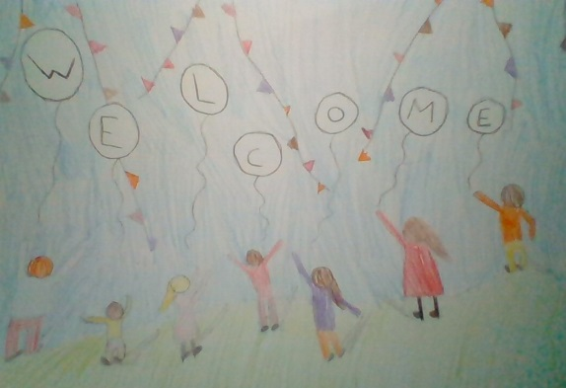
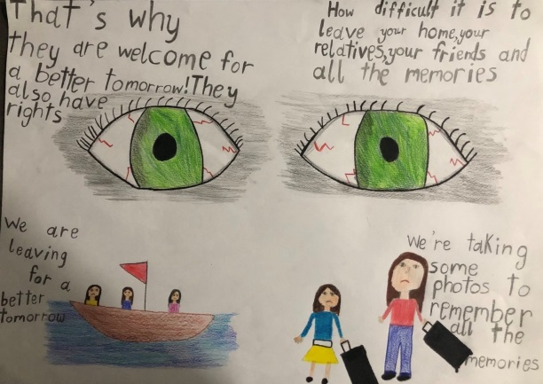
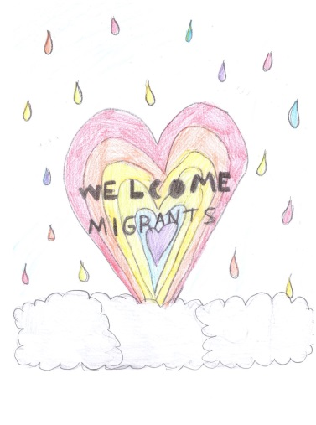
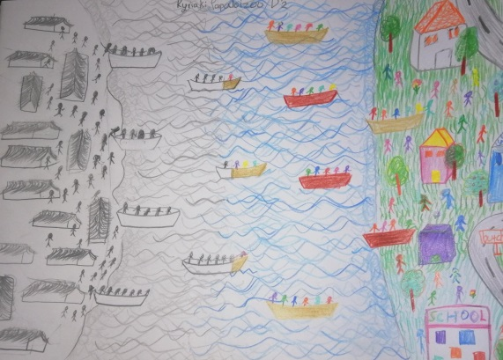
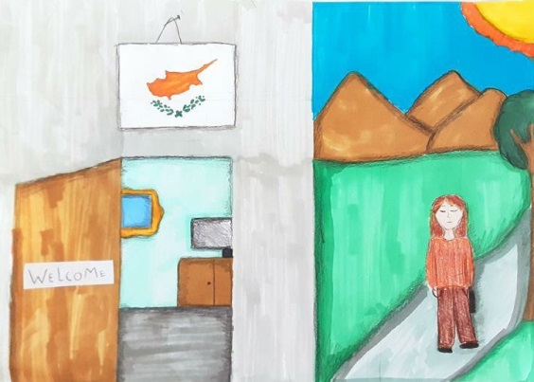
In this competition participated only the 4th, the 5th and the 6th grader students of our school. The competition’s terms were explained to the students on line during art class. After discussing the theme of the competition and explaining to the students, how important it is, to treat migrants with respect and acceptance, they were asked to create a drawing on the subject.
Many students sent their creations and got involved to this activity and as hard as it was, we think we managed to pick the top three.

Slide 3
Title: «reaching hands…»
The first drawing was made by our student Alexandros Panaou. Alexandros is 11 years old and he is a six grader to our school.
The artist used two types of techniques. To create the moon and the boat he used collage and the rest of the drawing was made by using crayons.
According to him, through his drawing he wants to give the message that we should all try our best to offer help to those in need, to those in pain, to those who need hope… Alexandros was very influenced by the spot we have shown you on Wednesday concerning 12 migrant childrens’ journey on a boat, trying to escape their country to find a new, better place to live.

Slide 4
Title: «off to a better life»
The second drawing was made by our student Emmelia Constantinou. Emmelia is also 11 years old and she is a student in six grade too.
The technique she uses is coloring by pencil and felt markers.
Emmelia separated her drawing in half, trying to show the difference between a migrant’s old life, full of suffering and poverty by using only black toned colors and a migrant’s new life, in a new country, where he is welcome and has a bright future. She tried to show his new promising future by using color pencils this time.

Slide 5
Title: «one big family»
Last but not least, the third drawing was made by our student Stavria Ioannou. Stavria is 10 years old and she is a fifth grader to our school.
The technique she uses is coloring by pencil.
She separated her drawing in four parts. The up left part of the picture is referring to migrants trying to leave their country where there is war and suffering and in the down left part Stavria tried to show migrants, finally reaching a safe land, after a long, suffering journey on a boat.
She also wrote in Italian, that if someone is a migrant or not, it doesn’t matter, because we are all humans after all. We should all consider all the suffer migrants have to go through and that we should all welcome them to our country and treat them like family.

Slide 6
Thank you for your attention!!!

