Slide 1
Together We Can
4th Mobility - Spain

Slide 3
History of the gender inequality

Slide 4
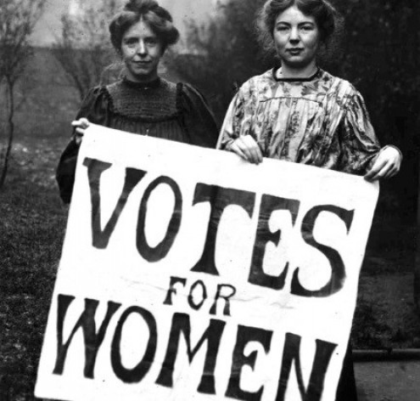

Slide 5
Education level

Slide 6
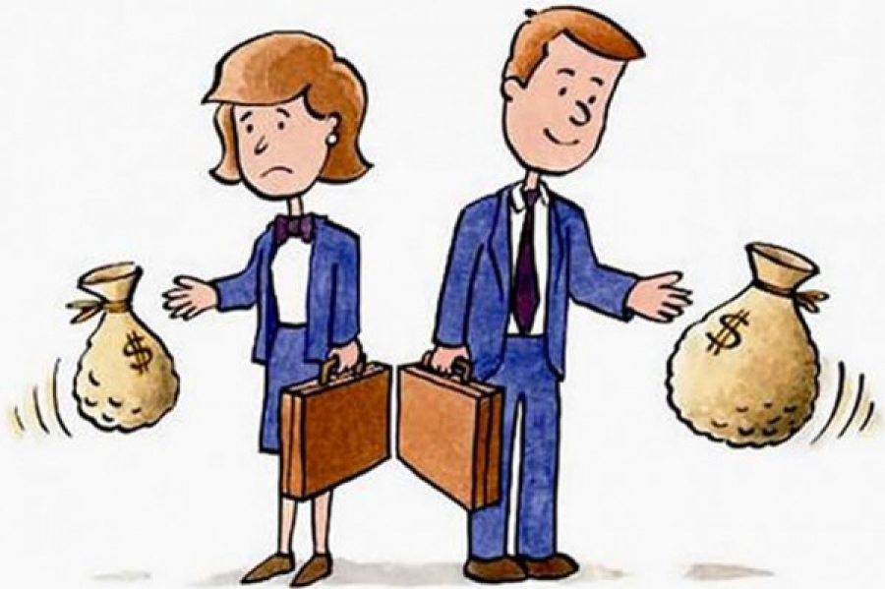

Slide 7
Basic monthly remuneration and gain

Slide 8
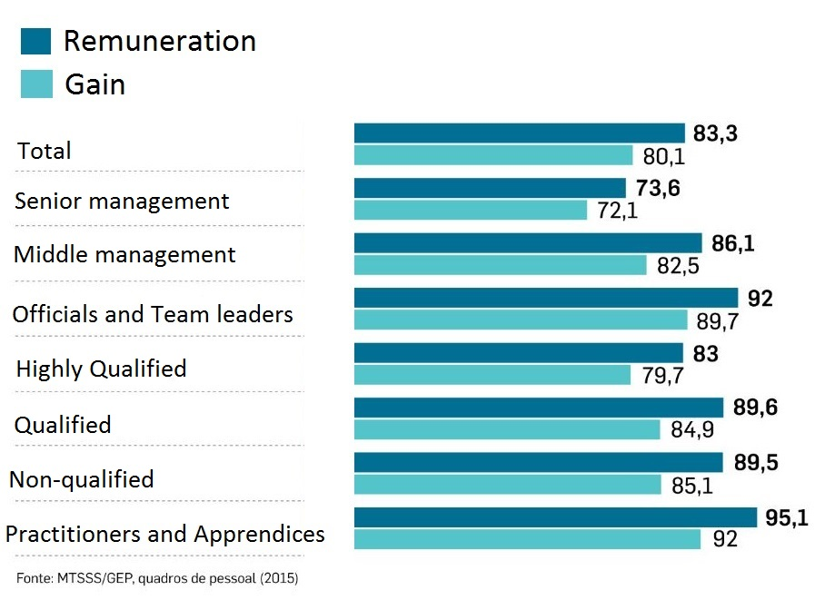
Wage inequalities according to qualification levels
Practitioners and Apprentices
t

Slide 9
School levels

Slide 10
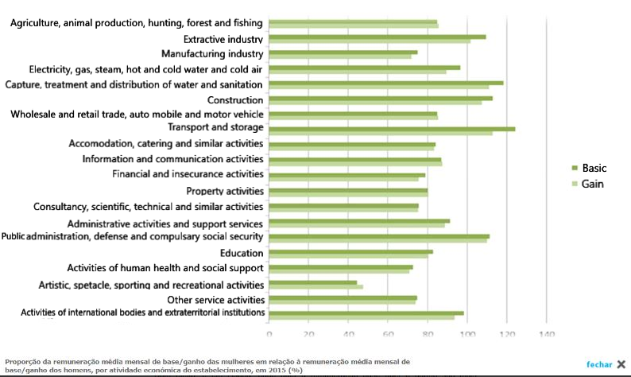
Gender wage difference by economic activity
Financial and insurance activities
Artistic, spectacle, sporting and recreational activities

Slide 11
Gender wage difference per working hour

Slide 12
Solutions

