Slide 1

TOGETHER WE CAN

Slide 2
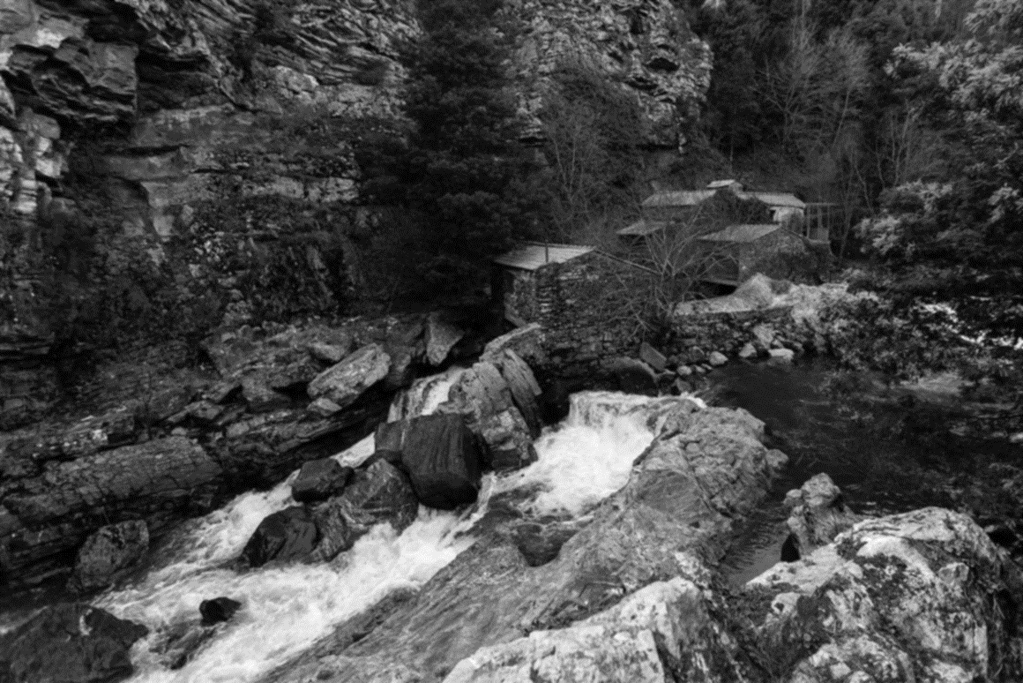
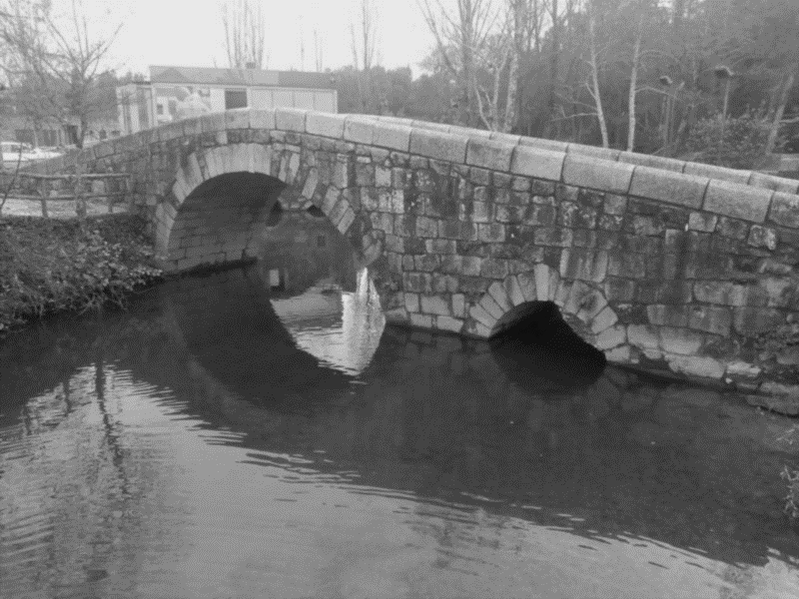
The History of Valongo
A História de Valongo

Slide 3
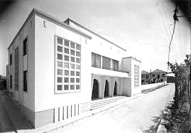
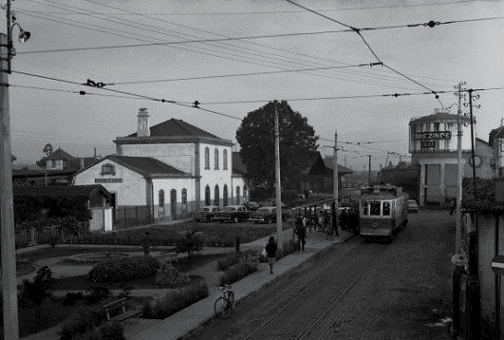
Old Ermesinde´s Cinema
Train station

Slide 4
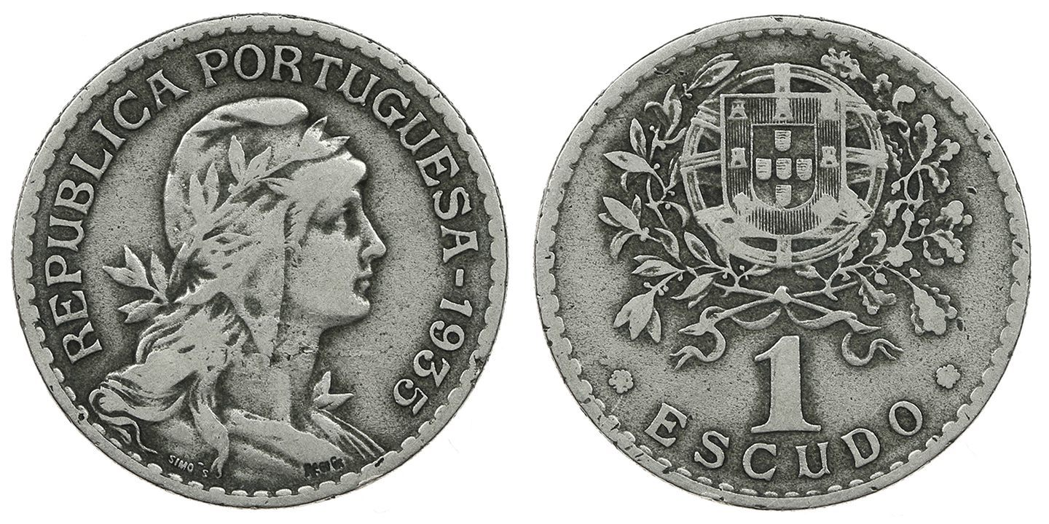

Slide 5
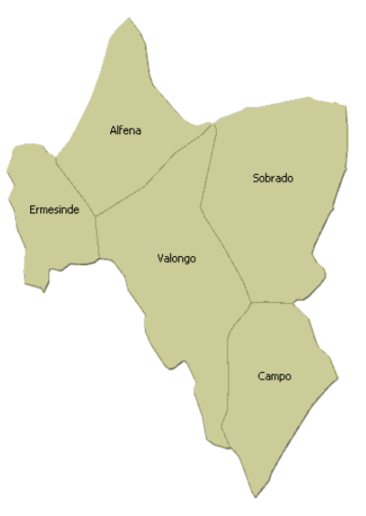
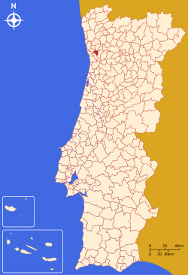
The various parish councils of the municipality of Valongo are:
    Alfena;
    Ermesinde;
    Campo-Sobrado;
    Valongo.

Slide 6

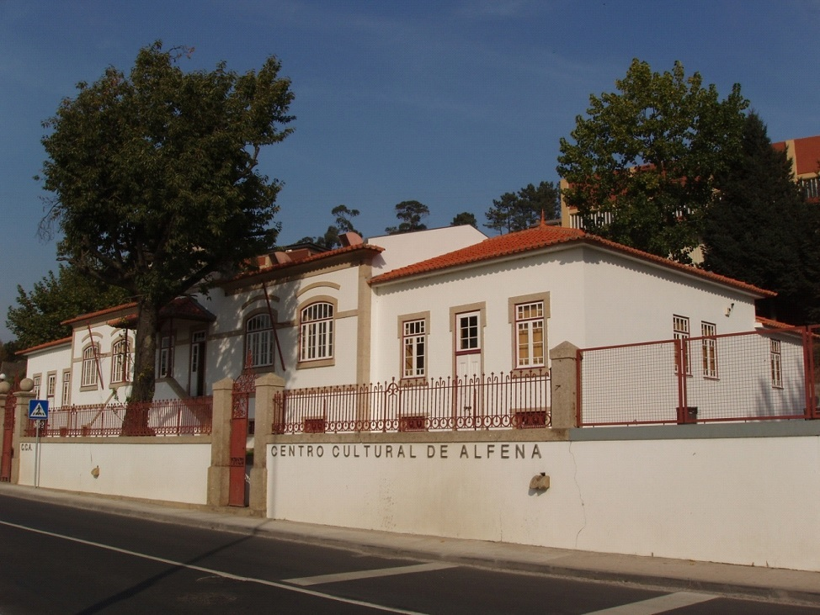
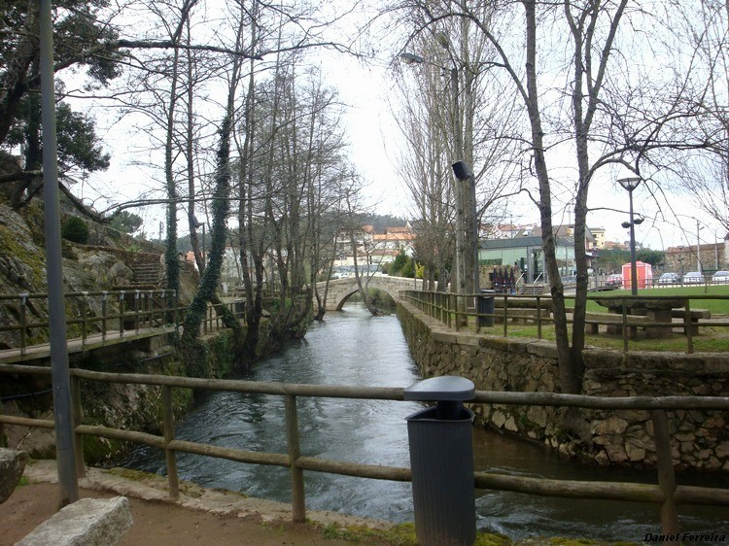
Alfena’s Cultural Centre
River Leça-Alfena

Slide 7

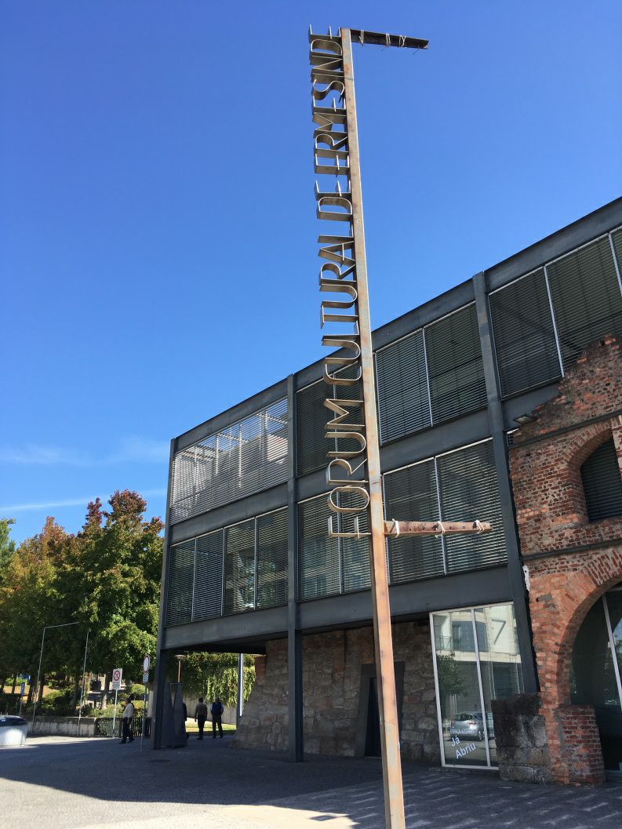
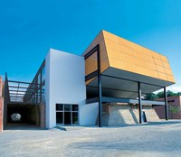
Ermesinde’s Cultural Forum

Slide 8



Slide 9
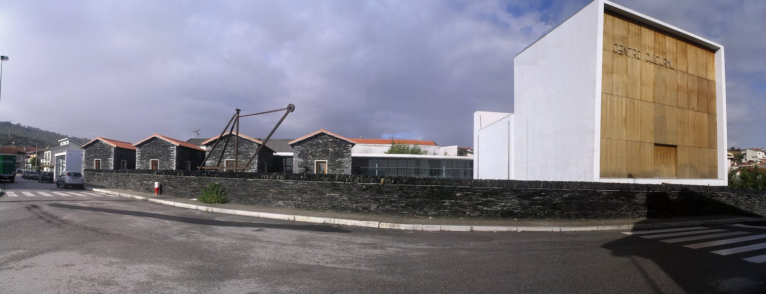
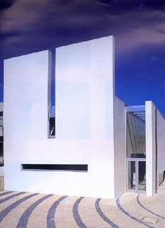
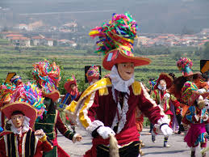
Campo’s Cultural Centre- Museu da Lousa
Sobrado’s festival
Sobrado’s Cultural Centre

Slide 10

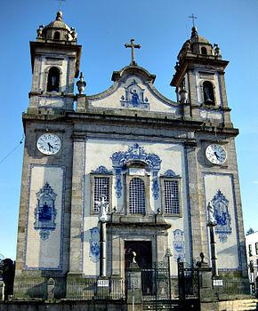
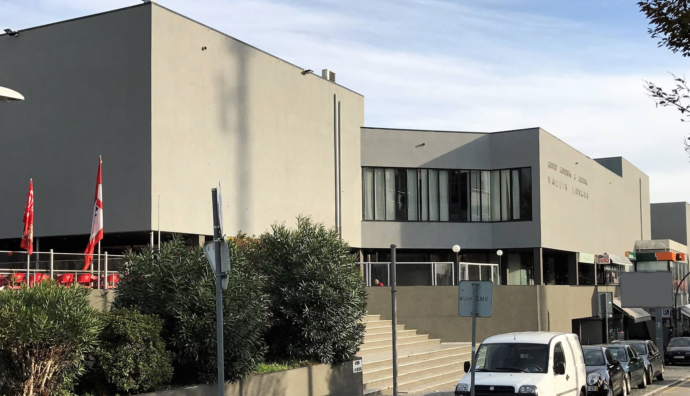
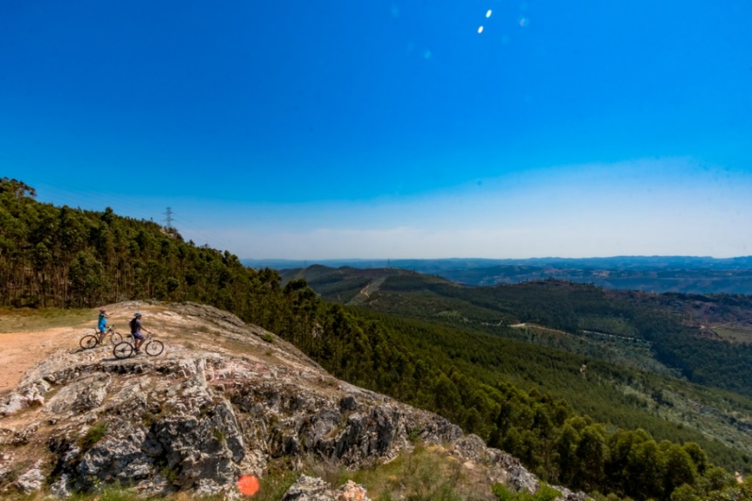
Valongo’s Mother Church
Cultural Forum Vallis Longus
Valongo´s Mountain Ranges

Slide 11
Traditions & Culture
Toys;
São João de Sobrado, Bugiada e Mouriscada;
Queima do Velho;
Popular festivities;
Slate;
Regueifa and biscuits.

Slide 12
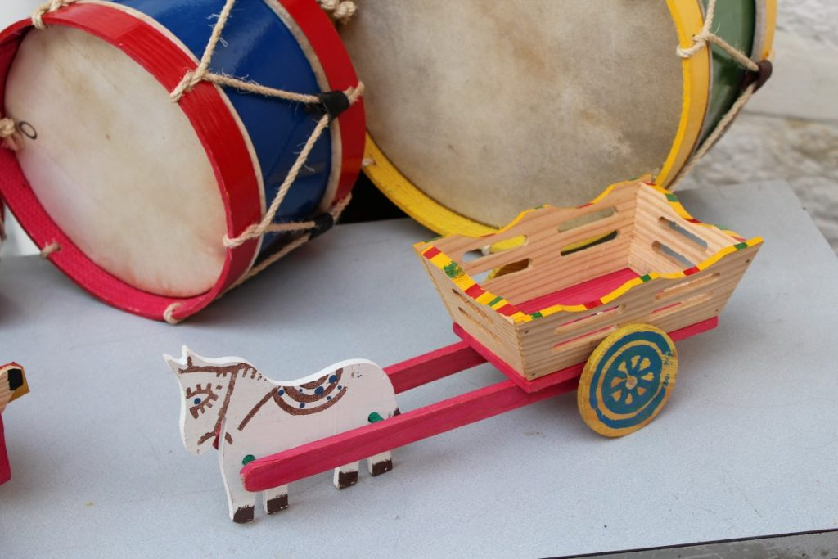
Toys

Slide 13
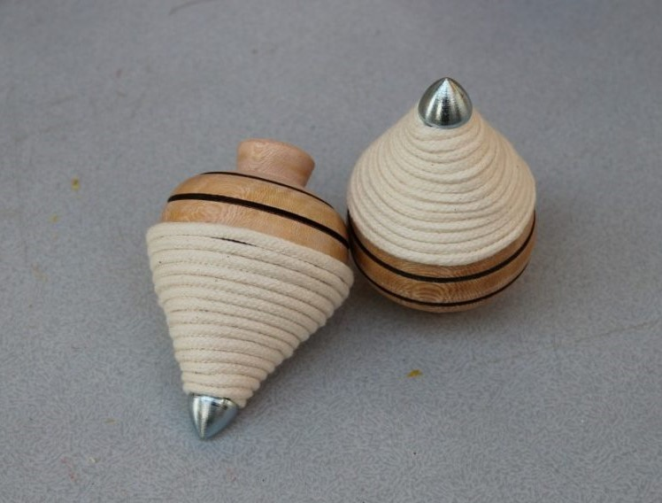
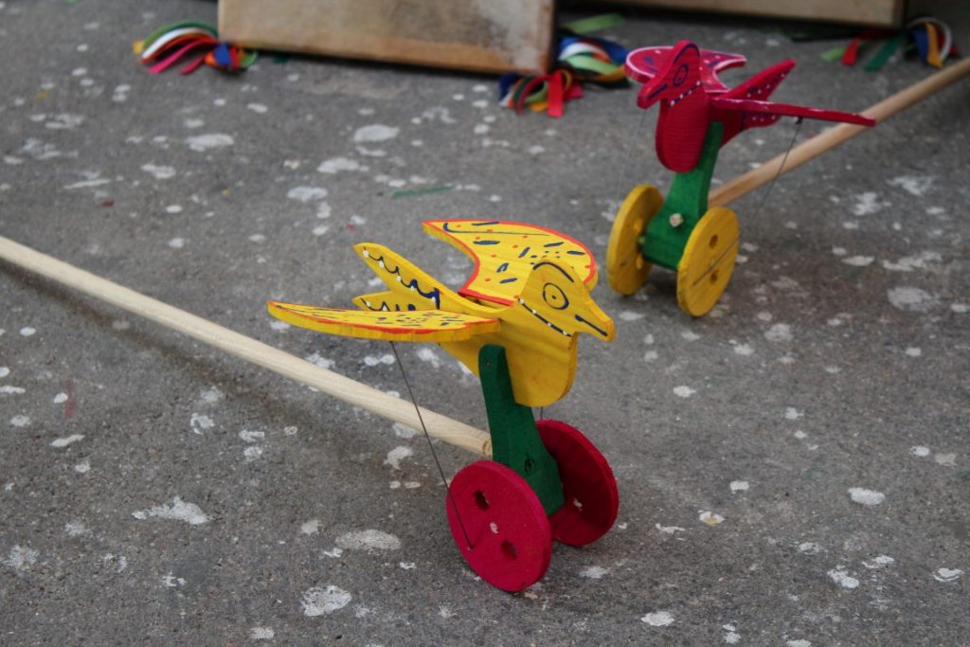
Typical portuguese Toys

Slide 14
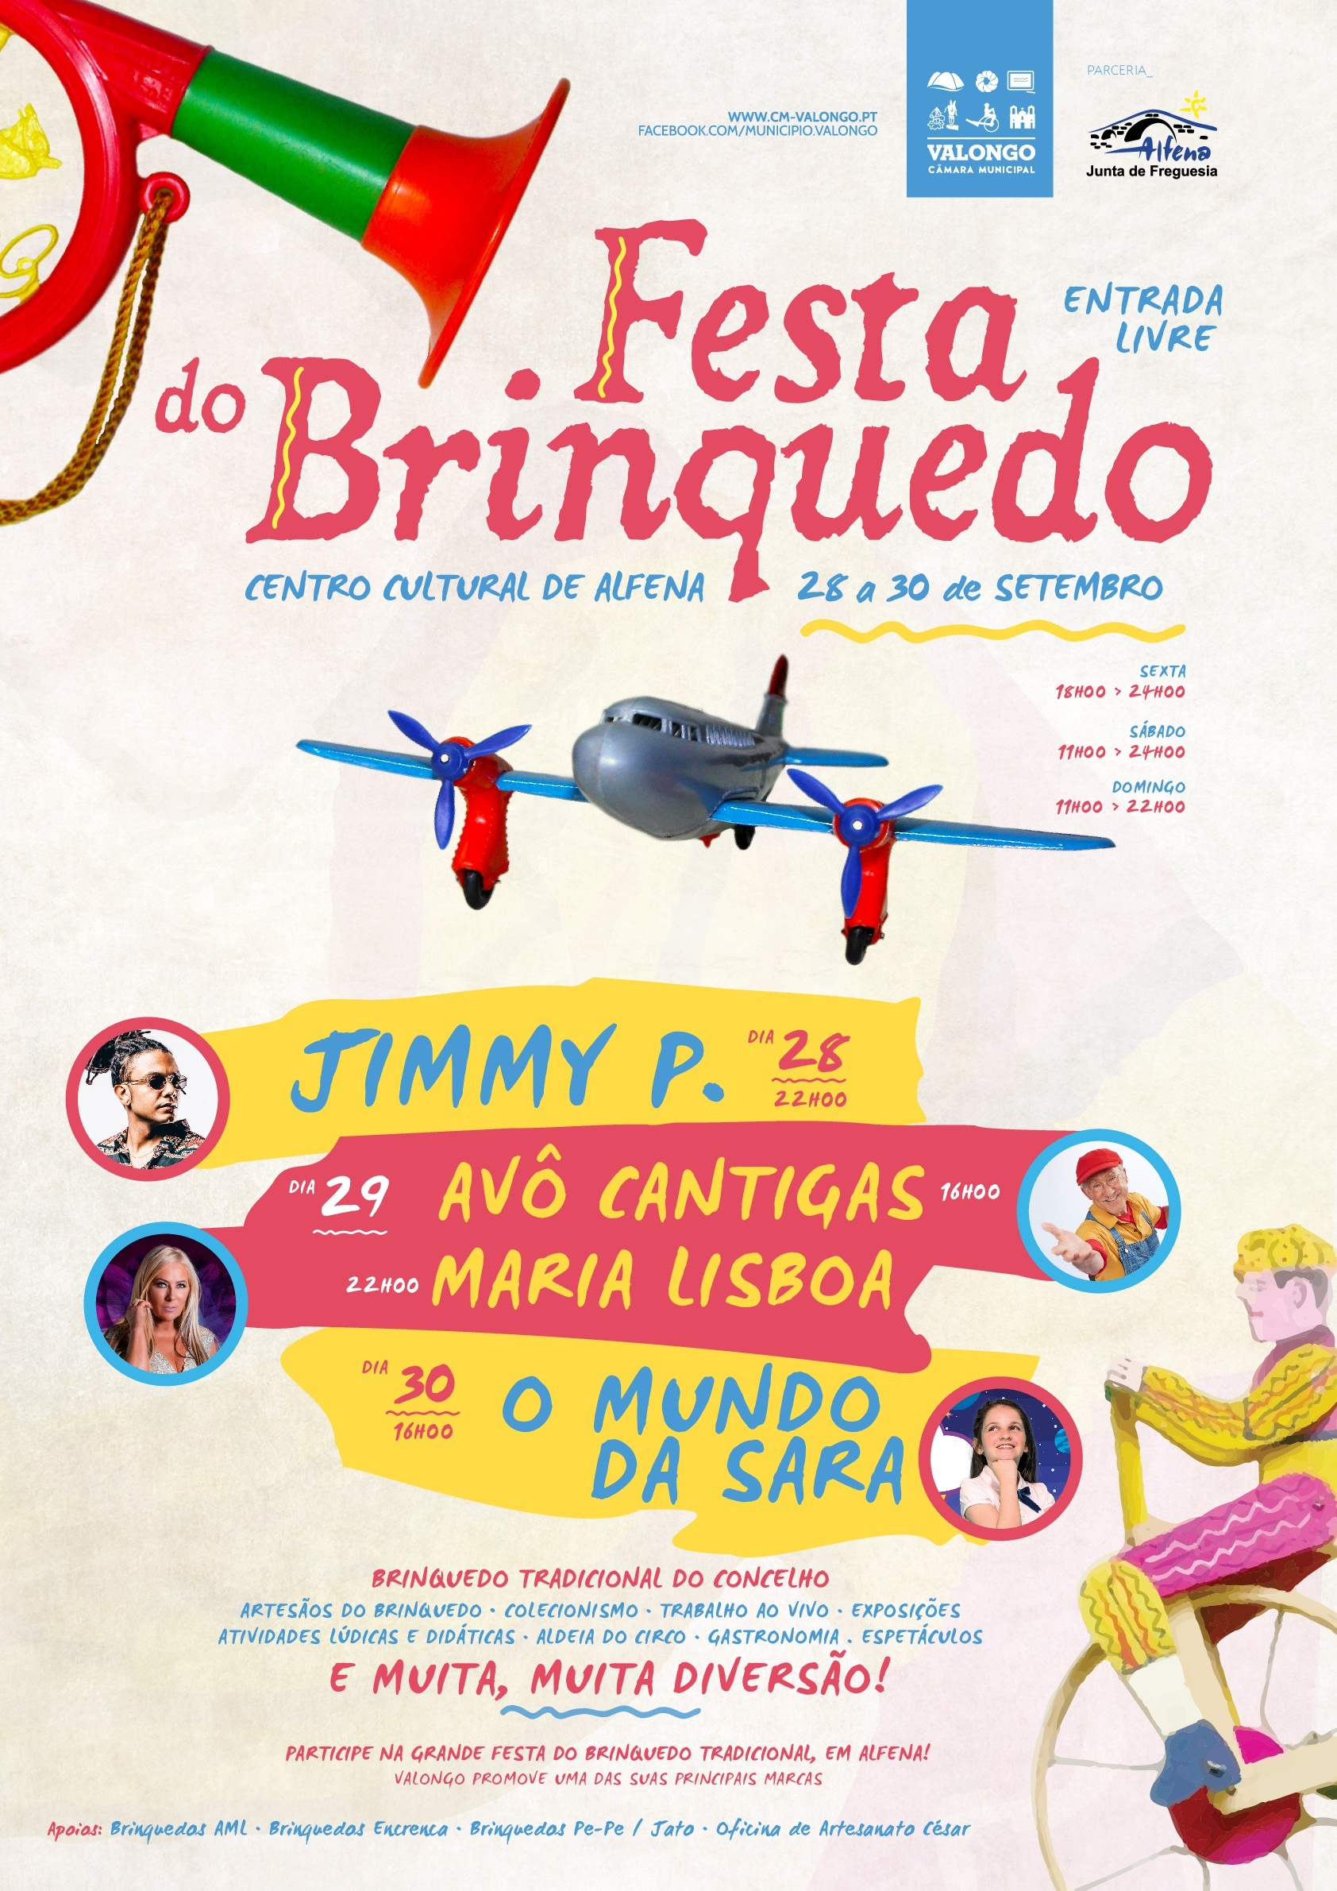
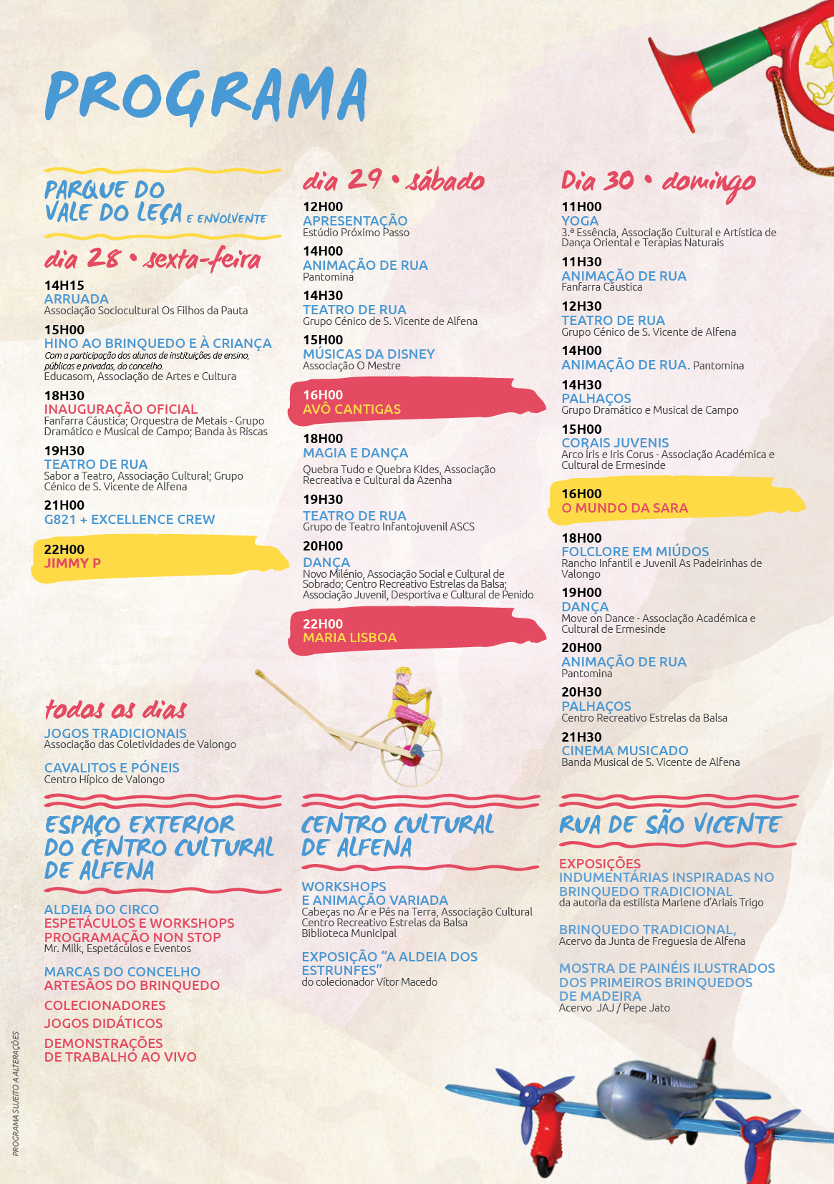
Toys Festival

Slide 15
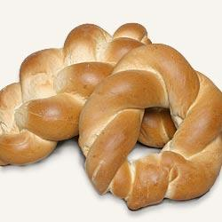
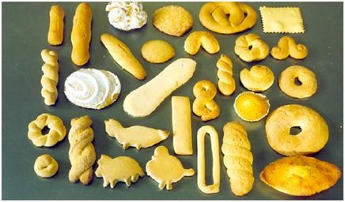
Different types of biscuits
The Regueifa

Slide 16
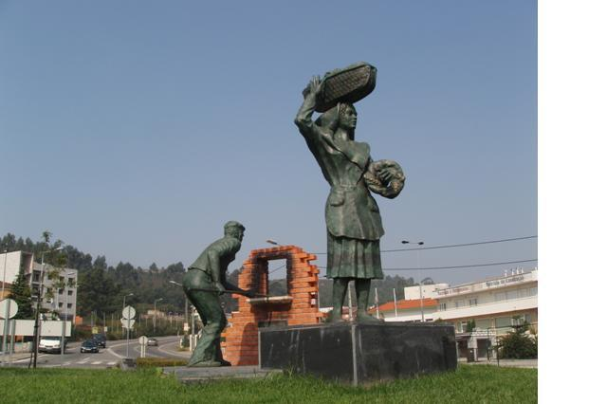
Tribute to the bakers

Slide 17
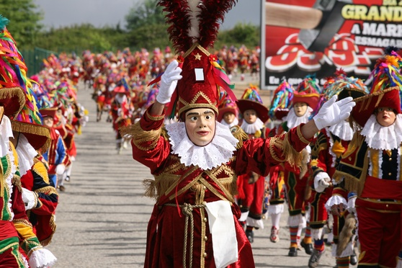
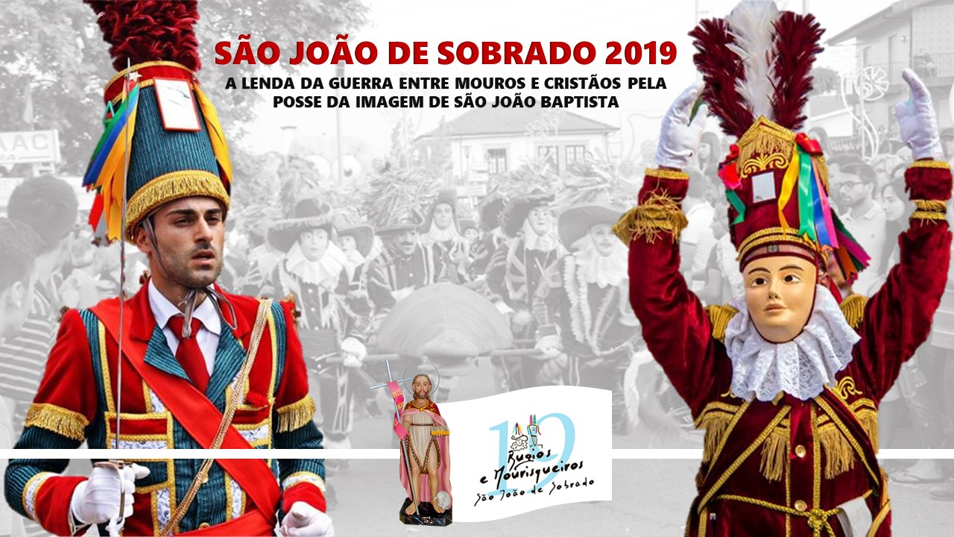
São João de Sobrado, Bugiada and Mouriscada

Slide 18
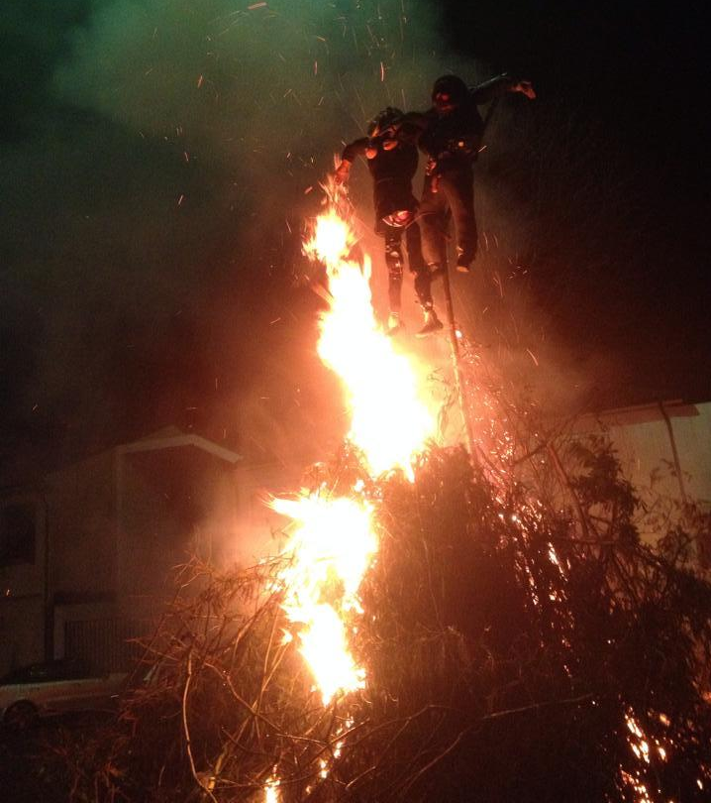
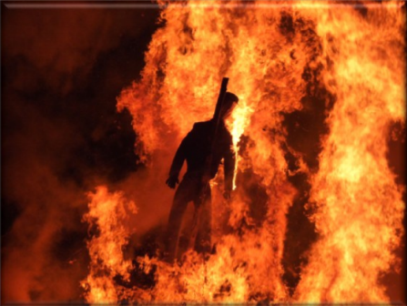
Queima do Velho

Slide 19
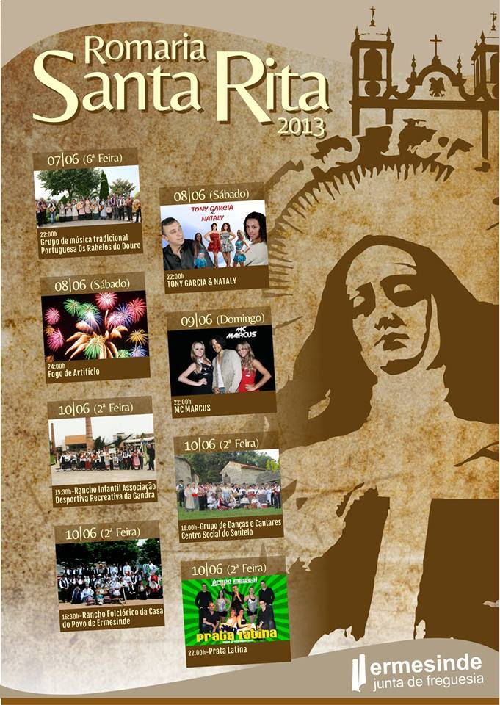
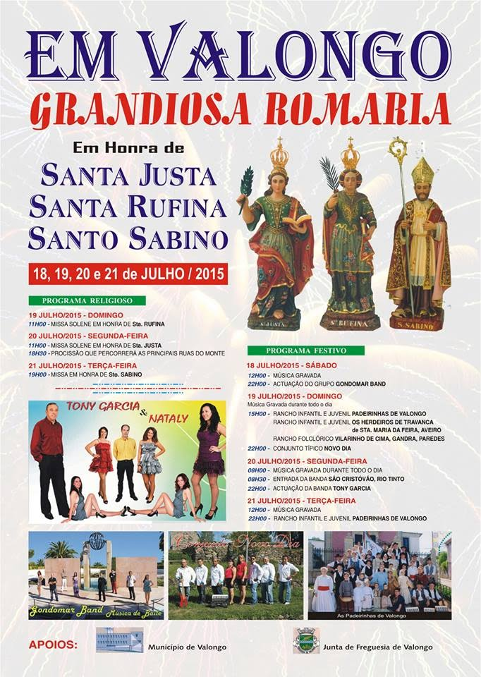
Santa Rita e Santa Justa

Slide 20
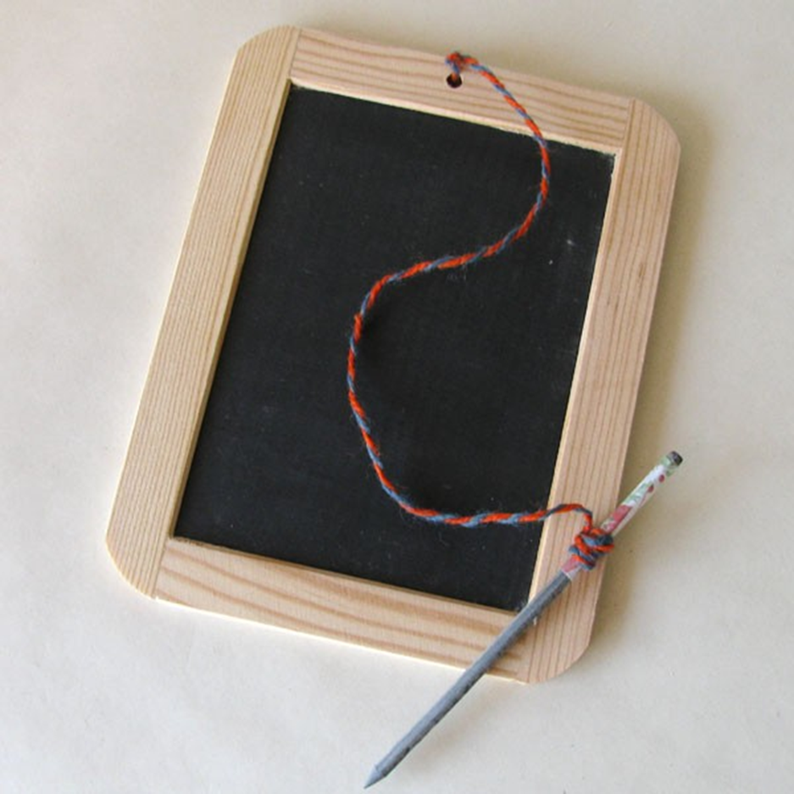
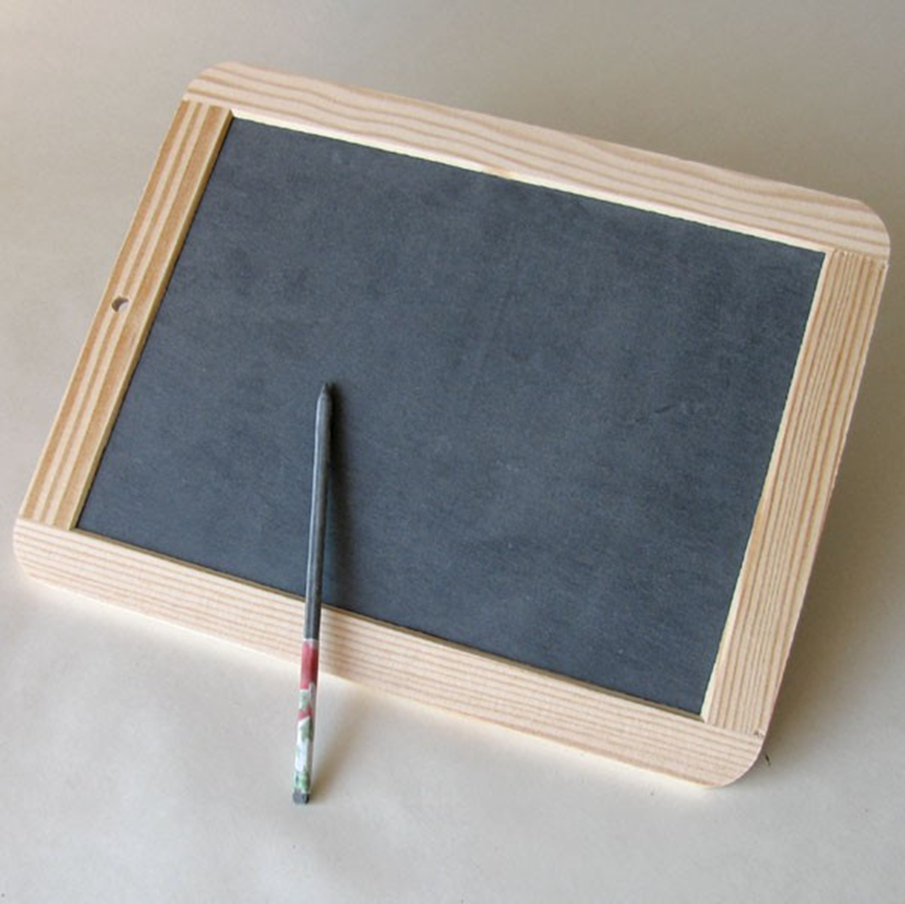
The School Slate

Slide 21
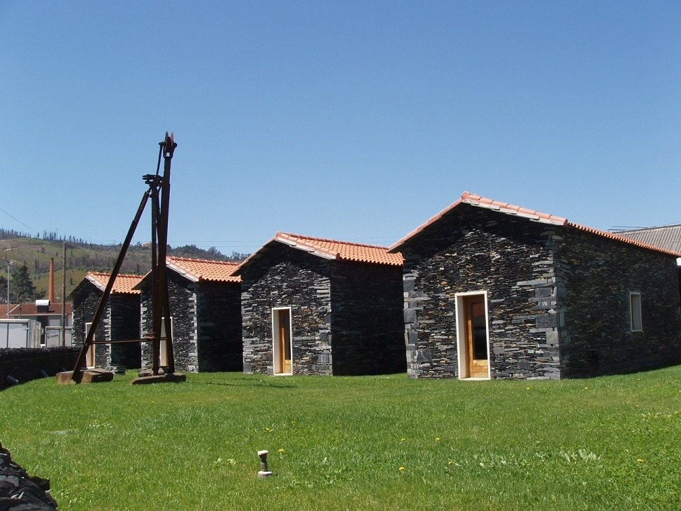
The Slate Museum

Slide 22
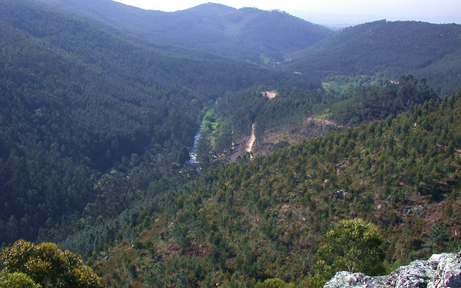
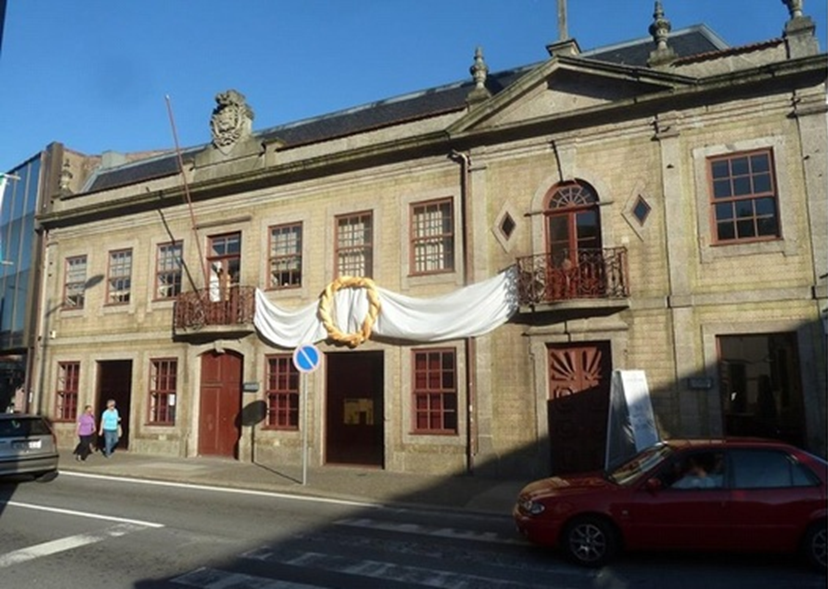
Municipal museum of Valongo
Paleozoic Park

Slide 23
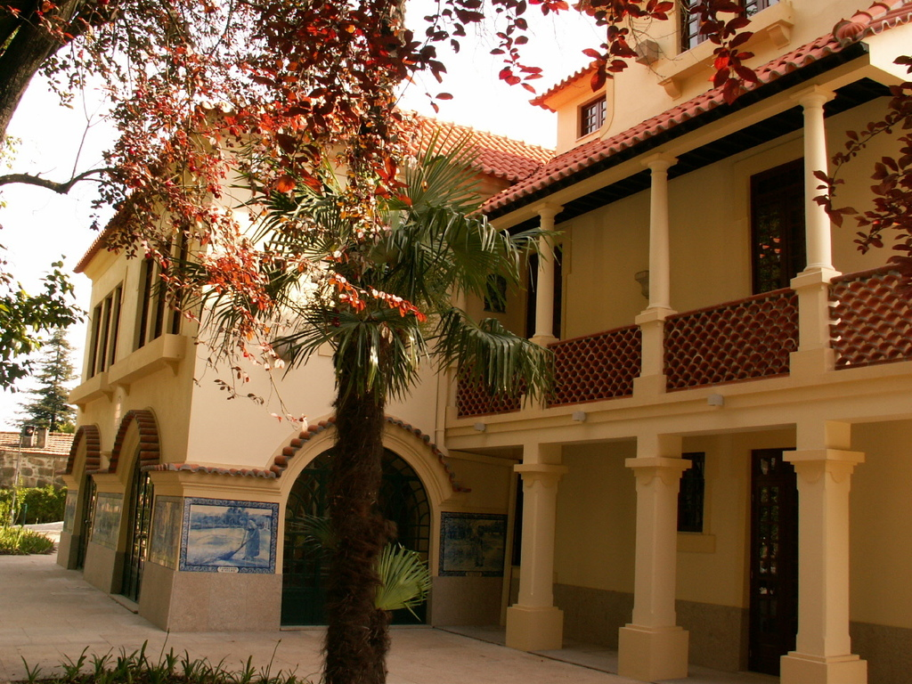
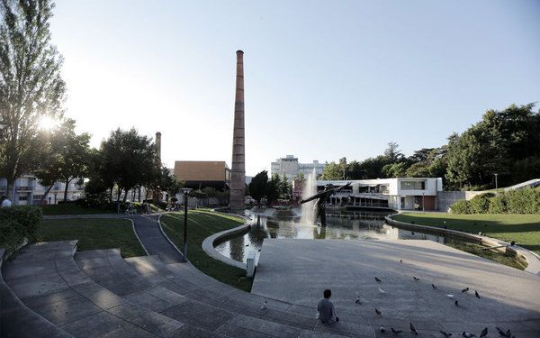
Urban Park in Ermesinde
Vila Beatriz

Slide 24





The end

Slide 25
Made by:
Erasmus Club

