Slide 1



TOGETHER WE CAN

Slide 2

ERMESINDE’S GROUP OF SCHOOLS

Slide 3
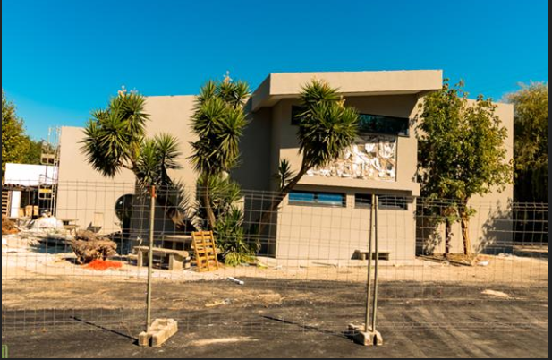
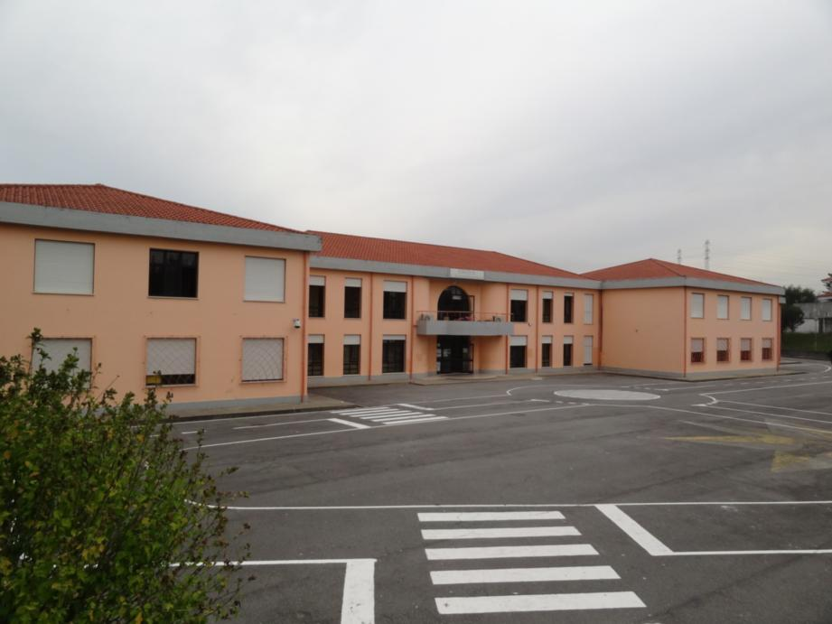
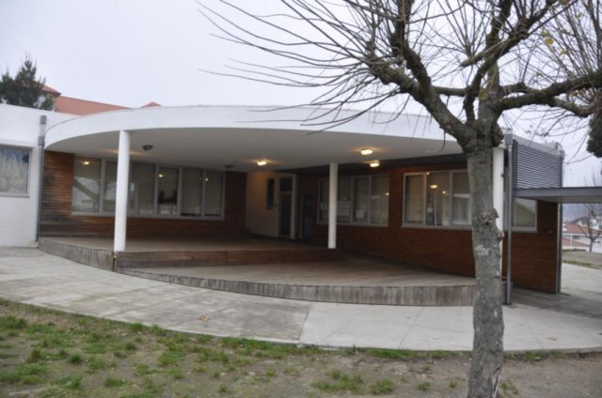
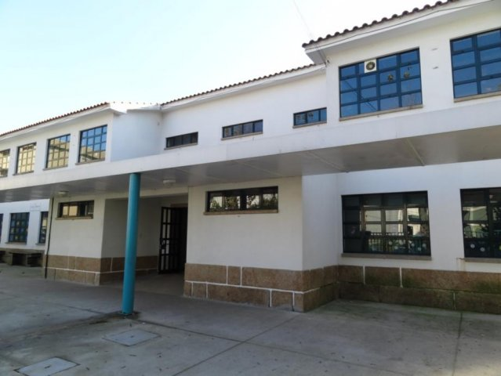
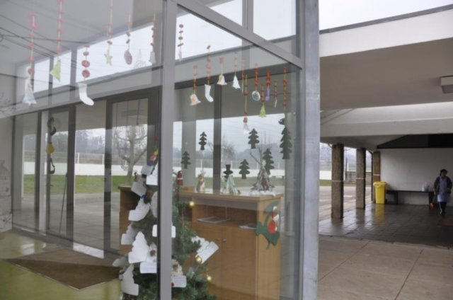
ESCOLA SECUNDÁRIA DE ERMESINDE
E.B.2/3 D. ANTÓNIO FERREIRA GOMES
EB1/JI DA BELA
EB1/JI DA GANDRA
EB1/JI DE SAMPAIO
Our Agrupamento de Escolas de Ermesinde (Ermesinde’s Group of Schools) is made up of five different schools, each one with its own characteristics and located in different areas of the city. Altogether, the Group has about 2.325 students, 239 teachers and 79 educational aids.

Slide 4
The headquarters of the group of schools is the secondary school;
The direction of the AEE, the office that deals with the issues concerning the personel and the finances, as well as with all the matters concerning the students’enrollment, exams,etc, are established headquarters’ building;
Each one of the other 4 schools has a Coordinator designated by the director.

Slide 5
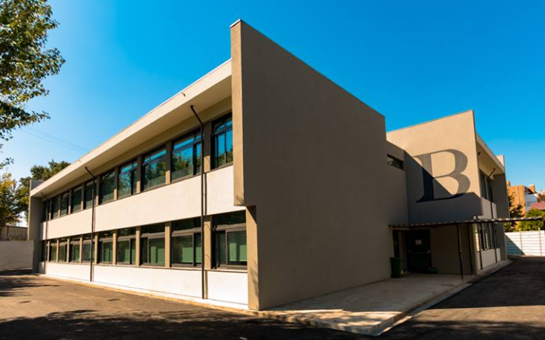
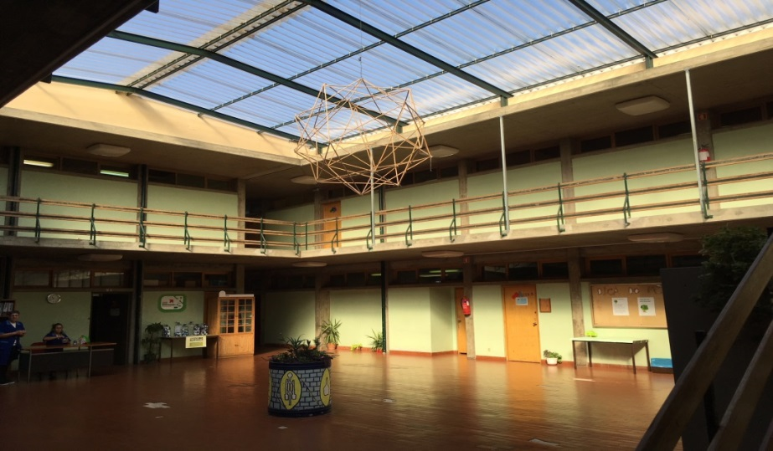
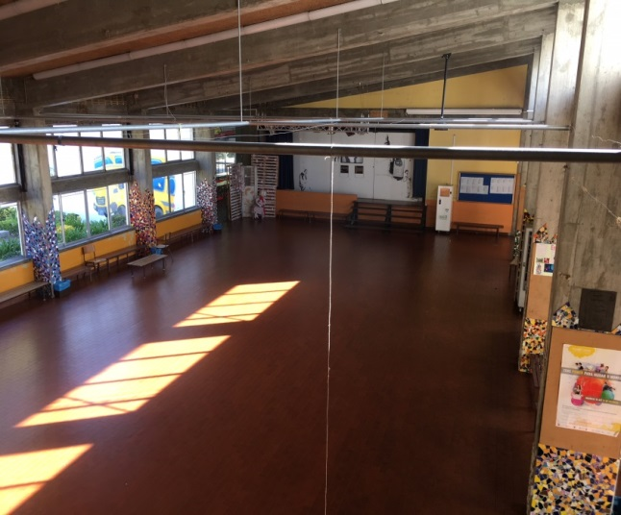
Escola Secundária de Ermesinde - a middle and secondary school, embracing students between 10-18 years of age.
At the Secondary Education level, this school delivers 4 Scientific- Humanistic Courses: Science and Technology, Socio-Economic Sciences, Social and Human Sciences and Visual Arts and 3 professional courses.
There is also Education and Training Courses.
ESCOLA SECUNDÁRIA DE ERMESINDE

Slide 6
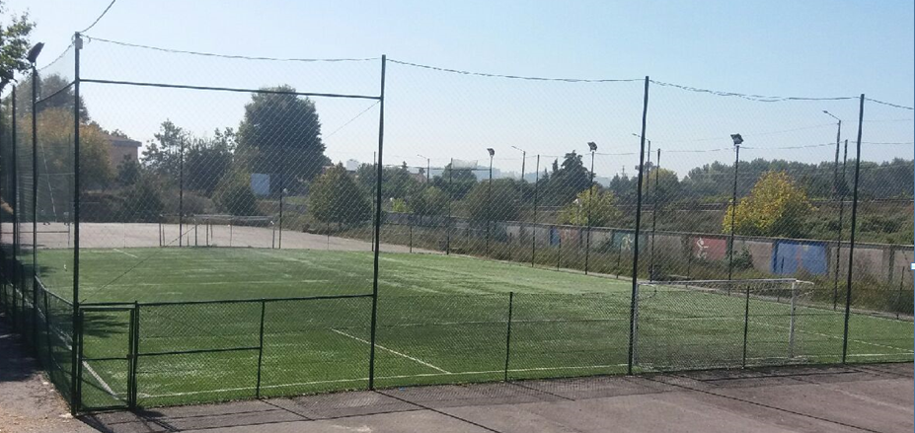
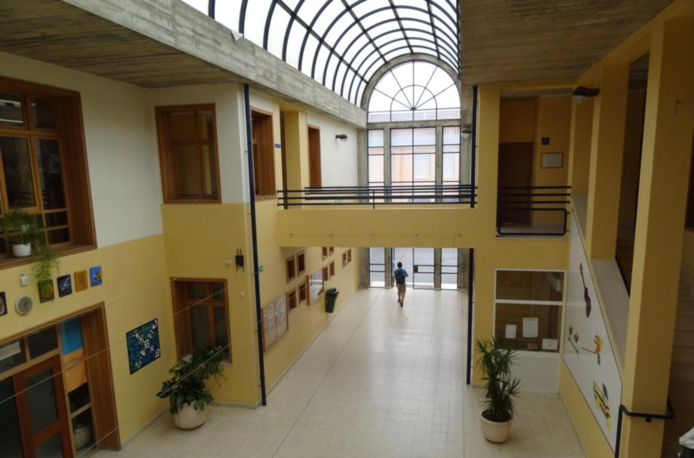
E.B. 2/3 D. António Ferreira Gomes - a middle school.
It offers the General Basic Course for students between 10-15 years of age.
E.B. 2 / 3 D. ANTÓNIO FERREIRA GOMES

Slide 7
EB1/JI DA BELA
EB1/JI DA GANDRA
Three primary Schools with Kindergarten – they embrace students between 3-9 years old.
EB1/JI DE SAMPAIO
PRIMARY SCHOOLS WITH KINDERGARTEN

Slide 8
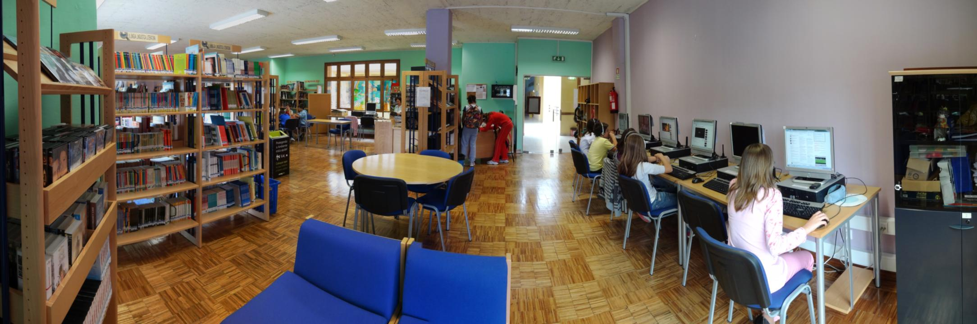
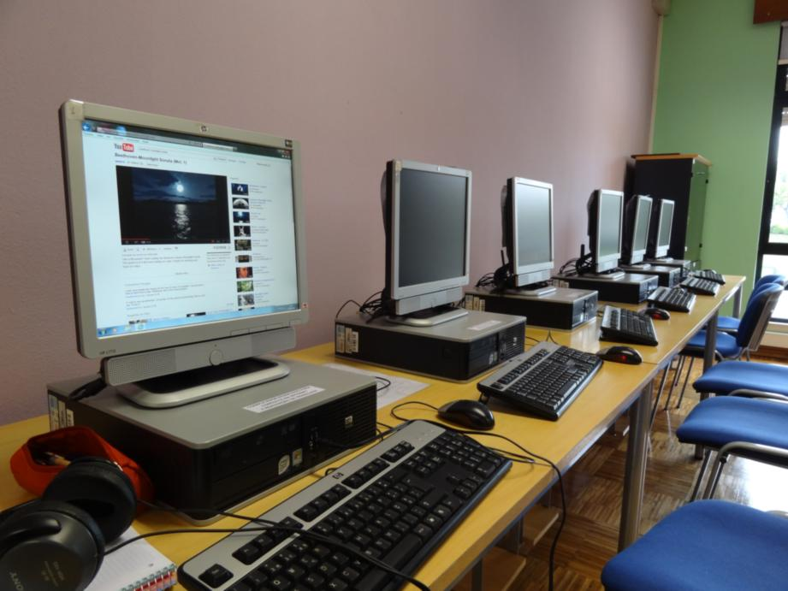
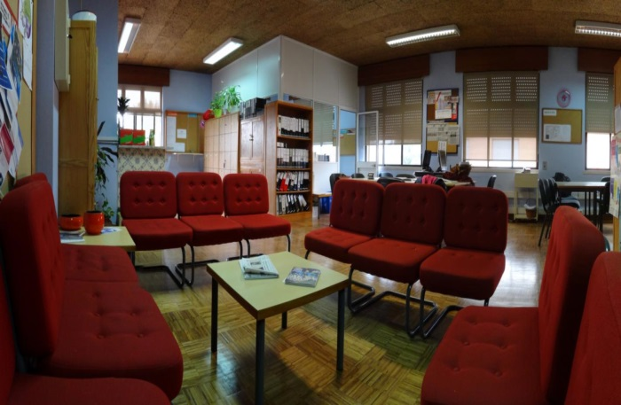
As for school facilities, the Group provides regular classrooms with projectors and computers connected to the Internet in most of them, computer rooms and science labs, teachers’ rooms, general offices, comfortable libraries, canteens, buffets, medical care rooms, tutors’ rooms and the Director’s office. In addition, the group holds gymnasiums, sports fields and one auditorium where sessions of diverse nature take place.
SCHOOL FACILITIES

Slide 10
Presentation made by: Erasmus Club, AEE, Novembro 2018
for
TOGETHER WE CAN
Erasmus+ project

