Slide 1
RELATIONSHIPS IN ANDALUCIA

Slide 2
Easter
In Andalucia many people are looking forward easter to see the brotherhoods that come out during that week.
In Seville come out 61 brotherhoods during this week. The people rent chairs, that are placed on the streets, to see the steps sitting.
In Alcalá del Río the relatioship depends a lot of the brotherhood. Sometimes people discuss defending a his brotherood, but they never reach an agreement.

Slide 3
Hermandad de la Vera Cruz
Hermandad de la Soledad

Slide 4
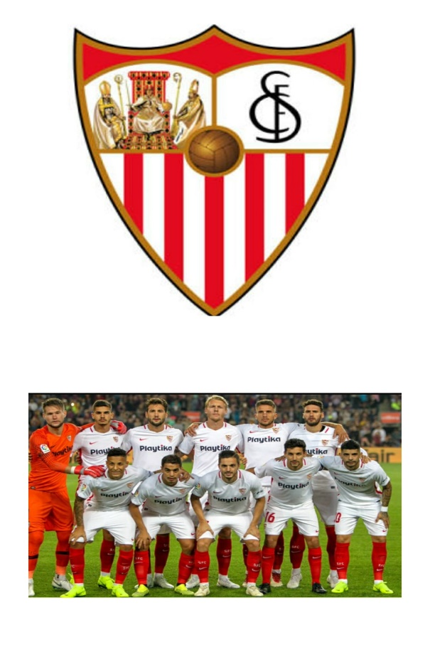
Football
In Andalucia the football is very important, there are nine football teams.
The mains one are Sevilla and Betis, there are a lot of derbis, many people in Seville are going to see it.

Slide 5
Guadalquivir river
In Alcalá del Río, near the Guadalquivir river, there is a very large park where many groups of friends meet, you can walk the pets or even exercise.

Slide 6
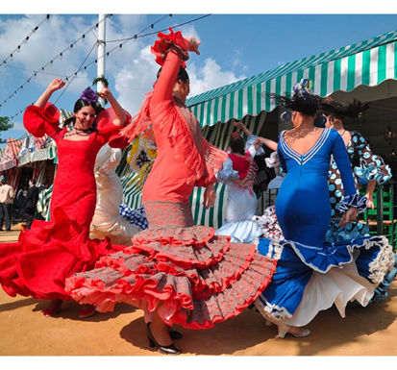
April Fair
The April Fair is a spring festival held annually in the city of Seville, where the public meets in a large venue called Real of the Feria, with streets with booths, decorated with lanterns, where horse rider circulated for which they spend daily 500,000 visitors. It is celebrated one or two weeks after the Holy Week and coincides with the bulls in the Plaza of the Maestranza. It has a great economic and social impact in the city and is declared a Festival of International Tourist Interest.

Slide 7
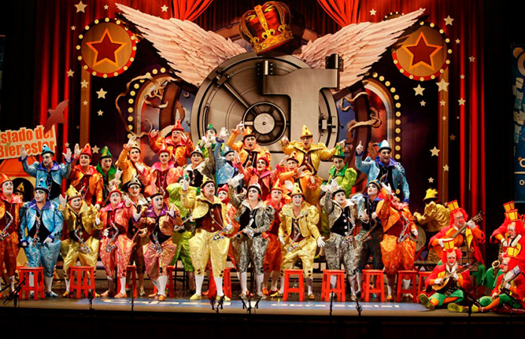
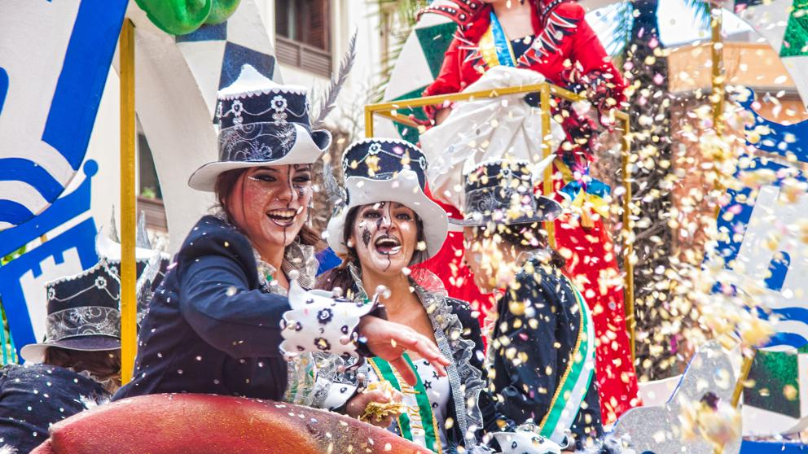
Cadiz Carnival
The Carnival of Cádiz is one of the most famous and important carnivals in Spain, for which it has been recognized with the declaration of the Festival of International Tourist Interest.
Each town celebrates the carnival with a walk through the streets of the town and dj. Many groups of friends come together to have fun and have a good time.

Slide 8
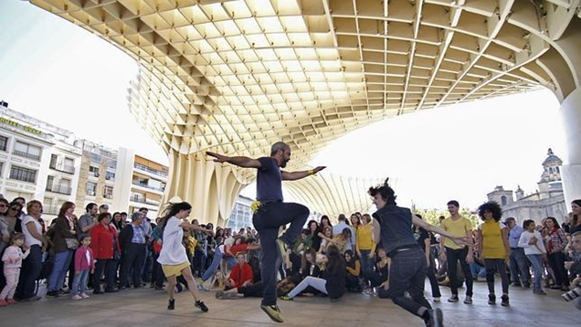
Dance contest in Sevilla Setas
Many children from other cities come to Sevilla Setas for a new dance contest in which they compete with other contestants until they reach at the end.

Slide 9
My friends group
Many times we meet at a friend's house to eat and spend some time together although almost always we go to a park.

