Slide 1
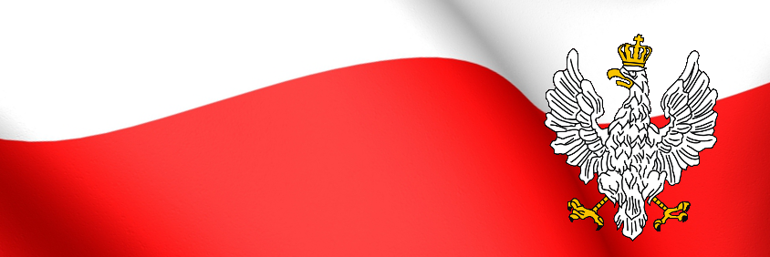
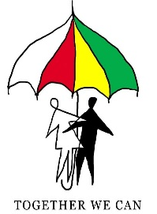
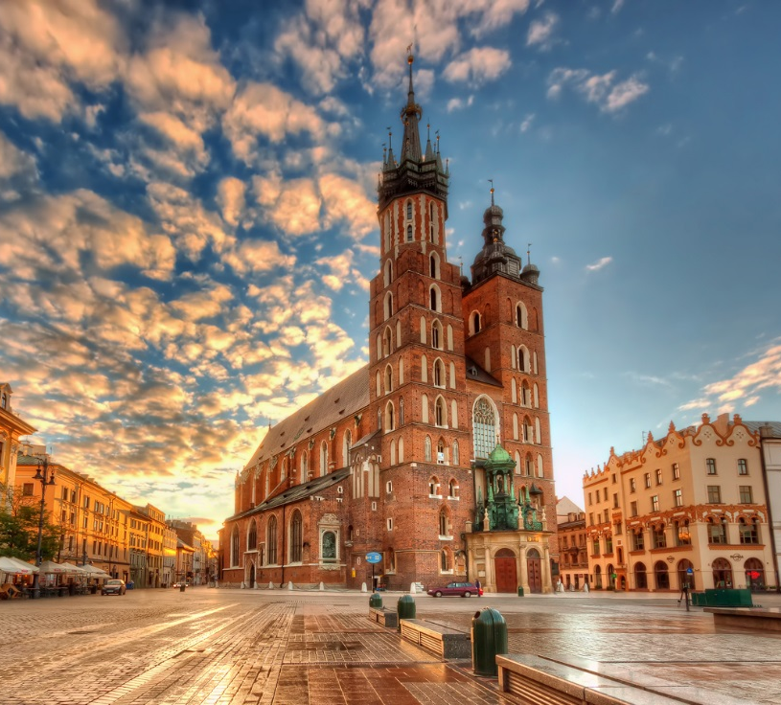
Erasmus Plus Project Together we can
34 Primary School, Cracow, Poland
November 2018
POLISH CULTURE
TRADITIONS, SONGS, DANCES, MUSIC, LITERATURE, CUISINE

Slide 2
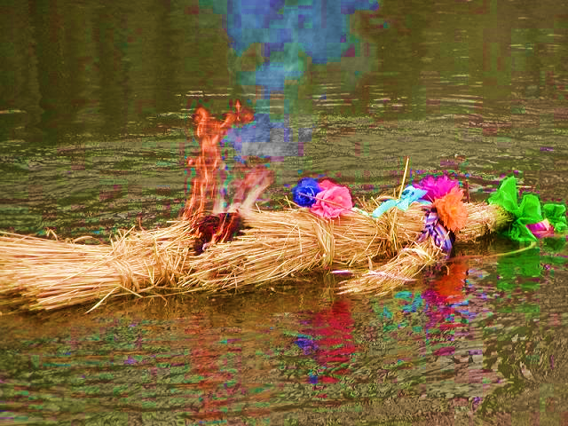
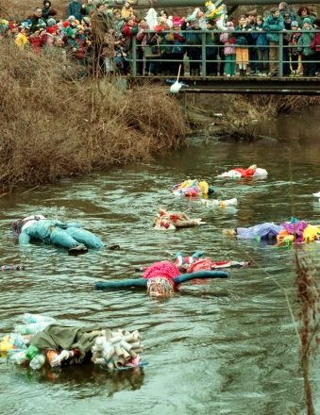
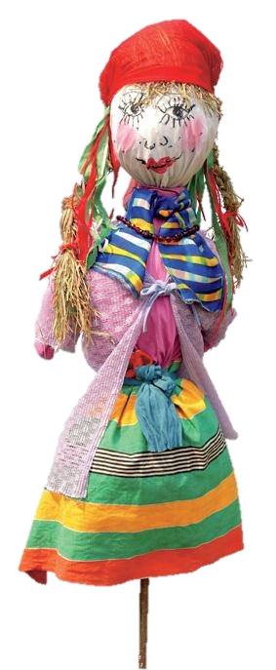
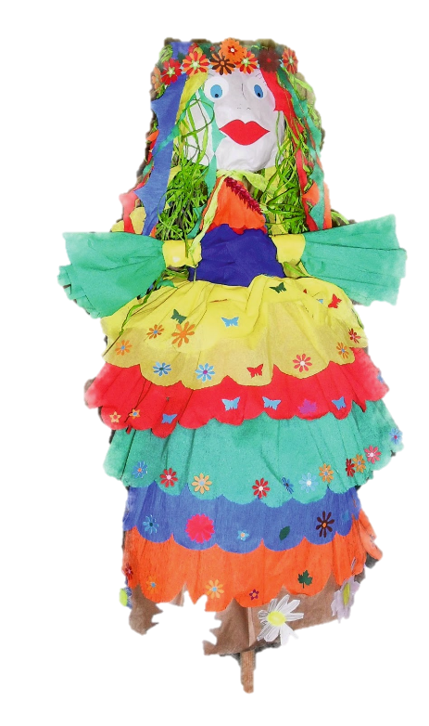
TRADITIONS
DROWNING OF MARZANNA Every year, on the first day of spring, March 21, there is a rite of melting or burning a straw Marzanna effigy symbolizing winter (death).

Slide 3
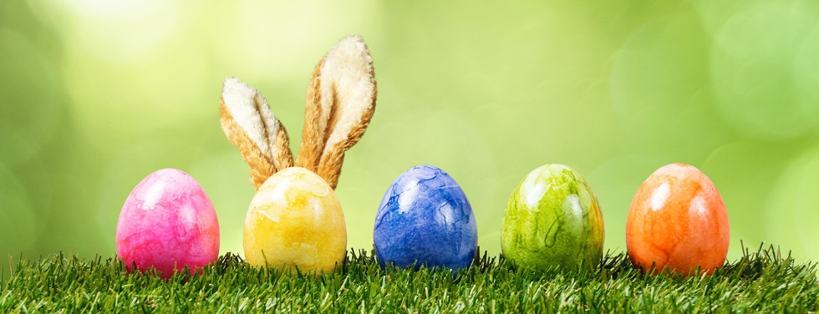
TRADITIONS
EASTER
The oldest and the most important Christian holiday commemorating the death and resurrection of Christ. In the Polish custom, the family sits down to a festive breakfast and divides sacred food from a basket: eggs, bread, mazurkas.

Slide 4
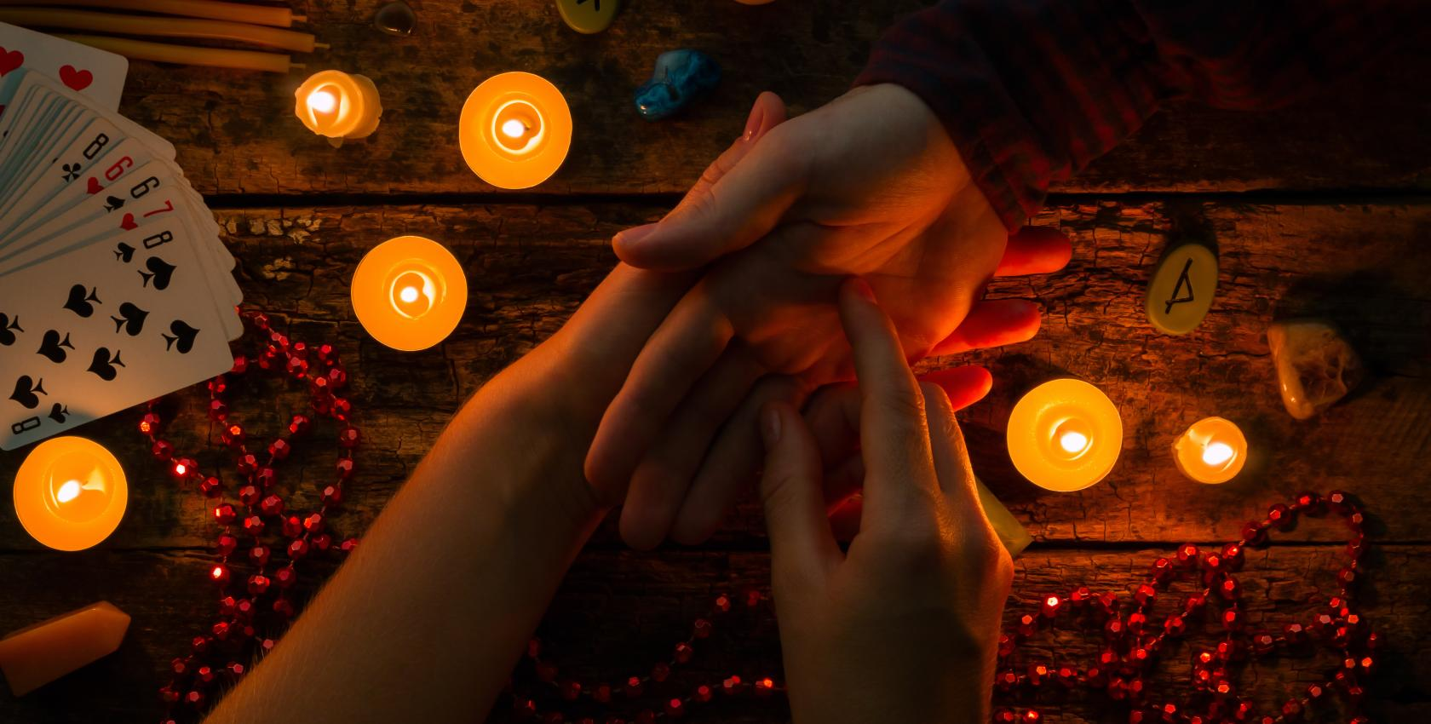
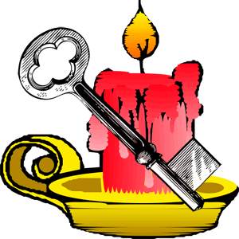
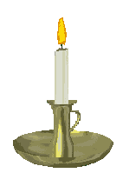
TRADITIONS
ST. ANDREW’S DAY An evening of fortune-telling celebrated on November 29 as the last Advent fun. The most popular omens are reading future fates from the shapes that hot wax takes in cold water.

Slide 5
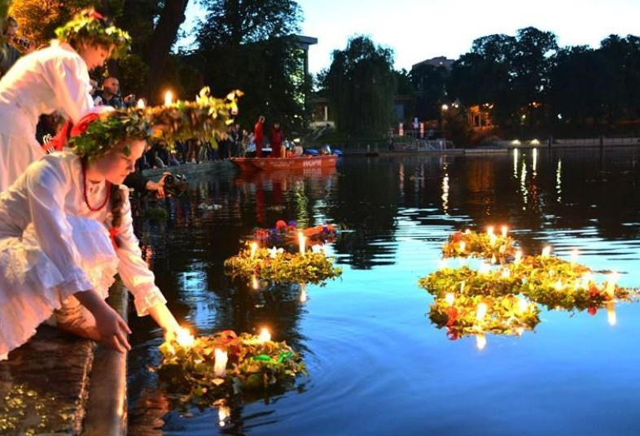
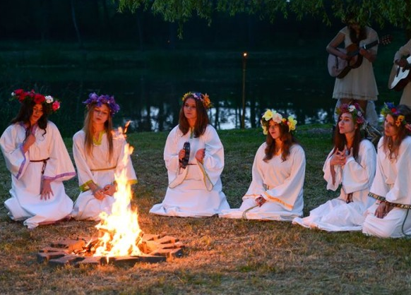
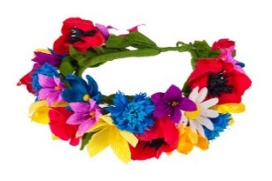
TRADITIONS
KUPALA NIGHT
A feast of fire celebrated on the shortest night of the year, June 23-24. During the celebrations, a big bonfire was lit (bonbons), there were jumps through the fire, burned dried herbs and wreaths were thrown on the water.

Slide 6
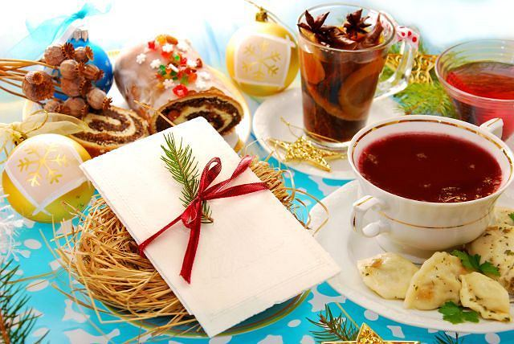
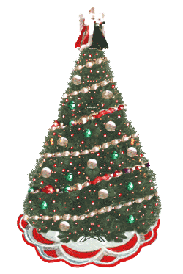
TRADITIONS
CHRISTMAS EVE This is the most important evening of the year, where all household members sit down to supper. During Christmas Eve, you should share the wafer, try 12 traditional dishes and leave a free seat at the table.

Slide 7
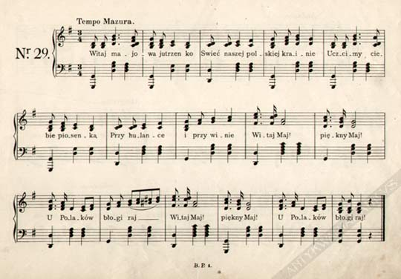
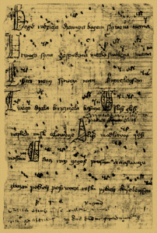
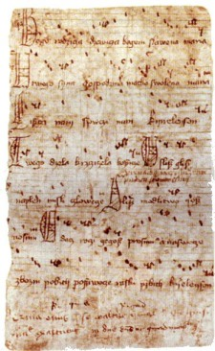
NATIONAL SONGS
BOGURODZICA
The oldest Polish religious song and the first Polish national anthem. The first record of the text comes from 1407, and its author is unknown.

Slide 8
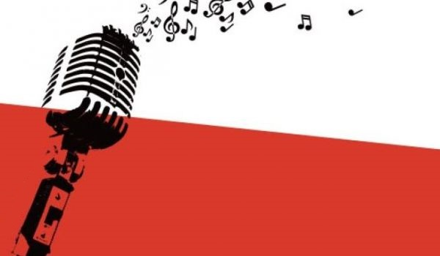
NATIONAL SONGS
The most popular national Polish songs are:
„Marchers are marching”,
„White roses were blossoming”,
„War, war”,
„White cross”,
„The uhlans came to the window”
„Oh, my rosemary”.

Slide 9
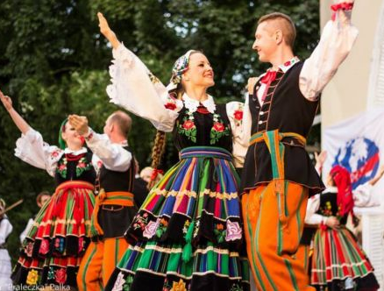
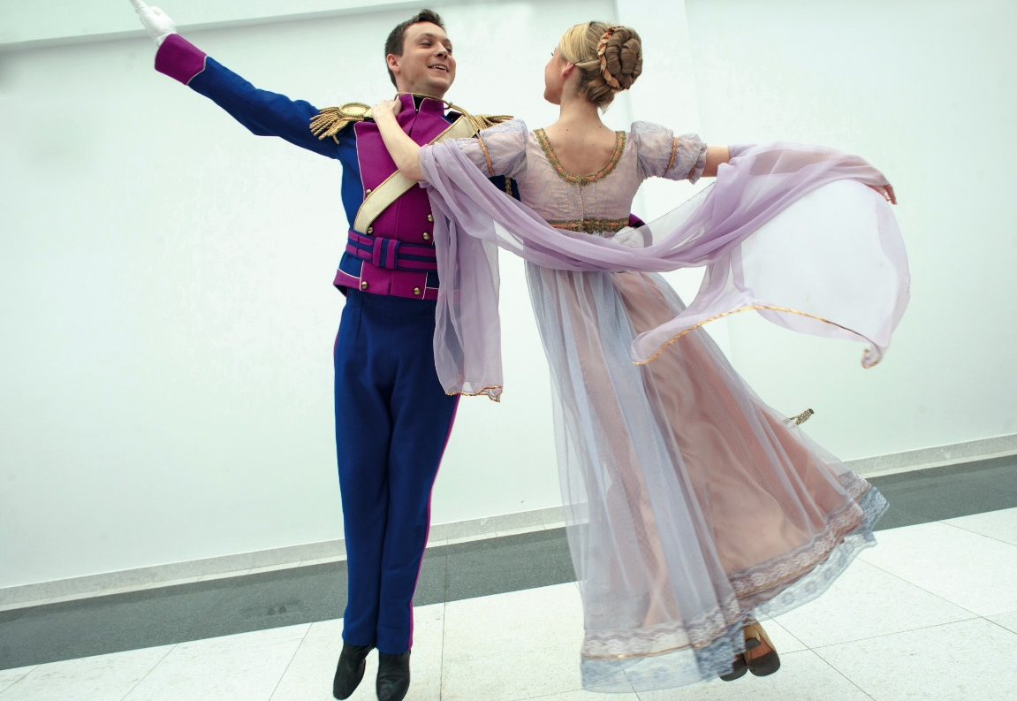
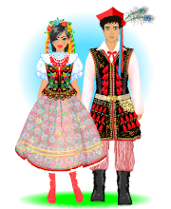
DANCES
KRAKOWIAK
Krakowiak is a dance that comes from around Krakow. He is lively and happy, and the dancers appear in Krakow's costumes.
POLONEZ
Polonez (otherwise walked) - a very festive dance beginning with important balls at royal courts.

Slide 10
And this is a dance called Mazur.

Slide 11
Here is a another Polish national dance called Oberek.

Slide 12
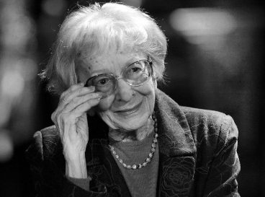
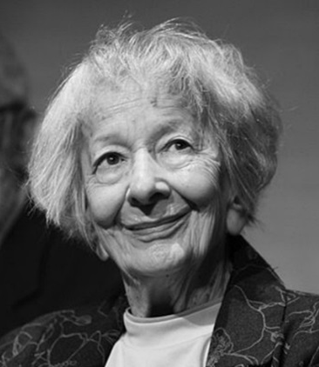
LITERATURE
WISŁAWA SZYMBORSKA
The most famous Polish poet was Wisława Szymborska (1923-2012). She has published over 350 poems for which she received in the 1996 Nobel Prize. Her the most beautiful poets are: "Woman's portrait", "On the Tower of Babel", "A cat in an empty apartment”

Slide 13
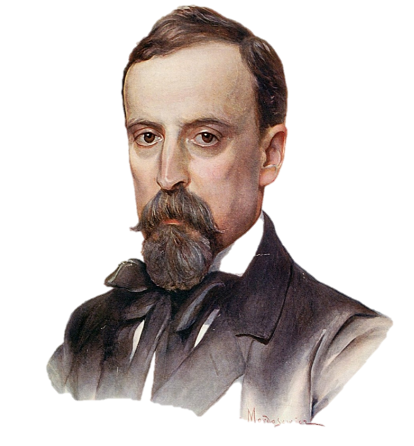
LITERATURE
HENRYK SIENKIEWICZ
Polish Nobel Prize winner, one of the most popular Polish writers at the turn of the 19th and 20th centuries. He wrote many important novels, including "Quo Vadis", "Teutonic Knights", "Deluge", "In Desert and Wilderness", "Fire and Sword"

Slide 14
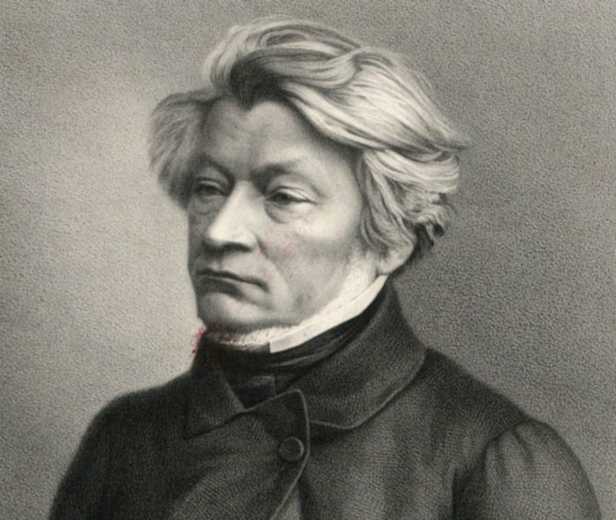
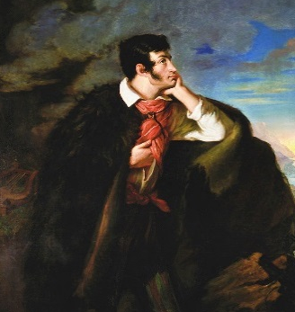
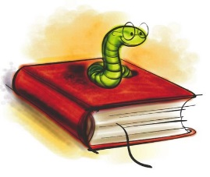
LITERATURE
ADAM MICKIEWICZ
Poet, philosopher, teacher, political activist. He was one of the most outstanding Polish artists. He wrote many works, eg "Pan Tadeusz", "Świteź", "Crimean Sonnets"

Slide 15
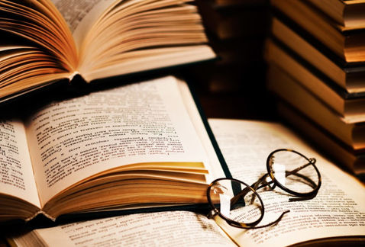
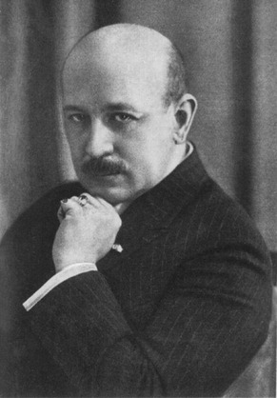
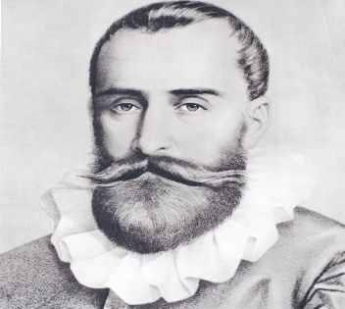
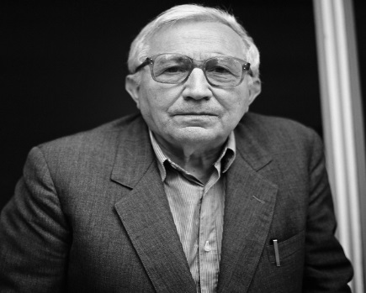
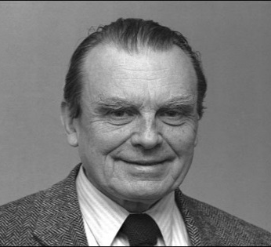
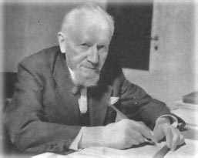
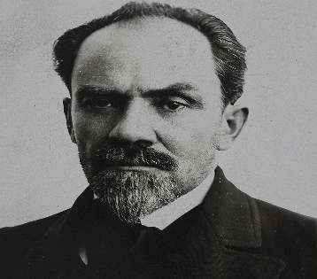
LITERATURE
OTHER WRITERS
- Kornel Makuszyński - Czesław Miłosz
- Jan Kochanowski - Leopold Staff
- Tadeusz Różewicz - Stefan Żeromski

Slide 16
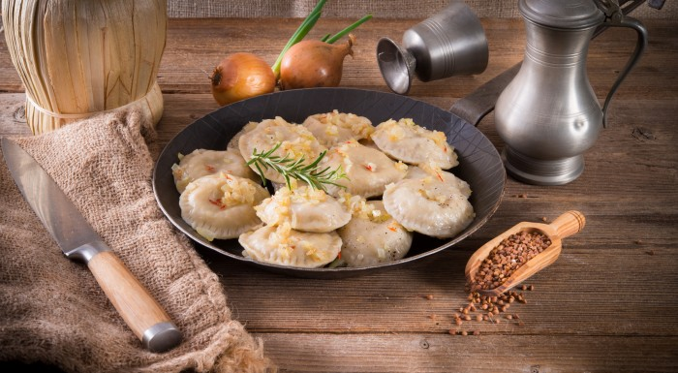
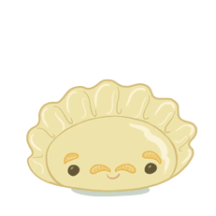
CUISINE
DUMPLINGS (PIEROGI)
Traditional, flourish Polish dish, eaten savory or sweet with various stuffing, eg with mushrooms, cabbage, meat, cheese, strawberries or blueberries.

Slide 17
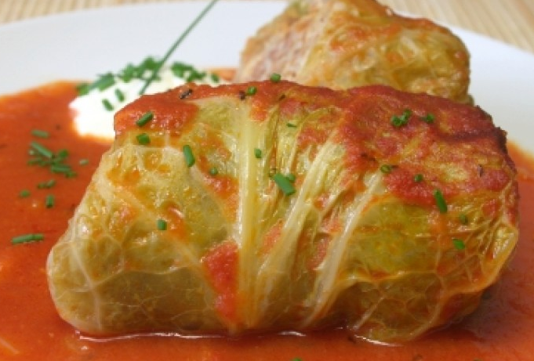
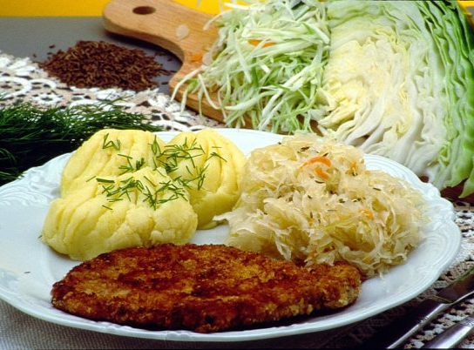
CUISINE
DOVES (GOŁĄBKI)
Half-meat dish with white cabbage leaves. The ingredients for stuffing are ground pork and rice or groats with additions.
The most popular traditional Polish dinner consists of pork chop, potatoes and fried cabbage. It is the dish most eagerly eaten by Poles, but at the same time very caloric.

Slide 18
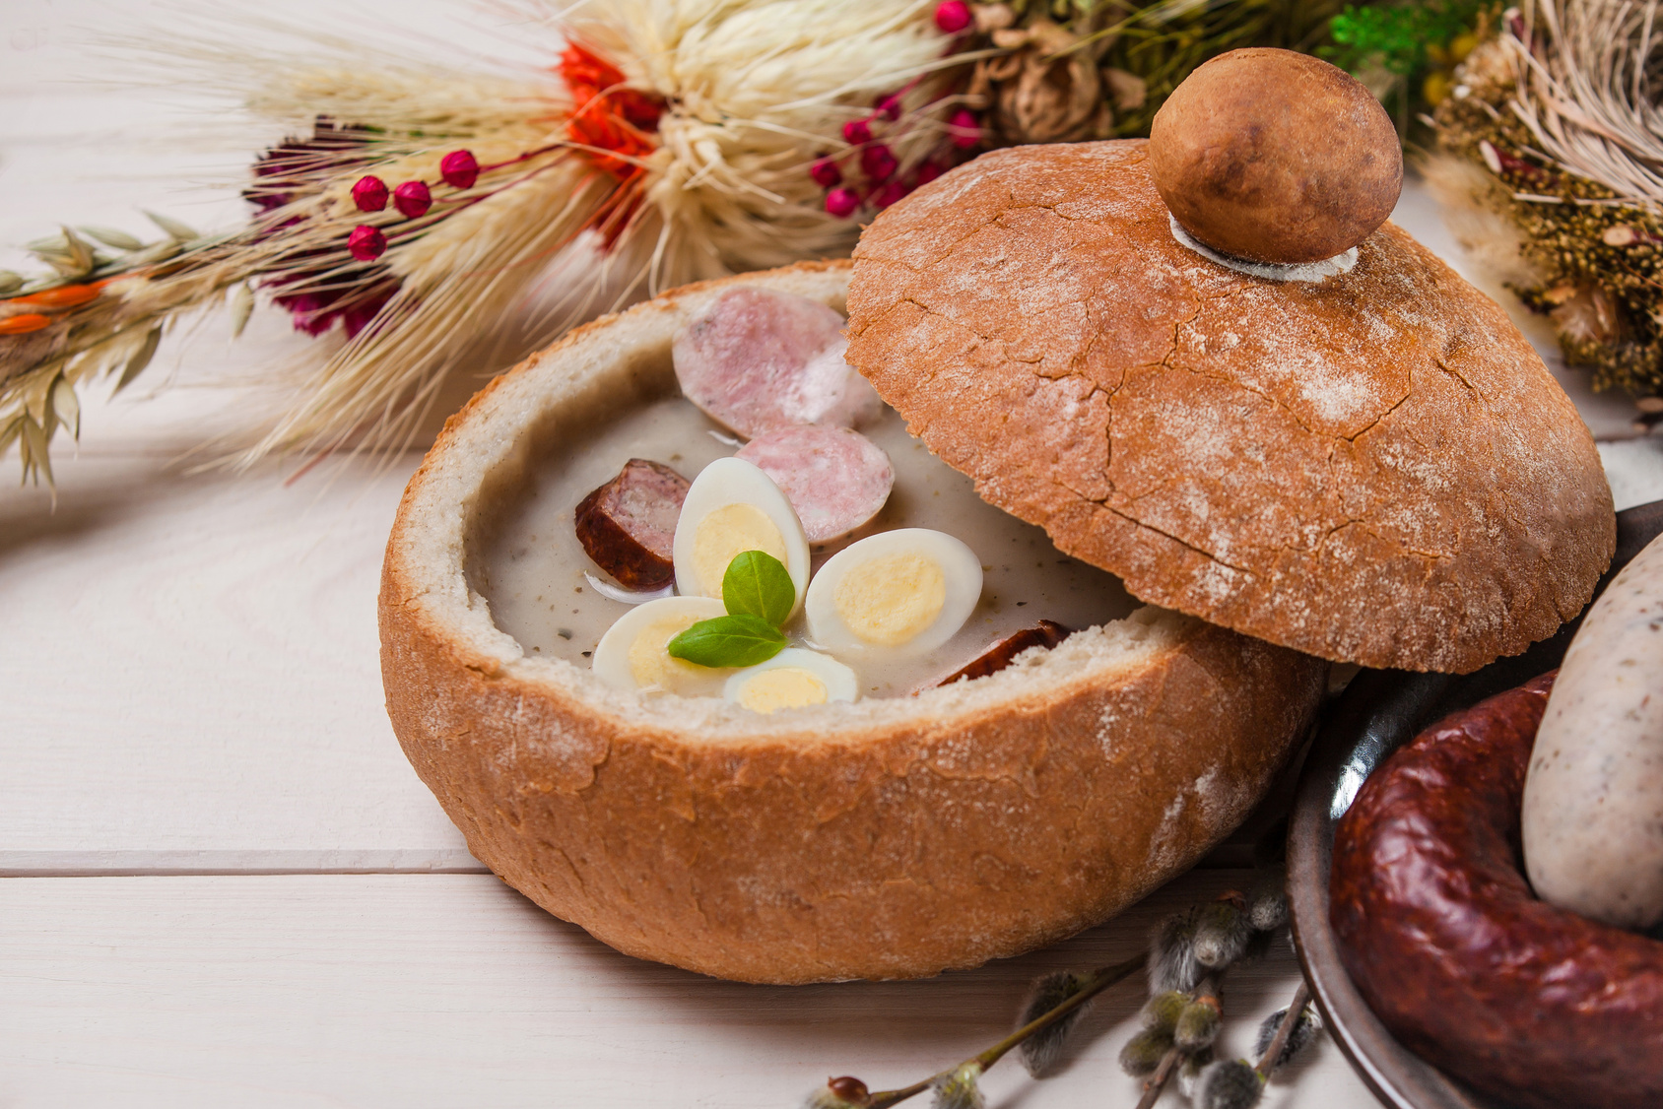
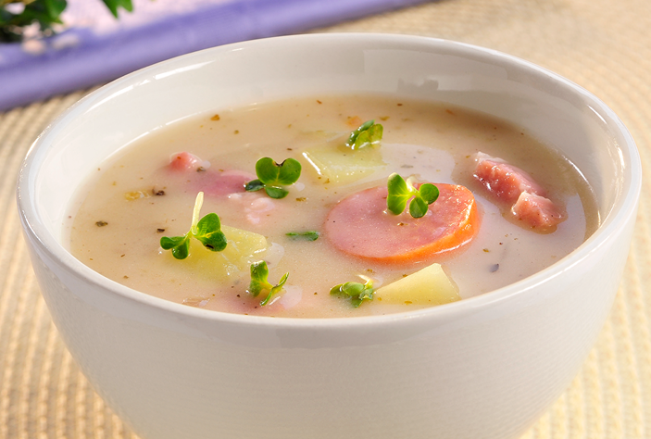
CUISINE
SOUR SOUP (ŻUREK)
One of the oldest Polish soups made with sourdough with a characteristic sour taste. Most often it is eaten for Easter with white sausage and egg.

Slide 19
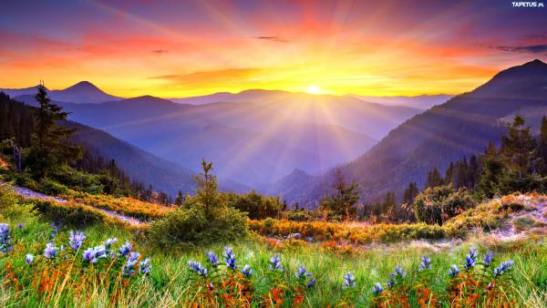
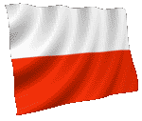
THE END! Thank you for your attention!
Presentation made by
PATRYCJA ZACHARA

