Slide 1
EXOTERMIC AND ENDOTHERMIC REACTIONS
By:1.o

Slide 2
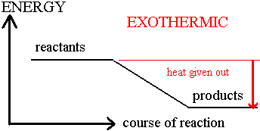
EXOTHERMIC REACTIONS
During a chemical reaction in the system could result in the realise of heat
Chemical or physical change in which heat is released is called exothermic reaction

Slide 3
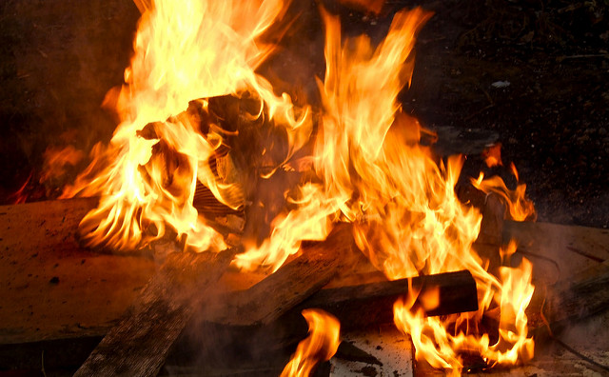
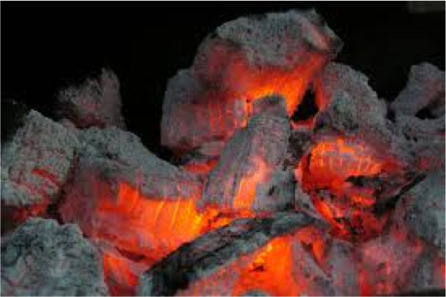
EXOTHERMIC REACTIONS
The best known exothermic reactions are burning coal,wood,natural gas etc.
In exothermic changes, other than heat, energy can be released in the form of light,labor or electricity

Slide 4
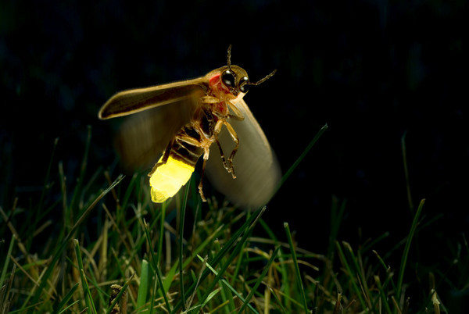
EXOTHERMIC REACTIONS
Many glowing sea organisms or even fireflies produce light by chemical reactions
If the reaction exothermic in one direction,it’s endothermic in the opposite way
Other: candle flame,burning sugar,making an ice cube

Slide 5
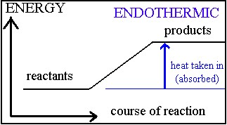
ENDOTHERMIC REATIONS
These reactions take energy from the environment
Energy is normally transfered as heat energy, which causes the reaction mixture and its surroundings to get colder
The temperature decrease can also be detected using a thermometer

Slide 6
ENDOTHERMIC REATIONS
They are the ones in which heat is absorbed and are facilitated by and increase in temperature
Internal energy of the product is bigger than the internal energy of the reactants
If the reaction is one direction, it’s enxothermic in the opposite one

Slide 7
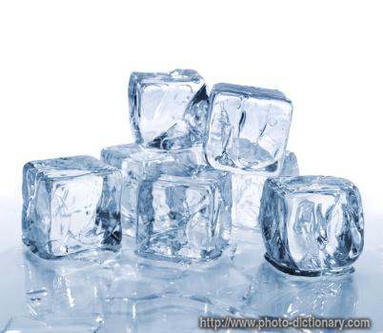
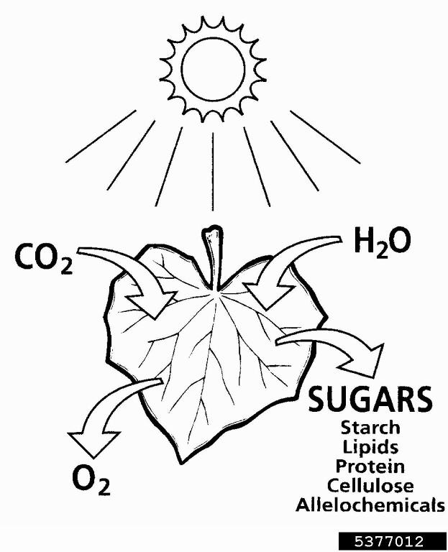
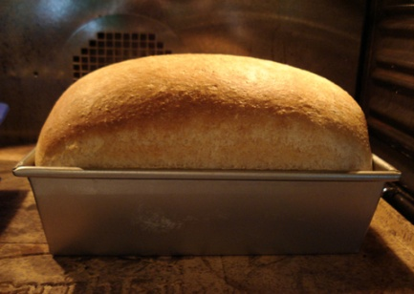
ENDOTHERMIC REACTIONS
Some exemples of endothermic reaction we can see in everyday life,such as :
Melting ice cubes
Baking bread
Cooking an egg
Plants take part in there reactions by producing sugar by photosynthesis

Slide 8
LITERATURE
http://antoine.frostburg.edu
http://www.bbc.co.uk
www.khanacademy.org

