Slide 1
KINETIC AND POTENTIAL ENERGY
By:1.o

Slide 2
ENERGY
Energy occurs in many forms, including chemical energy, thermal energy, gravitational energy, electric energy, elastic energy, nuclear energy etc.
These can be categorized in two main classes: potential energy and kinetic energy

Slide 3
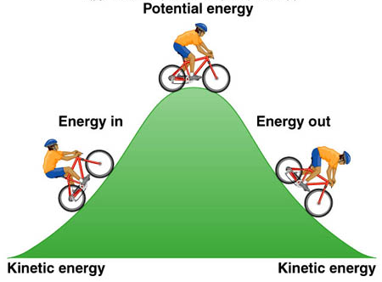
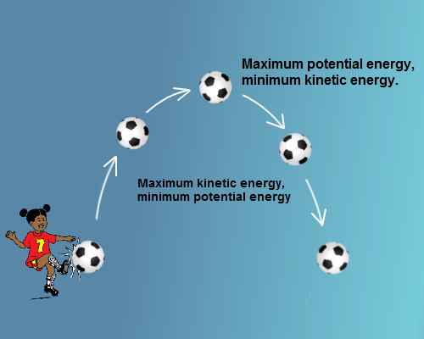
KINETIC ENERGY
Kinetic energy is the energy of motion; it’s defined as the work needed to accelerate a body of a given mass from rest to its stated pace
The kinetic energy, as well as all other forms of energy can not be generated nor disappear by any known way; it can be transferred between objects and transformed into other kinds of energy

Slide 4
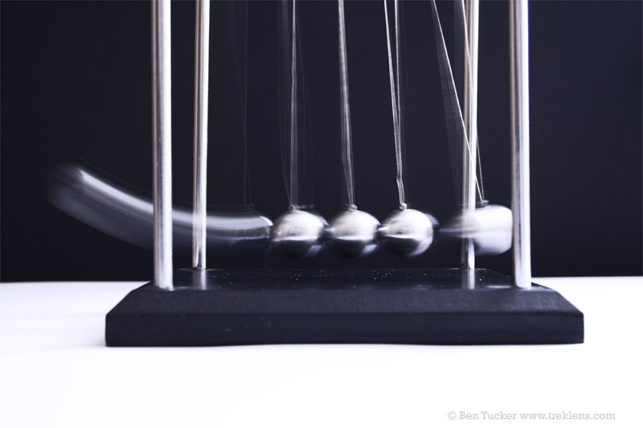
KINETIC ENERGY
The more havier and faster body is, more kinetic energy it will have
Gaining this energy during its acceleration, the body maintains this kinetic energy unless its speed changes

Slide 5
POTENTIAL ENERGY
Potential energy is the stored energy of position possessed by an object;it results from position or configuration
Resting, every object has rest mass potential energy; if the object is in a position to fall and be affected by gravity, it has gravitational potential energy

Slide 6
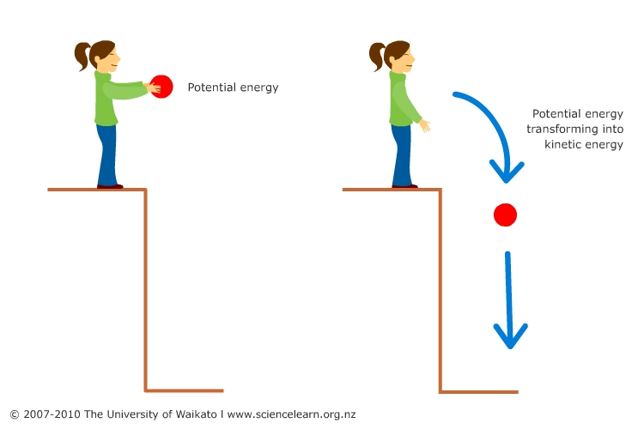
POTENTIAL ENERGY
Physicaly looking, potential energy is energy possessed by a body by virtue of its position relative to others, stresses within itself and with other factors
There are various types of potential energy: gravitational potential energy (a result of a position in a gravitational field), electric potential energy (an electric field) or magnetic potential energy (magnetic field)

Slide 7
LITERATURE
www.physicsclassroom.com
www.eschooltoday.com
www.hyperphysics.phy-astr.gsu.edu
www.whatis.techtarget.com

