Slide 1
Exothermic and endothermic reactions
Dora Milevoj and Dorian Kanciani 1.o

Slide 2
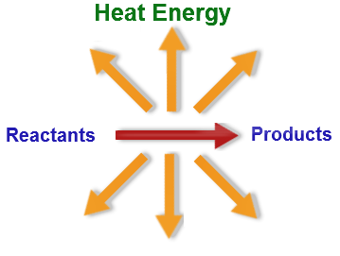
Exothermic reactions
These are reactions that transfer energy to the surroundings. The energy is usually transferred as heat energy, causing the reaction mixture and its surroundings to get hotter. The temperature increase can be detected using a thermometer. Some examples of exothermic reactions are:
burning ( combustion)
neutralisation reactions between acids and alkalis
the reaction between water and calcium oxide

Slide 3
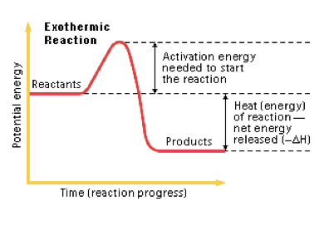
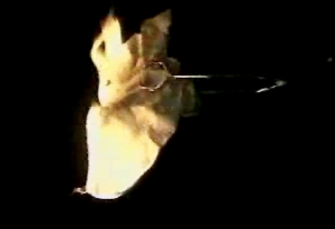
Exothermic reactions
An example of an Exothermic reaction.

Slide 4
Examples:
Combustion reactions of fuels
Neutralization
Burning of a substance
Deposition of dry ice (carbon dioxide) from the gaseous state
Adding water to anhydrous copper(II) sulfate
The thermite reaction
Reactions taking place in a self-heating can based on lime aluminium
Many corrosion reactions such as oxidation of metals
Most polymerization reactions
The Haber process of ammonia production
Respiration
Decomposition of vegetable matter into compost
Solution of sulfuric acid into water
Dehydration of sugars upon contact with sulfuric acid
Detonation of nitroglycerin
Nuclear fission of uranium-235

Slide 5
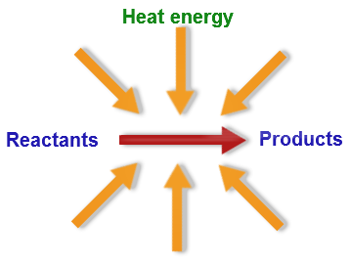
Endothermic reactions
These are reactions that take in energy from the surroundings. The energy is usually transferred as heat energy, causing the reaction mixture and its surroundings to get colder. The temperature decrease can be detected using a thermometer. Some examples of endothermic reactions are:
the reaction between barium hydroxide and ammonium chloride
the reaction between ethanoic acid and sodium carbonate

Slide 6
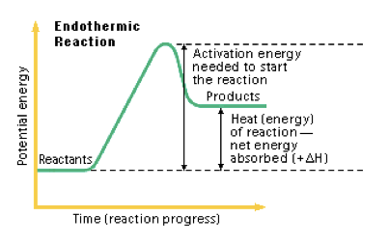
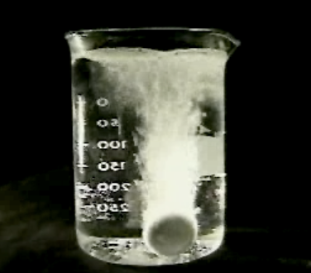
Endothermic reactions
An example of an Endothermic reaction

Slide 7
Examples:
Photosynthesis
Melting ice
Evaporating liquid water
Sublimation of carbon dioxide (dry ice)
Cracking of alkanes
Thermal decomposition reactions
High-energy neutrons can produce tritium from lithium-7 in an endothermic reaction, consuming 2.466 MeV. This was discovered when the 1954 Castle Bravo nuclear test produced an unexpectedly high yield
Electrolytic decomposition of sodium chloride into sodium hydroxide and hydrogen chloride
Dissolving ammonium chloride in water
Nucleosynthesis of elements heavier than nickel in stellar cores
Nuclear fusion of elements heavier than iron in supernovae

Slide 8
Sources:
http://tinyurl.com/6rswwkr
http://tinyurl.com/884a536
http://tinyurl.com/7haoyyg
http://tinyurl.com/7haoyyg
http://tinyurl.com/3qtt6oq
https://thesmartproject.wikispaces.com/Endothermic+%26+Exothermic+Reactions
☺

