Slide 1
FISICA Y QUIMICA
CHEMICAL ENERGY
Sandra López

Slide 2
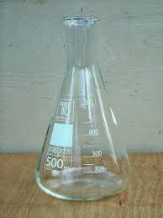
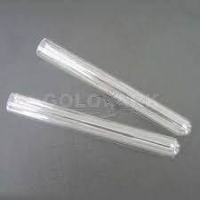
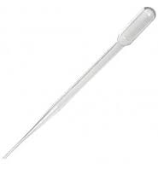
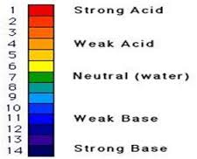
1th PRACTICE: EXOTHERMIC REACTION
MATERIALS
-NaOH 1 M
-HCI 0,5 M
-pH indicator
-2 Assay tube
-pippete
-termomether

Slide 3
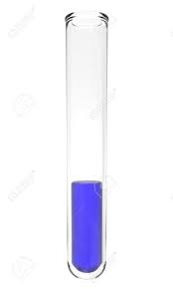
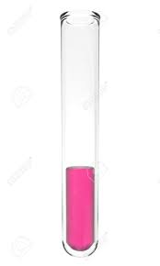
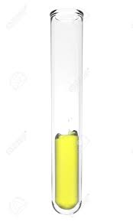
THE PROCES:
First you must add 2,5mL of NaOH 1 M and 2 drops of pH indicator in the tube A and in the tube B add 5mL of HCI 0,5 M and 2 drops of pH indicator.
Then mesure the temperature in both tubes.
Finally mix both tubes and mesure the temperature of the result of the mix.
A B
+ =

Slide 4
THE RESULTS
ASSAY TUBE | COLOUR OF THE LIQUID | TEMPERATURE
A | BLUE | 22ºC
B | PINK | 22ºC
Mixture | YELOW | 24ºC

Slide 5
CONCLUSIONS
- When we mix the substance A with B the
color change to yellow.
- The temperature up 2 ºC

Slide 6
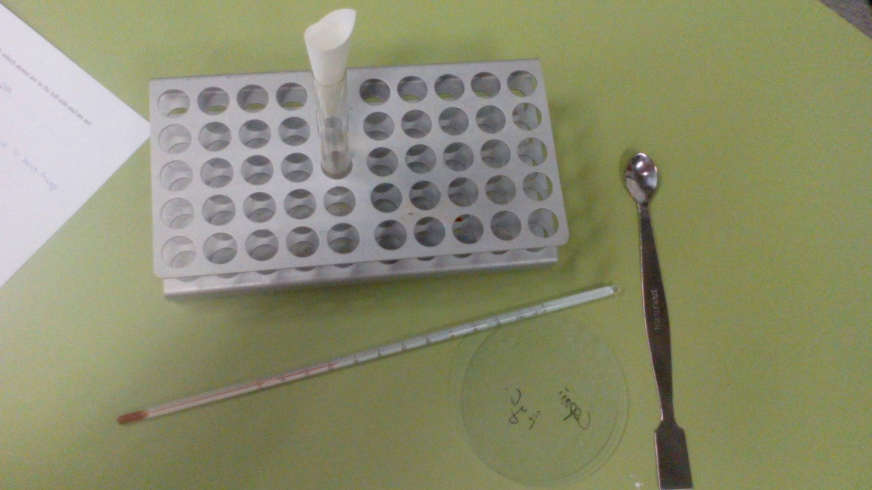
2th PRACTICE ENDOTHERMIC REACTION
MATERIALS
- Ba(OH)2
- NH4NO3
- Assay tube
- thermometer
- watch glass

Slide 7
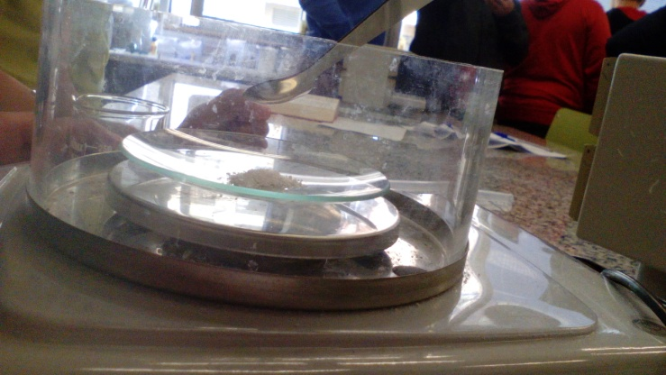
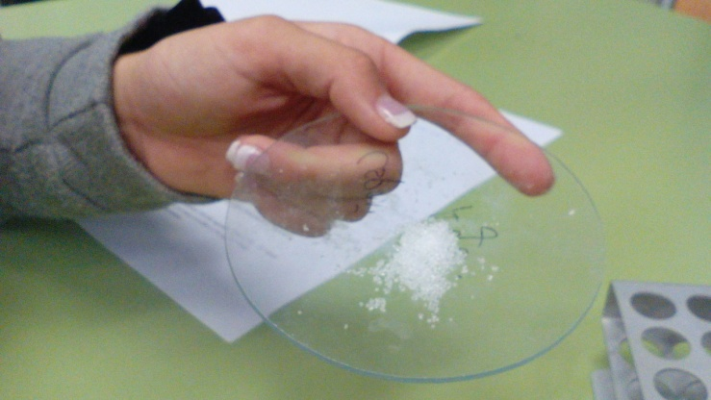
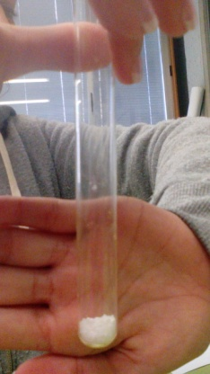
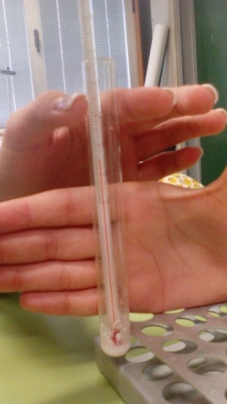
THE PROCES:
First you must mesure the room temperature
Then mesure 0,642g of Ba(OH)2 in watch glass and add the assay tube mesure 0,600g of NH4NO3 in the watch glass and add it to the essay tube too
Finally mix it and measure the temperature of the mixture

Slide 8
THE RESULTS:
ROOM TEMPERATURE | FINAL TEMPERATURE
22ºC | 5ºC

Slide 9
CONCLUSIONS
- The mixture becomes liquid and cold
- The temperature of the mix has gone down 17ºC

Slide 10
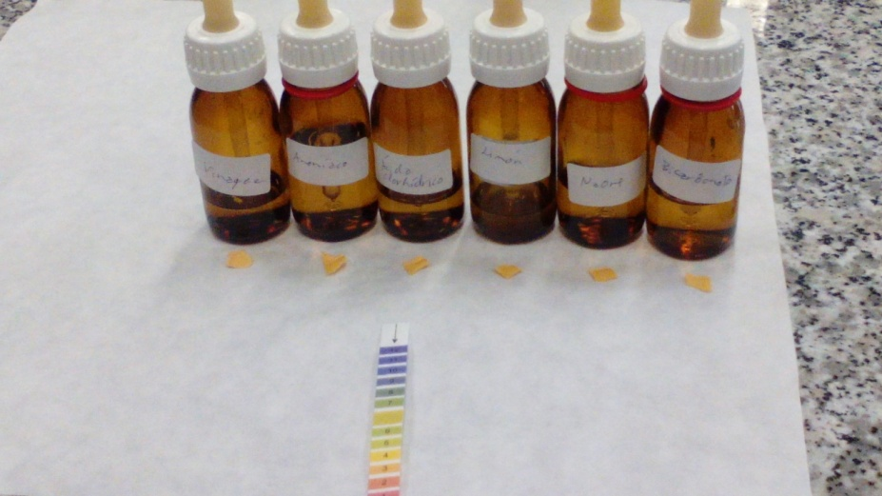
3th PRACTICE ACIDS AND BASES
MATERIALS
-Acid base indicator
- Substancies(Vinegar, ammonia, hydrochloric acid, bicarbonate, lemon, N7OM)

Slide 11
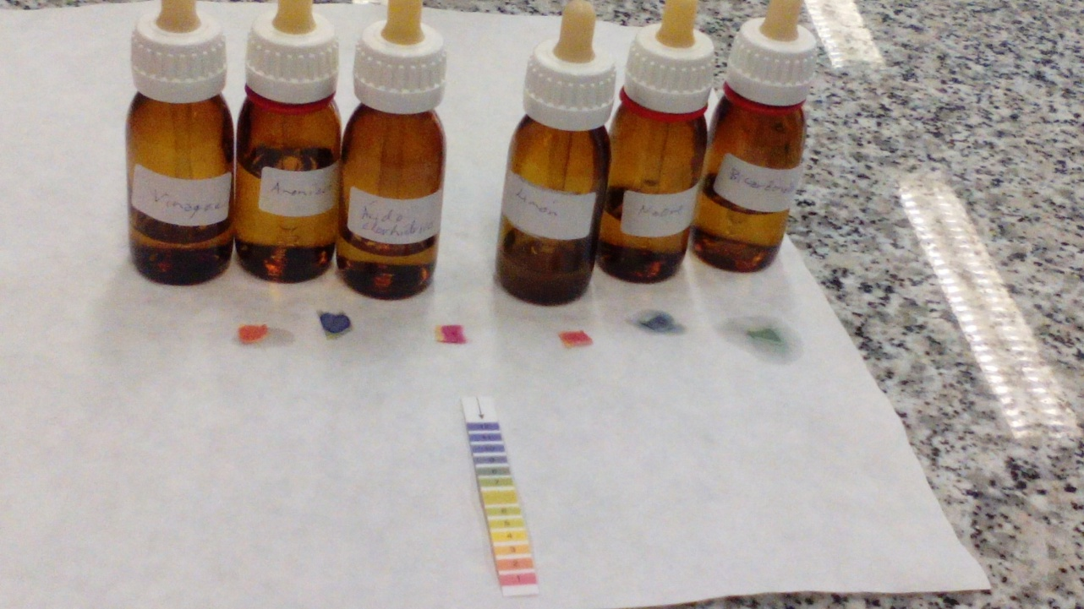
PROCES:
Add one drop of each of the tubes of the indicator

Slide 12
THE RESULTS
SUBSTANCE | pH
Bircarbonate | 7
N7OM | 9
Lemon | 2
Hydrochloric acid | 1
Ammonia | 10
Vinegar | 30

Slide 13
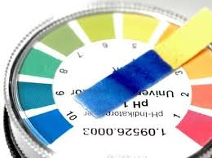
CONCLUSIONS
Each acid has a different components

