Slide 1
Physics and chemistry work
Made by soheib daadi lachi.

Slide 2
Materials (i)
Termomether:to mesure the temperature
Pipette to put substances
pH indicator
2 assay tubes
NaOH 1M
HCl 0.5 M

Slide 3
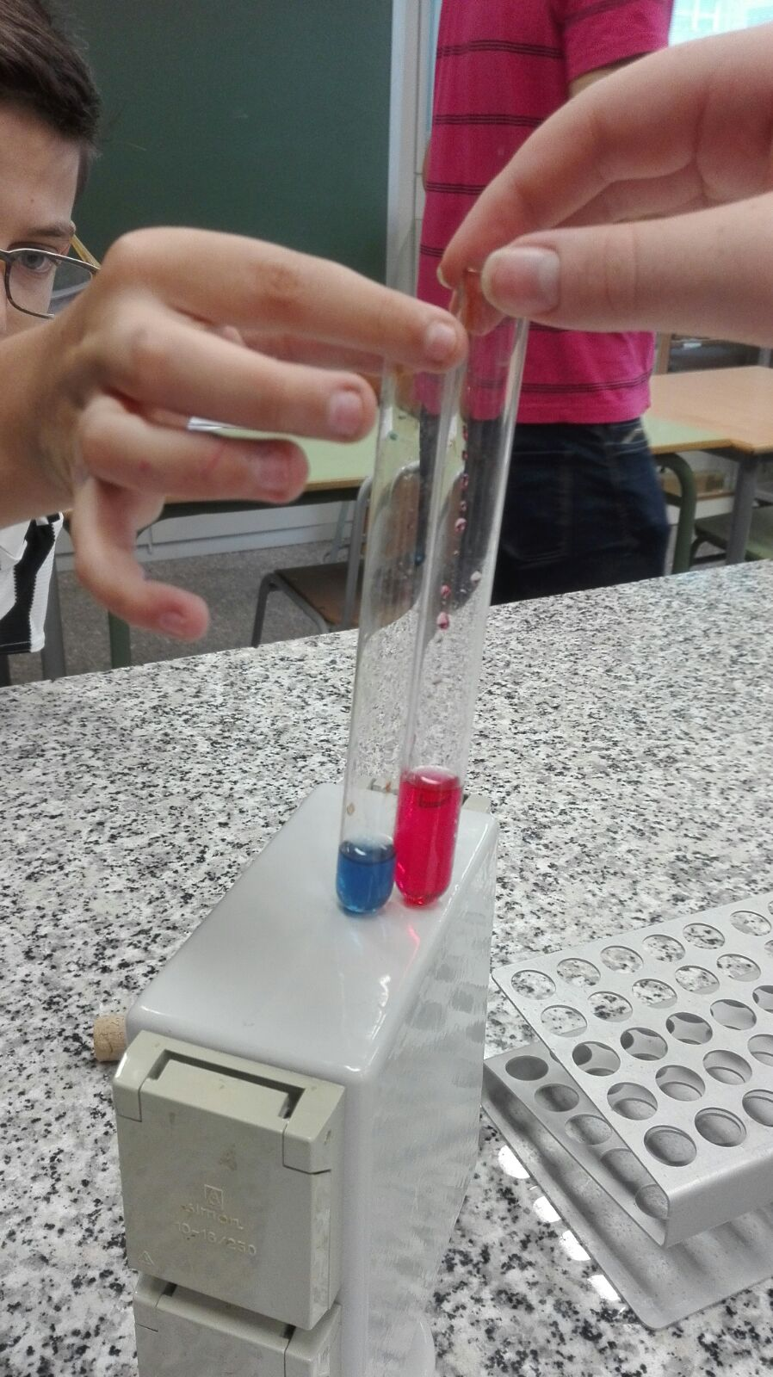
Procedure
First,in the test tube A we put 2.5 ml of 1M NaOH and two drops of the pH indicator
Then,in the test tube B we put 5 ml of 0.5 M HCl and two drops of the pH indicator
TUB A TUB B
NaOH HCl

Slide 4
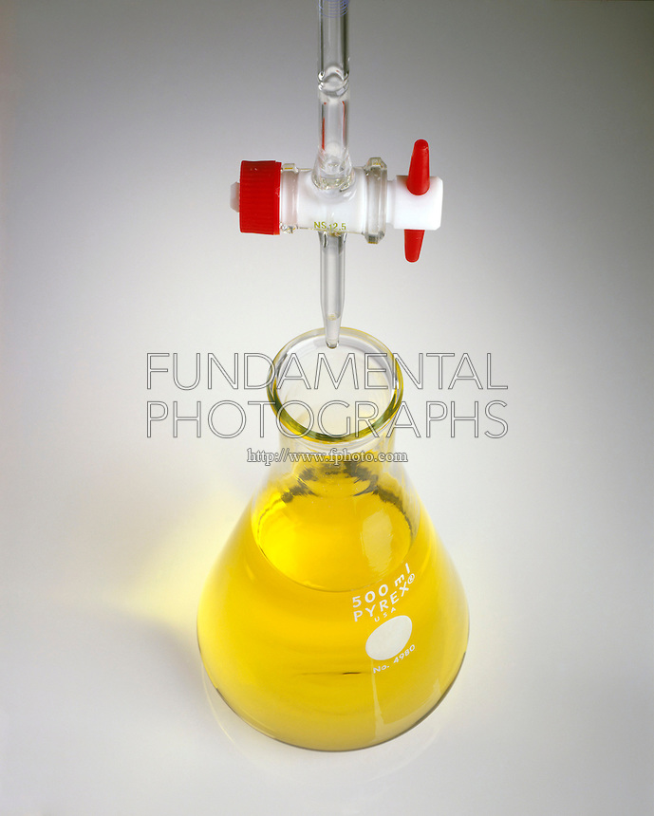
Results
NaOH+HCl
The result is a yellow liquid like this and point it at the table.

Slide 5
The data table (I)
This is the data table,we point the data on it.(this is the exothermic reaction)
A | Blue | 24°C
B | Fuchias | 24°C
The mix | Yellow | 26°C

Slide 6
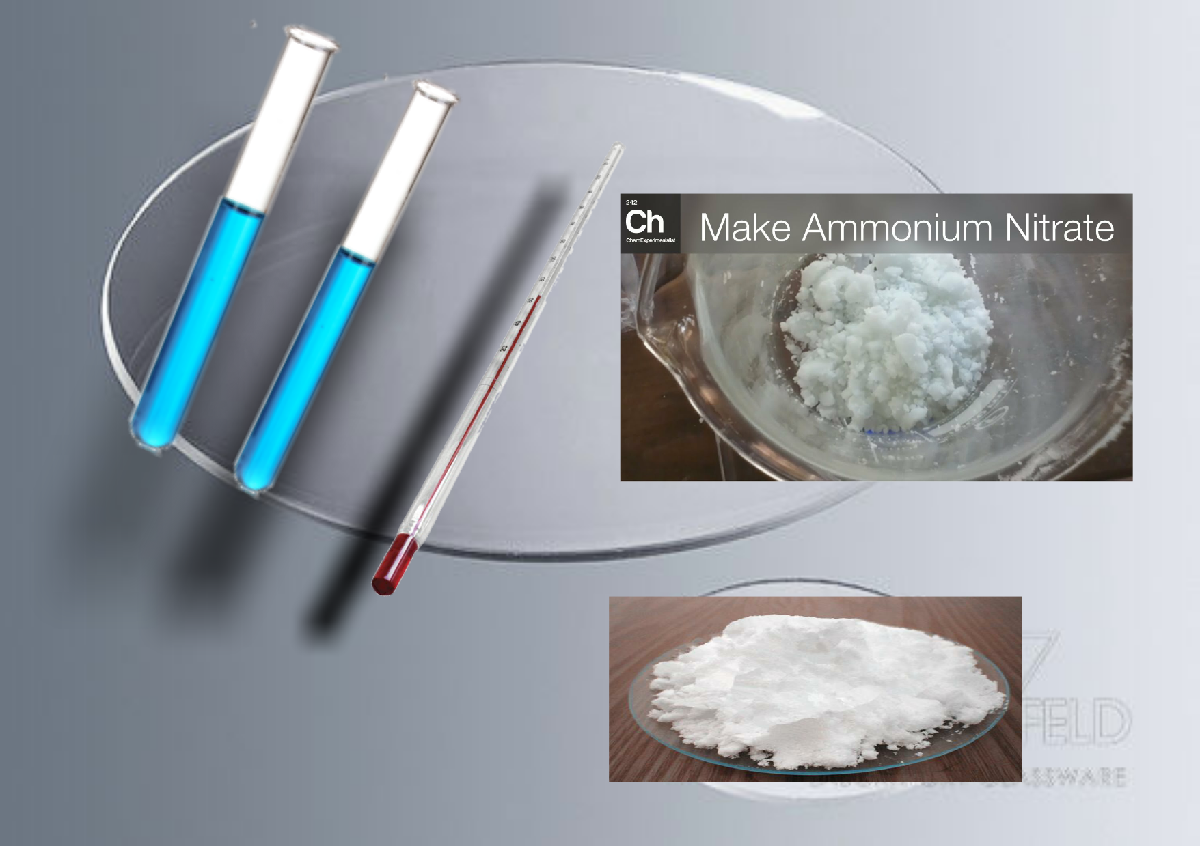
Materials (ii)
Two test tubes: to mix and see results
A thermometer: to measure temperature
NH4NO3 in a test tube
Ba (OH) 2 in another test
Watch glass

Slide 7
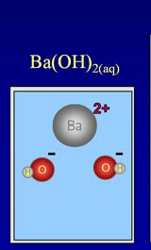
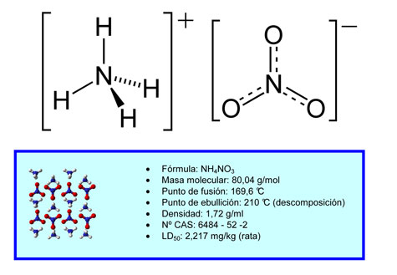
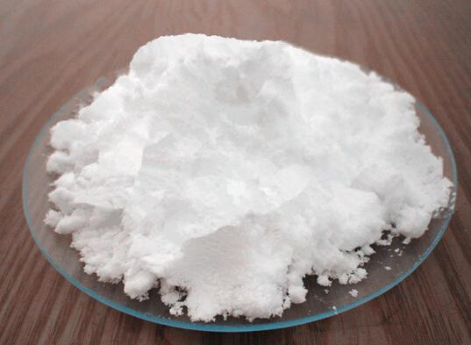
Procedure
First take NH4NO3 (ammonium nitrate), put on the watch crystal 0'600 g and put into glass test tube.
Then take Ba (OH) 3 (barium hydroxide), put on the watch glass 0'642 g and put it into a test tube.
After we mix it

Slide 8
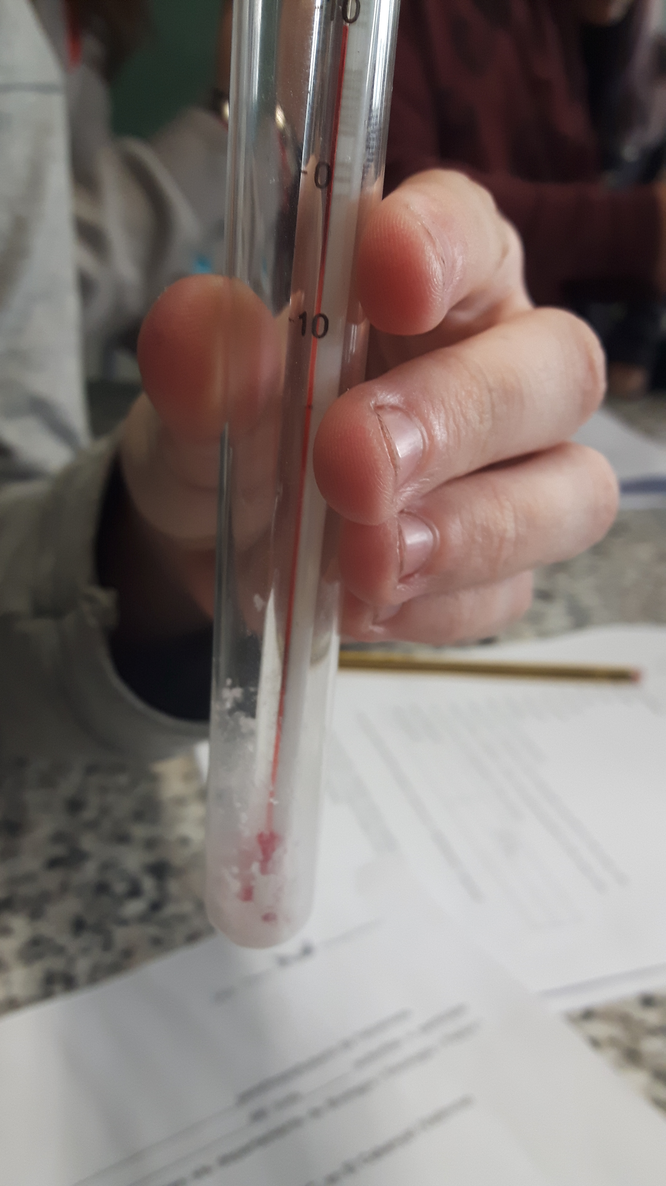
Results
The result of the mixture of NH4NO2 and Ba (OH) 2 is a very cold liquid is approximately 8 ° CAnd everything we do point in the table.

Slide 9
Data table (II)
The data table as follows: (endothermic reaction)
NH4NO3 + Ba(OH)2
First temperature | 21°C
Last temperature | 8°C

Slide 10
To calculate the energy
To calculate the energy in the test tube we need this formule:
E=M•Ce(Tf-Ti)
For example=1’242 g Ce=specific heat Ti=21°C
Tf=8°C
E=1’242×1(8-21) E=1’242×(-13) E=-16’146 cal
To pass it on Joules= 1cal=(4’18 J) -16’146cal×4’18=−67’49028 J

Slide 11
The end

