Slide 1
Christmas and New Year’s customs in Greece

Slide 2
Christmas customs
At Christmas in Greece, we decorate a tree or a boat, which is more traditional.

Slide 3
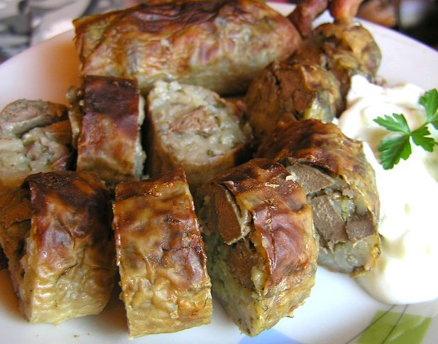
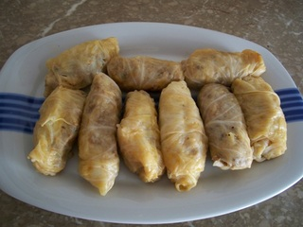
Before Christmas, every family slaughters a pig, which they buy in spring. Then, they give the intestines to women and they make “bombares” and “giaprakia”, our traditional Christmas food.

Slide 4
Bombares
Ingredients
2 large intestines of a pig
3 cups of rice
½ kg tsigarides (pork)
2 onions
Oregano, salt, black and red pepper
Mint and parsley
1 lemon
1 glass of oil 1 teaspoon of cumin
We wash the intestines and put them in a pot with water and lemon
We chop the onions and put them in a pan with oil.
We add tsigarides and rice and mix.
We add the spices and the rice and leave them to boil.
We fill the intestines with the mixture and cook in the oven with water in 200 degrees.

Slide 5
Giaprakia
We remove the exterior leaves of the cabbage that are black.
We cut the leaves
We boil the cabbage leaves until soft.
We leave the leaves to drain.
We chop the fresh onions and the parsley
We mix the minced meat, the rice, the parsley, the onion, 1 tablespoon of salt, the pepper and the oil with our hand.
We cut the leaves in 15x15 cm
We put in each leaf a tablespoon of the mixture and we wrap it
We place all the wrapped leaves in a kettle, in which we have placed few stalks from the leaves on the bottom
We pour a cup of oil and a tablespoon of salt
We place a dish on top, that presses the giaprakia
We pour 3 mugs of water
We cook for half an hour in low heat
Ingredients
300 gr. minced veal
300 gr. minced pork
400 gr. Carolina rice
some parsley
5 green onions
1 middle-sized onion
1 big cabbage
2 tablespoons of salt
¼ teaspoon of pepper
1 and ½ cup of virgin olive oil

Slide 6
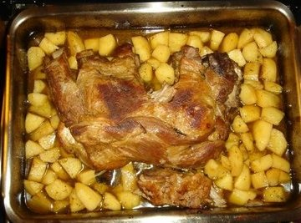
Pork with potatoes
Ingredients
Wash thoroughly the piece of meat. Put in a bowl to marinate, adding salt, pepper, oregano and ointments with mustard.
Purify and cut the potatoes into large chunks.
Place them in the pan.
Add salt, pepper and oil after the pan and put them and the meat in the oven for about 2 hours at 200o C
2 kg pork
1,5 kg patatoes
pepper
salt
oregano
mustard
olive oil

Slide 7
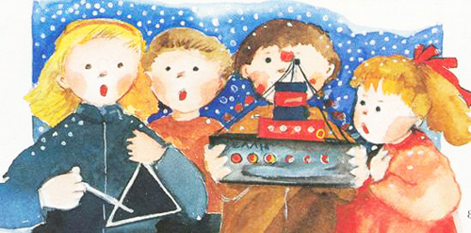
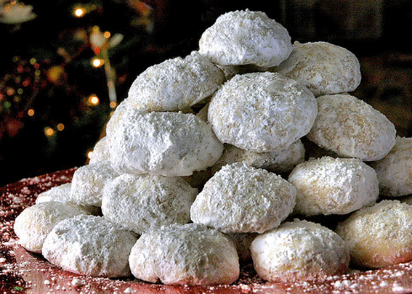
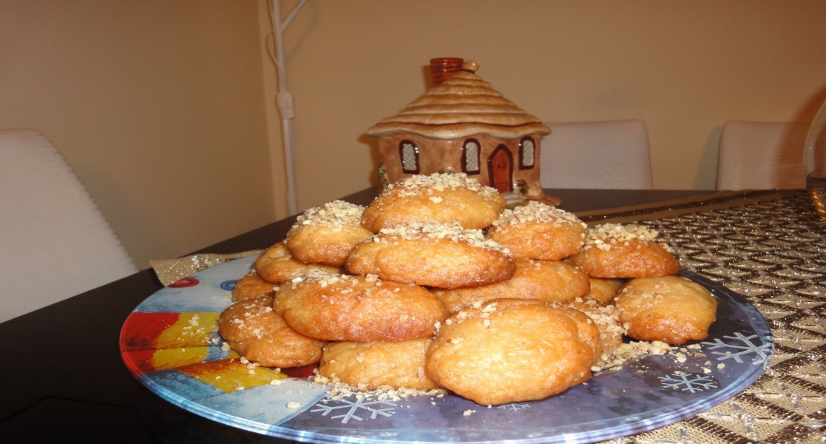
One day before Christmas, the children go out in the streets and sing the Christmas carols (called “kalanta” in Greece).
People give them sugar-coated almond butter biscuits (kourabiedes) and honeycakes (melomakarona).

Slide 8
Kourabiedes
Ingredients
½ kg of pure butter
1 cup of confectioner’s sugar
2 eggs yolks
1 teaspoon of soda dissolved in lemon
2 vanillas
flour (as much as it takes)
almonds
We mix the butter with sugar until it becomes white. Then, we add the eggs, the soda, the vanillas, the almonds and the flour. Cut them in shapes and bake until they become red. When they get cold, we add sugar…!!!

Slide 9
Melomakarona
Ingredients
Stir the oil, sugar and orange juice.
Add the other materials and the flour, at the end.
Bake at 180o C for 30 mins
Boil the water and the sugar
Add the honey and boil in low heat for 5 mins.
Remove the pot from heat and dip the melomakarona in the syrup.
Sprinkle with almonds
2 glasses of oil
1 glass of sugar
1 glass of orange juice
1 cup of cognac
a little semolina
2 teaspoons of baking soda
1 spoon of clove
½ teaspoon of baking powder
½ teaspoon of cinnamon
flour (as much as it takes)
1 cup of almonds
For the syrup
2 glasses of sugar
1 glass of water
1 glass of honey

Slide 10
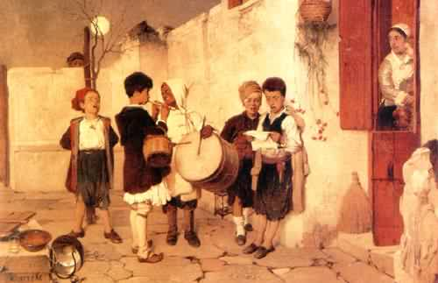
New Year’s customs
On New Year’s Eve, the children go from house to house and sing the New Year’s carols.

Slide 11
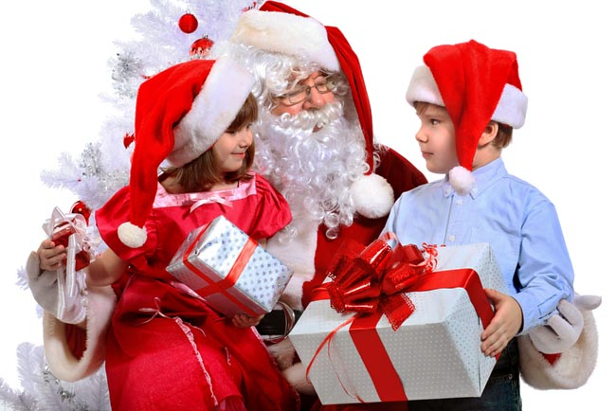
On the 1st of January (Protochronia) the children wait for Agio Vasili, because he brings them presents. Agio Vasili is the Greek Santa Claus
Mum and grandmother make biscuits for Agio Vasili and they make vasilopita and put a coin in it (flouri)

Slide 12
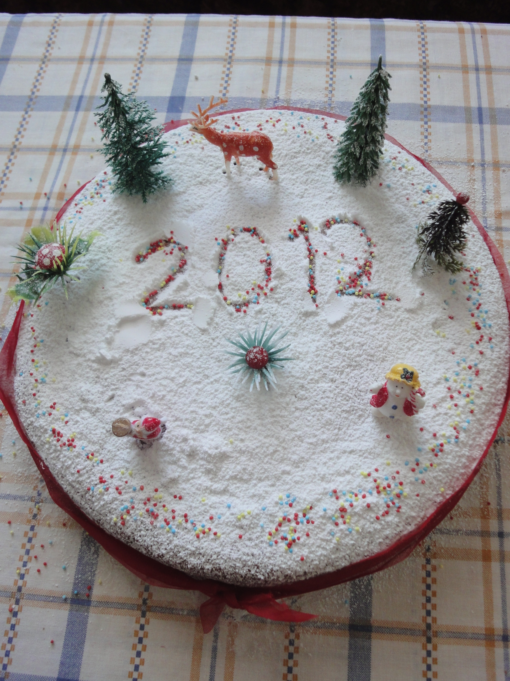
The family gets together, celebrates and the children open the presents and cut the vasilopita.
The first piece is for Christ, the second for the house and then pieces for everyone.
The one who gets the piece with the coin will be the lucky one of the year.

Slide 13
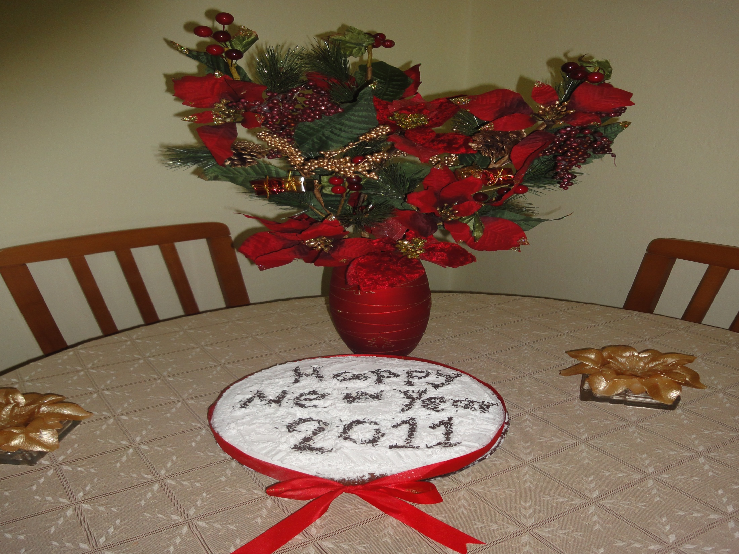
Vasilopita
Heat the milk to lukewarm, melt within this the brewer’s yeast.
Add a few tablespoons of flour to become a thick batter. Cover and leave in a warm place
Put the flour and the salt in a large bowl, melt butter and add to flour.
Boil some water with mahlepi strain it and pour to the flour
Add the eggs, sugar and brewer’s yeast that has swelled
Knead all ingredients until a soft dough
Cover the dough, put in a warm place and let it double in volume
Knead again and place on greased oven dish
Brush with the egg, sprinkle with almonds and sesame seeds
Bake for over an hour
Ingredients
1,250 grams flour
3 tablespoons yeast
330 grams of butter milk
440 grams of sugar
4 tablespoons sesame
100 grams almonds and white broker
1 tablespoon mahlepi or anise
220 grams milk
A little salt

