Slide 1
English Project Slide
Studies and S.O.S Project Robotics Parts

Slide 2
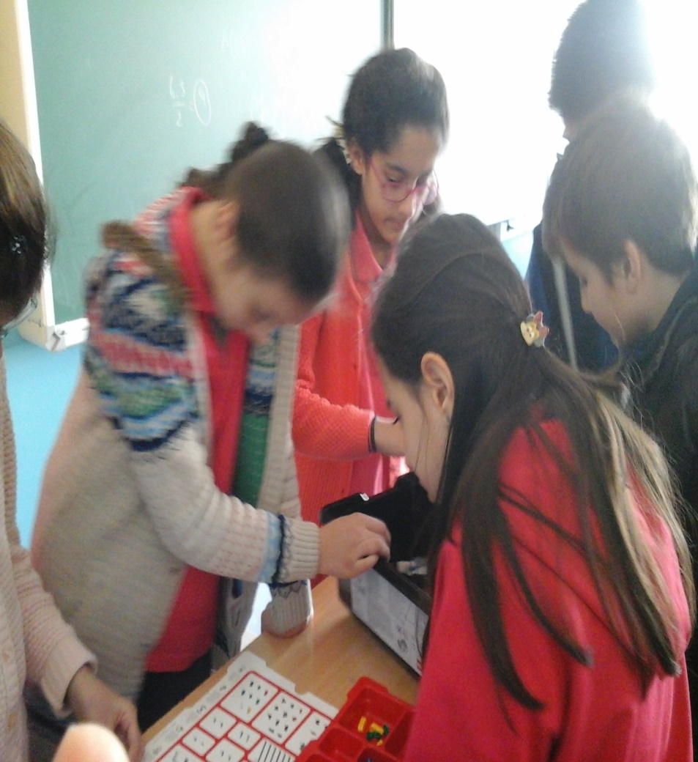
Studies

Slide 3
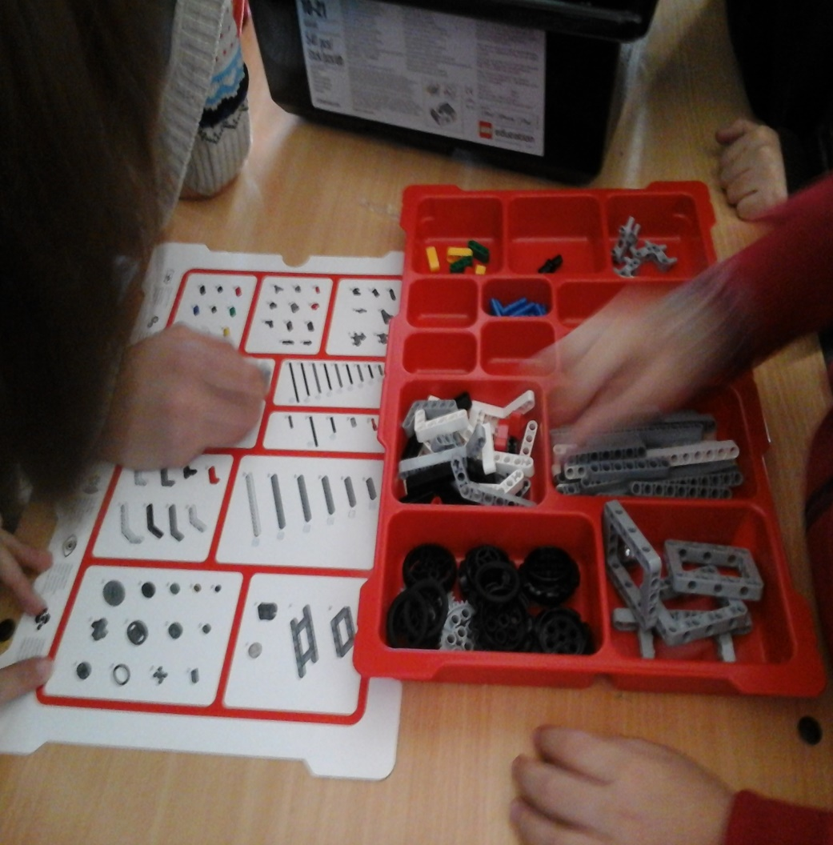
S.O.S project robotIcs Parts

Slide 4
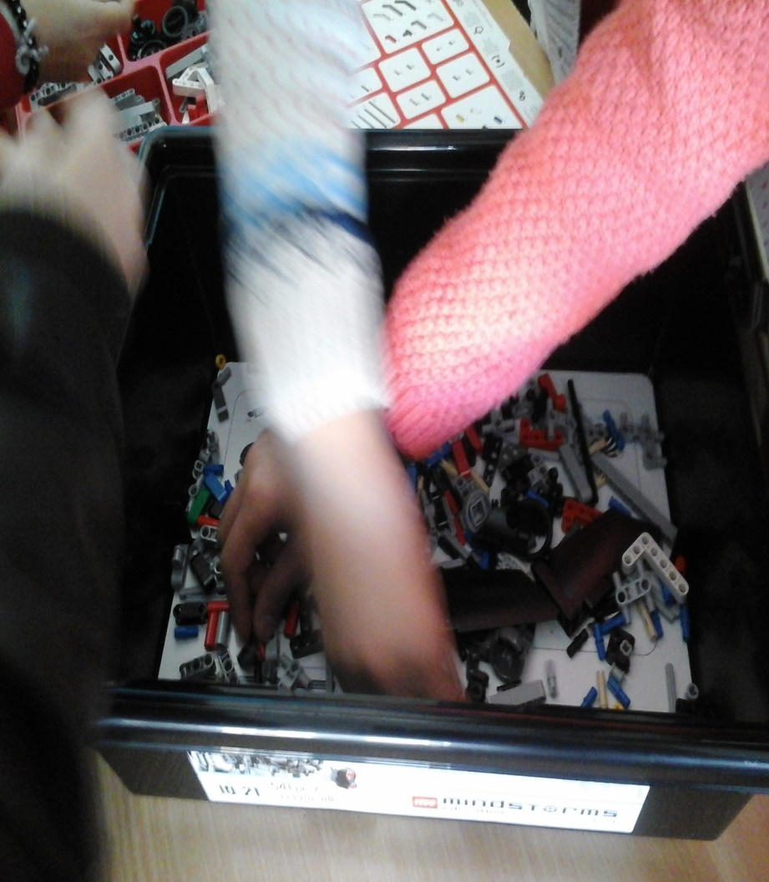
Studies

Slide 5
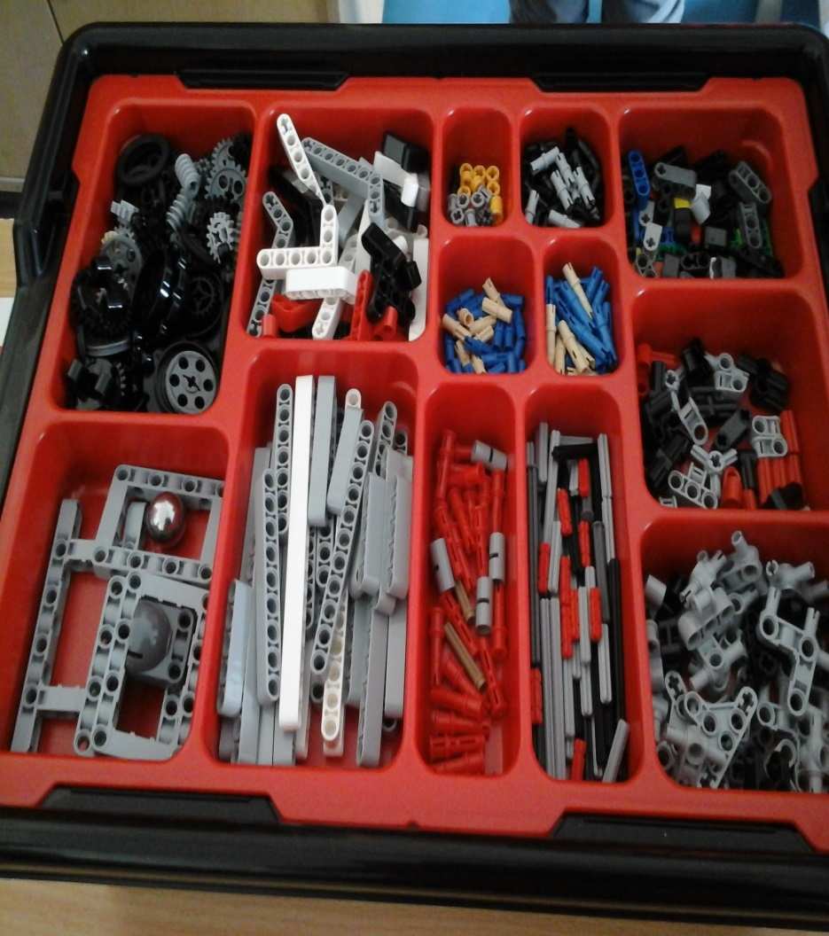
S.O.S project robotIcs Parts

Slide 6
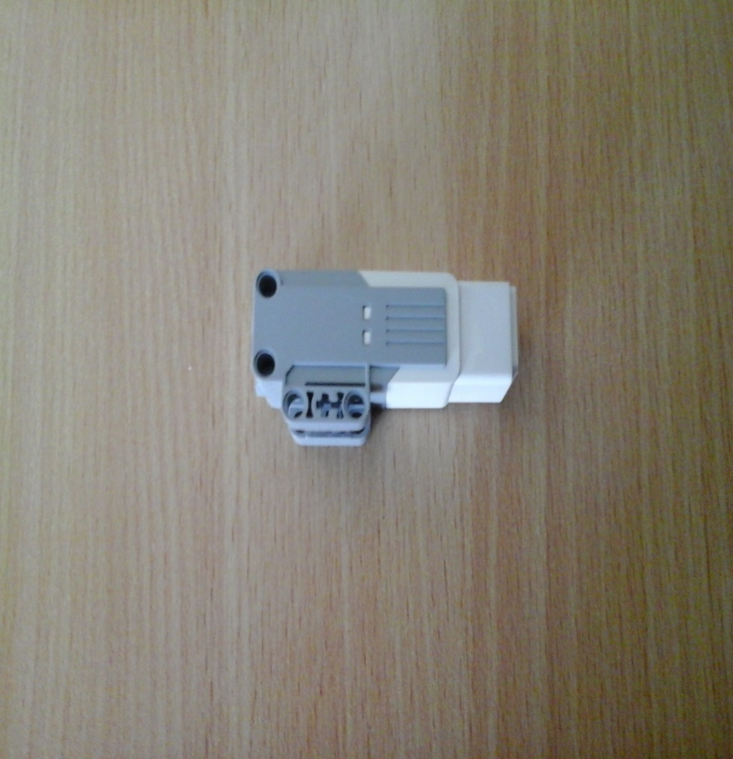
S.O.S project robotIcs Parts (large engine and medium engine)

Slide 7
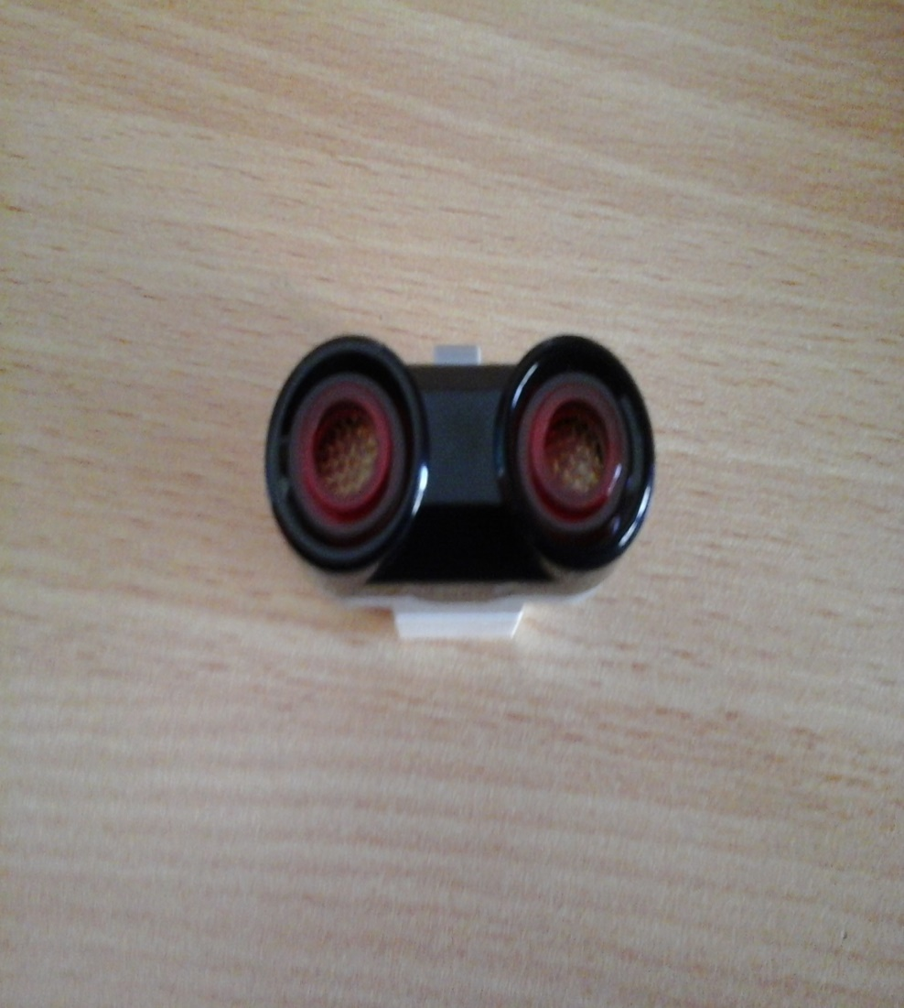
S.O.S project robotIcs Parts (touch sensor and ultrasonIc sensor)

Slide 8
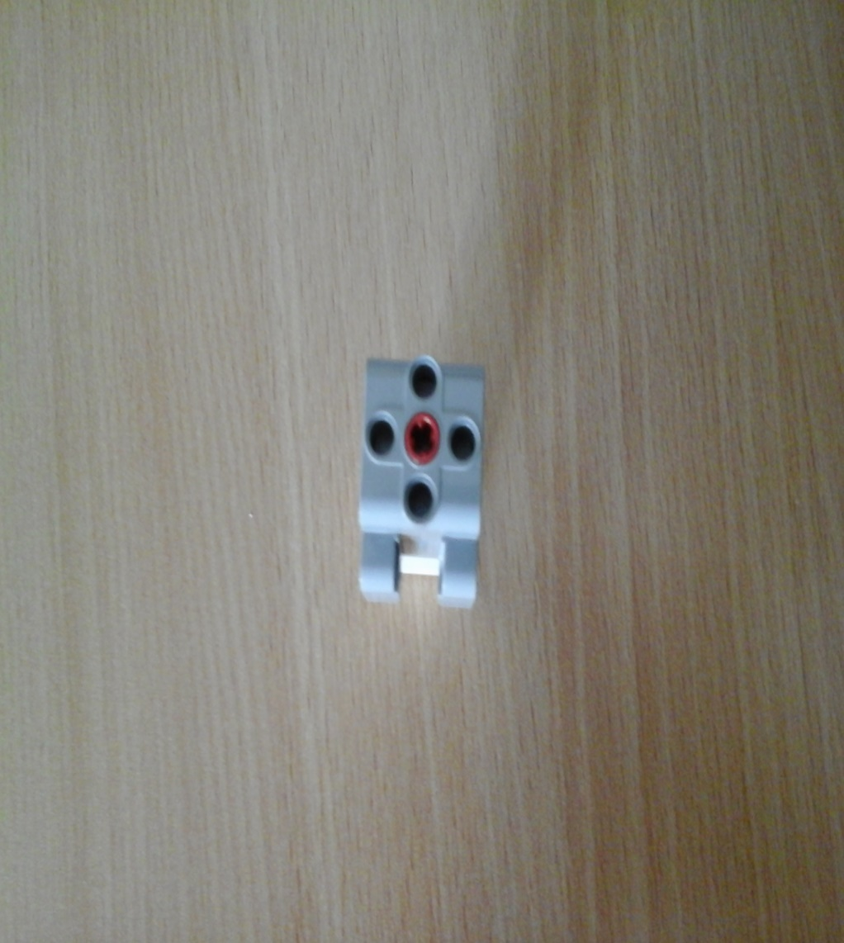
S.O.S project robotIcs Parts (Gyro sensor and medIum engine)

Slide 9
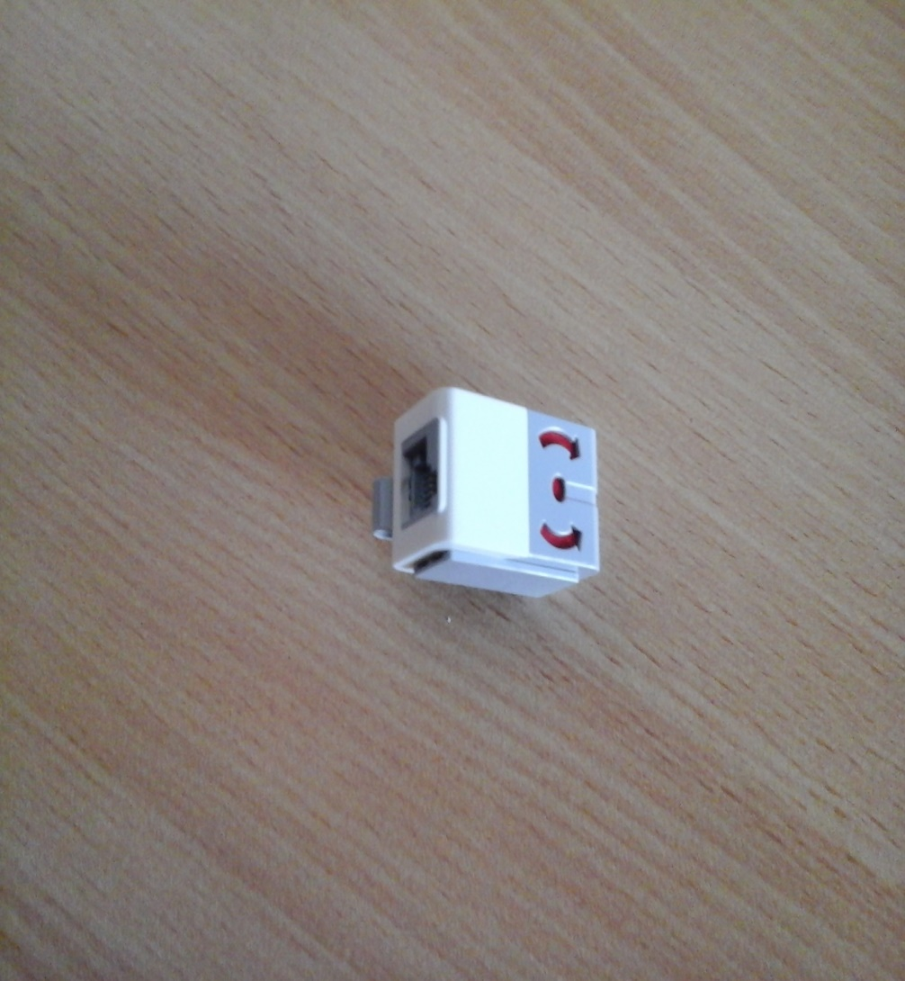
S.O.S project robotIcs Parts (color sensor and gyro sensor)

