Slide 1
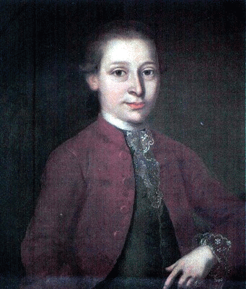
Johan Helmich Roman
”The father of the Swedish music”
”Sweden´s Händel”

Slide 2
Personal facts
He was born in Stockholm 1694, and died
63 years old 1758 in Kalmar.
He suffered from tongue cancer which finally killed him.
Roman got a very caring upbringing.
His father Johan Roman was kapellmeister at the royal court orchestra.

Slide 3
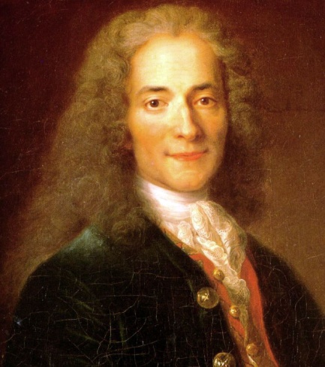
His mother was Catarina-Margareta von Elswish (she was from the nobility).
Roman was married first to Eva Emerentia Biörck, then to Maria-Elisabeth Baumgardt.

Slide 4
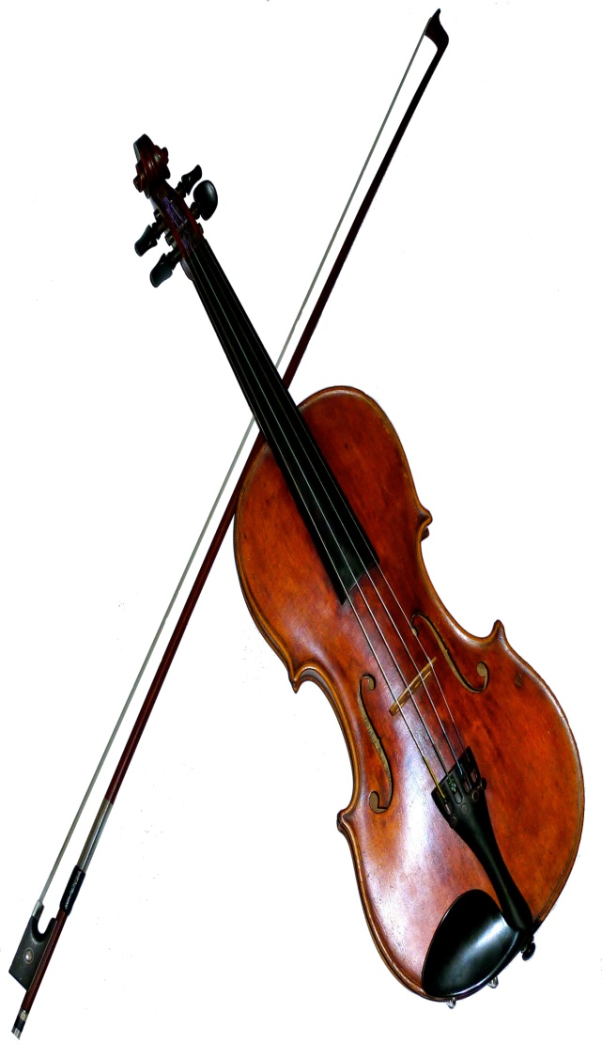
Music life
At seven years old he played the violin for
the royal court for the first time.
When he was 17 years old he was emplyoyed by the Royal court orhestra.
When he was 21 years old he was allowed by king Karl XII to make a study trip to London, and very quickly he was emplyed to play at the opera orchestra at the King´s theater under George Friedrich Händel.
He got deeply inspired by Händel.
Soon he was called back to Sweden and came back to the Royal court opera orchestra.
Roman had a career within the orchestra and 1754 he became superintendent for the Royal court orchestra.

Slide 5
He visited England, France, Italy and German to deepen his knowledge about music.
He was a virtous at the violin and the oboe.
He was an excellent musical director as well.
He translated and played a lot of works by other countries´composers, for example by Händel and Pergolesi.
The biggest importance Roman had has a composer, though.
Roman mainly was a baroque composer, but he made music within all genres except for opera.

Slide 6
Roman was drawn to spritual music, from which he was very inspired.
He wrote a lot of works for the orchestra, for a lot of different instruments, especally for the violin and oboe, but he also wrote a lot of vocal works.
His most famous work is ”Svenska mässan” (The Swedish mass) which was first performed in 1752.
https://www.youtube.com/watch?v=dQYcymRy2N0

