Slide 1
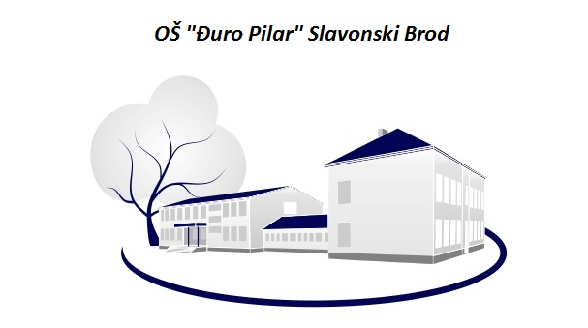
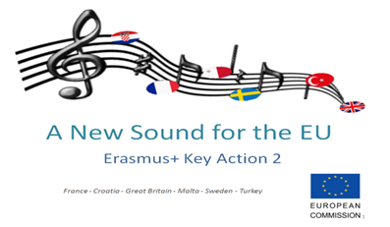
2nd mobility TURKEY
9th-16th March 2015

Slide 2


Croatian Traditional instrument
DIPILCA

Slide 3
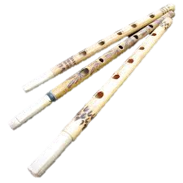
Diplica
A wooden wind instrument
Used by shepards while guarding the livestock
Made by CHILDREN (shepards)in the past
Single-reed ,
can be-double clarinets
From BARANJA (a region in Croatia)

Slide 4
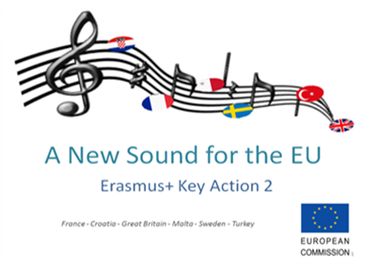
Making of…
!
Done by children
The „burning” part is done by the teacher

Slide 5
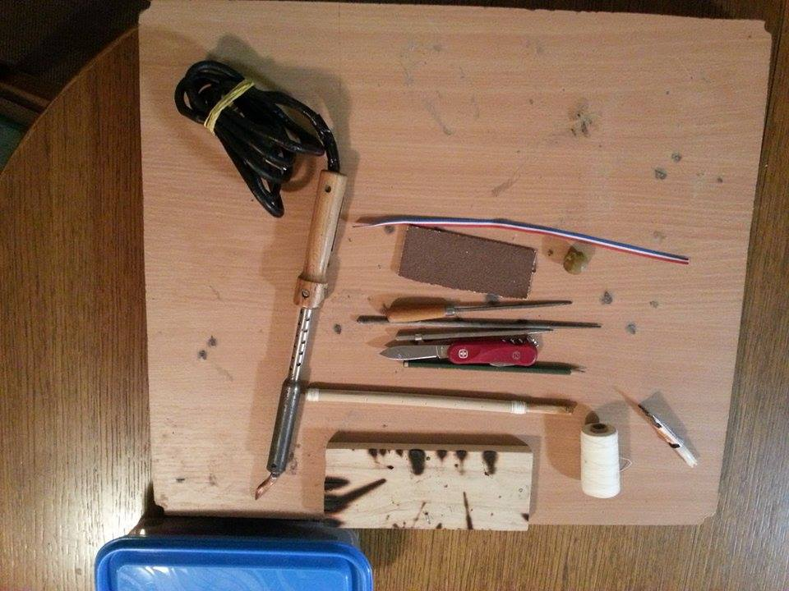
Tools, materials…
Willow branch, soldering iron, a knife, a chisel, some string, pencil(color), tricolor (Croatian traditional) string, a rasp

Slide 6
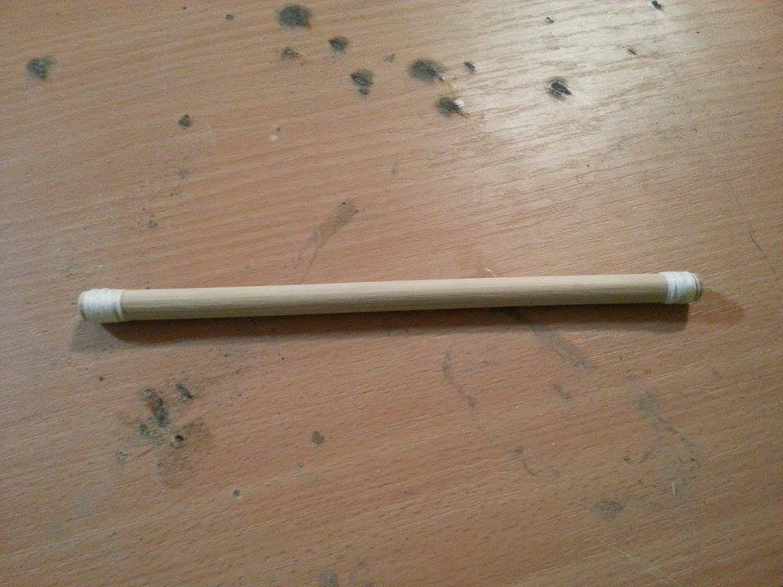
Basic material
A straight willow branch , hollow
Tightened with strings on both ends

Slide 7
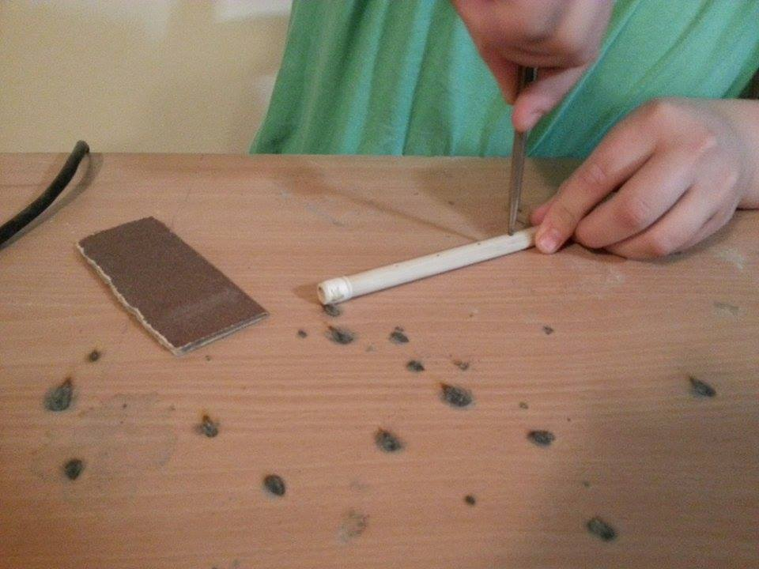
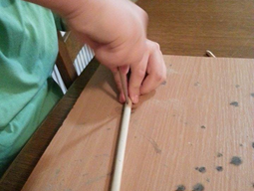
Step 3
Make 5 holes in a row with a sharp object

Slide 8
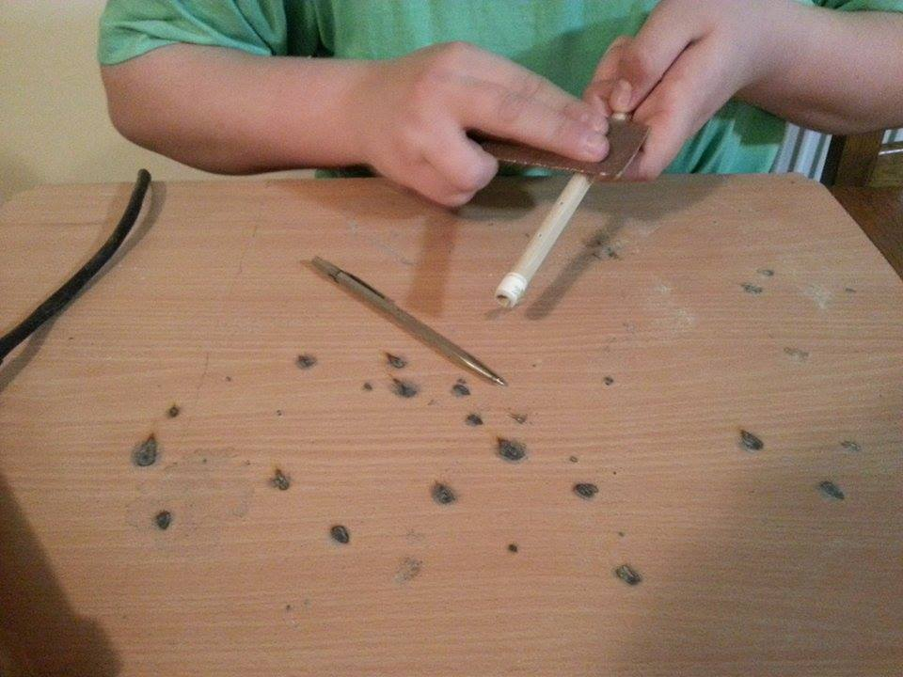
Step 2
Clean the surface of the flute wit some sand paper to make it smooth

Slide 9
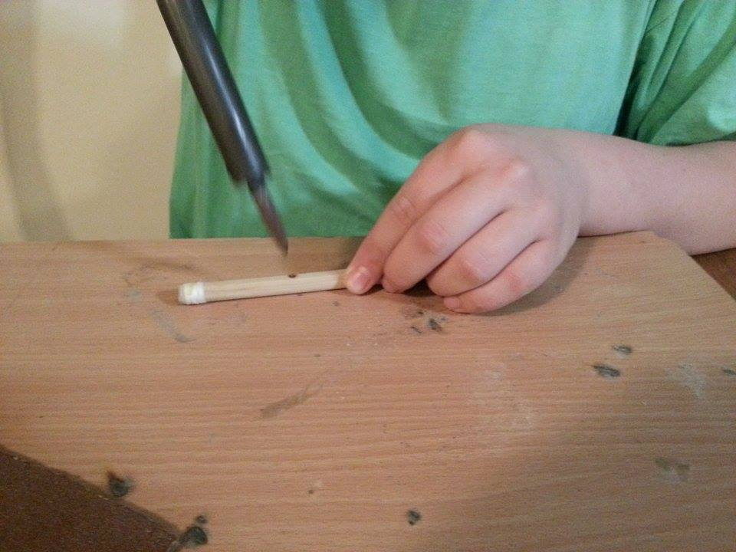
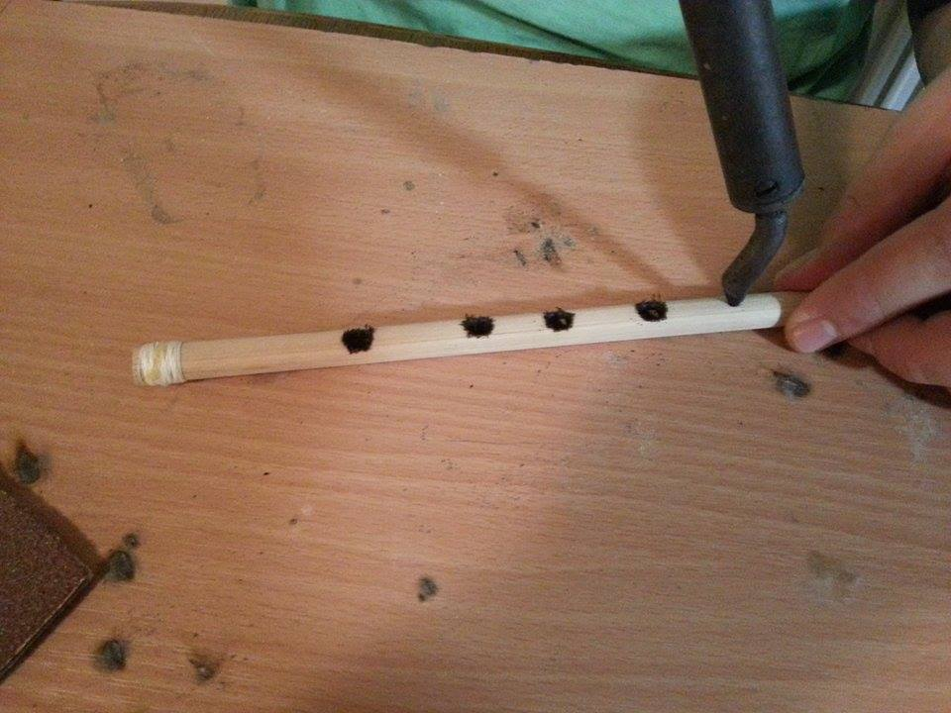
Step 3
„burn” the holes you made with a soldering iron

Slide 10
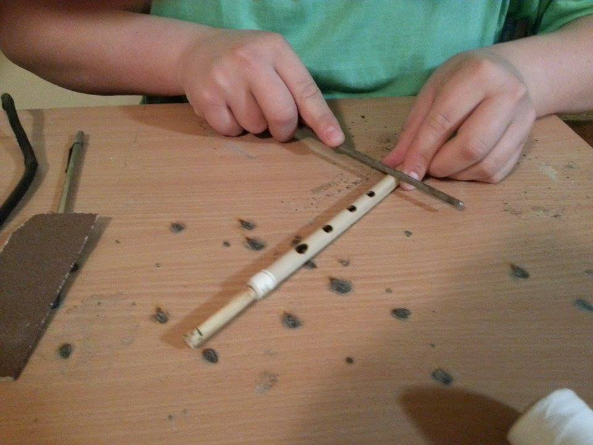
Step 5
Smoothen the holes with a rasp

Slide 11
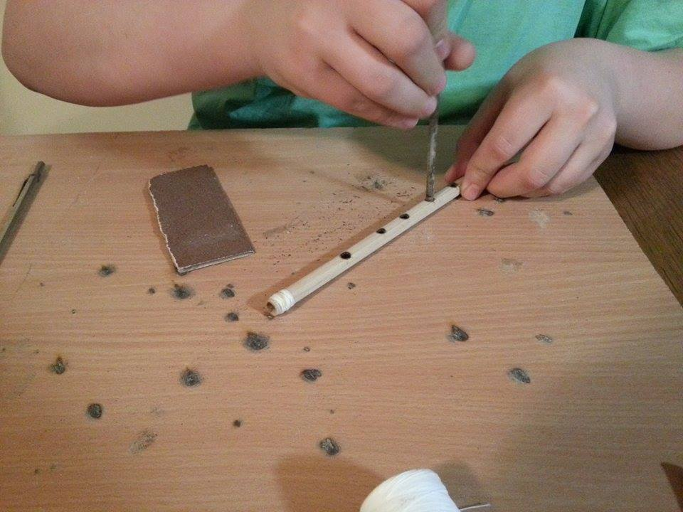
Step6
„clean” the holes with a nail with a circular motion

Slide 12
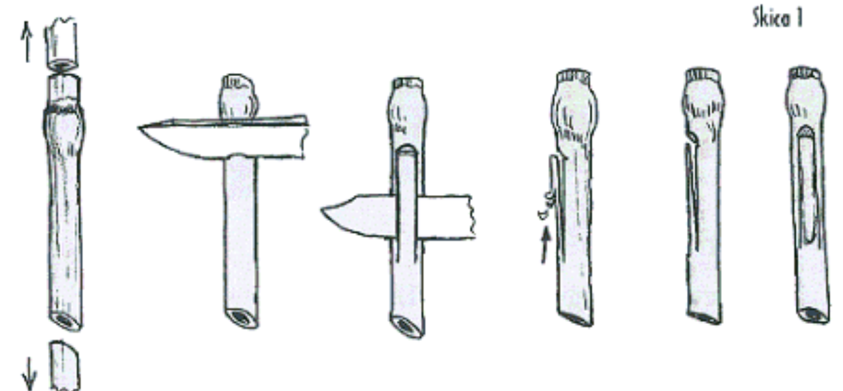
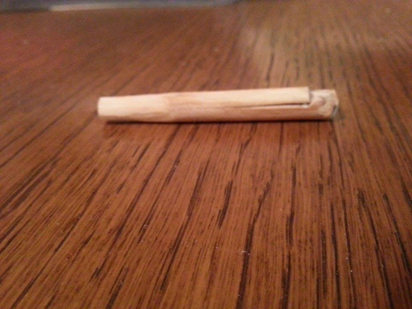
Step 6- Mouthpiece
Hand make the „mouthpiece/stout/nozzle” by hand from a small piece of willow wood

Slide 13
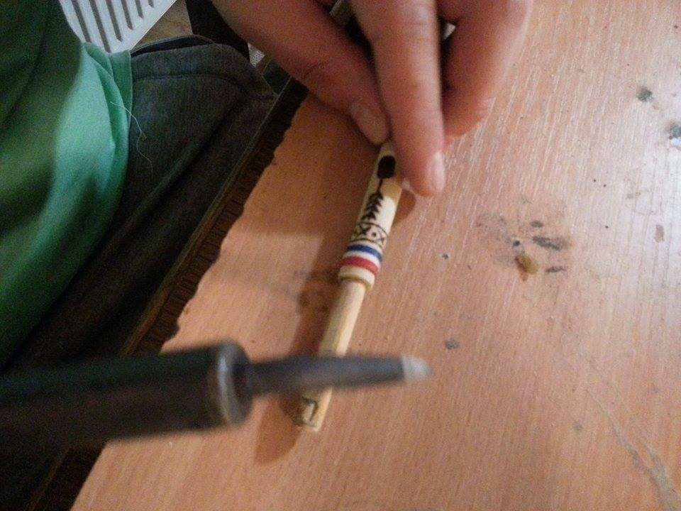
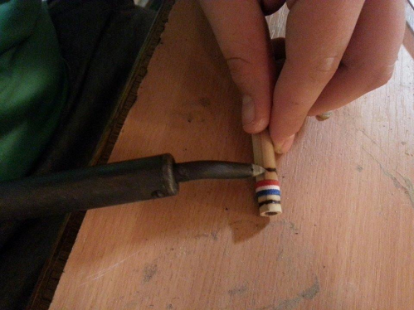
Step 7- Decoration
You can decorate the DIPLICA with colours,string, soldering iron…

Slide 14
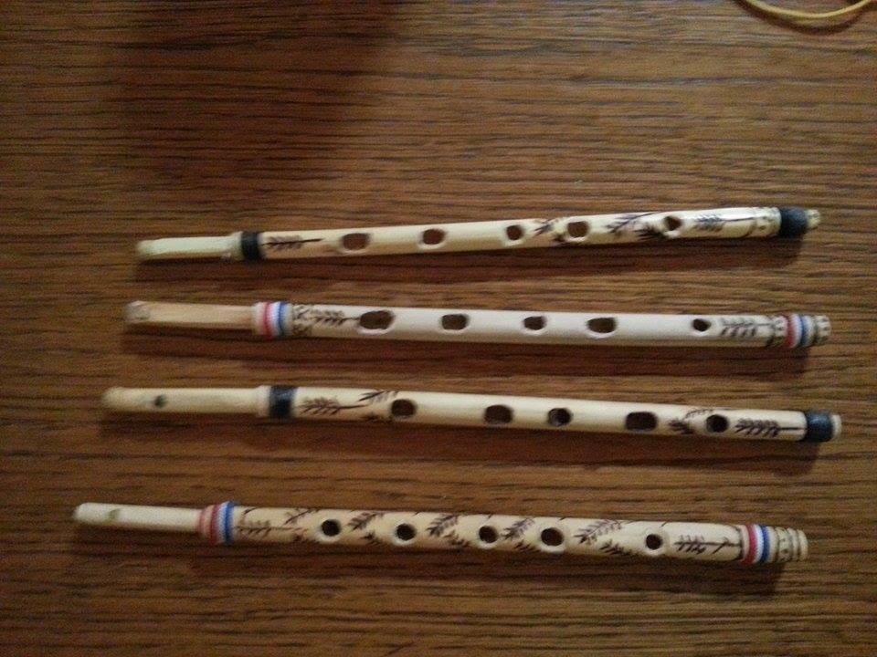
Step 8
Voila!!!

Slide 15
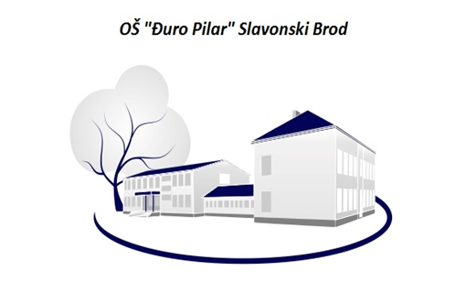
THANK YOU!
„Đuro Pilar” primary school, Slavonski Brod CROATIA

