Slide 1
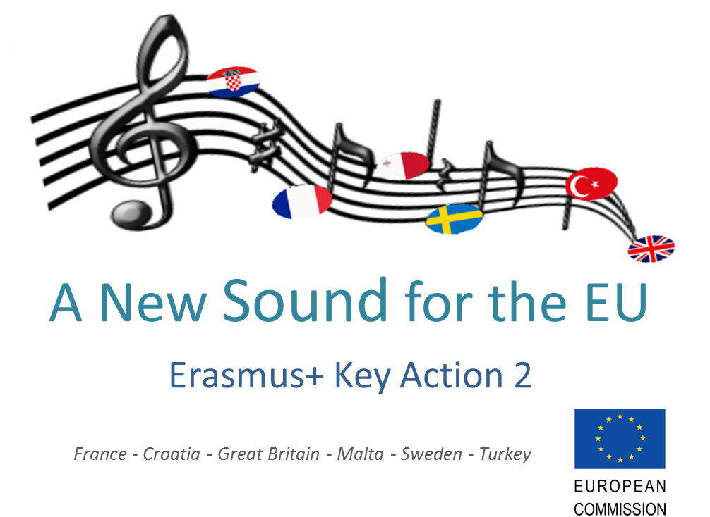
Yenikonak YBO First Questionnaire

Slide 2
1- The Love for music
Primary Age : 7,8,9,10 Total : 25 pupils | Middle Age : 11,12,13,14,15 Total : 65 Students

Slide 3
2-The genre they listen to
Primary Age : 7,8,9,10 | Middle Age : 11,12,13,14,15

Slide 4
3- a. The period of time they listen to music
Primary Age : 7,8,9,10 | Middle Age : 11,12,13,14,15

Slide 5
3- b. The means they listen to music through
Primary Age : 7,8,9,10 | Middle Age : 11,12,13,14,15

Slide 6
4- a. The ones whose parents listen to music
Primary Age : 7,8,9,10 | Middle Age : 11,12,13,14,15

Slide 7
4-b. The genres the parents listen
Primary Age : 7,8,9,10 | Middle Art : 11,12,13,14,15

Slide 8
5- a. Can they play any instruments?
Primary Age : 7,8,9,10 | Middle Age : 11,12,13,14,15

Slide 9
5- b. The instruments the pupils can play
Primary Age : 7,8,9,10 | Middle Age : 11,12,13,14,15

Slide 10
5- c. The instruments pupils would like to play
Primary Age : 7,8,9,10 | Middle Age : 11,12,13,14,15

Slide 11
6- The favourite instrument of the pupils
Primary Age : 7,8,9,10 | Middle Age : 11,12,13,14,15

Slide 12
7- The composers they know
Primary Age : 7,8,9,10 | Middle Age : 11,12,13,14,15

Slide 13
8- Their feelings when they listen to music
Primary Age : 7,8,9,10 | Middle Age : 11,12,13,14,15

Slide 14
9- a. The pupils who like singing
Primary Age : 7,8,9,10 | Middle Age : 11,12,13,14,15

Slide 15
9- b. The places where they sing
Primary Age : 7,8,9,10 | Middle Age : 11,12,13,14,15

Slide 16
10- The places where they learned the songs they know
Primary Age : 7,8,9,10 | Middle Age : 11,12,13,14,15

