Slide 1
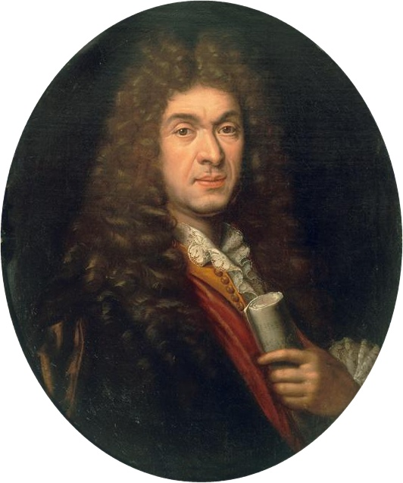
Jean-Baptiste Lully
Researches made the pupils of Mr Fays

Slide 2
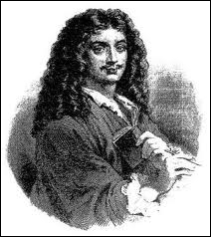
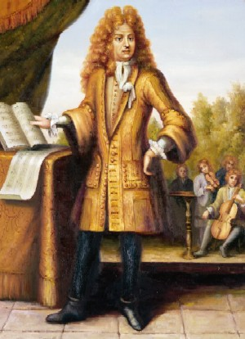
Facts:
Name : Lully
Firstname : Jean-Baptiste
Born : November 28th 1632
In : Florence ( Italy)
Died : March 22nd 1687
In : Paris
Nationality : French
Musical period : Baroque

Slide 3
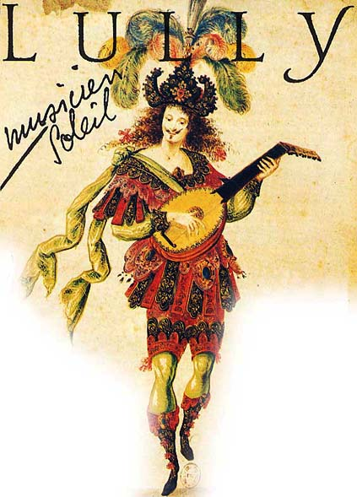
Giovany Battista Lulli , born in Florence, arrived in France at the age of 13.
He gets initiated to music and danse by the guests of the place he was living in.
He decided to take part for the King (Louis XIV) during some times of troubles ; he managed to play a show for the King,The King liked him so much that he decide to make him : musician and virtuoso dancer at the King’s cour

Slide 4
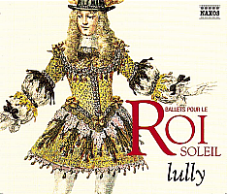
Life at the Cour
He was so brilliant , far more gifted than all the other composers.
In 1653, he became the official composer for Louis XIV.
In 1661 , he became french and he changed his name to Jean-Baptiste Lully.
In 1662, he married Madeleine Lambert.
Rich and famous , he was composing one opera
per year,

Slide 5
He also was a great show planner : he was producing big shows in honour of the « Roi Soleil » ( King of the Sun »)
In 1681 , he became the King’s secretary , the highest position he ever reached.
He died from gangrene in 1687 . He had wounded his foot with his cane orchestra ( he was using it to beat the rythm on the floor)

Slide 6
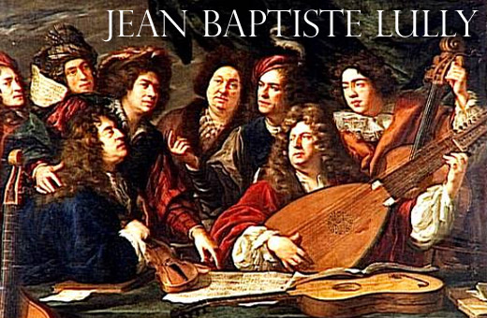
His works
Lully has composed many pieces of music . His contribution to religious music and his operas and ballets made him famous .
He has worked with Molière . They both wrote many ballet-comedies : le Bourgeois gentilhomme , l’amour médecin, le mariage forcé , some of them are studied at school by all french students.

Slide 7
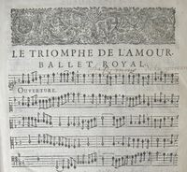
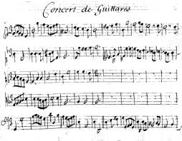
His famous works:
Te Deum : https://www.youtube.com/watch?v=5iYiY-tDWOA
Phaéton : https://www.youtube.com/watch?v=DNNiTayOajE
Thésée : https://www.youtube.com/watch?v=7viDNr1tXIk&list=PLSJXfom7rdgcEiC2S_yC2oMyRif9nGHFL
Armide : https://www.youtube.com/watch?v=eQWmmdreaeA

