Slide 1
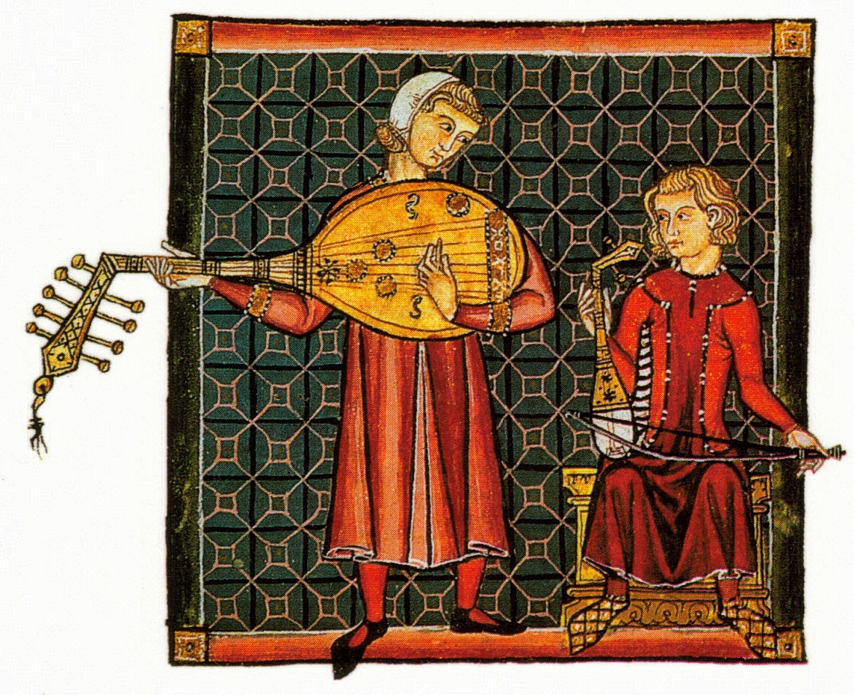
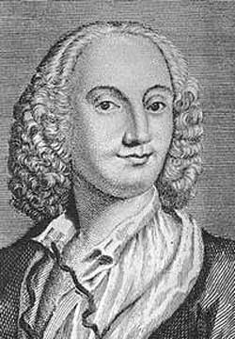
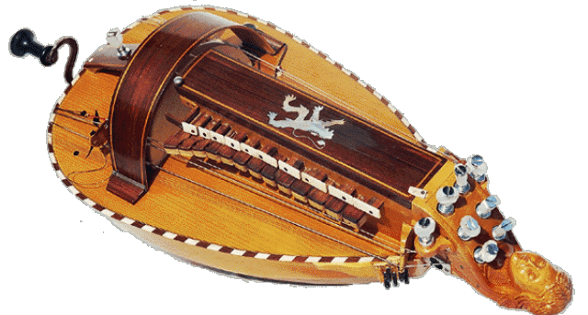
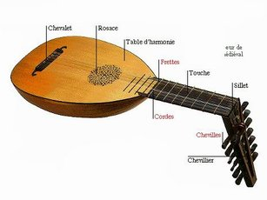
MIDDLE-AGE PERIOD
476
1492
There are songs sung
by troubadours and
they are religious songs.
Guillaume
de Machaut
A
vielle
A lute

Slide 2
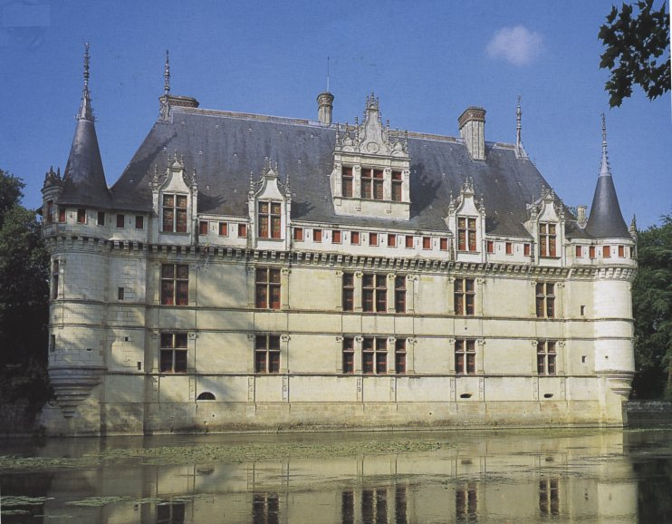
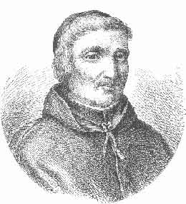
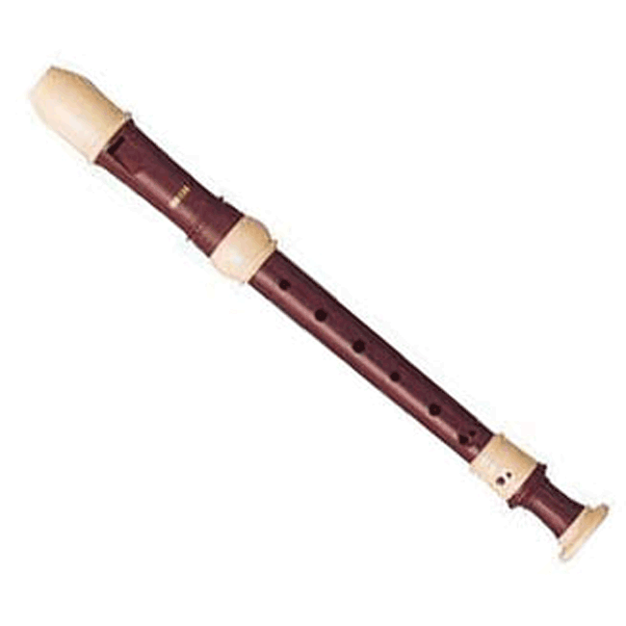
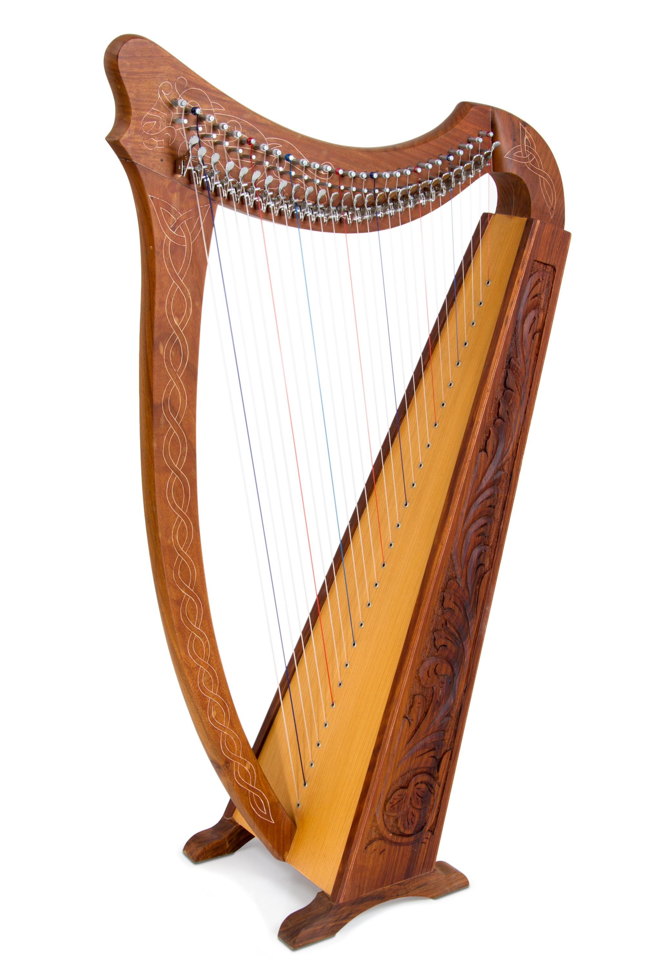
Renaissance PERIOD
1 492 1 600
It was the time of the first
polyphonic songs.
A castle from the Renaissance period
An harp
Thoinot-Arbeau
Flûte à bec

Slide 3
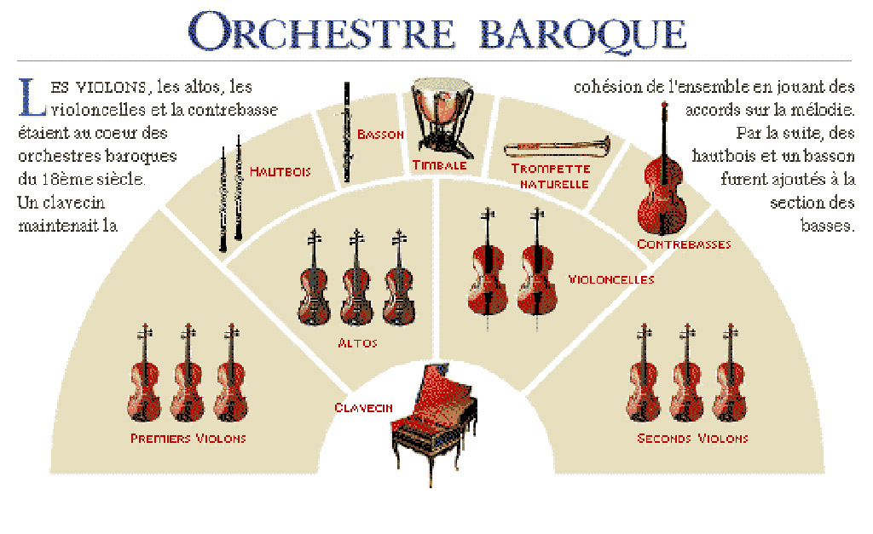
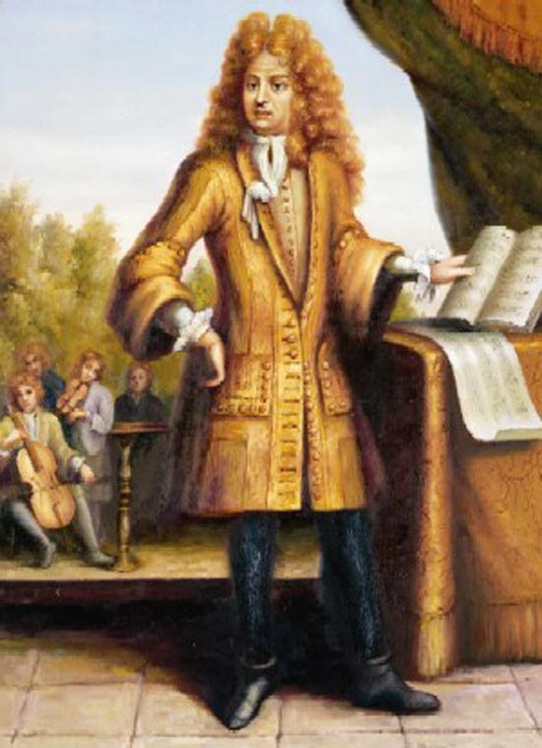
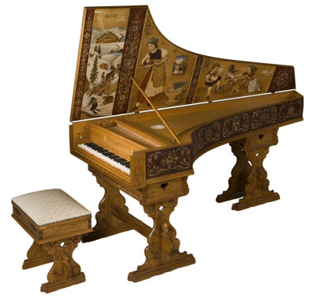
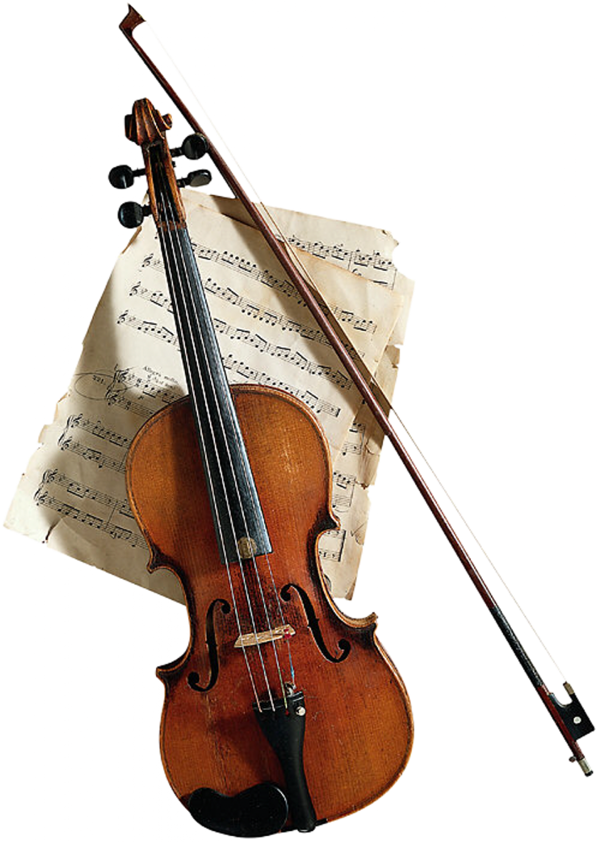
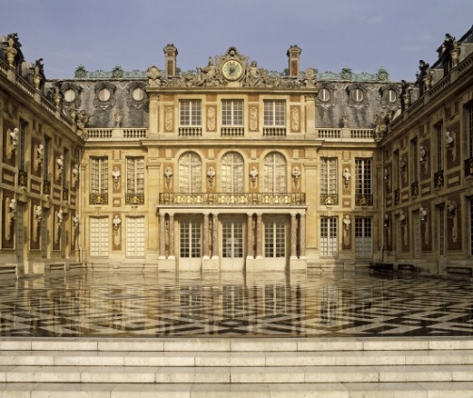
Baroque Period
1600 1750
It is quite a boucing kind
of music.
The strings have a
very important part.
This music has been
composed by Lully
or Bach.
An harpsishord
Lully
violon

Slide 4
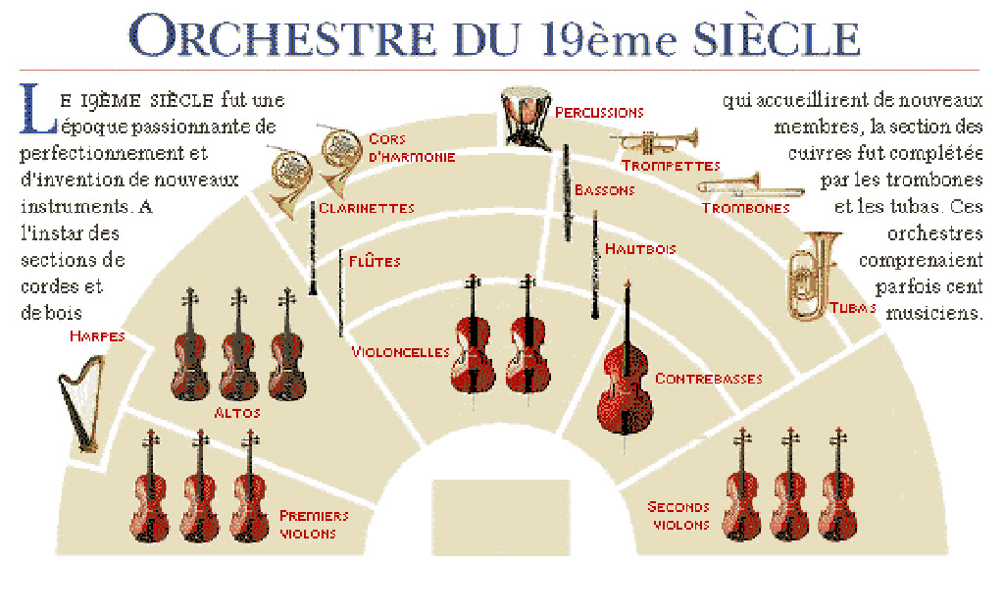
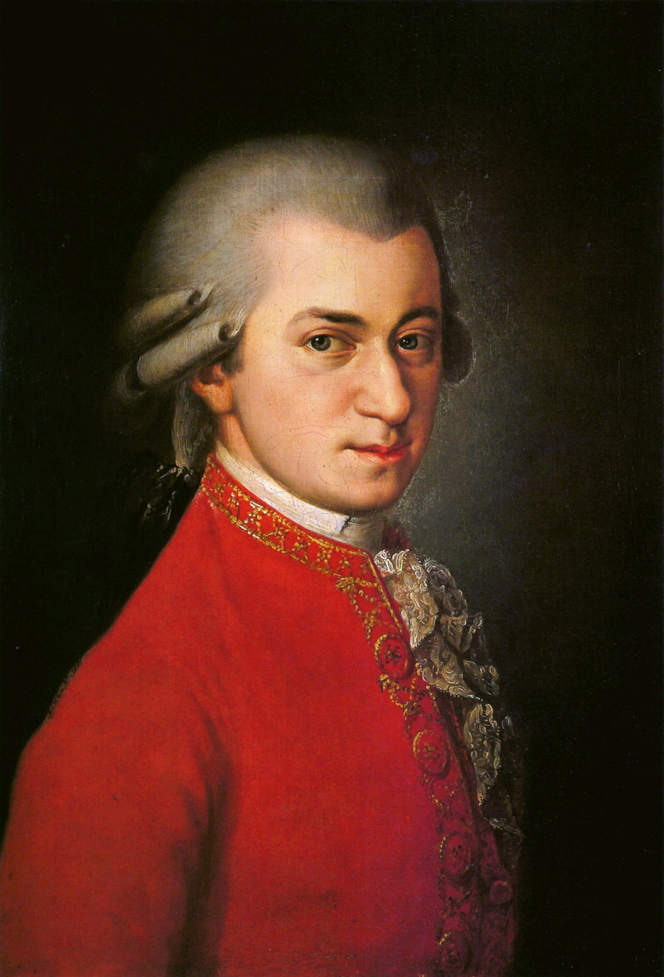
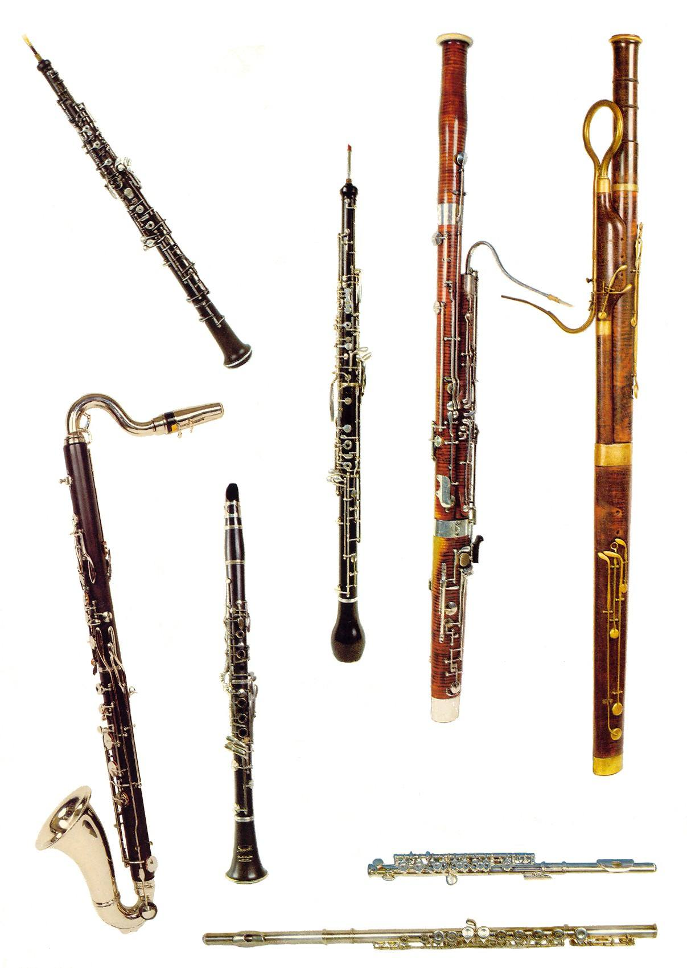
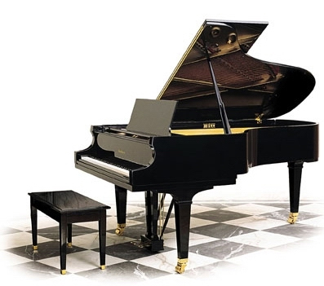
classic PERIOD 1750 1830
It is the beginning of
symphonic music.
There are more musicians in
the orchestra and the wind
instruments and the percussions
instruments are getting more
Important.
Mozart

Slide 5
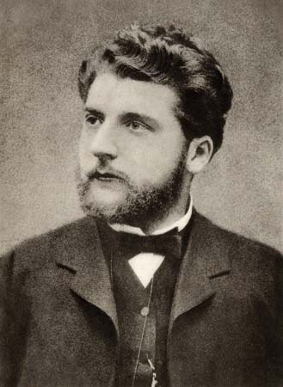
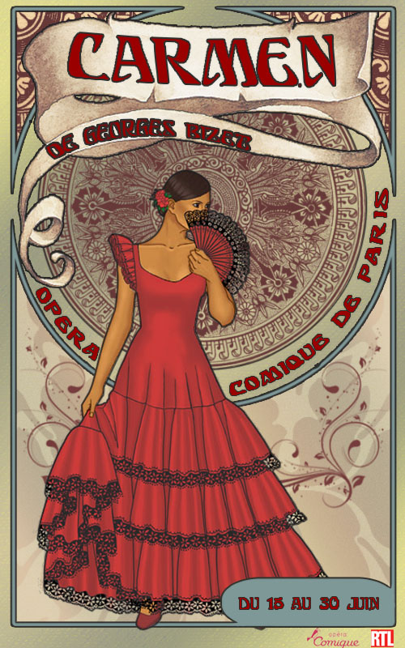
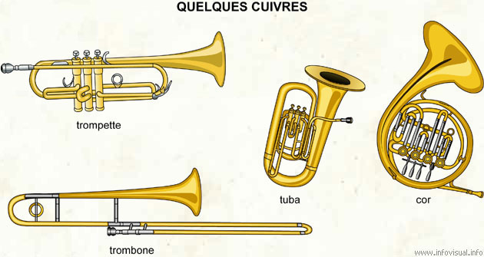
RomantiC PERIOD 1830 19OO
Symphonic orchestras are used.
The music is varied :
it can be strong or soft, slow or fast
All types of instruments are used.
Carmen
BIZET
Brass

Slide 6
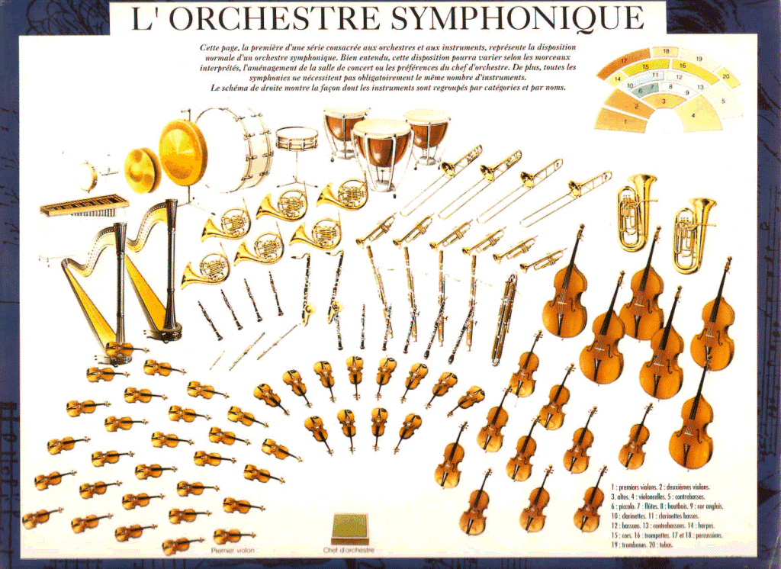
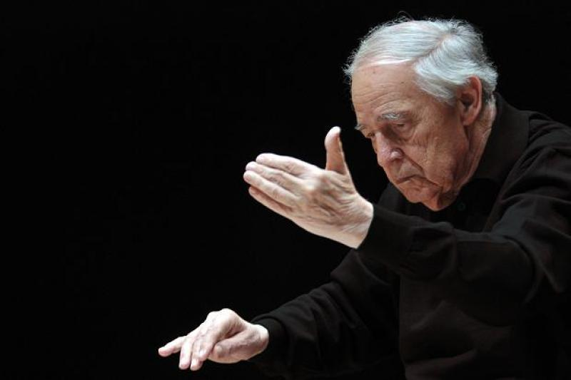
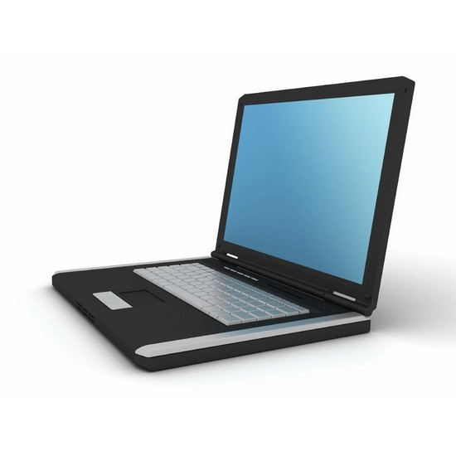
XXth Century Period
1 900
2 000
Symphonic orchestras are used.
The music can be experimental .
The melodies are not very
conventionnal.
.
Computer can be used to help
Pierre Boulez

