Slide 1
A New Sound for the EU
First questionnaire’s results
France Nouzonville
France

Slide 2
How it has been made ?
The questionnaire has been filled by pupils during school time .The youngest ones have been helped by their teacher to write their answers.
We have decided to divide the questionnaires into 2 years groups :
First age group : 6,7 and 8 years old pupils : 29 questionnaires
Second age group : 9,10 and 11 years old pupils : 31 questionnaires,

Slide 3
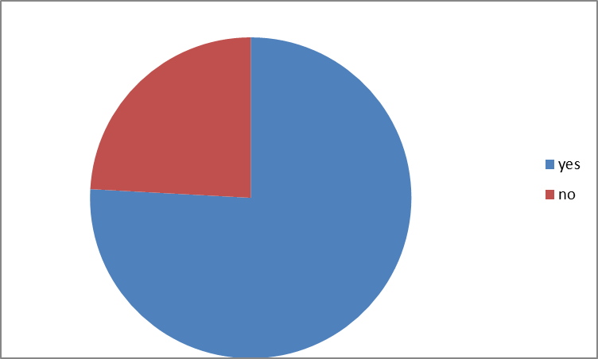
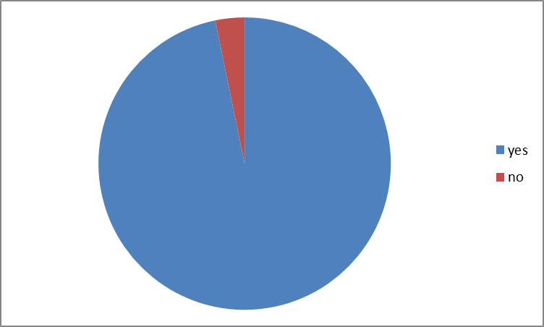
Do you like music ?
Second age group
First age group

Slide 4
Why ?
It calms me down 1
It does me good 4
It makes me happy 2
I don’t know 1
It makes noise 1
It’s cool 3
I love songs 1
I listen to music all the time 1
I don’t like silence 1
I practise 1
My mother is a music teacher 1
I practise 2
I love it 2
I can dance 1
It calms me down 3
It makes me happy 14
It keeps me busy 2
It’s good 2
It is fun 1
It gives me headaches 1
Second age group
First age group

Slide 5
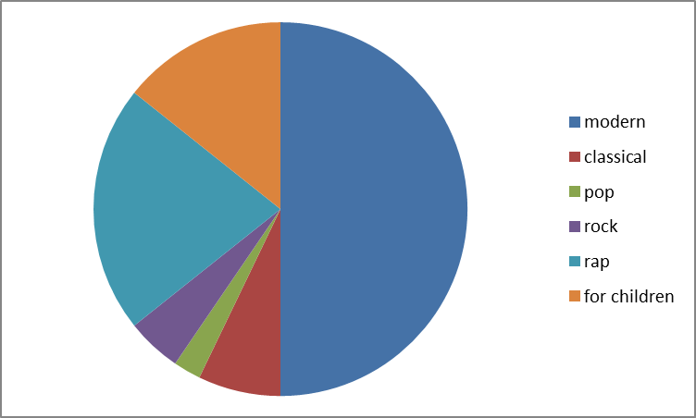
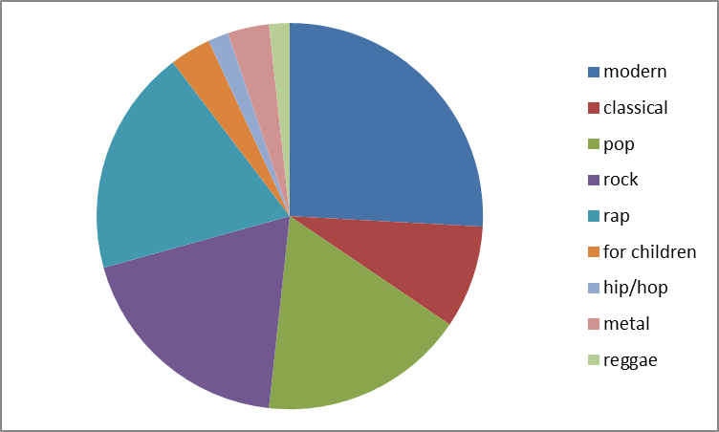
What type of music do you like listenning to ?
Second age group
First age group

Slide 6
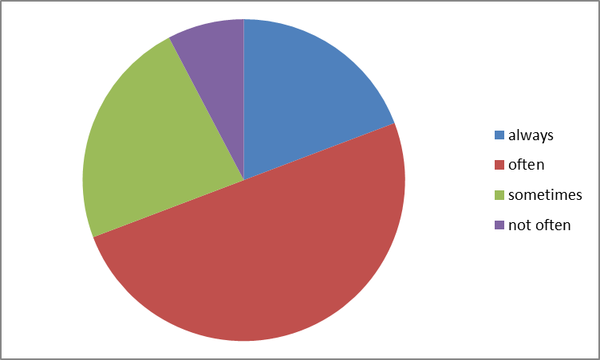
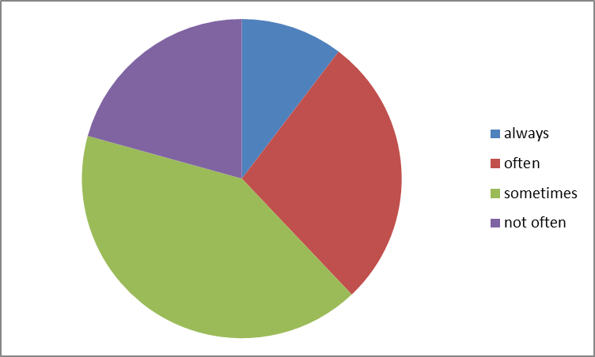
When do you listen to music ?
Second age group
First age group

Slide 7
By which means ?
In the car 1
Through the radio 7
On TV 11
With my mobile phone 2
With the computer 7
With my I pad 5
With my CD player 1
With my MP3 4
Through internet 1
First age group
In the car 3
Through the radio 5
On TV 13
With my mobile phone 1
With the computer 5
With my I pad 5
With my MP3 6
Through internet 5
With my PSP 2
With my hifi 5
Second year group

Slide 8
Do your parents listen to music?
Second year group
First year group

Slide 9
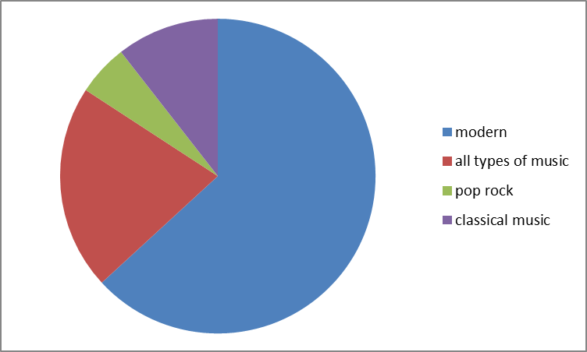
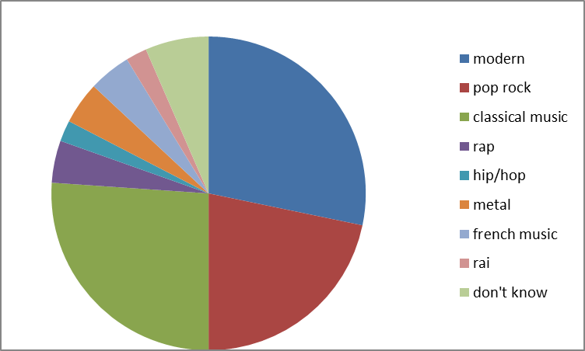
What kind of music do they listen to ?
Second age group
First age group

Slide 10
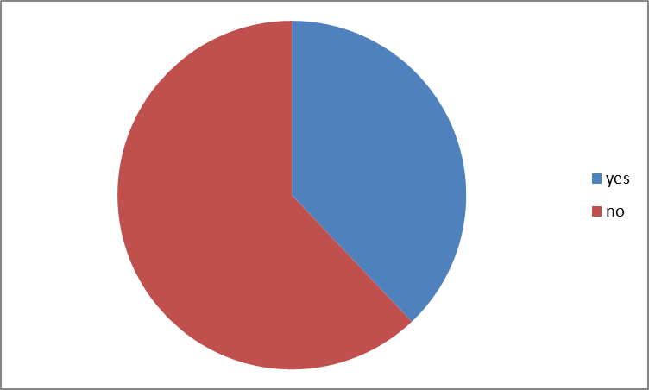
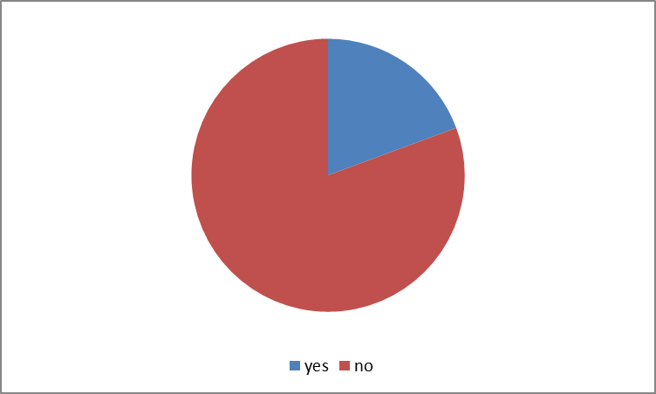
Do you play an instrument ?
Second age group
First age group

Slide 11
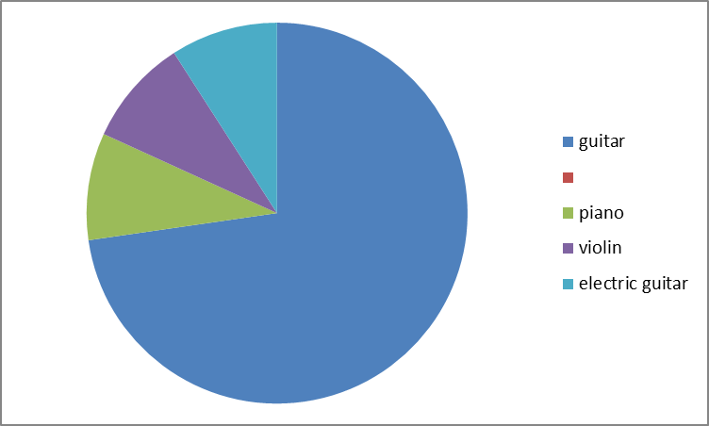
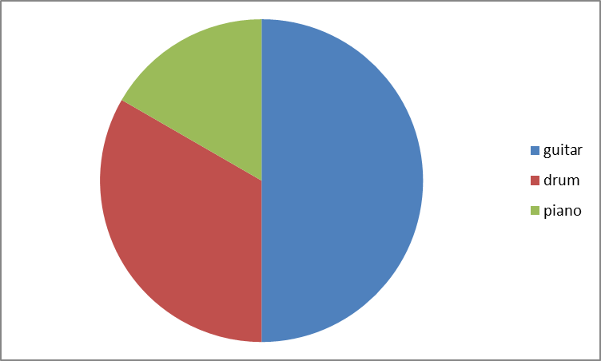
If so, what instrument do you play ?
Second age group
First age group

Slide 12
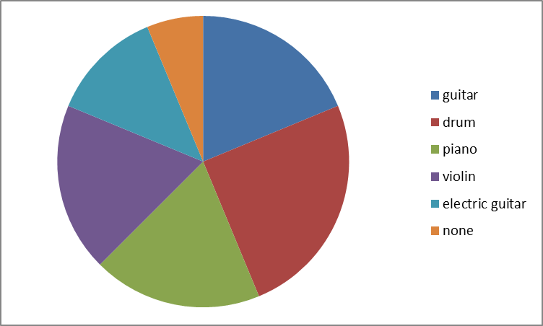
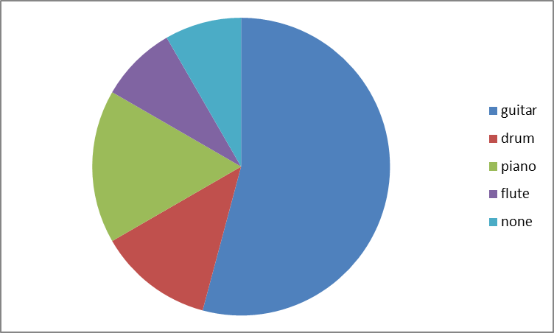
If no, what instrument would you like to learn?
Second age group
First age group

Slide 13
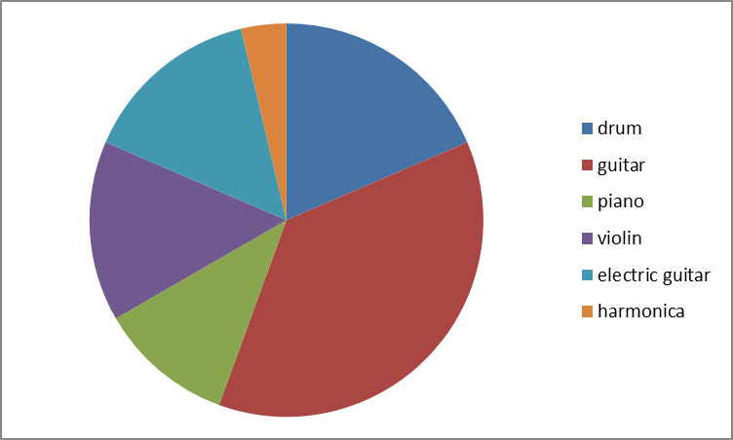
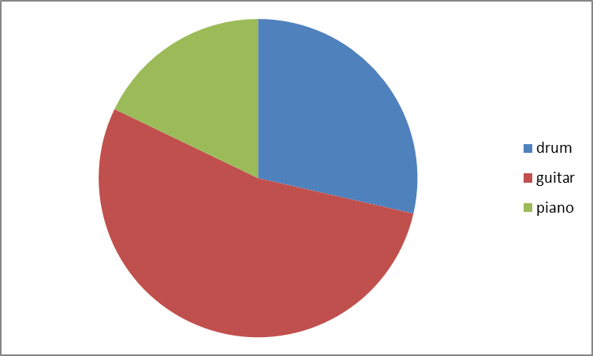
Which is your favorite instrument ?
Second age group
First age group

Slide 14
Why ?
Drums : 5
It is so loud 5
I like the sound 2
I love rythm 1
Guitar: 10
I got one at Christmas 1
We have several at home 1
I like the sound 4
It makes funny music 1
It’s cool 1
I love rock music 1
Electric guitar: 4
It’s plugged 1
I like the sound : it’s loud 1
Violin: 4
It’s nice 2
I like it 1
Maëlys played it at school
last year 1
Piano: 3
It’s good 1
My nanny has one she teaches me 2
Harmonica: 1
It’s easy to play 1
Second age group
Drums: 8
It’s noisy 3
It’s so rock 1
It’s good 1
I practise drum 1
I wish to make a band 1
with my dad who plays the
guitar
Guitar: 15
I love the sound 6
I love to play it 4
You can play different types 1
of music
I like it 4
Piano: 5
I like the sound 1
It has a nice sound 2
I have one 1
My favorite star plays the piano 1
None : 2
First age group

Slide 15
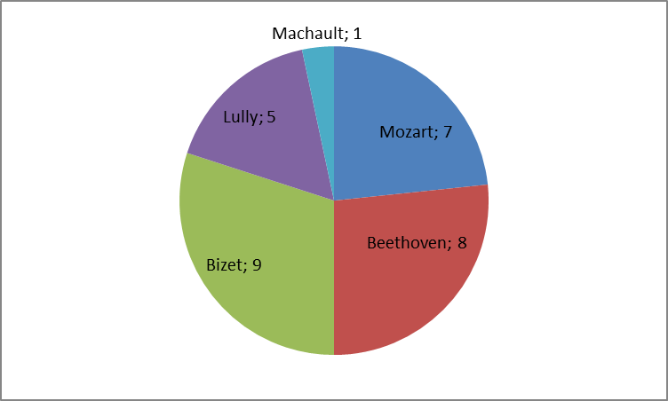
Do you know a composer ?
Second age group

Slide 16
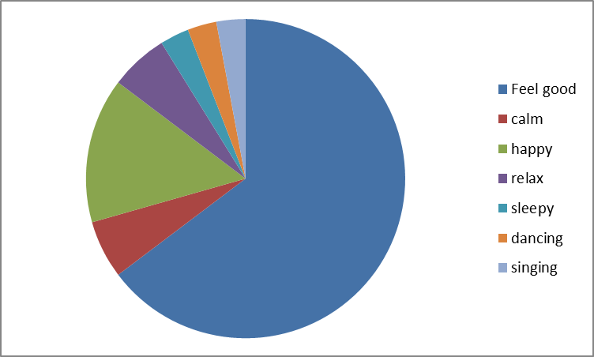
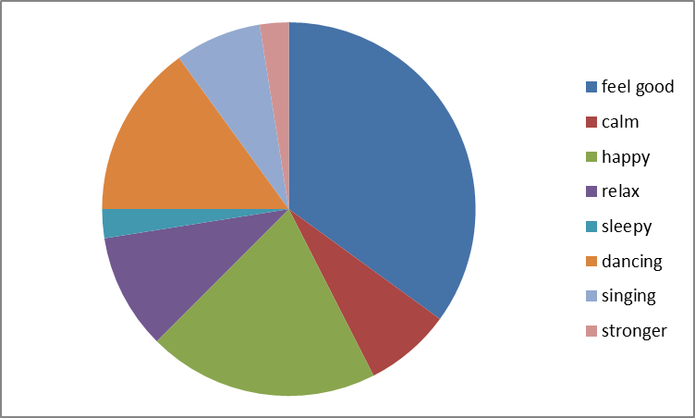
How do you feel while you are listenning to music ?
Second age group
First age group

Slide 17
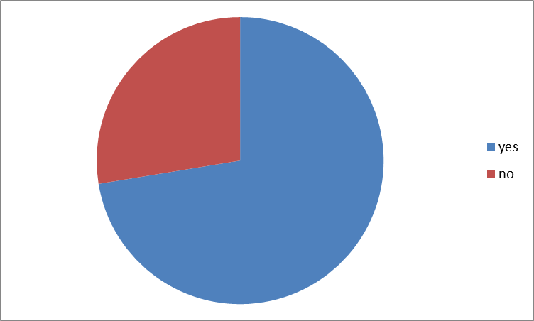
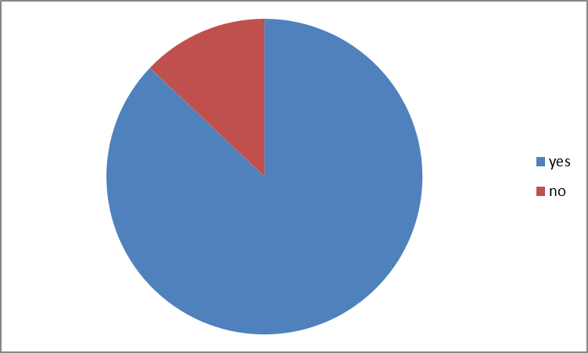
Do you like to sing ?
Second age group
First age group

Slide 18
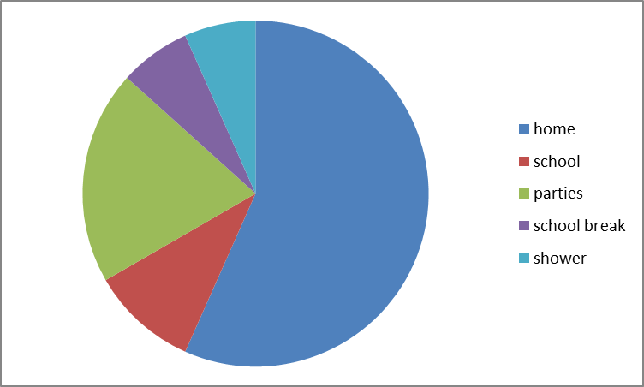
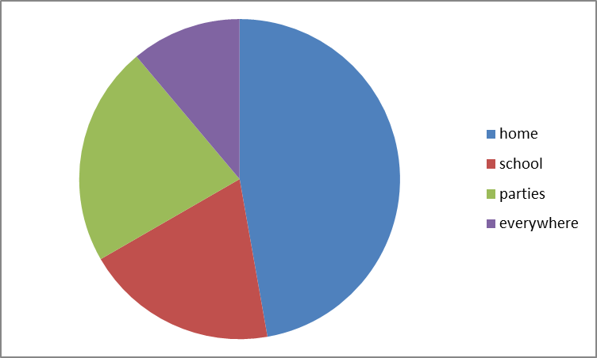
When do you sing ?
Second age group
First age group

Slide 19
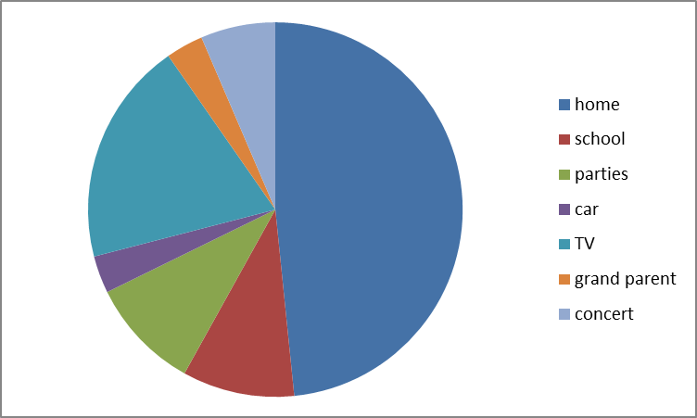
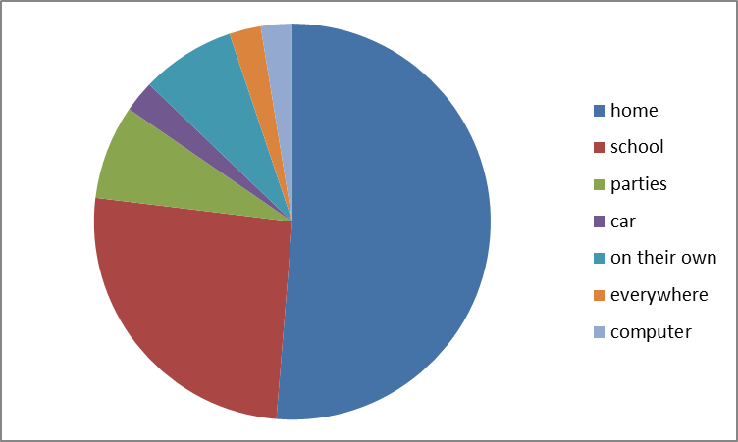
Where have you learned the majority of songs you know?
Second age group
First age group

Slide 20
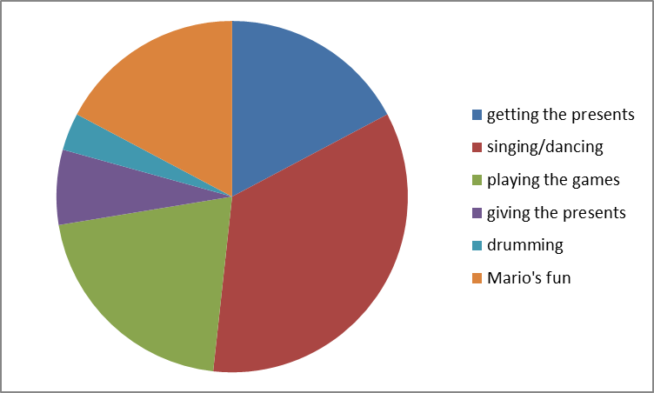
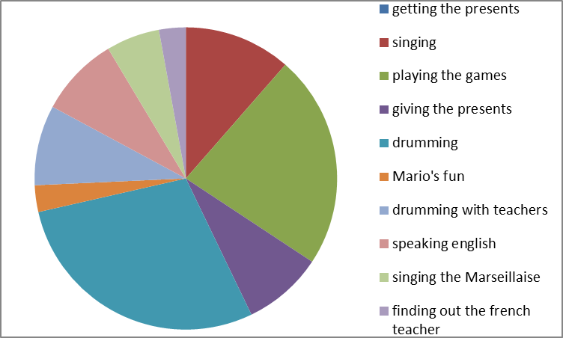
What was your favorite moment when you met the partners’ teachers of the project ?
Second age group
First age group

Slide 21
Why ?
They were funny
It has made me happy
It has been an extraordinary experience
We’ve had a lot of fun together
It was great
It was highly emotionnal
It was so funny
They were so kind
They were so nice
I loved their lovely presents

