Slide 1
Sveti Sava Primary School Kikinda, Serbia

Slide 2
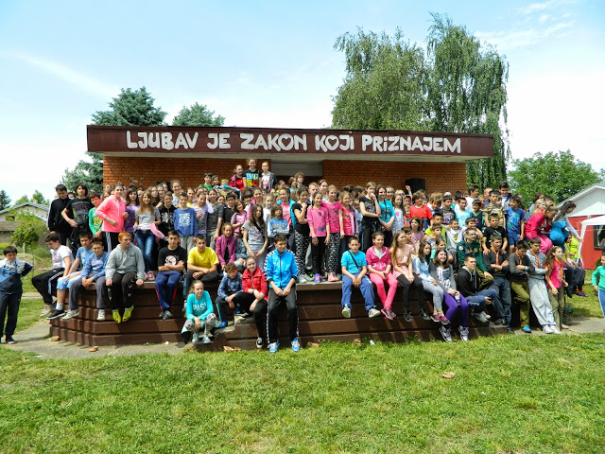
Let’s introduce ourselves…

Slide 3
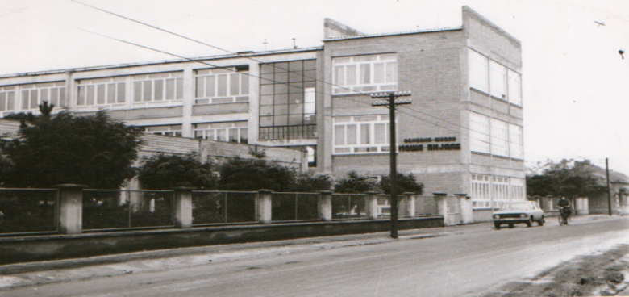
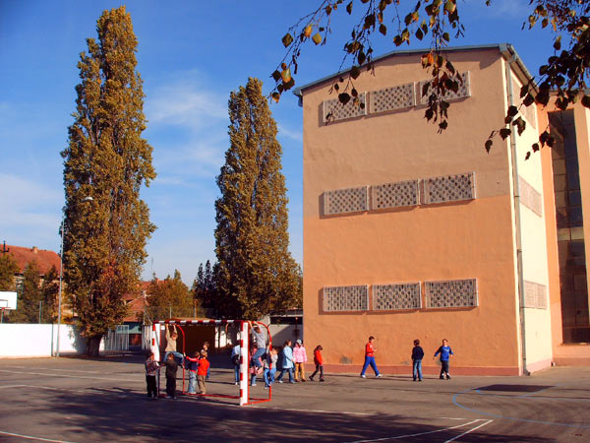
the school was founded in 1960 as Moša Pijade Primary School
in December 1994, its name was changed into Sveti Sava Primary School
one of two primary schools in Kikinda with lessons in Serbian and Hungarian
the biggest primary school in the municipality of Kikinda

Slide 4
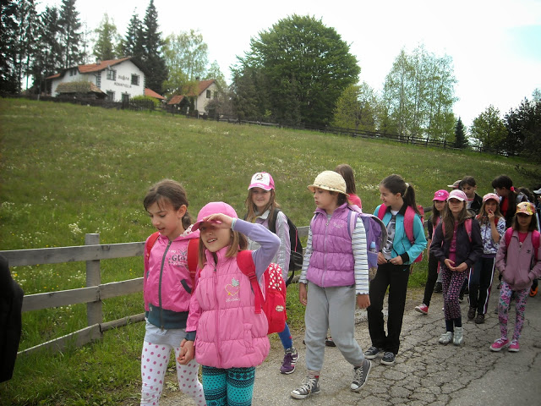
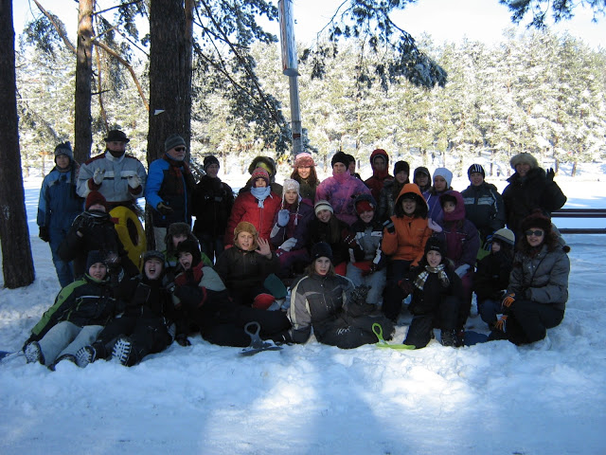
Courses
school in the nature for lower classes
ski school for higher classes
swimming lessons for classes 1 and 2

Slide 5
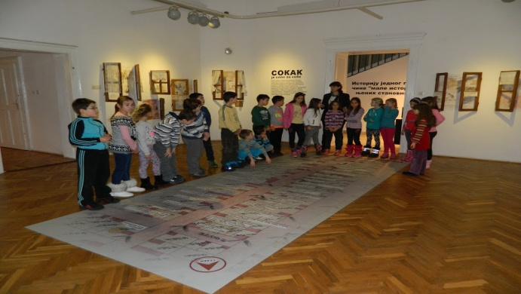
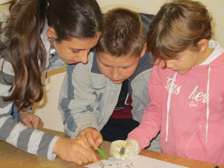
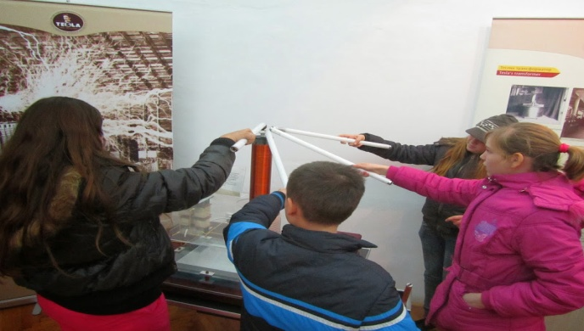
Museum as classroom
all year round
exhibitions
educational workshops
creative workshops
professional orientation

Slide 6
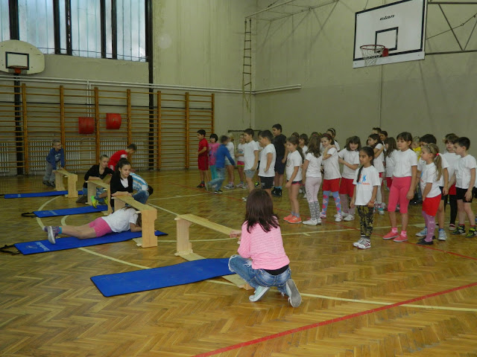
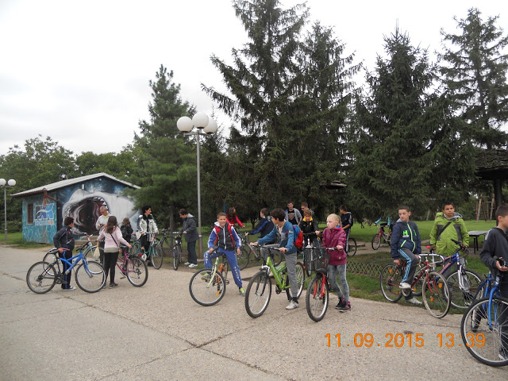
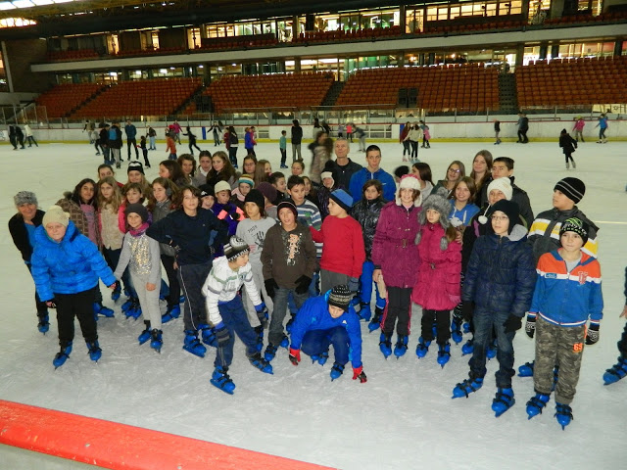
Sports Week
in September
sports tournaments (mini handball, basket 3x3, volleyball, table tennis...)
Funny Olympics
sport polygons
cycling
skating...

Slide 7
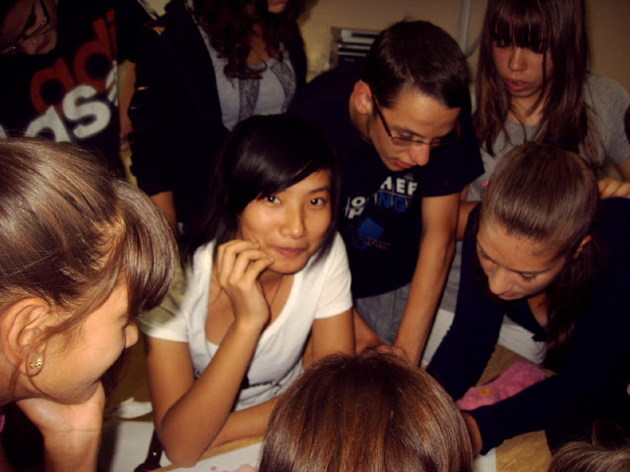
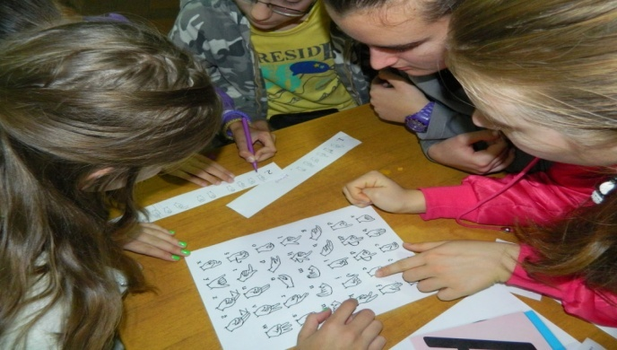
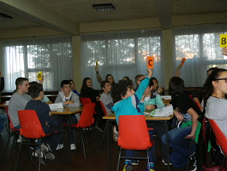
European Day of Languages
since September 2011
quizzes
tongue twisters
word association games
- language games

Slide 8
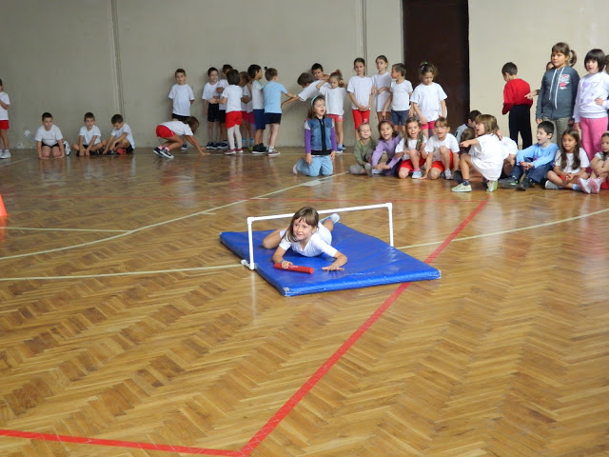
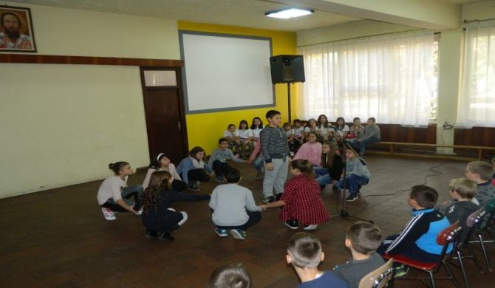
Children’s Week
first week in October
Mini Olympics for 1st graders
creative workshops
concerts

Slide 9
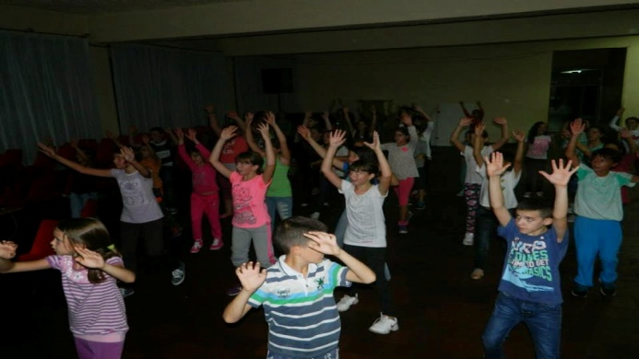
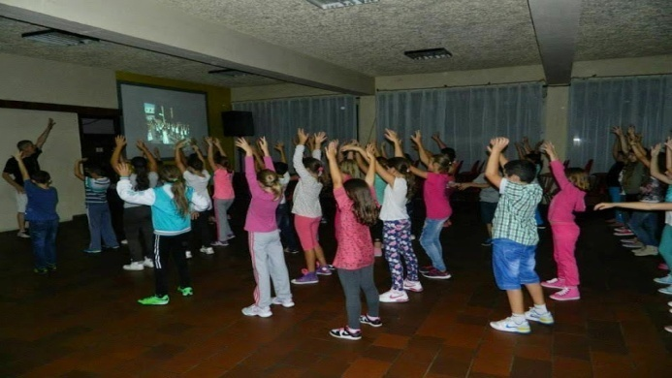
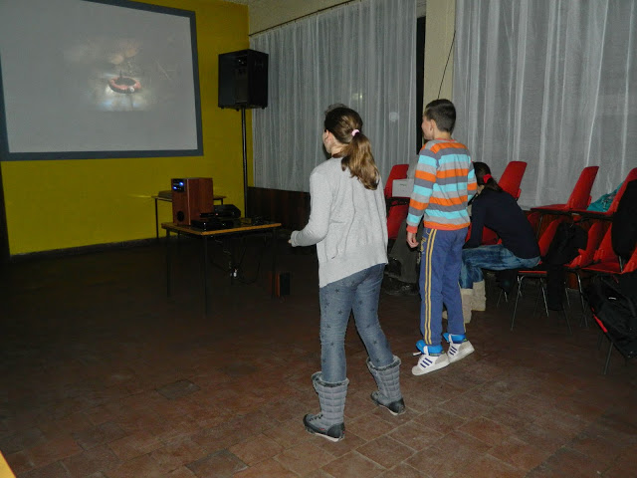
Class 5 hang outs
every other Friday
dancing
Xbox

Slide 10
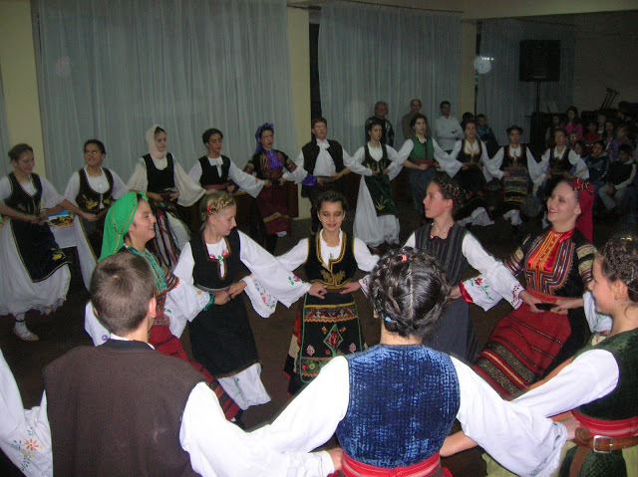
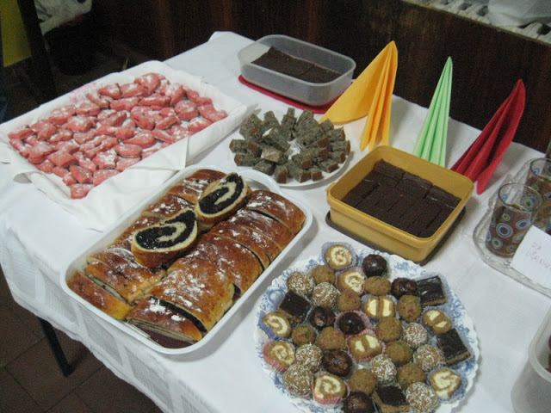
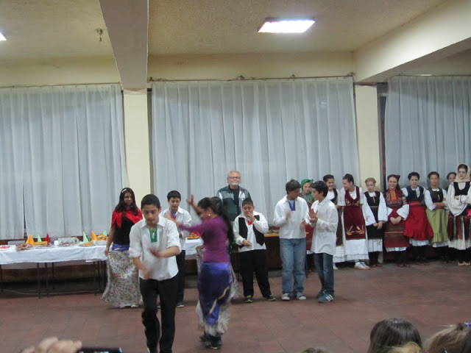
Day for Tolerance
in November
educational workshops
dancing and singing performances
concerts

Slide 11
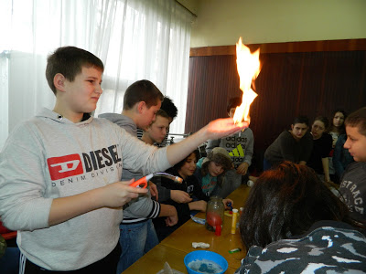
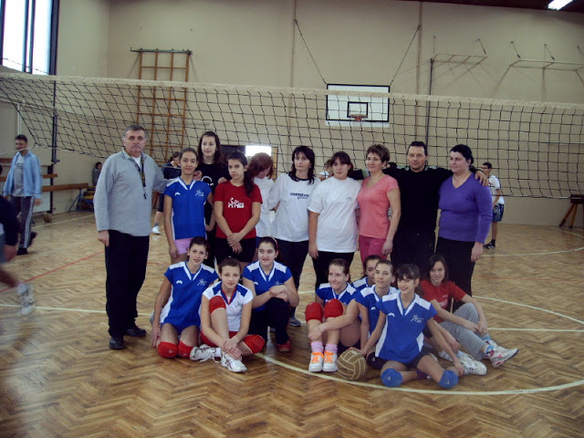
School Day
27 January (last week in January)
St Sava’s Brain Teasers (Maths quiz competition)
nice handwriting competition
writing contests
exhibitions
sports matches (children and parents)
Knowledge Festival
school plays...

Slide 12
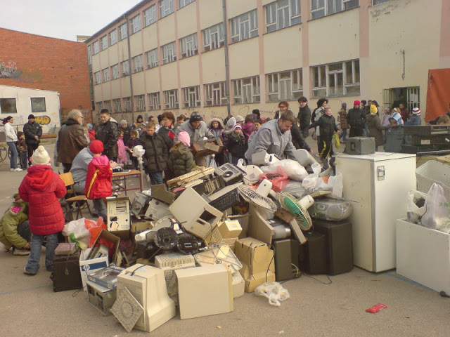
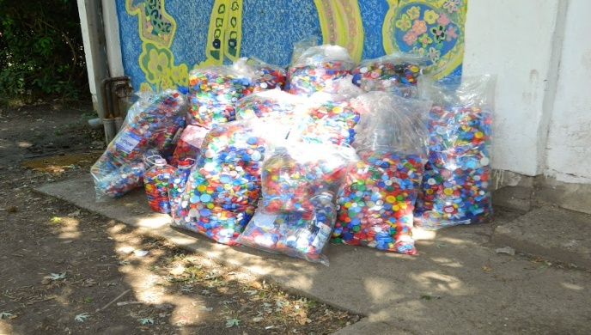
Eco activities
collection of electronic waste
Green Mile
educational workshops
creative workshops

Slide 13
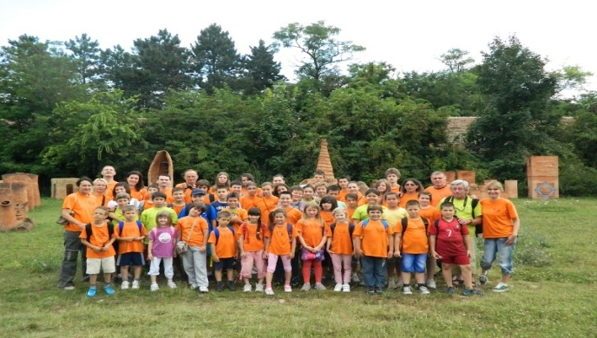
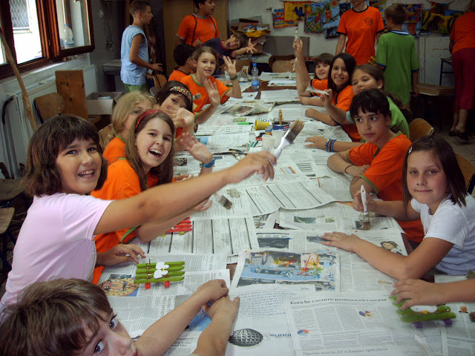
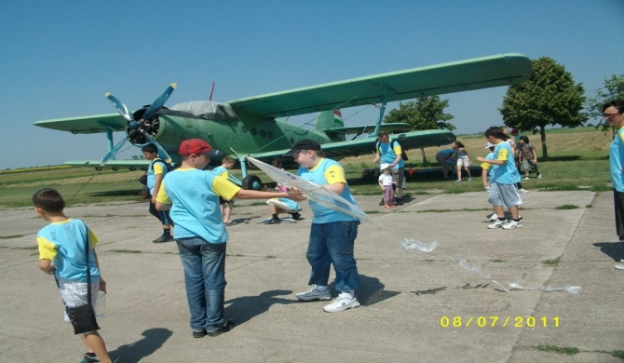
Summer camp
started in June 2007
educational workshops
creative workshops
sports activities
drama
exhibitions
field trips

Slide 14
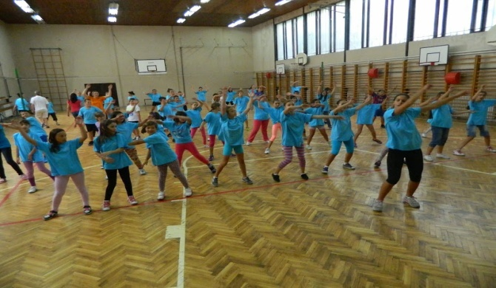
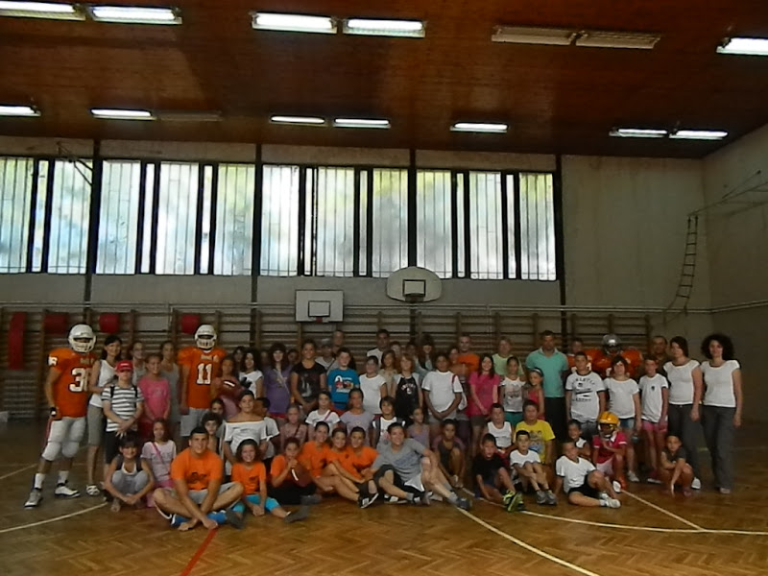
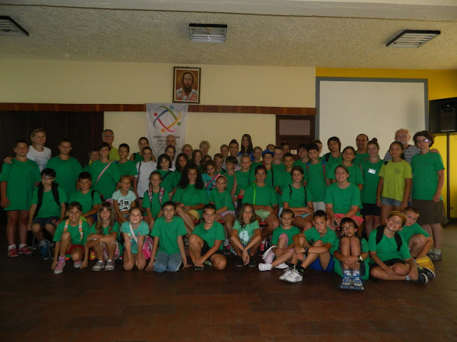
Summer sports camp Boomerang
started in August 2013
educational workshops
sports activities
presentations of sports clubs

Slide 15
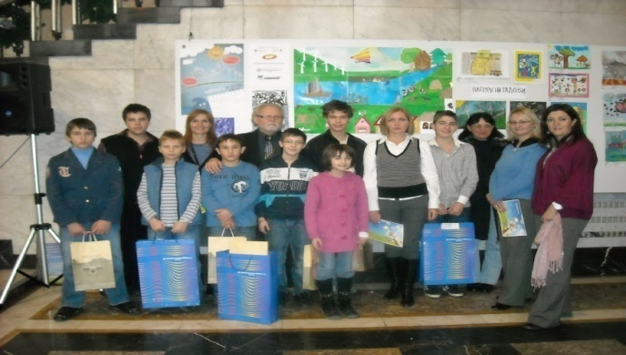
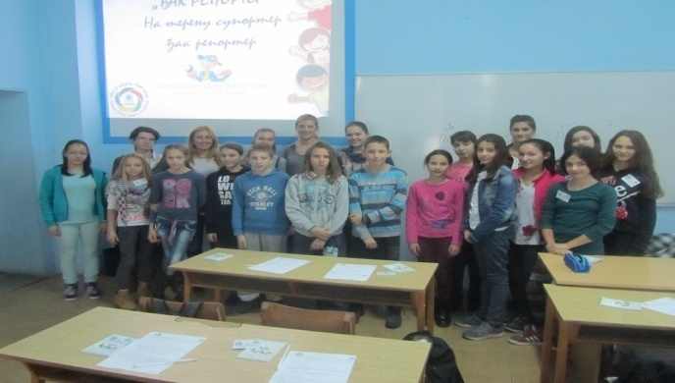
Projects
Energy is all around us since 2011/12 school year,
With entrepreneurship to Europe in 2014 and 2015,
Student reporter since 2014/15 school year,
eTwinning projects since 2015/16 school year...

Slide 16
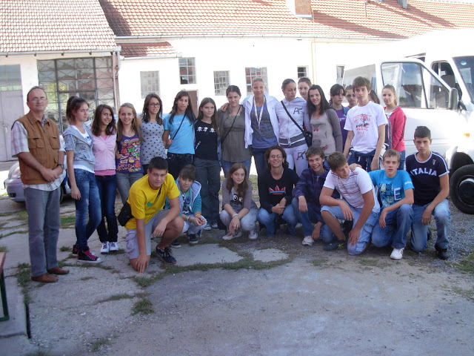
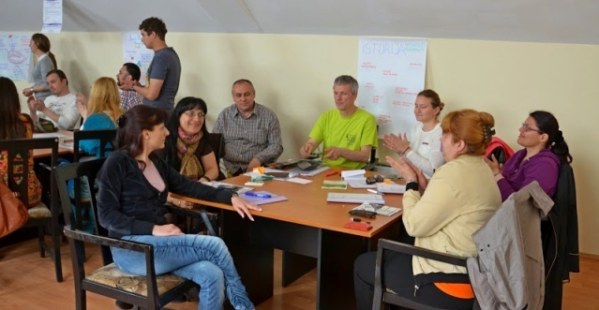
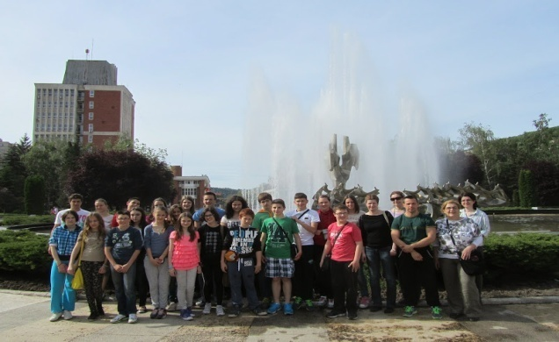
IPA projects
Banat on the European Road (2014-2017)
trainings
research work
quizzes
sports matches
monograph
Green Banat (2011-2012)
lectures
workshops

Slide 17
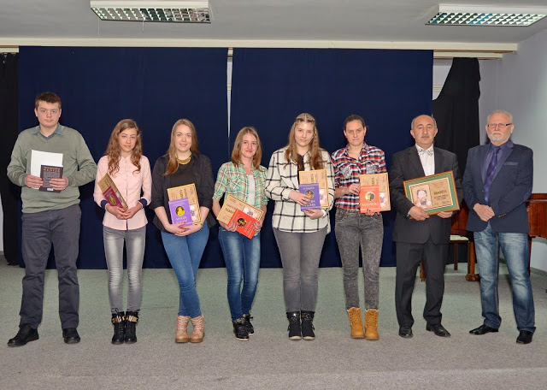
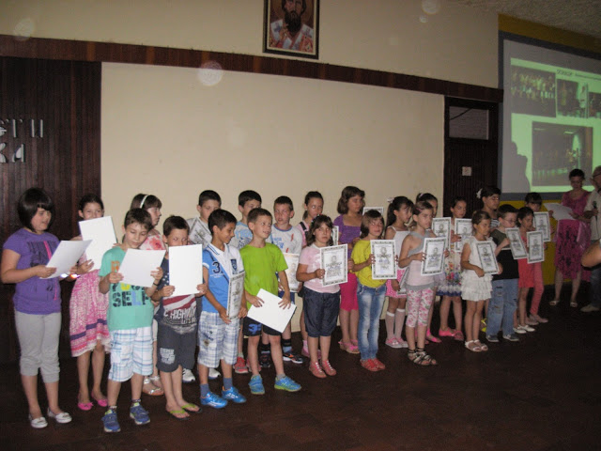
Promotion of students’ achievements
school website
school e-magazine
St Sava award
end-of-school-year performance

