Slide 1
Traditional food in Poland

Slide 2
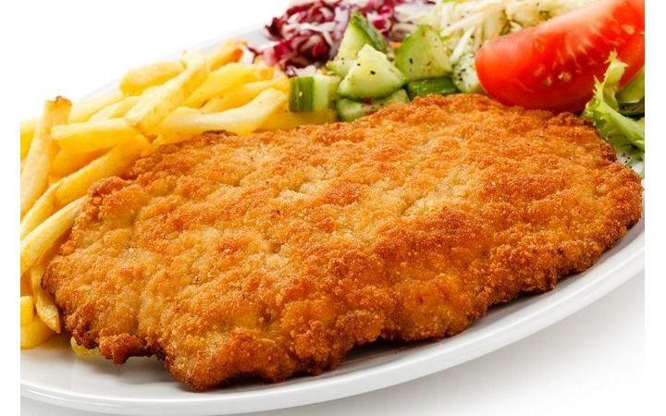
Kotlet Schabowy
Breaded pork loin.
Reminiscent of Wiener schnitzel.
History of Polish pork chops is dating back to the nineteenth century.

Slide 3
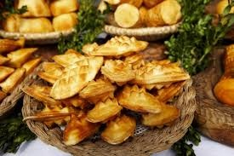
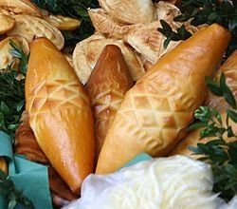
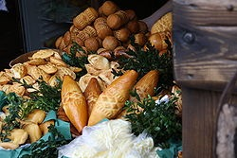
Oscypek
Hard smoked cheese.
It is make from sheeps' milk. It is characteristic for Polish mountains, especially Podhale.

Slide 4
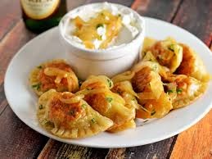
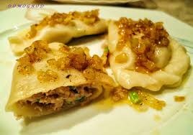
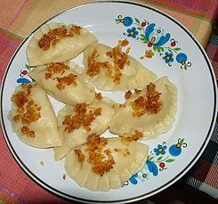
Pierogi
Boiled dough.
It can be stuffed with meet, white cheese(twaróg) or vegetables.

Slide 5
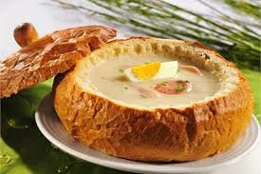
Żurek
Acidified soup flour with eggs
and sausage.
The perfect addition is bread.

Slide 6
Polish food is amazing and perfect for everyone. If you want to come to Poland, I encourage you to taste these dishes.

