Slide 1
Sports in Our Town

Slide 2
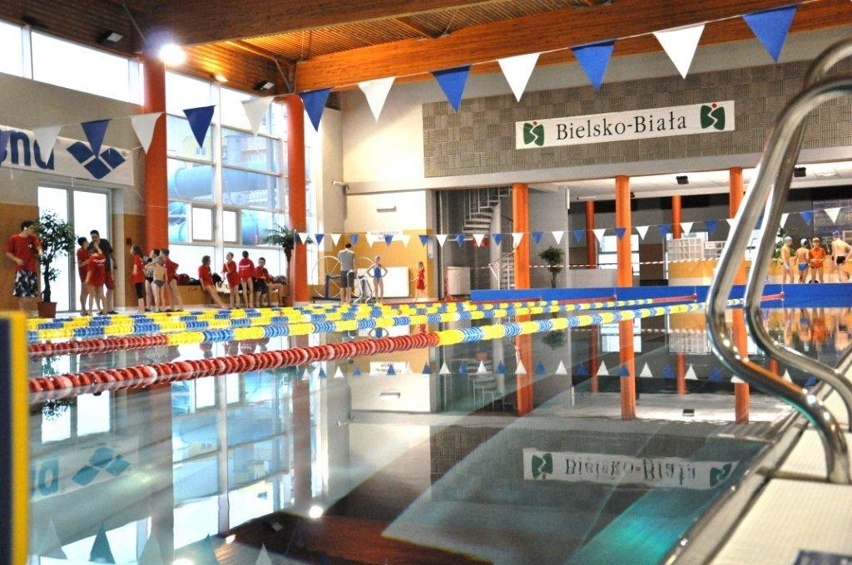
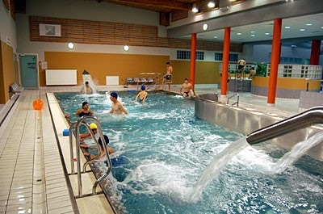
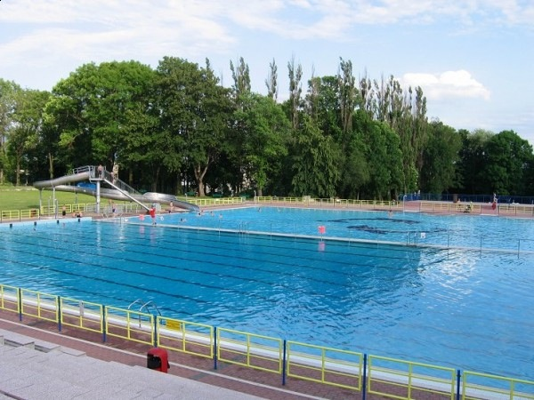
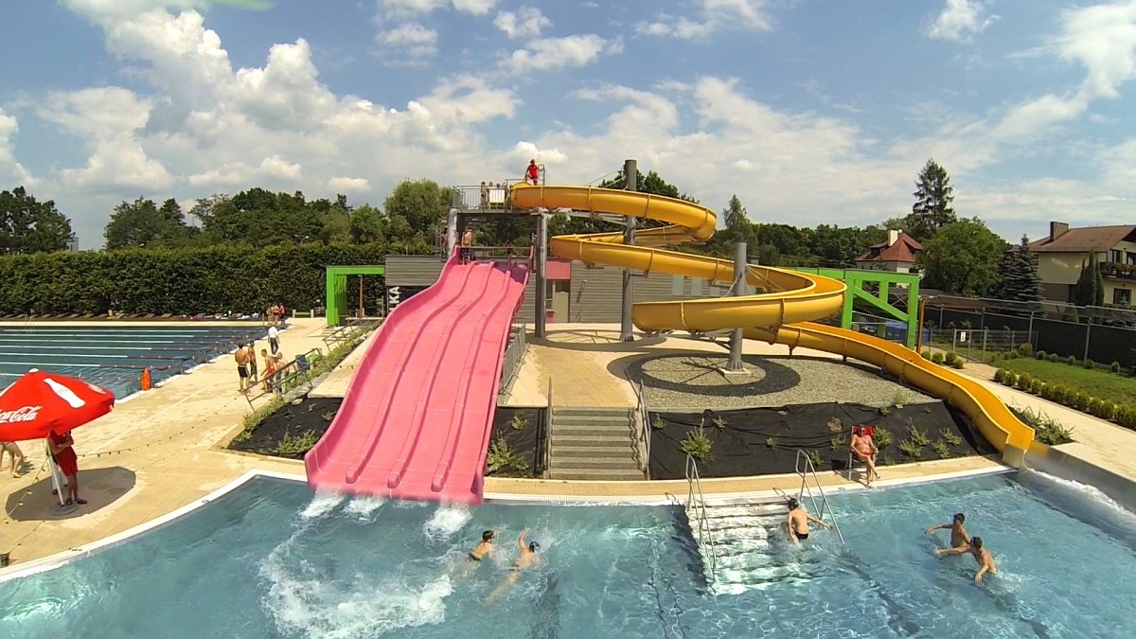
In our town we have four swimming pools, 2 covered and 2 outdoors .

Slide 3
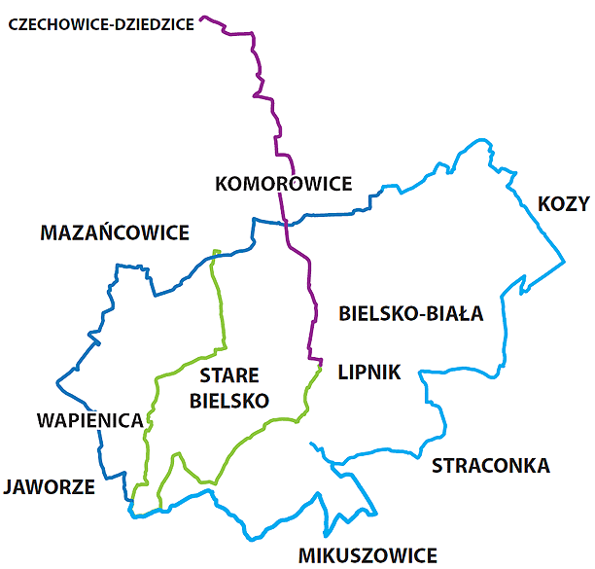
We also have a lot of bicycle paths to cycle safely.

Slide 4
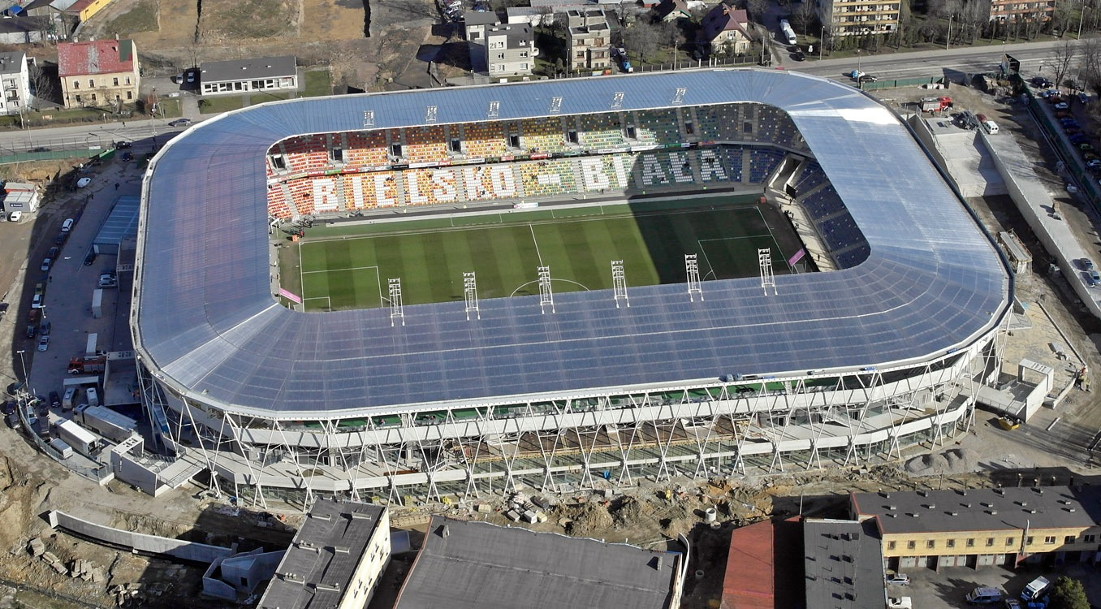
We have a lot of pitches and 1 large stadium .

Slide 5
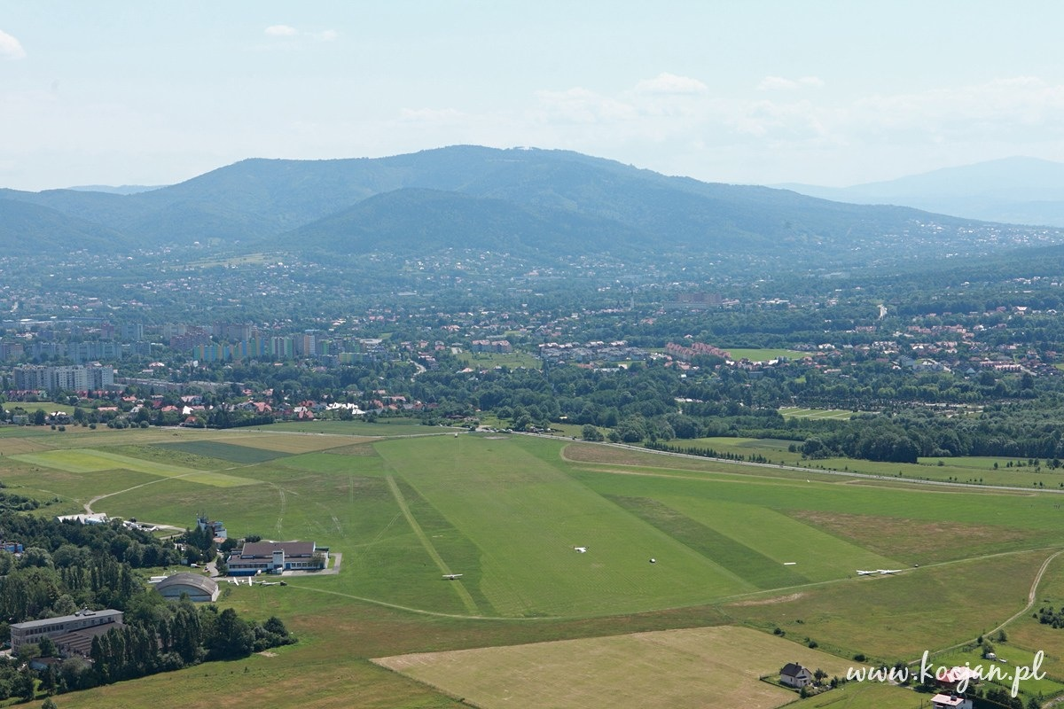
Aero Club Bielsko - Bialski has existed in Bielsko - Biala since 1945. It’s base is Aleksandrowickie Airport. The Aero Club has four sections: airplanes , gliders , parachutes , modeling.

Slide 6
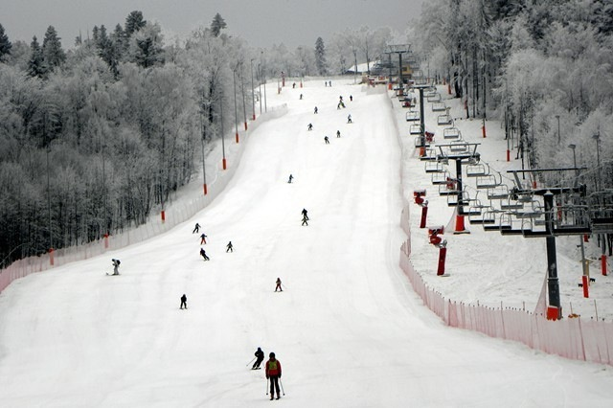
Recently ( in 2013 ) the city built a ski slope "Debowiec" .

