Slide 1
The occupations in my region in the ancient times
The occupations in my region in the ancient times

Slide 2
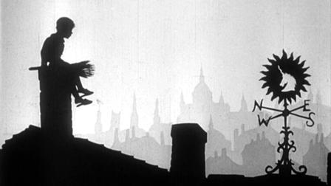
Chimney sweep
Chimney sweep
A chimney sweep is a worker who clears ash and soot from chimneys,
He also checks the condition of the chimneys.
.
A chimney sweep is a worker who clears ash and soot from chimneys.

Slide 3
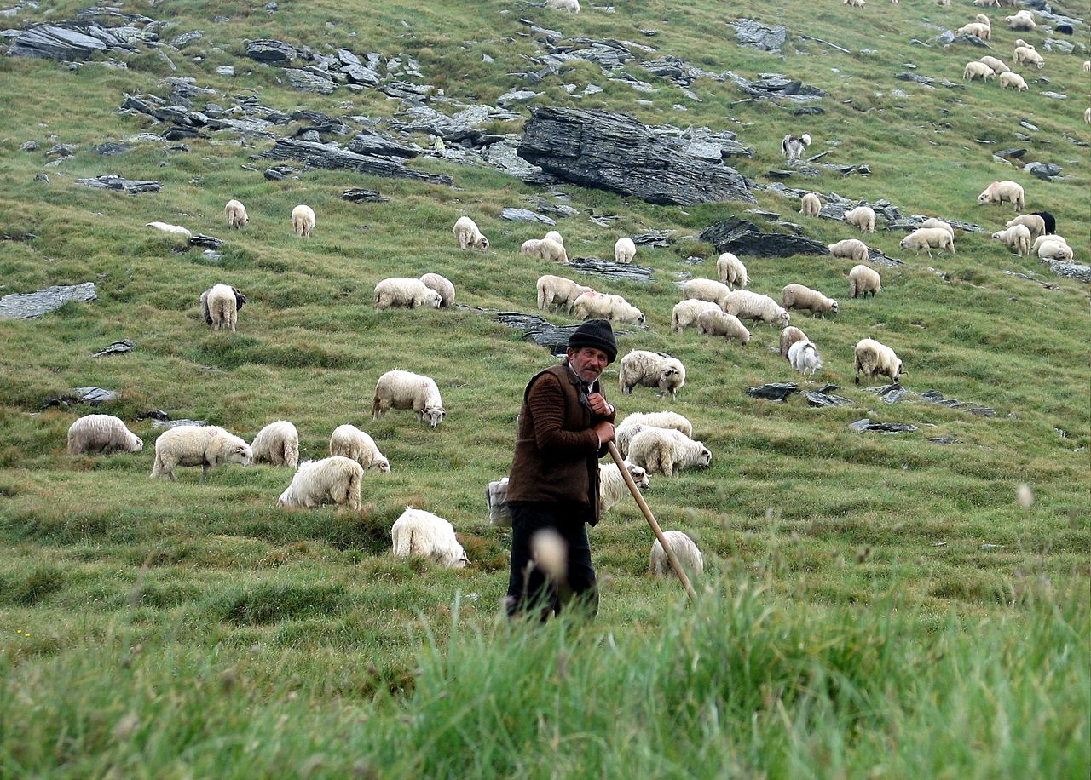
Shepherd
Shepherd
A shepherd is a person who takes care of or guards herds of sheep.
A shepherd is a person who tends, herds, feeds, or guards herds of sheep.
Shepherding is one of the oldest occupations, beginning some 5,000 years ago in Asia . Sheep were kept for their milk, meat and especially for their wool.

Slide 4
Smith
A smith creates objects from iron or steel by forging the metal, using tools
For example a hammer
A smith produces such things as:
furniture
sculptures,
tools
gates

Slide 5
Cooper
A cooper makes casks, drums and barrels and other accessories, usually out of wood, but sometimes using other materials.
More examples of what a cooper can make:
Barrels
Buckets
Tubs
Pipes

Slide 6
Thank you for your attention I hope you came closer to jobs from our region

