Slide 1
3 Spanish festivals internationally well-kown
San Fermín. Fallas de Valencia. Tomatina
by Daniel Mt

Slide 2
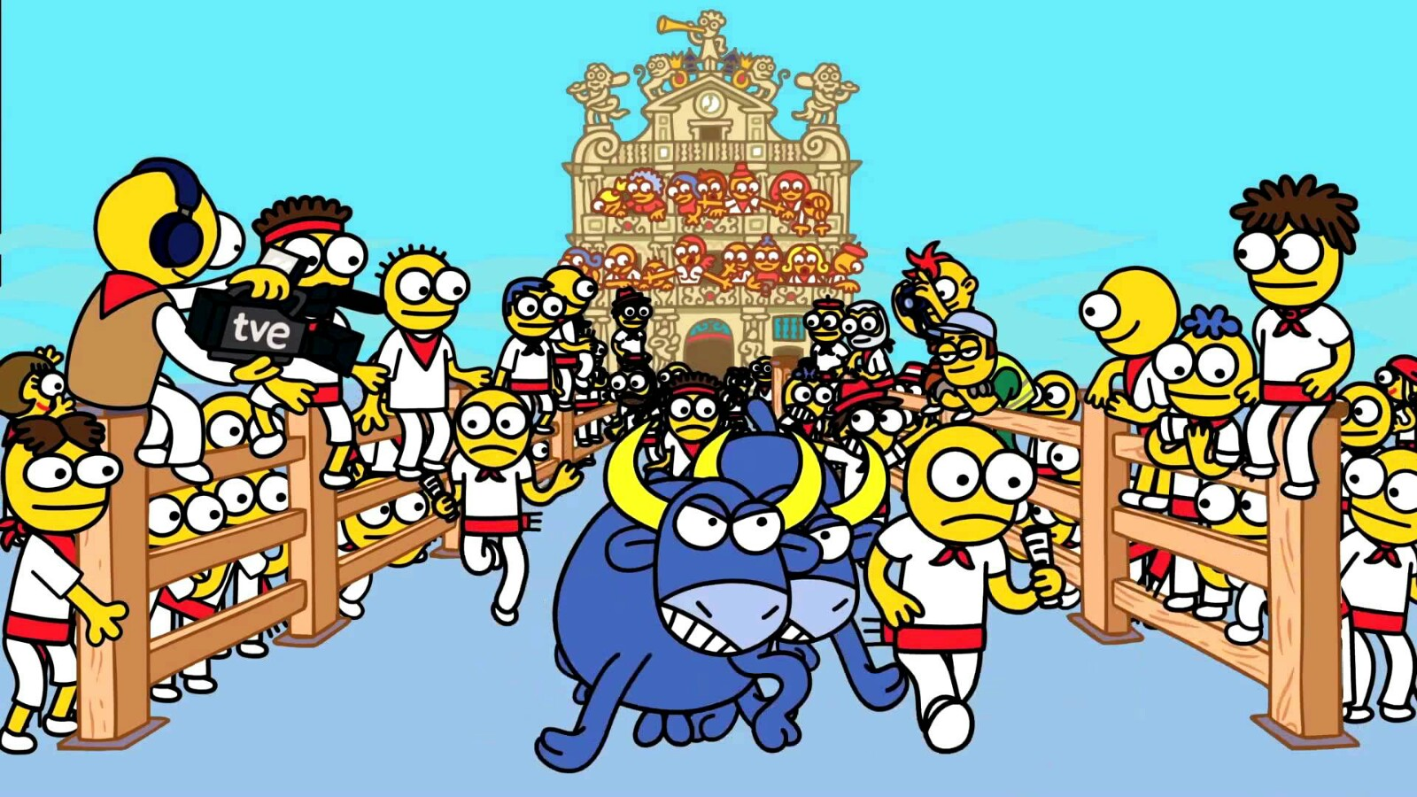
San Fermín
The festival takes place in Pamplona, the capital of the Navarre province, in honor of San Fermín, the saint patron of the city
It begins on July 7th and ends on July 14th
The “chupinazo” (loud bang) marks the beginning of san fermín
This is the name of the rocket that is launched on July 6th

Slide 3
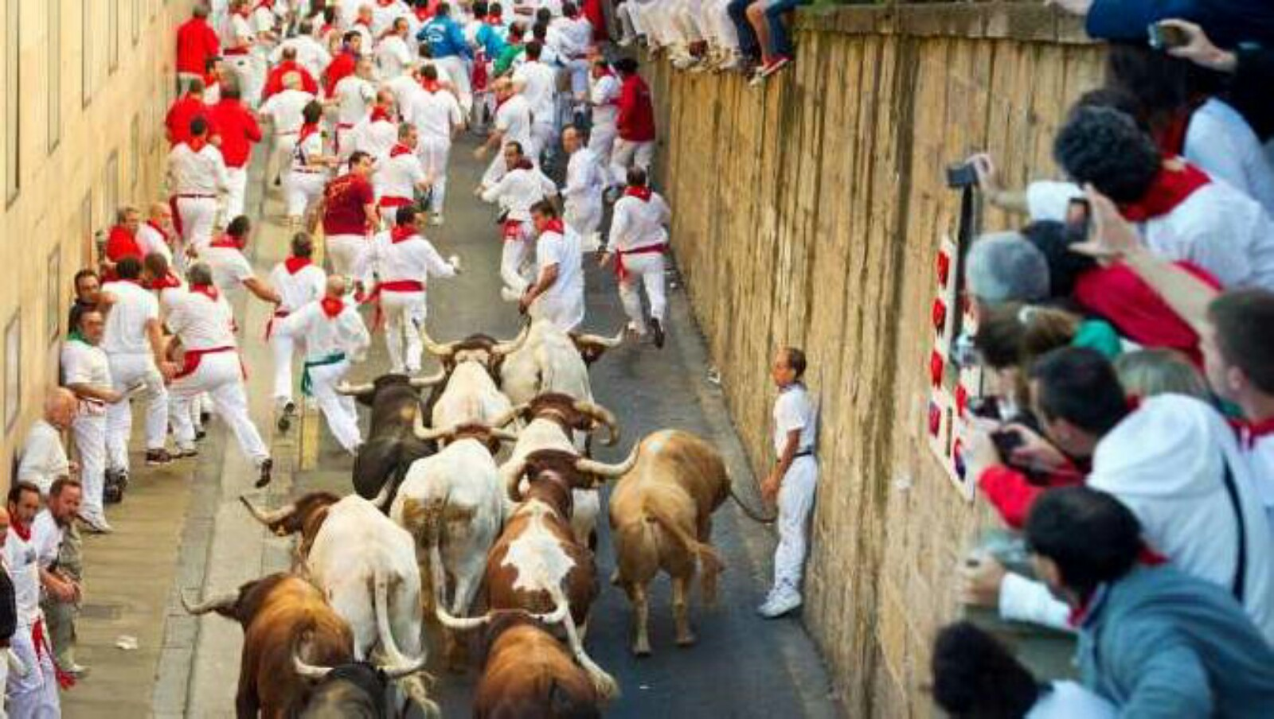
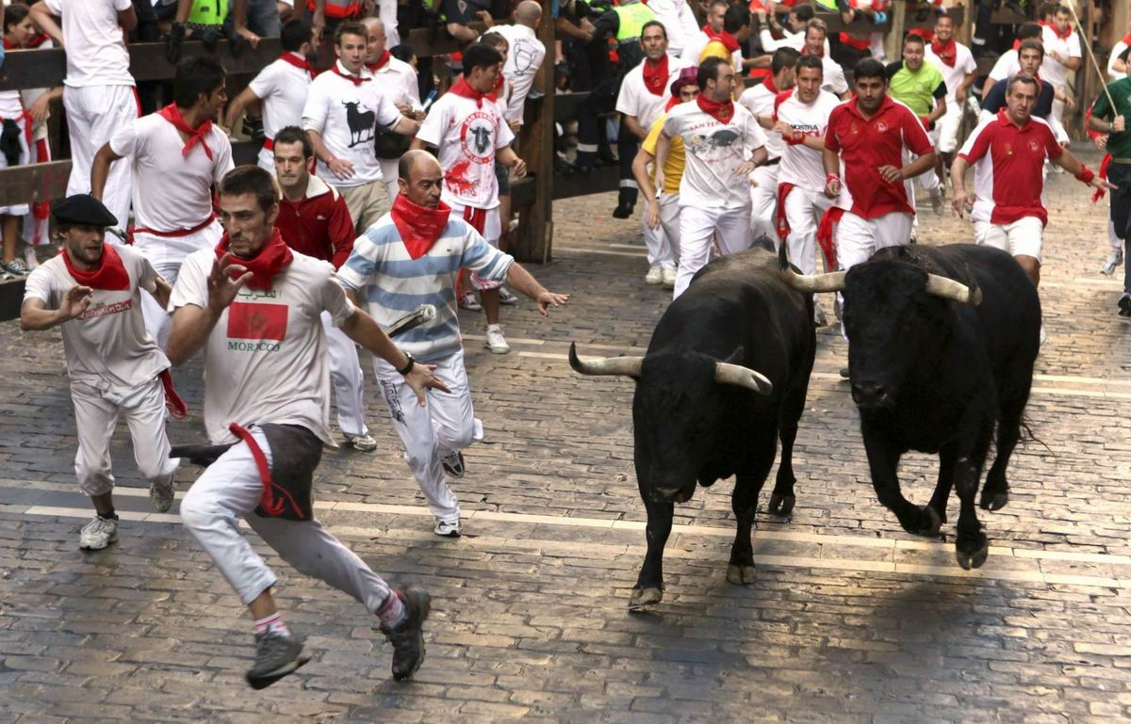
San Fermín
The best-known event is undoubtedly the running of the bulls from July 7th to 14th
This consists of driving a herd of bulls at 8 in the morning from Santo Domingo street (which is a mild slope) to the bull ring
It’s a very dangerous act but thousands of people come from all over the world to take part in it
Since 1924, 15 deaths have been recorded
As in other many Spanish festivals, music and fireworks are a must

Slide 5
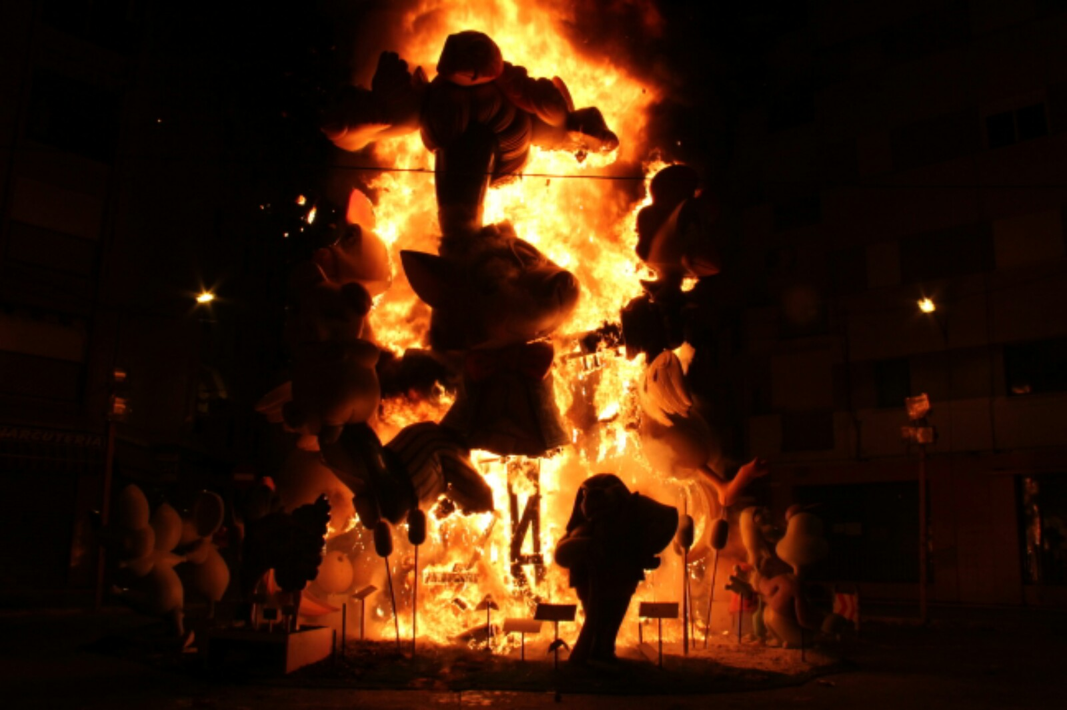
Fallas de Valencia
It is a celebration which is listed as a Festival of International Tourism Interest
They are held in honor of St. Joseph, saint patron of carpenters, between March 15th and 19th
This celebration revolves around the Falla monuments: huge, usually satirical sculptures that will end up burning except one taht will be awarded

Slide 6
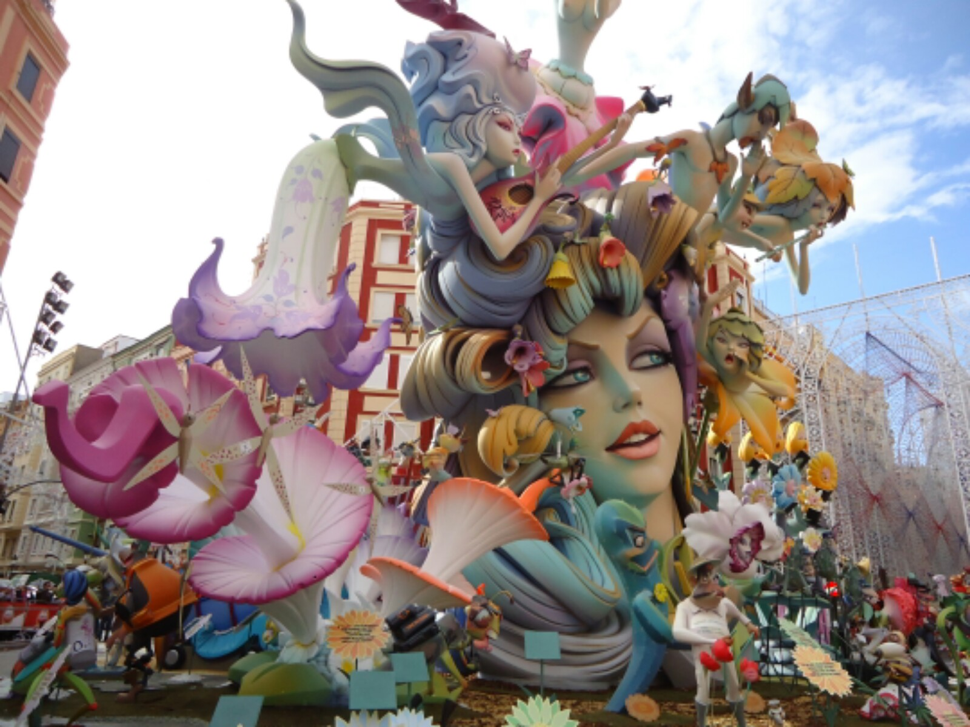
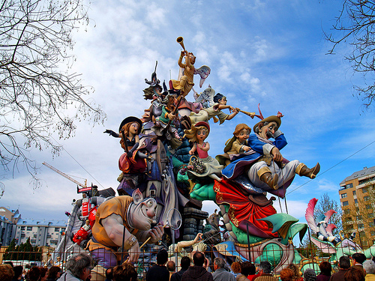
Fallas de Valencia
Until March 11 you can visit an exhibition whare you’ll find around 800 monuments hoping to be able to avoid the fire
Which one will be free from the “Cremà” (burning) is decided by popular vote
This gigatic sculpture will be exhibited next to the ones that were saved in previous years, at the Fallero Museum
The Fallas will be displayed in the streets on March 14th and 15th, what is known as the “plantà”

Slide 8
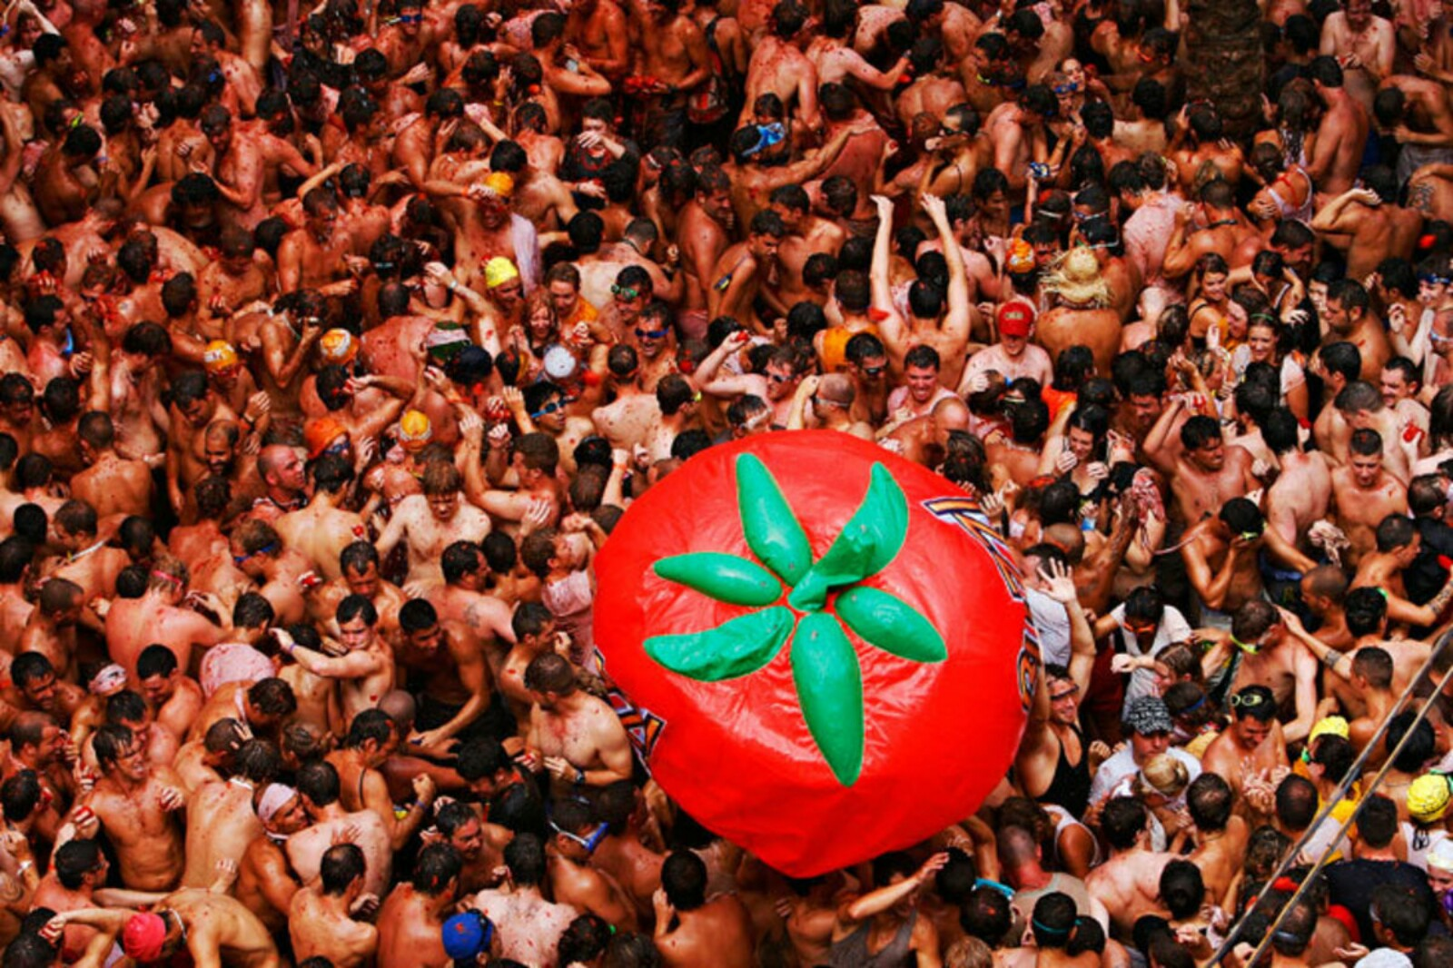
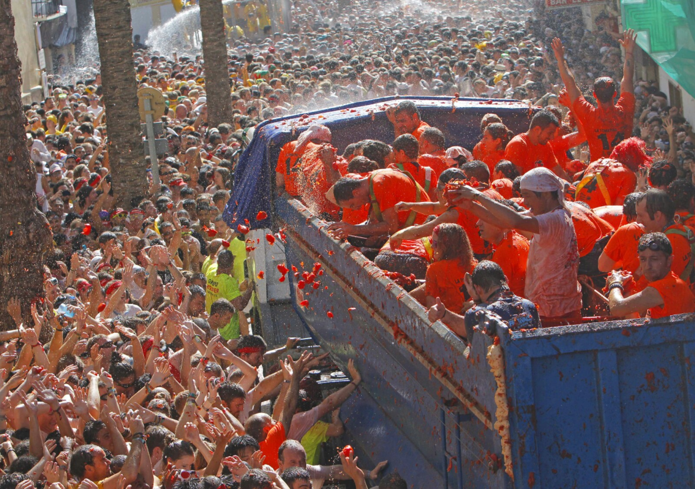
La Tomatina
La tomatina is a Spanish celebration that consists in throwing tomatoes in all directions against other members of the party
This celebration happens on the last Wednesday of August
This festival is considered to have originated is 1945

Slide 9
La Tomatina
At 10 in the morning is when the ``soap stick´´ occurs
It involves climbing a slippery pole, which has been greased, and which has a ham on the top
The start signal is given when someone brings down one of the hams
At this time trucks fill the plaza with tomatoes
The fight ends exactly in one hour

