Slide 1
THE HOLY WEEK IN SPAIN
BY NAYARA VALDIVIESO SÁNCHEZ

Slide 2
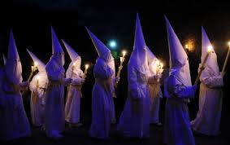
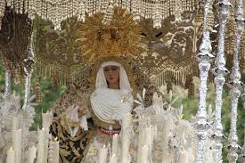
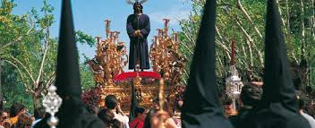
INTRODUCTION
With the spring entry, the Holy Week comes: one of the most authentic, emotive festivities and with more centuries of history that is celebrated in Spain. The streets of the great majority of cities and villages turn into scenes of fervor and religious devotion, to remember Christ's death, with the music, the art, the colour and the magic of the processions in which numerous people accompany to the religious images of Jesus and the Virgin.
The whole Spain commemorates the Holy Week, a celebration that is different in every region and corner of our country.

Slide 3

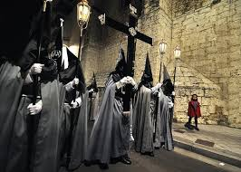
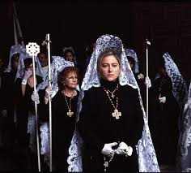
HOLY WEEK IN VALLADOLID (CASTILE)
Some of his nineteen confraternities take the streets of Valladolid into a real museum of the baroque sculpture. The sculptures on the “pasos” (literally “steps”) seem to take life before the respectful look of the inhabitants and the tourists who come every year attracted by the unusual beauty of this Holy Week, which has could transmit its tradition from parents to children since 1923.

Slide 4
SCULPTORS
Alonso Gonzalez Berruguete (c.1490 - Toledo, 1561),was a sculptor Castilian (Spanish). He devoted himself to the height of altarpieces and images
Gregorio Fernandez (April 1576, province of Lugo - on January 22, 1636, Valladolid), was a Spanish sculptor of the Baroque. He gives preference to the mysticism on the aesthetics, seeking to transmit much more pain and suffering that sensuality.
Juan de Juni (Francia 1506–Valladolid 10 of April) He was a Franco-Spanish sculptor.
Together with Alonso Berruguete, Juni formed the great school of the Castilian sculpture, with a great and extensive work realized mainly in more than thirty years that he remained in Valladolid.

Slide 5
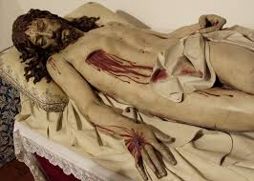
Alonso Gonzalez Berruguete Gregorio Fernandez
Juan de Juni
By Juan de Juni
By Gregorio Fernández
By Gregorio Fernández

Slide 6
DIFFERENCES BETWEEN CASTILE AND ANDALUSIA
Andalusia is characterized as the rest of Spanish cities by the diversity and the heterogeneity. The Holy Week is baroque, replete with compliments, happiness and colour.
In turn in Castile the processions are in the habit of being silent for respect to Christ's death and it is prolonging about seven days

Slide 7
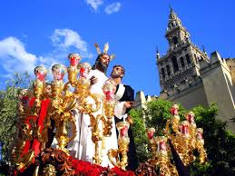
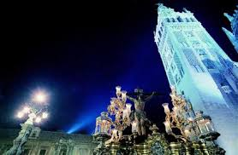
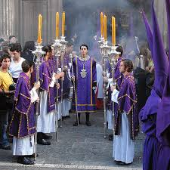
HOLY WEEK IN SEVILLE (ANDALUSIA)
The Holy Week of Seville commemorates the passion and Christ's death.
It is declared of Tourist Interest, constituting one of the big springs holidays of the city, close to the Fair of April.
The Saeta is the made prayer done sing and it is proper of the zone of Andalusia, unlike castile where drums and trumpets are used to accompany the literally steps instead of singing

Slide 8
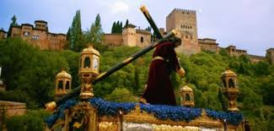
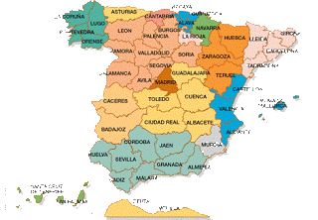
HOLY WEEK IN GRANADA (ANDALUSIA)
The Holy Week of Granada is the celebration of the passion, death and Christ's resurrection across the processions that realize the confraternities in this week for the city. In Granada the Holy Week supposes a phenomenon of sociocultural tourist and economic character of great important being one of the most beautiful of Andalusia and of Spain.

Slide 9
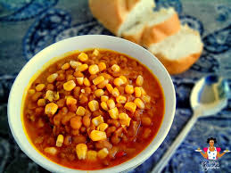
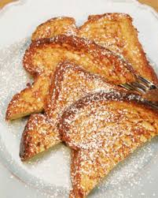
GASTRONOMY
The Gastronomy of the Holy Week corresponds to all those culinary customs and all that food allowed during the sacred period of the Christianity
THE POTTAGE OF WAKE:
it is a pottage that has been served every Friday of Lent as consequence of the religious prohibition of eating meat in this period .
FRENCH TOAST:
Traditional sweet of Lent that consists of a slice of bread (habitually hard, of several days) soaked in milk and, after being muffled in egg, fried in a frying pan with oil.

Slide 10
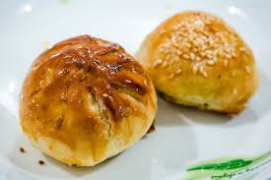
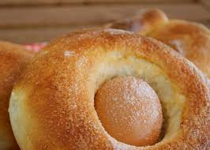
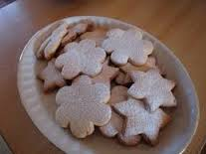
GASTRONOMY
THE HONEY – COATED PASTRY:
Doughnut typical of the south of Spain, elaborated with mass of flour, fried in olive oil and coated with honey.
THE MONKEY:(LA MONA)
It is a typical Valencian and Catalan food that consists of a cake of the Easter which degustation symbolizes that the Lent has finished.
THE CRESPELLS:
The crespells are one of the typical Majorcan sweets seemed to cookies.

Slide 11
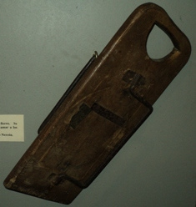
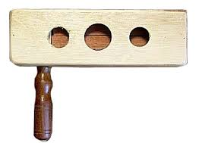
TYPICAL INSTRUMENT
The rattle is in use in the Spanish churches during the Holy Week, former it was in use to silent the people in the days of the Passion or to wake them up in matins, when the bells could not be used, Also the area of the Holy Week, some penitential fraternity rattles make sound during the parade processional. The rattle is used also to simulate an earthquake in the Trade of Glooms of the Holy Week.

